Slide 1

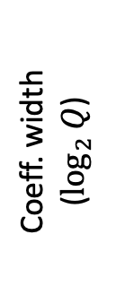
Application computation Bootstrapping
$$slope \sim \log_{2}{S}$$
Coeff. width ($\log_{2}{Q}$)
Time

Slide 2










Overhead: 24 bits per residue
$${\overline{r}}_{0}$$
$${\overline{r}}_{1}$$
$${\overline{r}}_{2}$$
$${\overline{r}}_{3}$$
$${\overline{r}}_{4}$$
$${\overline{r}}_{5}$$
64-bit
HW word size
40-bit residues
(a) RNS-CKKS (prior work)
Overhead: 16 bits total
$$r_{0}$$
$$r_{1}$$
$$r_{2}$$
$$r_{3}$$
64-bit
HW word size
64-bit residues
(b) BitPacker (this work)

Slide 3


User
Accelerator
FHE PROGRAM
PROGRAM CONSTRAINTS
HW CONSTRAINT
(1) Polynomial size: N
(2) Max level: L_{max}
(3) Max modulus: Q_{max}
(4) Min modulus: Q_{min}
(5) Level → Target scale (L → T_{L})
input: “x”
Level: 2
(1) Word width: w
multiply
Level: 2
modDown
Level: 1
rescale
Level: 1
LEVEL-TO-MODULUS MAP
(1) Level → Modulus (L → Q_{L})
(2) Scale at maximum level: T_{Lmax}
(3) Level → Scale (L→ S_{L}) (implied from (1), (2))
Such that:
All residue moduli fit in wordsize
T_{L}*sqrt(2)/2 < S_{L} < T_{L}*sqrt(2), Q_{min} < Q_{L} < Q_{max} for all L
add
Level: 1
output
Level: 1

Slide 4






































Level
Modulus
Scale
$$q_{0}$$
$$q_{1}$$
$$q_{2}$$
$$q_{3}$$
$$q_{4}$$
$$q_{5}$$
$$6$$
$${\overline{r}}_{0}$$
$${\overline{r}}_{1}$$
$${\overline{r}}_{2}$$
$${\overline{r}}_{3}$$
$${\overline{r}}_{4}$$
$${\overline{r}}_{5}$$
$$S_{6}$$
$$Q_{6}=q_{0}q_{1}q_{2}q_{3}q_{4}q_{5}$$
$$q_{0}$$
$$q_{1}$$
$$q_{2}$$
$$q_{3}$$
$$q_{4}$$
$${\overline{r}}_{0}^{′}$$
$${\overline{r}}_{1}^{′}$$
$${\overline{r}}_{2}^{′}$$
$${\overline{r}}_{3}^{′}$$
$${\overline{r}}_{4}^{′}$$
$$S_{5}=S_{6}^{2}/q_{5}$$
$$5$$
$$Q_{5}=q_{0}q_{1}q_{2}q_{3}q_{4}= Q_{6}/q_{5}$$
$$q_{0}$$
$$q_{1}$$
$$q_{2}$$
$$q_{3}$$
$$4$$
$${\overline{r}}_{0}^{′′}$$
$${\overline{r}}_{1}^{′′}$$
$${\overline{r}}_{2}^{′′}$$
$${\overline{r}}_{3}^{′′}$$
$$S_{4}=S_{5}^{2} /q_{4}$$
$$Q_{4}=q_{0}q_{1}q_{2}q_{3}=Q_{5}/q_{4}$$
…
…
…

Slide 5



























Level
Modulus
Scale
$$q_{0}$$
$$q_{1}$$
$$q_{2}$$
$$q_{3}$$
$$6$$
$$r_{0}$$
$$r_{1}$$
$$r_{2}$$
$$r_{3}$$
$$S_{6}$$
$$Q_{6}=q_{0}q_{1}q_{2}q_{3}$$
$$q_{0}$$
$$q_{1}$$
$$q_{2}$$
$$q_{3}^{′}$$
$$5$$
$$r_{0}^{′}$$
$$r_{1}^{′}$$
$$r_{2}^{′}$$
$$r_{3}^{′}$$
$$S_{5}=S_{6}^{2}q_{3}^{′}/q_{3}$$
$$Q_{5}=q_{0}q_{1}q_{2}q_{3}^{′}=Q_{6}q_{3}^{′}/q_{3}$$
$$q_{0}$$
$$q_{1}$$
$$q_{2}^{′}$$
$$4$$
$$r_{0}^{′′}$$
$$r_{1}^{′′}$$
$$r_{2}^{′′}$$
$$S_{4}=S_{5}^{2}q_{2}^{′}/{q_{2}q}_{3}^{′}$$
$$Q_{4}=q_{0}q_{1}q_{2}^{′}=Q_{5}q_{2}^{′}/{q_{2}q}_{3}^{′}$$
…
…
…

Slide 6






























Level
Modulus
Scale
$$q_{0}$$
$$q_{1}$$
$$q_{2}$$
$$q_{3}^{′}$$
$$5$$
$$r_{0}$$
$$r_{1}$$
$$r_{2}$$
$$r_{3}$$
$$S_{5}^{2}$$
scaleUp(ct, [$q_{2}^{′}$])
$$q_{0}$$
$$q_{1}$$
$$q_{2}$$
$$q_{3}^{′}$$
$$q_{2}^{′}$$
$$r_{0}^{′}$$
$$r_{1}^{′}$$
$$r_{2}^{′}$$
$$r_{3}^{′}$$
$$r_{4}^{′}$$
$$S_{5}^{2}q_{2}^{′}$$
scaleDown(ct, [$q_{2}$, $q_{3}^{′}$])
$$q_{0}$$
$$q_{1}$$
$$q_{2}^{′}$$
$$4$$
$$r_{0}^{′′}$$
$$r_{1}^{′′}$$
$$r_{2}^{′′}$$
$$S_{4}=S_{5}^{2}q_{2}^{′}/{q_{2}q}_{3}^{′}$$

Slide 7




























Level
Modulus
Scale
$$q_{0}$$
$$q_{1}$$
$$q_{2}$$
$$q_{3}^{′}$$
$$5$$
$$r_{0}$$
$$r_{1}$$
$$r_{2}$$
$$r_{3}$$
$$S_{5}$$
mulConst(ct, K=$S_{4}q_{3}^{′}/S_{5}q_{2}^{′}$)
$$q_{0}$$
$$q_{1}$$
$$q_{2}$$
$$q_{3}^{′}$$
$$r_{0}^{′}$$
$$r_{1}^{′}$$
$$r_{2}^{′}$$
$$r_{3}^{′}$$
$$S_{4}q_{3}^{′}/q_{2}^{′}$$
bpRescale(ct)
$$q_{0}$$
$$q_{1}$$
$$q_{2}^{′}$$
$$4$$
$$r_{0}^{′′}$$
$$r_{1}^{′′}$$
$$r_{2}^{′′}$$
$$S_{4}$$

Slide 8








Ciphertext (Ct)
Plaintext
ct.0
ct.1
Secret key
5.398
Scale ($S$)
3.141
$$n$$
2.721
Encrypt
…
…
$$N=2n$$
…
Random noise
6.465
…
mod $q_{0}$
mod $q_{1}$
mod $q_{R−1}$
$$w$$
$$w=\log_{2}{Q}$$

Slide 9
Keyswitch hint generator (KSHGen)
Change-RNS-base (CRB)
Pipelined FUs
Number-theoretic trans. (NTT) ✕ 2
Automorphism
Adder ✕ 5
Multiplier ✕ 5
…
2,048 vector lanes
…
Banked register file (256 MB)
High-bandwidth Memory (1TB/s)

Slide 10
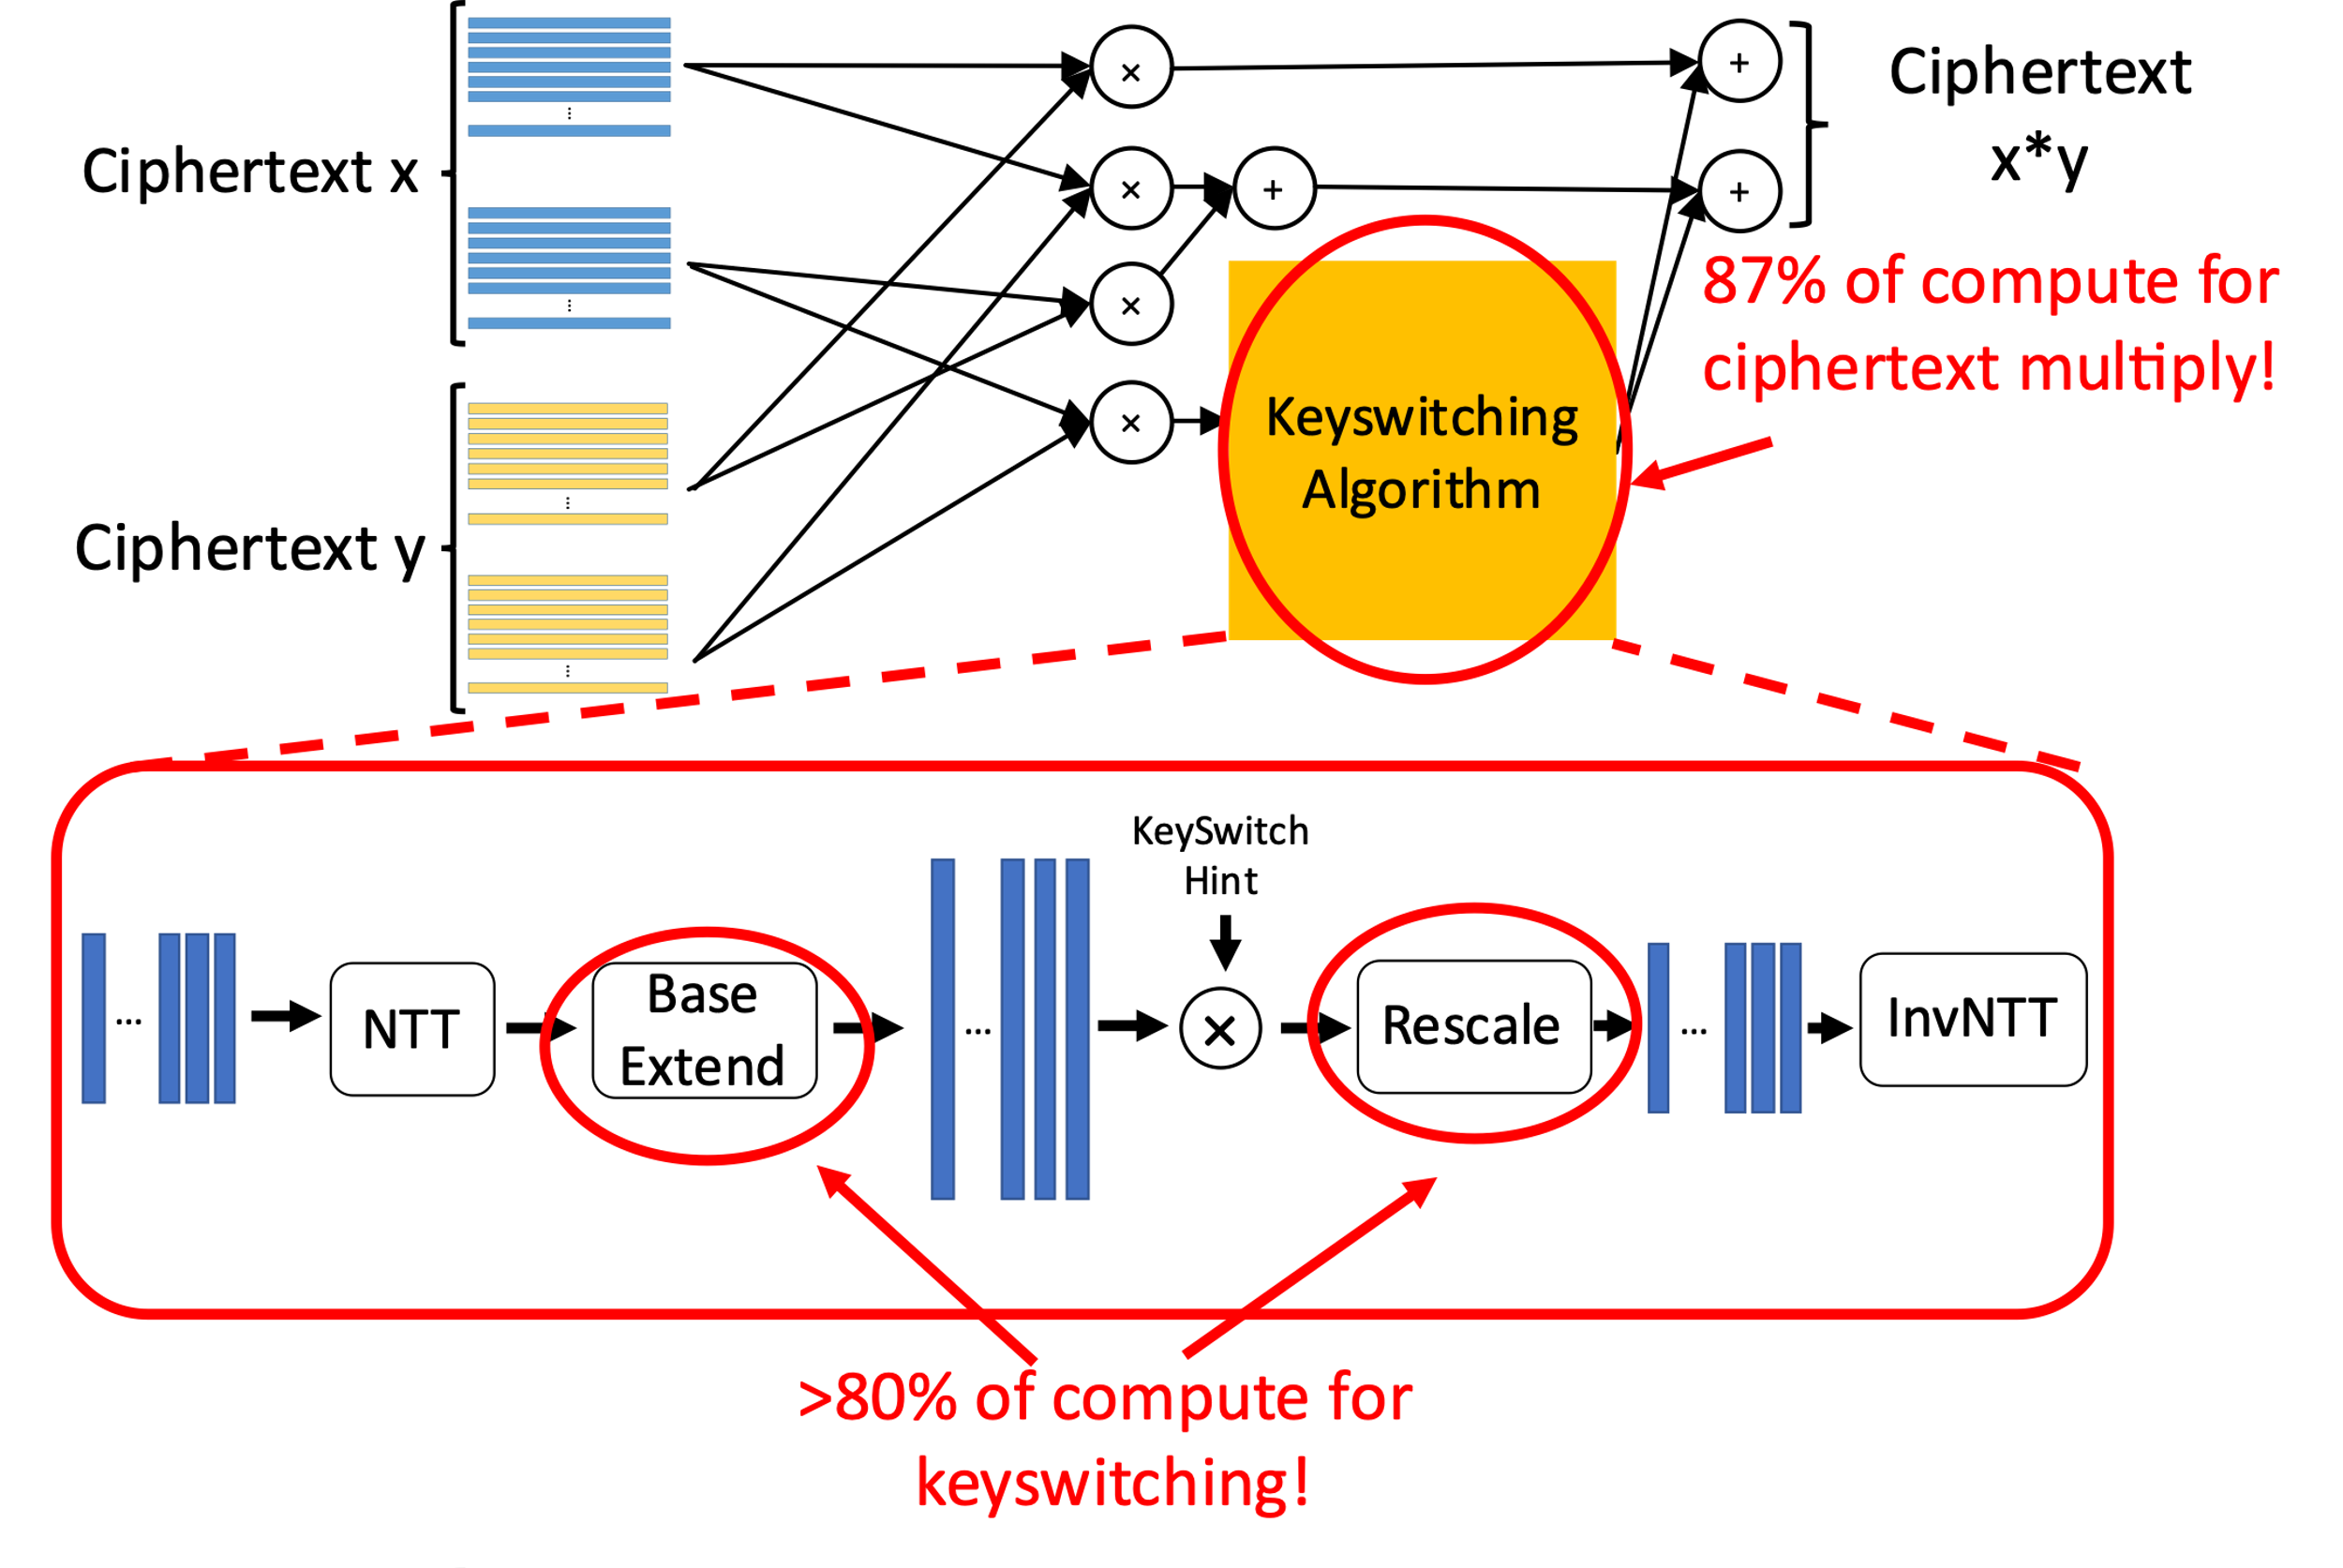

Slide 11
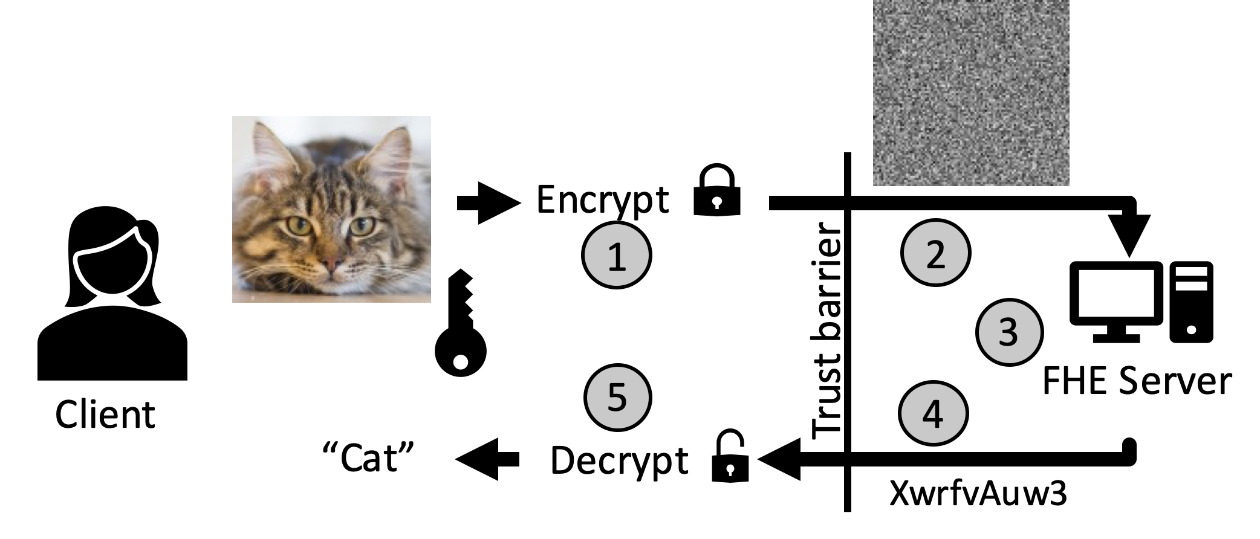

Slide 12
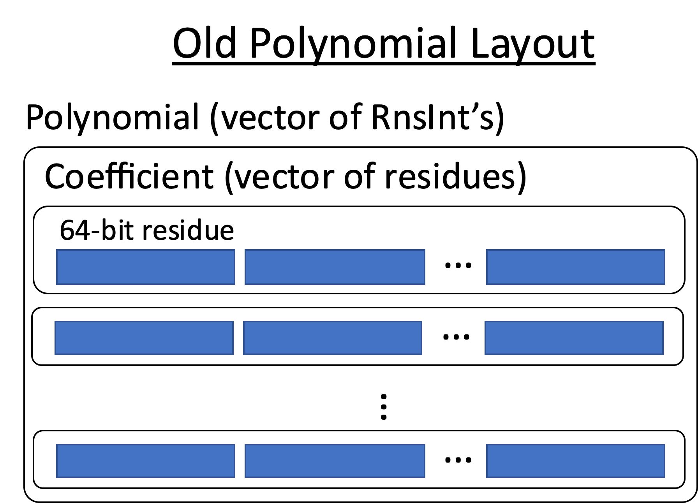

Slide 13
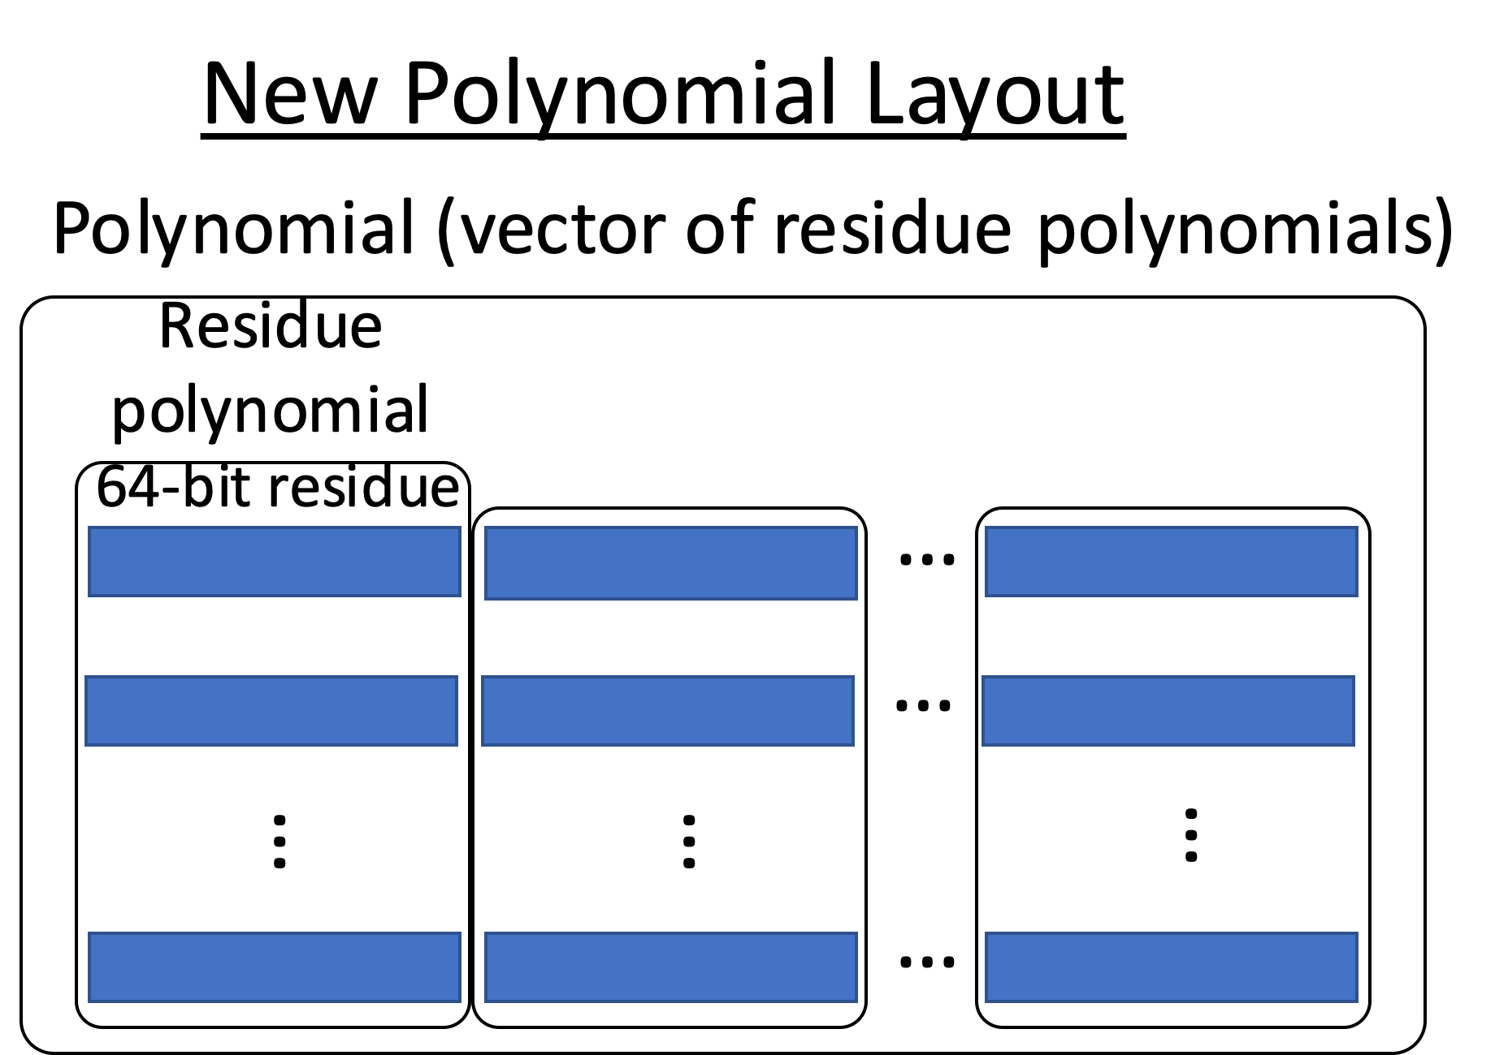

Slide 14
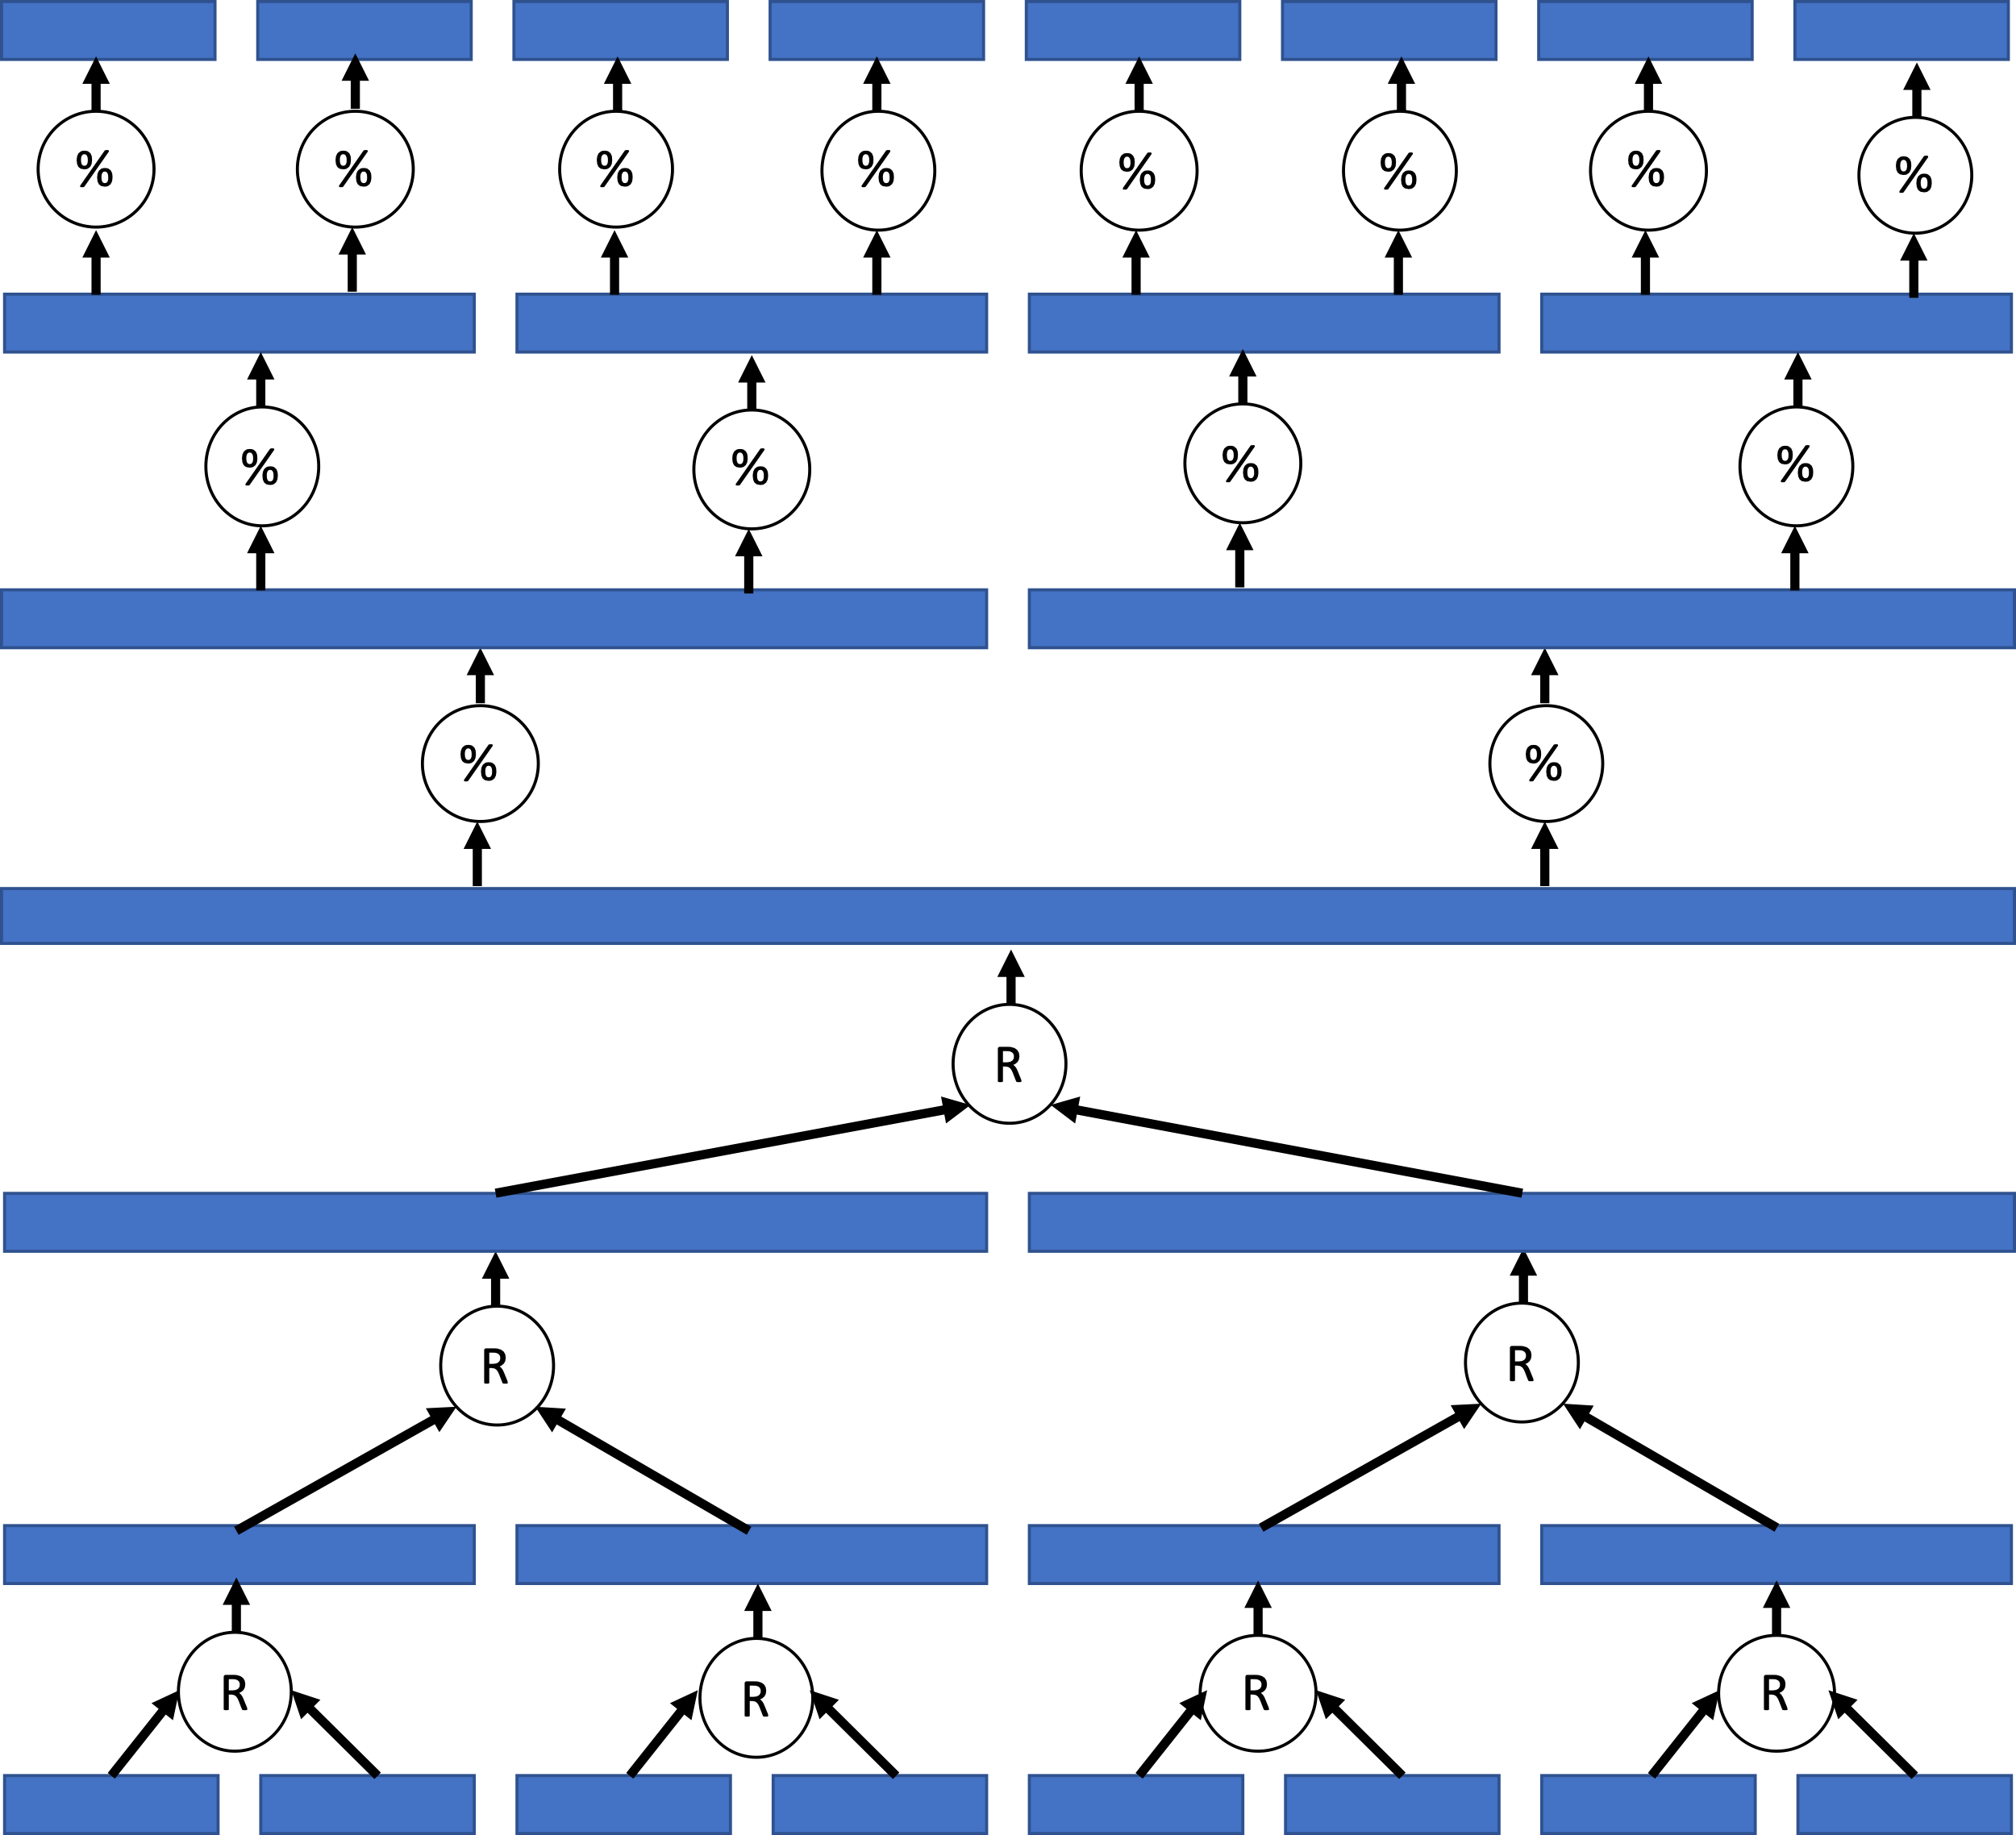

Slide 15
%
%
%
%
%
%
%
%
%
%
%
%
%
%
R
R
R
R
R
R
R

