Slide 1


Slide 2
Logical organization
Physical organization
Keyswitch hint generator (KSHGen)
256-lane group
256-lane group
Change-RNS-base (CRB)
Automorphism
Functional units
256-lane group
256-lane group
Number-theoretic trans. (NTT) ✕ 2
Adder ✕ 5
HBM memory controller
Transpose network
HBM memory controller
Multiplier ✕ 5
256-lane group
256-lane group
…
…
2,048 lanes
Register file (banked)
256-lane group
256-lane group
Main memory

Slide 3
Broadcast
Consts
Consts
Consts
Consts
×
×
…
×
×
×
…
×
…
×
×
…
×
×
×
…
×
+
+
…
+
+
+
…
+
…
+
+
…
+
+
+
…
+
Residue poly buffer
Residue poly buffer
…
Residue poly buffer
Residue poly buffer
MUX

Slide 4
Ciphertext
Ciphertext polynomial
Ciphertext polynomial
...
...
.
.
.
.
.
.
.
.
.
.
.
.
.
.
.
.
.
.
.
.
.
.
.
.
N x Coefficients
N x Coefficients
L x RNS Polynomials
L x RNS Polynomials

Slide 5






x
Encrypt
Encrypted(x)
Trust barrier
FHE
Accelerator
Client
Server
f(x)
Decrypt
Encrypted(f(x))

Slide 6
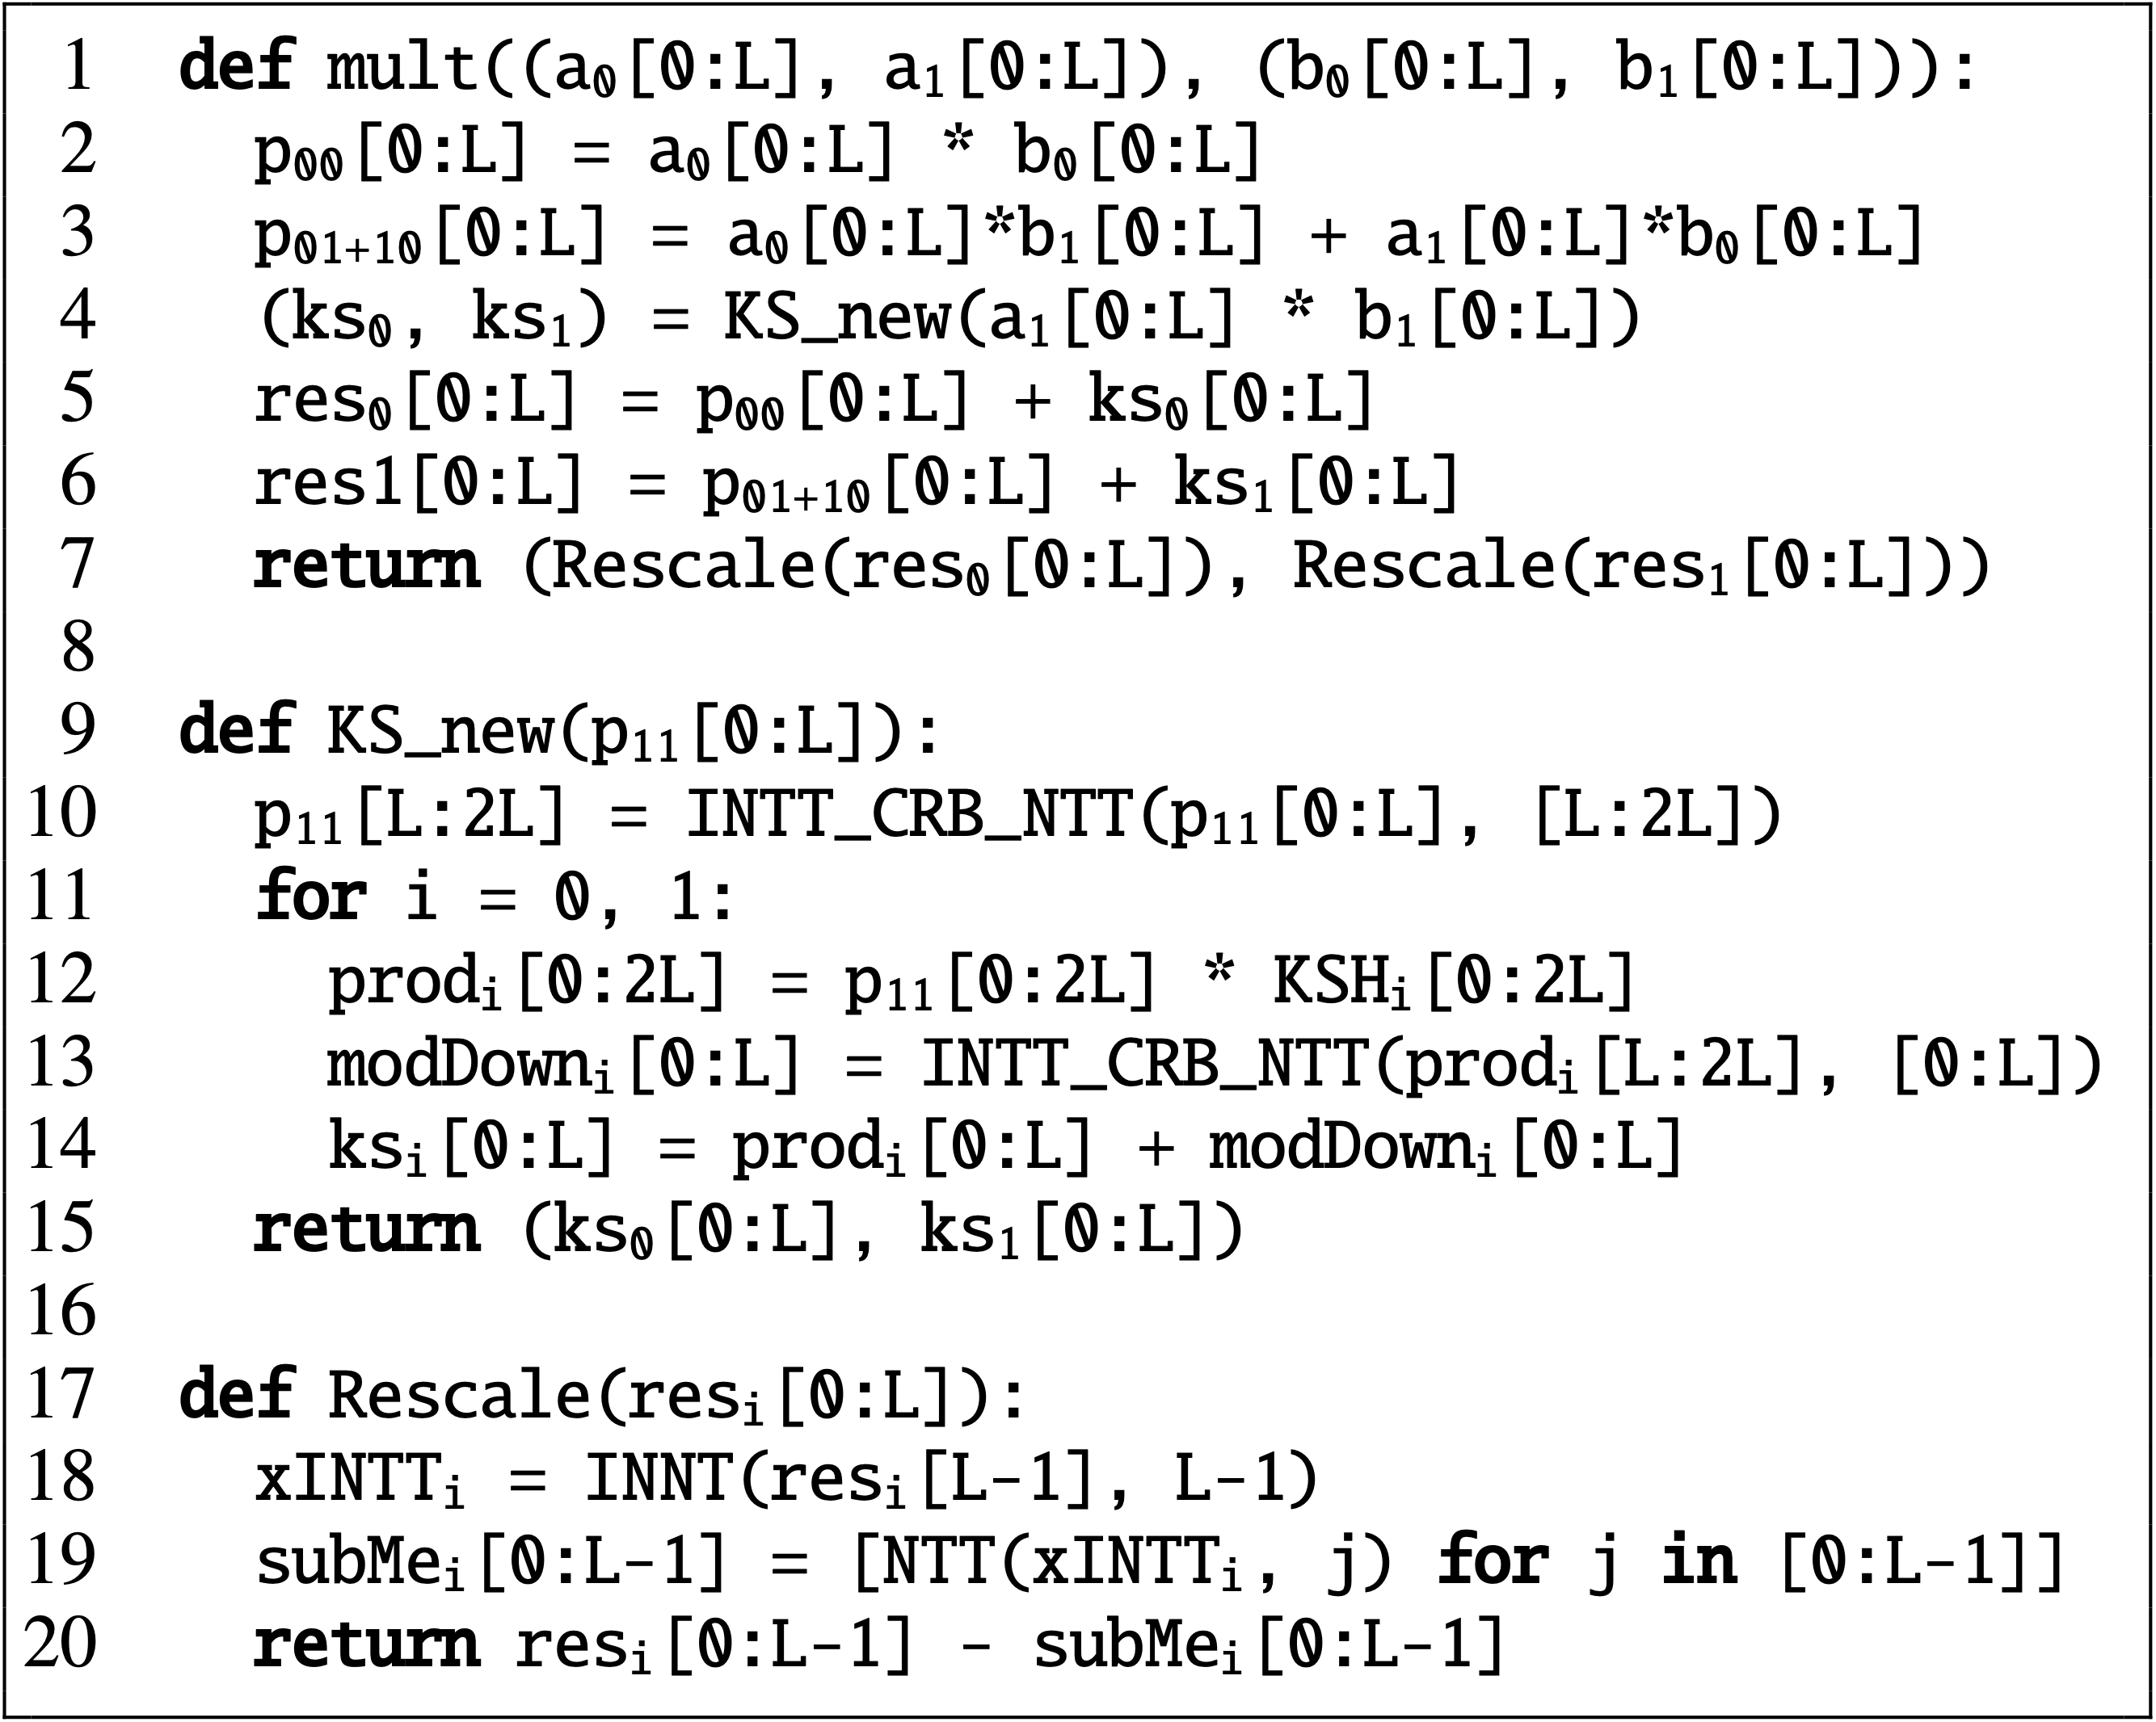

Slide 7
0
Lane group 0
Lane group 1
0
1
2
3
4
5
6
7
0
4
5
6
7
0
1
2
3
8
9
10
11
8
9
10
11
12
13
14
15
12
13
14
15
0
1
8
9
1
Local transpose
Local transpose
4
5
12
13
0
1
8
9
4
5
12
13
1
2
3
10
11
15
6
7
14
15
2
3
10
11
6
7
14
0
4
8
12
2
Fixed permutation network
1
5
9
13
2
2
6
10
14
0
4
8
12
1
5
9
13
3
7
11
15
2
6
10
14
3
7
11
15

Slide 8
NTT₀
modDown₀[0:L]
Legend
CRB
KSHGen
KSH₀[0:L]
mult()
CRB
boostedKeySwitch()
a₀[0:L]
Mul₁
prod₀[0:L]
b₀[0:L]
Mul₂
p₁₁[0:L]
p₀₀[0:L]
Add₀
res₀[0:L]
KSH₁[L:2L]
Add₁
Register File
Register File
p₁₁[L:2L]
Mul₀
NTT₁
prod₁[L:2L]
Add₂

Slide 9
bootstrapping
Multiplicative budget
Time

Slide 10
Naïve dataflow
Parititioned dataflow
ct
ptMatrix (4 x 4)
rot₀
…
rot₀(uw⁰)
rot₁(uw¹)
rot₂(uw²)
rot₃(uw³)
ct₀
…
rot₄
rot_{N/2-1}
rotvec0
rot₀
rot₁
rot_{N/2-2}
rot₀(uw⁰)
rot₁(uw¹)
rot₂(uw²)
rot₃(uw³)
ct₁
rotvec1
x
=
rot₈
rot₀(uw⁰)
rot₁(uw¹)
rot₂(uw²)
rot₃(uw³)
ct₂
x u₁
…
x u_{1N/2-2}
x u_{1N/2-2}
x u₀
rot₁₂
ct₃
rot₀(uw⁰)
rot₁(uw¹)
rot₂(uw²)
rot₃(uw³)
+
+
Partition 0
…
Partition 1
…
Partition P = log₄(N/2)
+

Slide 11
x₁₂
x₈
x₄
x₀
f₁₂
f₈
f₄
f₀
Twiddle SRAM
x₁₃
x₉
x₅
x₁
f₁₃
f₉
f₅
f₁
DIT NTT
Transpose
Multiply
DIF NTT
x₁₄
x₁₀
x₆
x₂
f₁₄
f₁₀
f₆
f₂
x₁₅
x₁₁
x₇
x₃
Inverse?
f₁₅
f₁₁
f₇
f₃
16-element NTT/Inverse NTT

Slide 12
Transpose Unit
top 4x4 buffer
swap if N == 64
8x8 Quadrant Swap
Swap?
bottom
4x4 buffer
Swap?
0
swap if N >= 32
Bypass line
1
4x4 Quadrant Swap
4x4 Quadrant Swap
A
B
8x8 Quadrant Swap
A
C
swap if N >= 16
C
D
B
D
2x2 QS
2x2 QS
2x2 QS
2x2 QS

Slide 13
swap if V > 4
swap if
V > 1
swap if V > 2
8x8 Quadrant Swap
4x4 Quadrant Swap
2x2 QS
2x2 QS
4x4 Quadrant Swap
2x2 QS
2x2 QS

Slide 14
Permute row
(i.e., transposed column)
Input
Permute column
Transpose
Transpose
12
8
4
0
12
8
4
0
1
2
3
0
1
6
11
0
4
8
12
0
13
9
5
1
15
11
7
3
5
6
7
4
13
2
7
12
15
3
7
11
14
10
6
2
14
10
6
2
9
10
11
8
9
14
3
8
10
14
2
6
15
11
7
3
13
9
5
1
13
14
15
12
5
10
15
4
5
9
13
1

Slide 15
Memory Hierarchy
Data Plane
Cluster (10x)
Vector register files (distributed)
Mem ctrl
x
x
+
+
x
x
+
+
x128
x128
...
...
...
...
x128
. . .
. . .
Mem ctrl
. . .
Scratchpad
Four-Step NTT/INTT
Main Mem Fetch (DMA) Engines
Mod mult
Mod mult
Mod add
Mod add
Automorphism
High-Bandwidth Memory
Mem ctrl
Mem ctrl
x
x
+
+
Control core
Decoder
Control Plane
Instruction & config memory

Slide 16
Matrix
V
Dot-products
M[0]
ciphertext (16K slots)
.
M[0]
V
.
M[0] V
.
ciphertext (16K slots)
.
M[1]
M[1] V
ciphertext (16K slots)
Rotate(1)
Vector
.
ciphertext (16K slots)
.
M[2]
M[2] V
…
…
.
Rotate(14)
ciphertext (16K slots)
.
M[3]
M[3] V

Slide 17
Ciphertext DFG
Instruction DFG
Data Mvmt DFG
x
y.b[0]
tmp
CTMul
MUL
INTT
store
y
x.b[0]
load
Python DSL
HOp Compiler
Data Mvmt Scheduler
Instruction Scheduler
Architecture
Description
App Code
Static Schedule
x = InputCT()
y = InputCT()
prod = Mul(x, y)
numClusters = 10;
numBanks = 16;
. . .
Cycle 37:
move RF1[0] <- B3[2]
issue NTT3 (RF3[2])

Slide 18
Architecture
Description
numClusters = 10;
numBanks = 16;
x = InputCT()
y = InputCT()
prod = Mul(x, y)
Homomorphic Operation Compiler
Data Movement Scheduler
Cycle-Level Scheduler
FHE DSL
1
2
Instruction DFG
Data Mov. DFG
Static Schedule
ADD
1
tmp
2
Cycle 37:
move RF1[0] <- B3[2]
issue NTT3 (RF3[2])
MUL
load
NTT
store

Slide 19
Memory hierarchy
Compute cluster
x
x
+
+
Mem ctrl
x
x
+
+
. . .
x128
...
...
...
...
x128
. . .
Mem ctrl
Scratchpad banks (x16)
On-chip network
(26x26 Clos)
Compute clusters
(x10)
NTT
Vector Register File (banked)
Mod mult
Mod mult
Mod add
Mod add
High-Bandwidth Memory
Automorphism
Mem ctrl
Mem ctrl
x
x
+
+
Vector functional units
Distributed control

Slide 20
High-Bandwidth Memory
Compute cluster
Vector Register File (banked)
...
Mem ctrl
Mem ctrl
Mem ctrl
Mem ctrl
...
x128 lanes
...
Scratchpad banks (x16)
NTT
Memory hierarchy
...
Automorphism
Distributed control
On-chip network
(3 16x16 crossbars)
...
Mod mult
x
x
x
Vector functional units
...
Mod mult
...
x
x
x
...
Mod add
Compute clusters
(x16)
+
+
+
...
Mod add
+
+
+

Slide 21
sign flip
aut_{𝜎}
Permute columns
cyclic shift
transpose
aut_{𝜎}
Permute rows
transpose

Slide 22
Python DSL
Ciphertext DFG
x = InputCT()
y = InputCT()
prod = Mul(x, y)
x
1
CtMul
y
1
Architecture
Description
numClusters = 10;
numBanks = 16;
...
Instruction DFG
HOp Compiler
KSH
2
MUL
2
NTT
Data Mvmt Scheduler
Data Mvmt DFG
3
tmp
3
Instruction Scheduler
load
store
Static Schedule
Cycle 37:
move RF1[0] <- B3[2]
issue NTT3 (RF3[2])

Slide 23
NTT0
CRB
PRG
CRB
Mul1
1
const
Mul2
CRB
res₁[L-1]
NTT
subMe₁[0:L-1]
Add
Mul
CRB
const
Add0
Add1
res₁[0:L-1]
a₁[0:L]
RegFile
NTT
Register File
Register File
Mul
p₁₁[0:L]
RegFile
Mul0
b₁[0:L]
NTT1
Add2
NTT0
1
CRB
res₁[L-1]
subMe₁[0:L-1]
CRB
PRG
a₁[0:L]
Mul1
b₁[0:L]
Mul2
Add0
const
res₁[0:L-1]
Add1
Register File
Register File
Mul0
p₁₁[0:L]
NTT1
Add2
NTT0
p₁₁[L:2L]
2
CRB
KSH₀[L:2L]
CRB
PRG
2
Mul1
PRG
KSH₀[L:2L]
a₀
NTT
Mul
NTT
Mul2
p₁₁[L:2L]
b₁
p₀₁₊₁₀
CRB
CRB
a₁
Add0
prod₀[L:2L]
b₀
p₁₁[L:2L]
Add1
a₀
p₁₁[L:2L]
Register File
prod₀[L:2L]
Register File
b₁
Mul
Mul0
RegFile
Add
p₀₁₊₁₀
RegFile
a₁
NTT1
b₀
Mul
Add2
NTT0
modDown₀[0:L]
3
3
CRB
PRG
KSH₀[0:L]
CRB
Mul
prod₁[L:2L]
NTT
CRB
NTT
CRB
a₀[0:L]
Mul1
modDown₀[0:L]
prod₀[0:L]
KSH₁[L:2L]
b₀[0:L]
Mul2
p₁₁[L:2L]
p₀₀[0:L]
Add0
a₀[0:L]
Add
res₀[0:L]
p₁₁[0:L]
res₀[0:L]
Mul
p₀₀[0:L]
b₀[0:L]
Add1
RegFile
Add
RegFile
KSH₁[L:2L]
Register File
p₁₁[0:L]
prod₀[0:L]
Register File
Mul
p₁₁[L:2L]
Mul0
KSH₀[0:L]
PRG
NTT1
prod₁[L:2L]
Add2
NTT0
subMe₀[0:L-1]
4
CRB
PRG
CRB
4
res₀[L-1]
prod₁[0:L]
Mul1
CRB
NTT
modDown₁[0:L]
CRB
p₁₁
Mul2
p₀₁₊₁₀
p₀₁₊₁₀
Add
KSH₁[0:L]
Add0
p₁₁
prod₁[0:L]
Add
res₁[0:L]
KSH₁[0:L]
Mul
res₀[0:L-1]
Add1
RegFile
Register File
Register File
res₀[L-1]
RegFile
const
Mul0
NTT
subMe₀[0:L-1]
const
Mul
NTT1
res₀[0:L-1]
Add
res₁[0:L]
modDown₁[0:L]
Add2

Slide 24
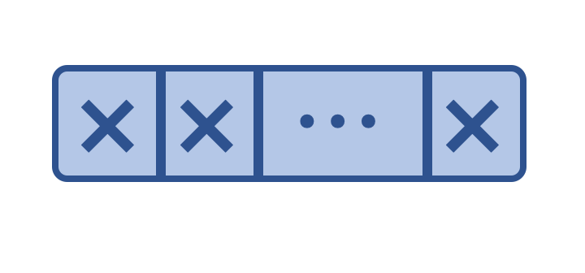
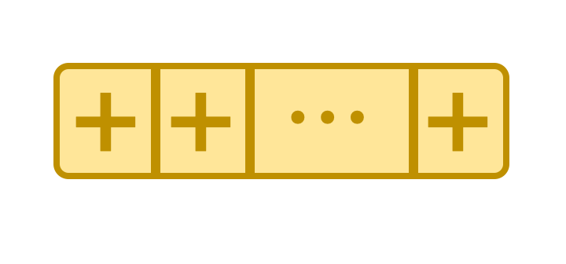
NTT
NTT
CRB
CRB
Transpose network
NTT
NTT
…
…
…
…
…
Keyswitching pipeline
256MB Banked Scratchpad
NTT
NTT
Transpose network
NTT
NTT
…
PRG
PRG
#$@1-
#$@1-
…
Automorphism
Automorphism
Transpose network
…
Simple pipeline
Transpose network
…

Slide 25
FU group 1
[256, 768)
FU group 2
[768, 1024)
FU group 3
[768, 1024)
4
4
4
4
2
3
1
2
3
1
2
3
1
2
3
Transpose network
1
2
3
4
1
1
1
2
2
2
3
3
3
4
4
4

Slide 26

Lane group 0
Lane group 1
Lane group 2
Lane group 3
Subchunk 0
Subchunk 1
Subchunk 2
Subchunk 3
Subchunk 4
Subchunk 5
Subchunk 6
Subchunk 7
Subchunk 8
Subchunk 9
Subchunk 10
Subchunk 11
Subchunk 12
Subchunk 13
Subchunk 14
Subchunk 15
Fixed transpose network
Local transpose
Transpose unit
Transpose unit
Transpose unit

Slide 27
256-lane group
256-lane group
256-lane group
256-lane group
High bandwidth memory
Transpose network
High bandwidth memory
256-lane group
256-lane group
256-lane group
256-lane group

Slide 28
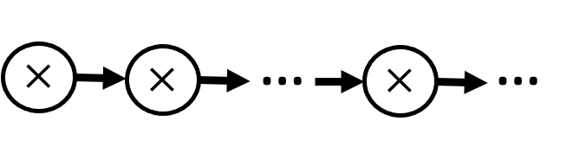
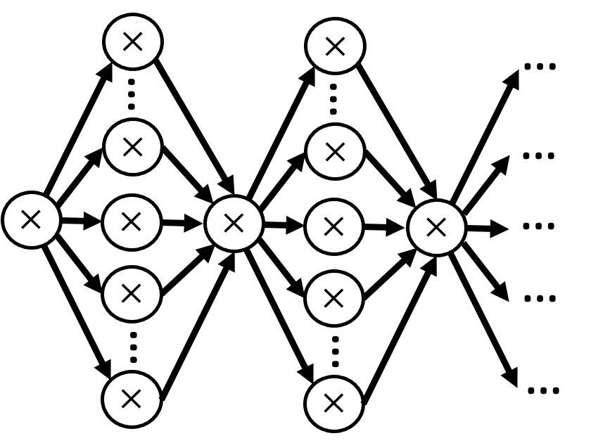
Multiplication chain:
Wide multiply-add graph:
+
+
100 ciphertext muls
+
Maximum ciphertext size
targeted by prior accelerators
Minimum size for
packed bootstrapping
Bootstrapping
computation
Application
computation

Slide 29
✕
✕
…
…
…
…
…
…
✕
✕
✕
✕
✕
…
✕
✕
✕
✕
✕
…
✕
✕
…
…
…
✕
✕

