Slide 1
TOPIC: A visual based method for teaching the children using Deep Learning Guided by: Prof. Ram Mohana Reddy Guddeti
SUBJECT: PROFESSIONALPRACTICE(IT890)
PRESENTED BY:
N SANJANA SHREE(222IT021)

Slide 2
INTRODUCTION
Image captioning and text-to-image captioning are two related fields in computer vision and natural language processing (NLP) that involve generating descriptions or captions of visual content.
Image captioning is the process of automatically generating a textual description of an image. This involves analyzing the visual content of an image and then generating a corresponding natural language description that captures its salient features and characteristics
On the other hand, text-to-image captioning is the inverse problem of image captioning. In this case, the goal is to generate an image that corresponds to a given textual description. This is a challenging problem that involves generating a visual representation that accurately reflects the meaning and intent of the input text.

Slide 3
PROBLEM STATEMENT This project focus on teaching the young children alphabets, sentences and visual analysis of a particular image using deep learning models such as stable diffusion model and Encoder-Decoder model.

Slide 4
OBJECTIVES
Study the different approaches for text to image and image to text translation to teach the young children.
Task 1
To implement text to image translation to teach young children.
Task 2
To implement image to text translation to teach young children.
Task 3

Slide 5
LITERATURE SURVEY
SNO. | Paper Name | Authors | Methodology
1 | Image Captioning Using Deep Learning | C.S.Kanimozhiselvi, Karthika V, Kalaivani S P, Krithika S | The methodology proposed in the IEEE research paper is a standard approach to image captioning using deep learning. It involves collecting a large dataset, preprocessing the data, designing a neural network architecture, training the model, evaluating its performance, and generating captions for new images.
2 | Facilitated Deep Learning Models for Image Captioning | Imtinan Azhar, Imad Afyouni, Ashraf Elnagar | This approach utilizes the encoder-decoder framework, where the encoder network extracts image features, and the decoder network generates captions. The authors propose a novel mechanism that combines attention and gating mechanisms to improve the performance of the decoder network.
3 | Text to Image Synthesis for Improved Image Captioning | Md. Zakir Hossain, Ferdous Sohel, Mohd Fairuz Shiratuddin, Hamid Laga, Mohammed Bennamoun | This method aims to improve the image captioning task by generating realistic images from textual descriptions using a conditional generative adversarial network (cGAN). The generated images are then used to train an image captioning model.
4 | A Text-to-Image Generation Method Based on Multiattention Depth Residual Generation Adversarial Network | Shuo Yang, Xiaojun Bi, Jian Xiao, Jing Xia | This approach combines the advantages of attention mechanisms and residual networks to generate high-quality images from textual descriptions. The proposed model consists of a generator network that generates images and a discriminator network that discriminates between real and generated images.
5 | Bottom-Up and Top-Down Attention for Image Captioning and Visual Question Answering | Peter Anderson et al | This model utilizes a bottom-up attention mechanism that detects salient regions in the image and a top-down attention mechanism that generates captions by attending to these regions. The authors propose a unified framework for both image captioning and visual question answering tasks​.

Slide 6
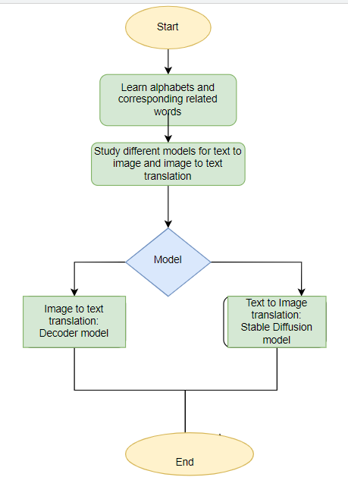
FLOWCHART

Slide 7
METHODOLOGY
Image to text conversion
Image Captioning is the process of generating a textual description for given images. It has been a very important and fundamental task in the Deep Learning domain. Image captioning has a huge amount of application.
This helps to improve accessibility for visually impaired individuals and also allows for easier understanding and organization of visual information. Image captioning can also be useful in a variety of applications such as image retrieval, content-based image search, and visual storytelling.
The application which is considered in this project is to teach children by generating text from an image.
The model architecture is build. Features are extracted from the image, and passed to the cross-attention layers of the Transformer-decoder.

Slide 8
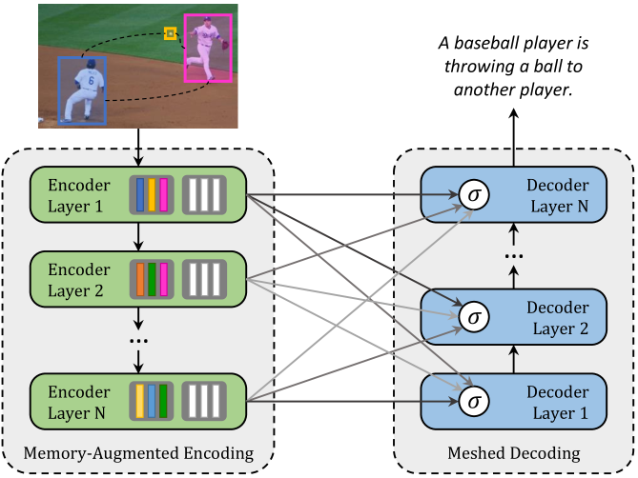
Working
The encoder-decoder model is a common approach for image captioning, which uses a combination of a convolutional neural network (CNN) as the encoder and a recurrent neural network (RNN) as the decoder. Here's how the model works:
Encoder: The input image is fed into a CNN, which extracts a feature vector that captures the visual content of the image. The output of the CNN is a fixed-length feature vector.
Decoder: The feature vector from the CNN is then fed into an RNN, which generates a sequence of words to form the caption. At each time step, the RNN takes as input the previous word in the sequence and a hidden state vector that captures the context of the previous words. The RNN then generates a probability distribution over the vocabulary of possible next words, and samples the next word from this distribution.
Training: During training, the model is fed pairs of images and corresponding captions. The encoder-decoder model is trained to minimize the difference between the predicted caption and the ground-truth caption for each image. This is typically done using a loss function such as cross-entropy loss.

Slide 9
Text to image translation The text description affects the quality of the image, so be as specific as possible. Explicitly mentioning the name of an artist, the art styles, or art mediums such as acrylic painting and oil painting helps to create the images you are looking for. Stable diffusion is an open source text-to-image deep learning model by stability.ai. In this project, we will discuss about how to use the KerasCV's implementation of stable diffusion to generate beautiful images based on text descriptions. Stable Diffusion consists of three parts: A text encoder, which turns your prompt into a latent vector. A diffusion model, which repeatedly "denoises" a 64x64 latent image patch. A decoder, which turns the final 64x64 latent patch into a higher-resolution 512x512 image.

Slide 10
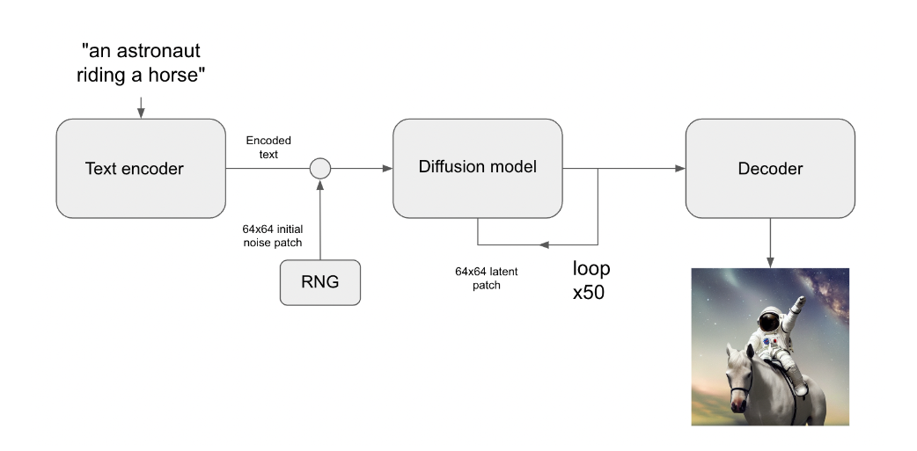
Working
Stable Diffusion Model (SDM) works for text-to-image translation, here is a high-level overview of its workings:
Conditioning on Text Input: The SDM takes as input a text description, which serves as a conditioning signal for generating the corresponding image.
Diffusion Process: The SDM generates the image by gradually diffusing noise, starting from a random initial state. The diffusion process involves iteratively updating the noise with small perturbations, which are drawn from a normal distribution that depends on the current noise state and the text embedding. The diffusion process is designed to generate high-resolution images that are consistent with the input text.
Likelihood Estimation: During training, the SDM is trained to maximize the likelihood of the generated image given the input text. This involves estimating the log-likelihood of the image using a pixel-wise Gaussian distribution, with the mean and variance parameters being dependent on the current noise state and the text embedding.
Sampling: Once the SDM is trained, it can be used to generate new images from unseen text inputs. This involves sampling noise trajectories from the diffusion process, conditioned on the input text. The final image is obtained by applying a post-processing step, such as denoising or color correction.

Slide 11
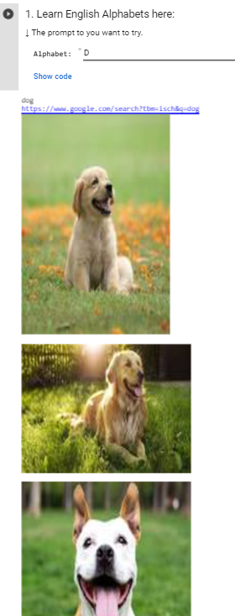
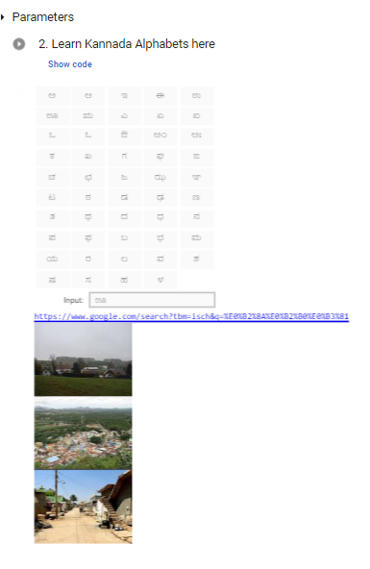
RESULTS

Slide 12
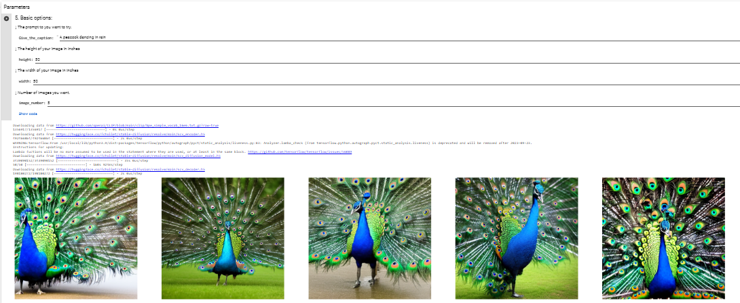

Slide 13
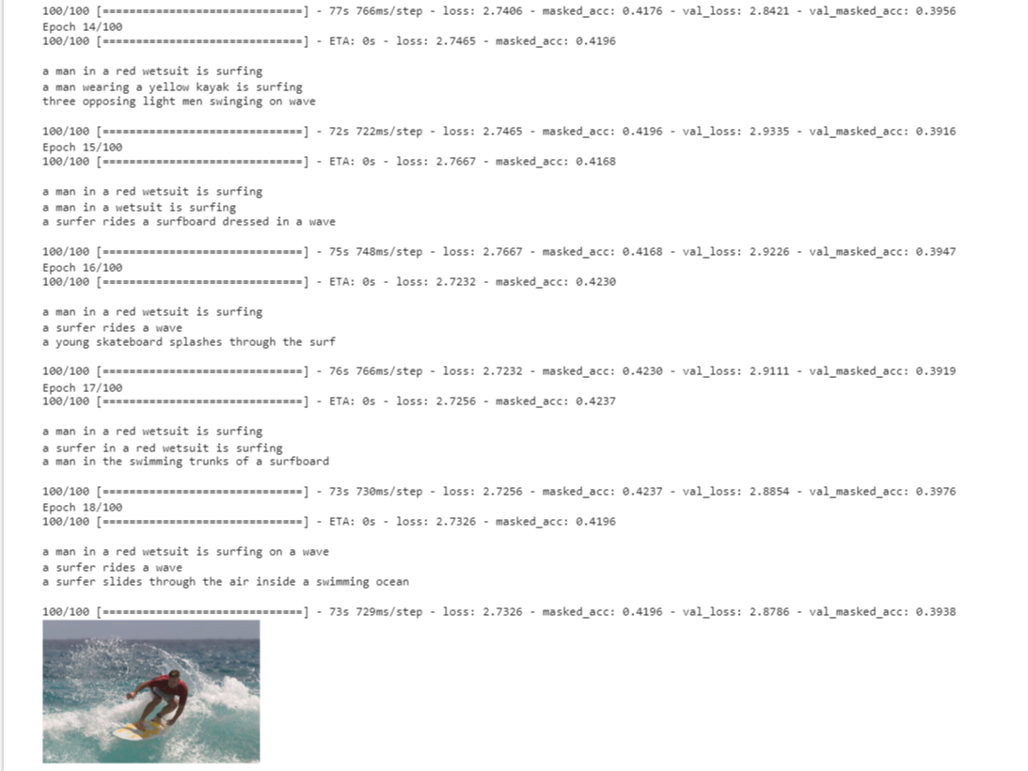
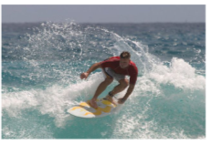

Slide 14
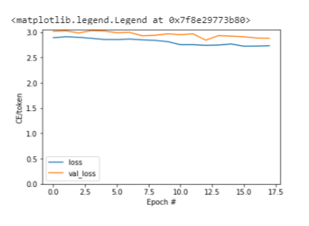
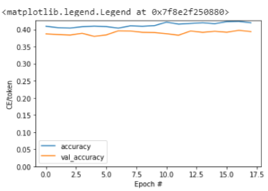
The best accuracy of Encoder Decoder model: 62.56%

Slide 15
Conclusions
Image captioning and text-to-image translation are two exciting and rapidly developing areas in the field of computer vision and natural language proces.Image captioning involves generating natural language descriptions of images, allowing machines to understand and describe visual content like humans.
Meanwhile, text-to-image translation aims to generate realistic images from textual descriptions, which can have applications in areas such as virtual reality, gaming, and content creation. In recent years, significant progress has been made in both fields, with the development of deep learning techniques such as convolutional neural networks (CNNs) and generative adversarial networks (GANs) proving particularly effective.
However, there are still many challenges to be addressed in these areas. For image captioning, there is a need to develop models that can generate more accurate and diverse captions, as well as handle complex scenes with multiple objects and actions. In text-to-image translation, generating high-resolution images that are both realistic and faithful to the textual input remains a challenge.

Slide 16
REFERENCES
[1] "Show, Attend and Tell: Neural Image Caption Generation with Visual Attention" by Kelvin Xu et al. (2015)
[2] "Learning to Generate Image Descriptions from Continuing Captions" by Huijuan Xu et al. (2016)
[3] "StackGAN: Text to Photo-realistic Image Synthesis with Stacked Generative Adversarial Networks" by Han Zhang et al. (2016)
[4]"Dense Image Captioning in the Wild" by Gao Huang et al. (2016)
[5]"Bottom-Up and Top-Down Attention for Image Captioning and Visual Question Answering" by Peter Anderson et al. (2018)
[6]"Image Captioning with Attention-Based LSTM and Visual Attention Mechanism" by Chen Chen et al. (2019)
[7] "Unpaired Image-to-Image Translation using Cycle-Consistent Adversarial Networks" by Jun-Yan Zhu et al. (2017)
[8] "Auto-Encoding Scene Graphs for Image Captioning" by Xu Huang et al. (2018)
[9] "DRAW: A Recurrent Neural Network for Image Generation" by Karol Gregor et al. (2015)
[10] "Text-to-Image Synthesis with Stacked Generative Adversarial Networks" by Tao Xu et al. (2017)
[11] "StackGAN++: Realistic Image Synthesis with Stacked Generative Adversarial Networks" by Han Zhang et al. (2017)
[12]"Generative Adversarial Text-to-Image Synthesis" by Scott Reed et al. (2016)

Slide 17
THANK YOU

