Slide 1


SMART ATTENDANCE MANAGEMENT SYSTEM
2020 - 21
SMART ATTENDANCE MANAGEMENT SYSTEM
Presented by
Kavay G P 1RN17IS044
N Sanjana Shree 1RN17IS058 Nagashree T S 1RN17IS059
Under the Guidance
of
Mr. Ravi Kumar S G
Assistant Professor Department of ISE, RNSIT, Bengaluru - 98
09-08-2021
Department Of Information Science and Engineering , RNSIT, Bengaluru-98

Slide 2
AGENDA
Abstract
Introduction
Literature Review
Methodology
Implementation
Discussion of Results
Conclusion and Future Enhancements
References

Slide 3
ABSTRACT
The face recognition student attendance system emphasizes its simplicity by eliminating classical student attendance marking technique such as calling student names or checking respective identification cards.
Furthermore, the face recognition based automated student attendance system able to overcome the problem of fraudulent approach and lecturers do not have to count the number of students several times to ensure the presence of the students
Image processing is a method to perform some operations on an image, in order to get an enhanced image or to extract some useful information from it.

Slide 4
INTRODUCTION
SMART ATTENDANCE MANAGEMENT SYSTEM
2020 - 21
In present academic system, regular class attendance of students’ plays a significant role in performance assessment and quality monitoring.
The conventional methods practiced in most of the institutions are by calling names or signing on papers, which is highly time-consuming and insecure. This project presents the automatic attendance management system for convenience or data reliability.
The system is developed by the integration of ubiquitous components to make a portable device for managing the students’ attendance using Face Recognition technology.
09-08-2021
Department of Information Science and Engineering, RNSIT, Bengaluru - 98
1

Slide 5
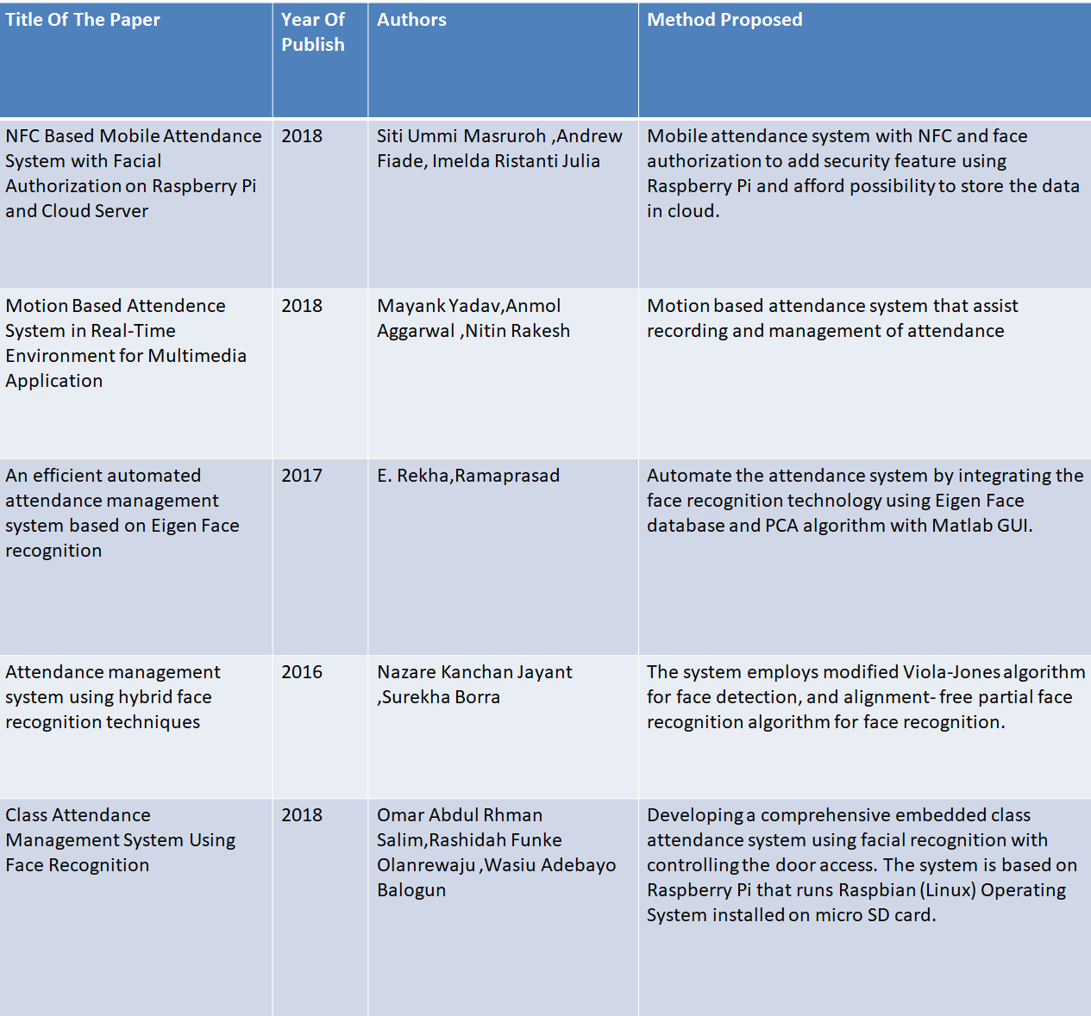
SMART ATTENDANCE MANAGEMENT SYSTEM
2020 - 21
LITERATURE REVIEW
09-08-2021
Department of Information Science and Engineering, RNSIT, Bengaluru - 98
2

Slide 6
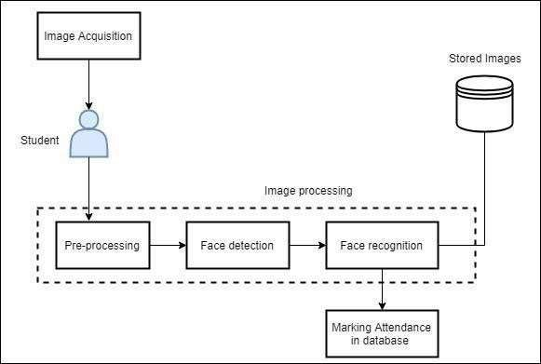
METHODOLOGY
SMART ATTENDANCE MANAGEMENT SYSTEM
2020 - 21
The System process can be separated into three working modules.
face representation
feature extraction, and
classification.

Slide 7
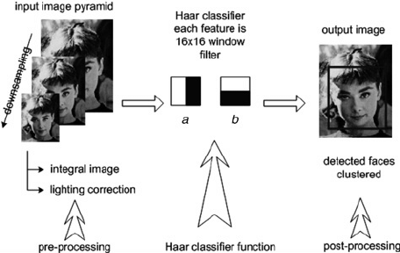
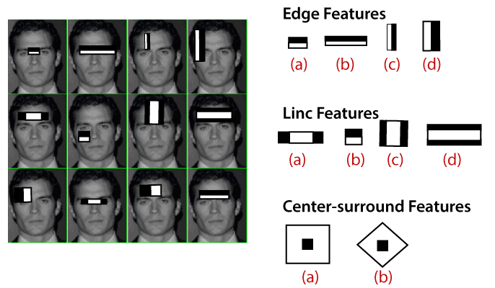
METHODOLOGY
SMART ATTENDANCE MANAGEMENT SYSTEM
2020 - 21
Haar Cascade is an Object Detection Algorithm used to identify faces in an image or a real time video. The algorithm uses edge or line detection features.
09-08-2021

Slide 8
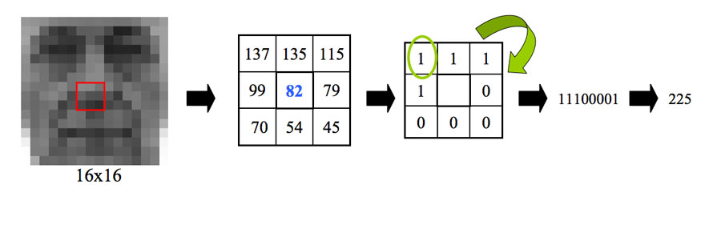
SMART ATTENDANCE MANAGEMENT SYSTEM
2020 - 21
LBPH (Local Binary Pattern Histogram) is a simple yet very efficient texture operator which labels the pixels of an image by thresholding the neighborhood of each pixel and considers the result as a binary number.
09-08-2021
Department of Information Science and Engineering, RNSIT, Bengaluru - 98

Slide 9
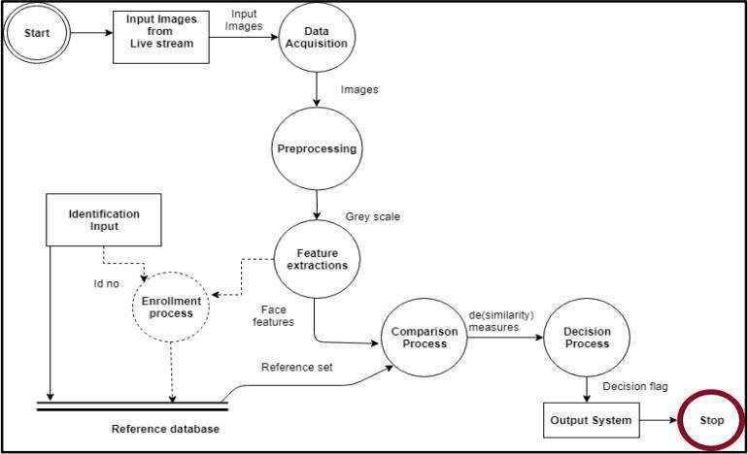
IMPLEMENTATION
SMART ATTENDANCE MANAGEMENT SYSTEM
2020 - 21

Slide 10
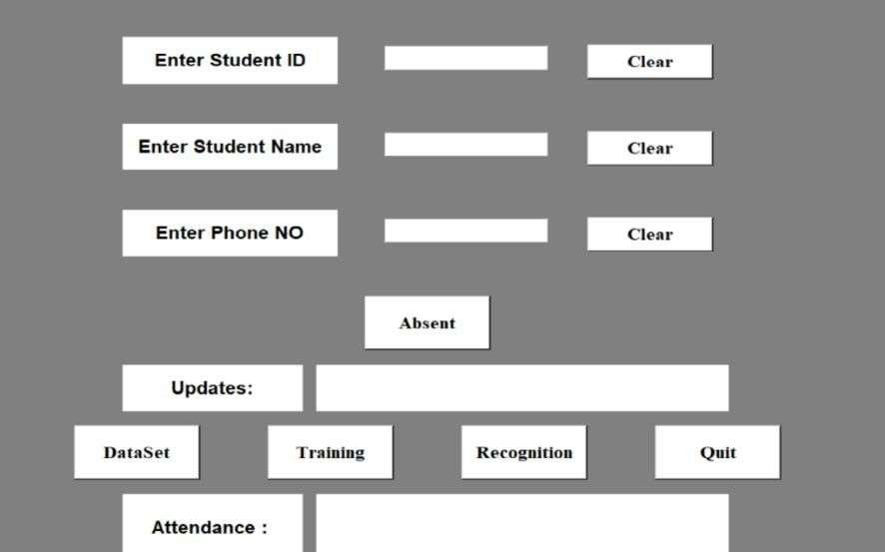
SCREENSHOTS OF PROJECT
SMART ATTENDANCE MANAGEMENT SYSTEM
2020 - 21
GUI for attendance

Slide 11
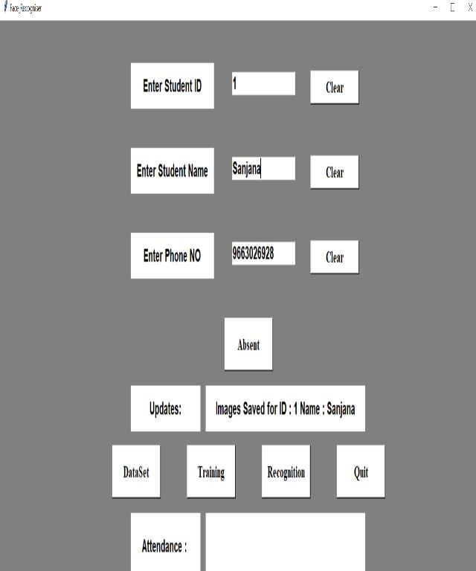
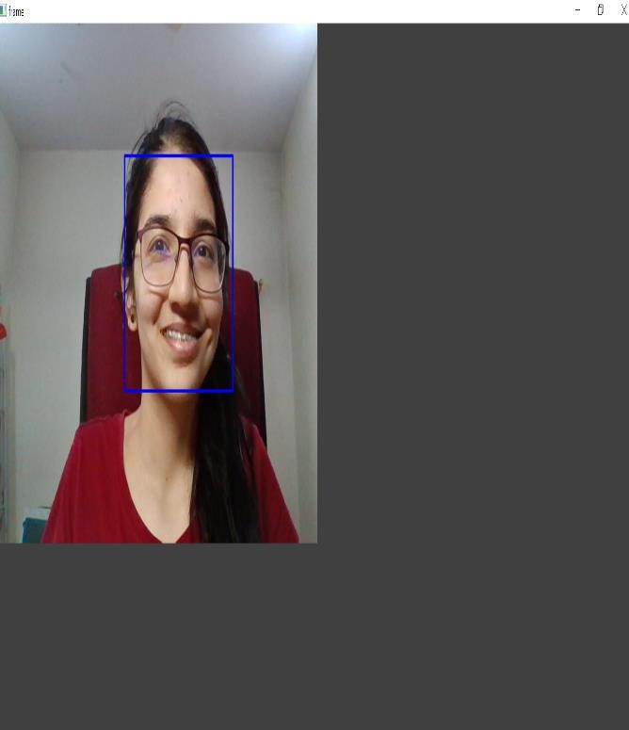
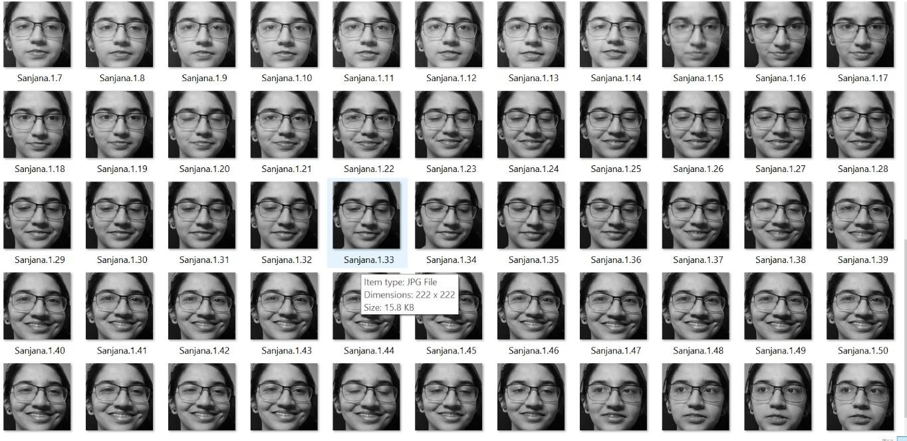
SMART ATTENDANCE MANAGEMENT SYSTEM
2020 - 21
Creation of Dataset
Capturing image for creation of Dataset
Dataset

Slide 12
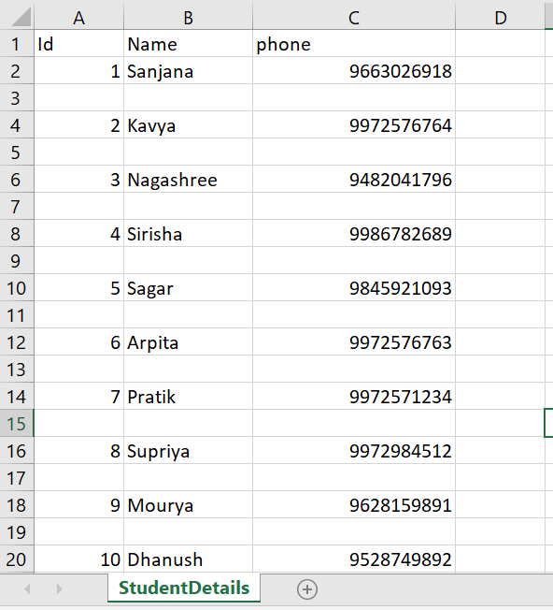
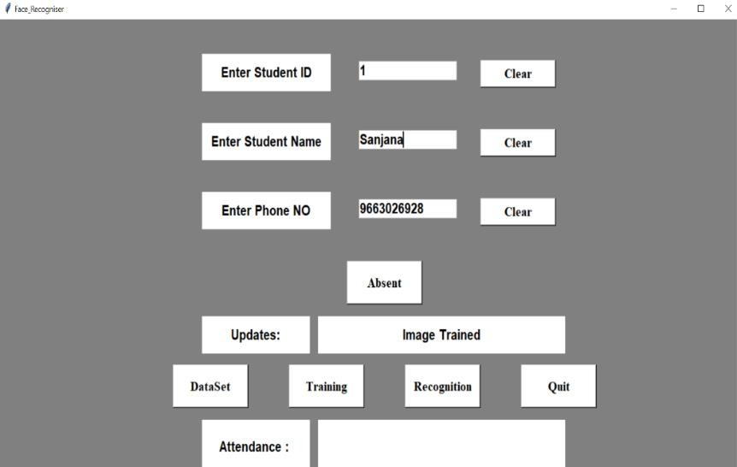
SMART ATTENDANCE MANAGEMENT SYSTEM
2020 - 21
Student details
Training of Dataset
09-08-2021
Department of Information Science and Engineering, RNSIT, Bengaluru - 98
9

Slide 13
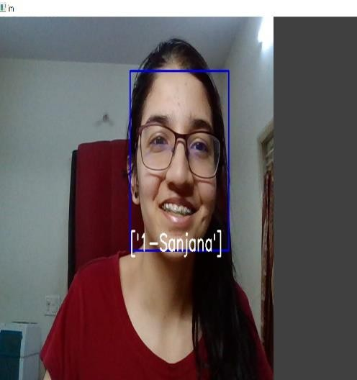
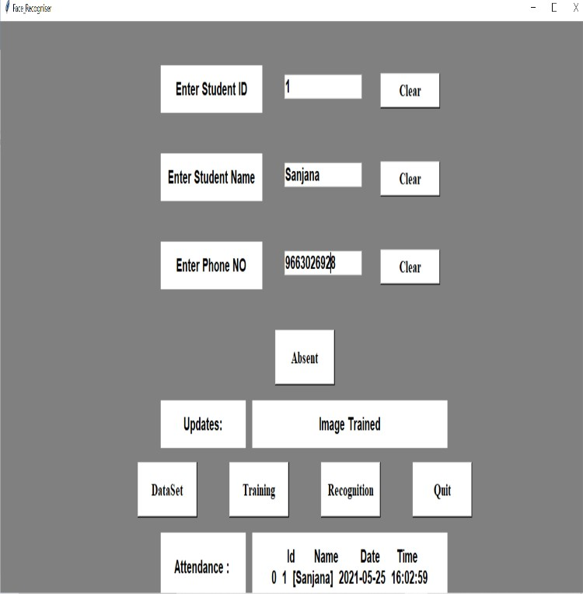
SMART ATTENDANCE MANAGEMENT SYSTEM
2020 - 21
Recognition of student
Attendance updating
09-08-2021
Department of Information Science and Engineering, RNSIT, Bengaluru - 98
10

Slide 14
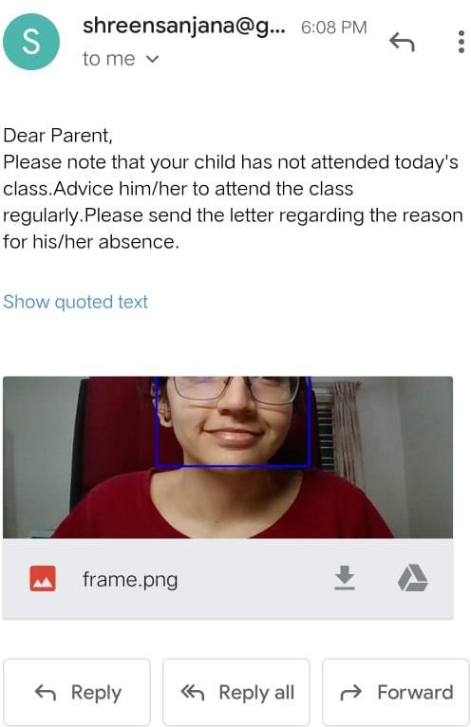
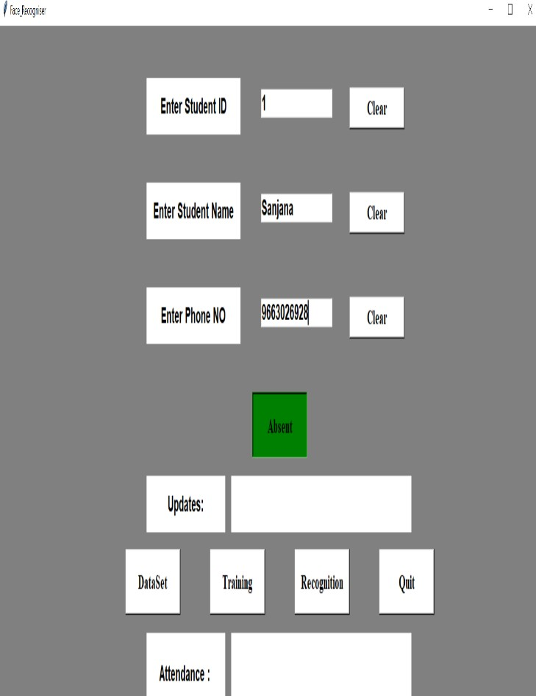
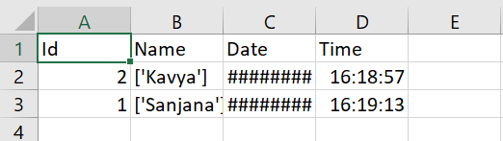
SMART ATTENDANCE MANAGEMENT SYSTEM
2020 - 21
Attendance in Excel Sheet
Absentee’s Mail
Mark as Absent

Slide 15
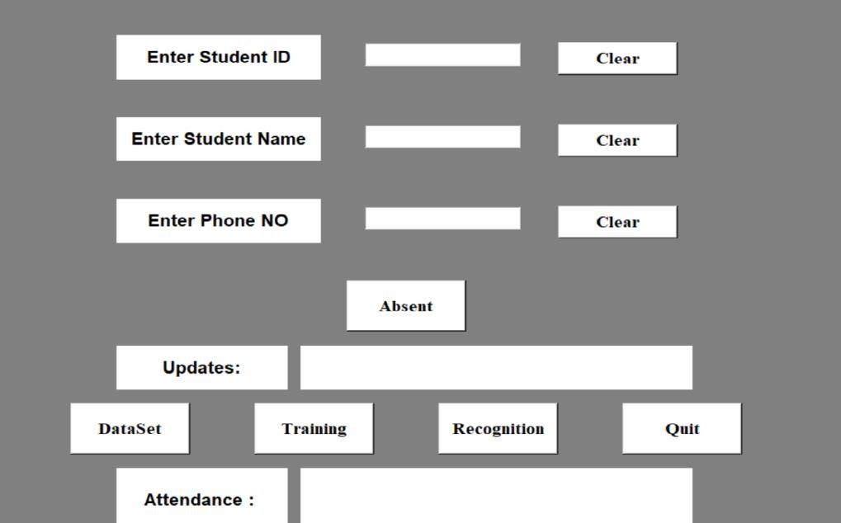
SMART ATTENDANCE MANAGEMENT SYSTEM
2020 - 21
Quit

Slide 16
CONCLUSION and FUTURE ENHANCEMENTS
SMART ATTENDANCE MANAGEMENT SYSTEM 2020 - 21
Finally in student attendance management system, the outcome of all the hard work done for attendance management system is here.
It is a software which helps the user to work with the attendance, fees update, course
update and messages etc.
This software reduces the amount of manual data entry and gives greater efficiency. The User Interface of it is very friendly and can be easily used by anyone. It also decreases the amount of time takento write details and other modules.
In future this system need be improved because these system sometimes fails to recognize students from some distance, also we have some processing limitation, working with a system of high processing may result even better performance of this system.

Slide 17
REFERENCES
SMART ATTENDANCE MANAGEMENT SYSTEM
2020 - 21
[1]. Shireesha Chintalapati; M. V. Raghunadh, "Automated Attendance Management System Based On Face Recognition Algorithms", 2013 IEEE International Conference on Computational Intelligence and Computing Research.
[2]. Phichaya Jaturawat; Manop Phankokkruad, "An Evaluation of Face Recognition Algorithms and Accuracy based on Video in Unconstrained Factors", 2016 6th IEEE International Conference on Control System, Computing and Engineering (ICCSCE)
[3]. Abhishek Jha: ABES Engineering College, Ghaziabad, "Class Room Attendance System Using Facial Recognition System", The International Journal of Mathematics, Science, Technology and Management (ISSN : 2319-8125) Vol. 2 Issue 3
[4]. S. SAYEED, J. HOSSEN, S.M.A. KALAIARASI, V. JAYAKUMAR, I. YUSOF, A. SAMRAJ, "Real-Time Face Recognition For Attendance Monitoring System" Journal of Theoretical and Applied Information Technology 15th January 2017.
09-08-2021
Department of Information Science and Engineering, RNSIT, Bengaluru - 98
14

Slide 18
THANK YOU
SMART ATTENDANCE MANAGEMENT SYSTEM
2020 - 21

