Slide 1

EXPLORATORY DATA ANALYSIS
U.S. TRENDING
VIDEOS
By: NEVILLE AGNEL SANTAMARIA
INSAID COHORT JAN 2021 BATCH

Slide 2

INTRODUCTION
YouTube is an online video platform owned by Google.
It is the second most-visited website in the world.
In 2019, more than 500 hours of video content were uploaded to YouTube servers every minute.
It maintains a list of the top trending videos on the platform.
Neville Agnel Santamaria

Slide 3

PROBLEM STATEMENT
Top trending video categories.
Best time to publish a video on YouTube.
Top trending videos from the trending list.
Waiting time for a video to be trended
Key parameters for videos to get trended.
Neville Agnel Santamaria

Slide 4
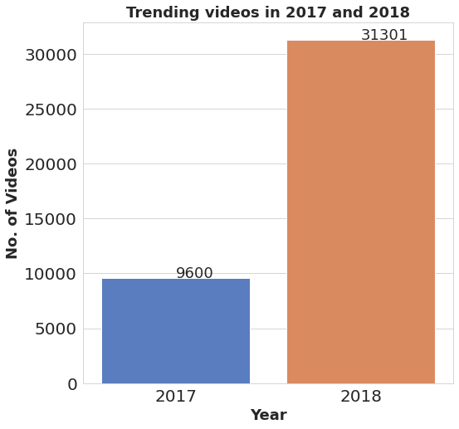
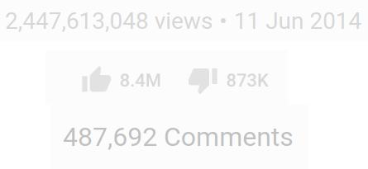
ABOUT THE DATASET
Neville Agnel Santamaria

Slide 5
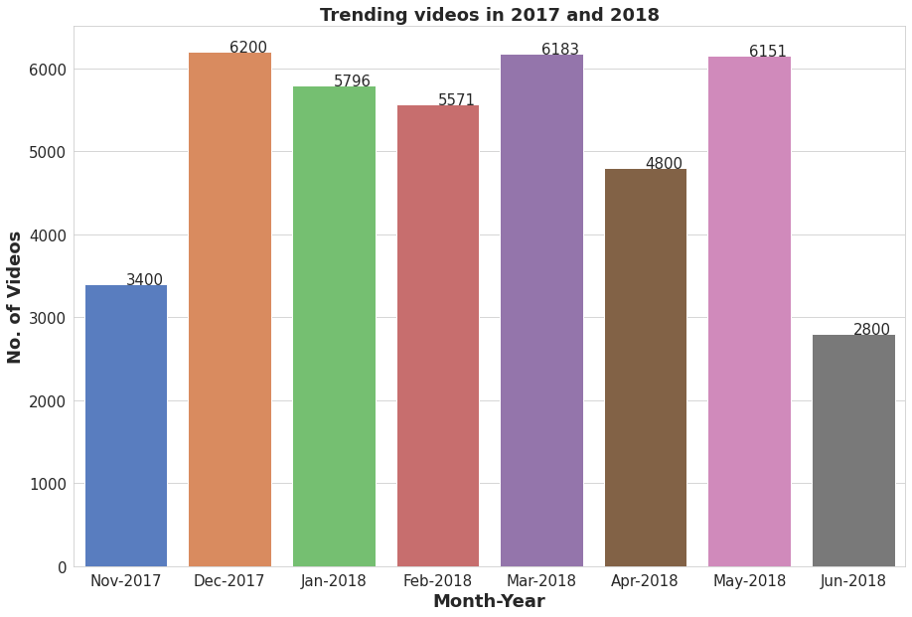
TOTAL TRENDING VIDEOS
Neville Agnel Santamaria

Slide 6
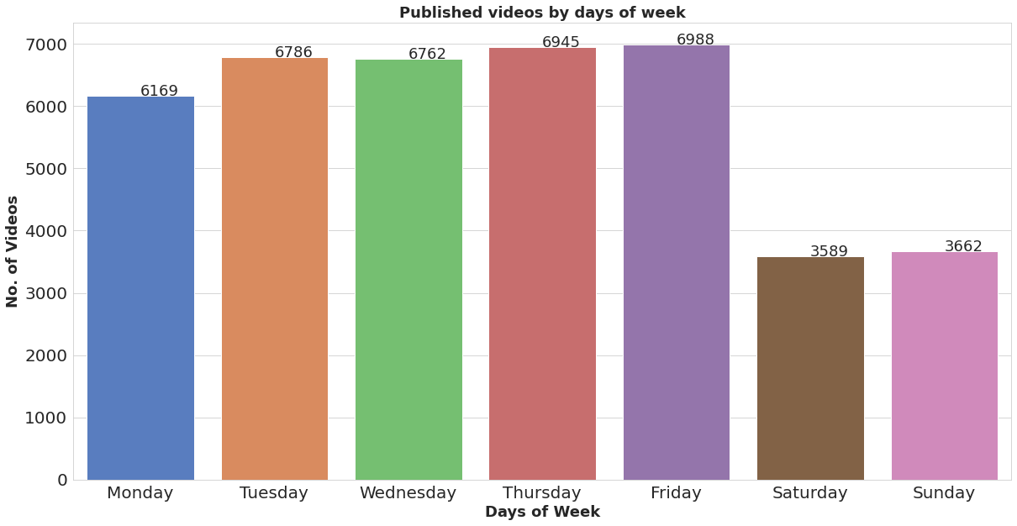
PUBLISHED BY DAYS OF WEEK
Neville Agnel Santamaria

Slide 7
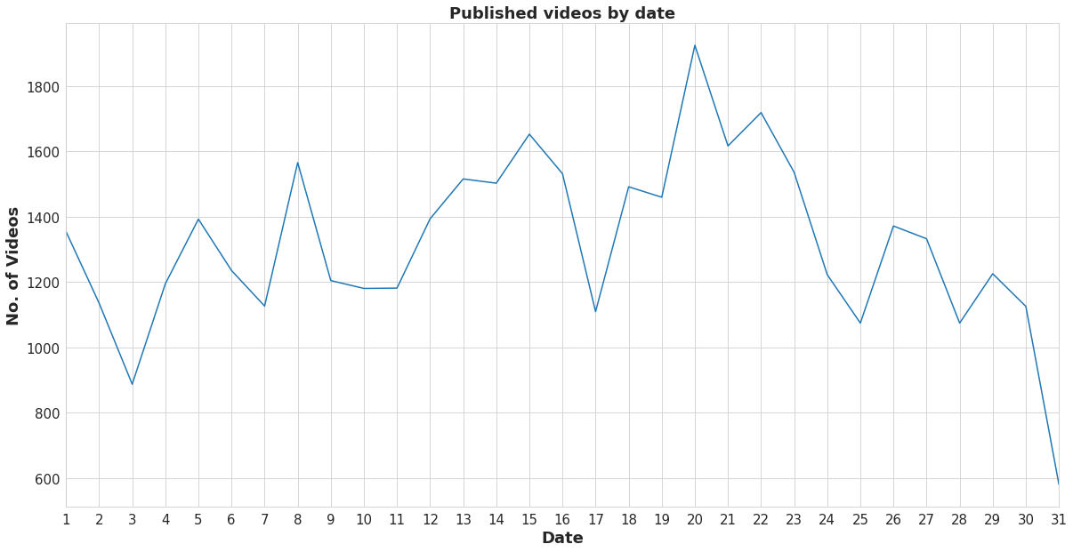
DATE OF PUBLISHED VIDEOS
Neville Agnel Santamaria

Slide 8
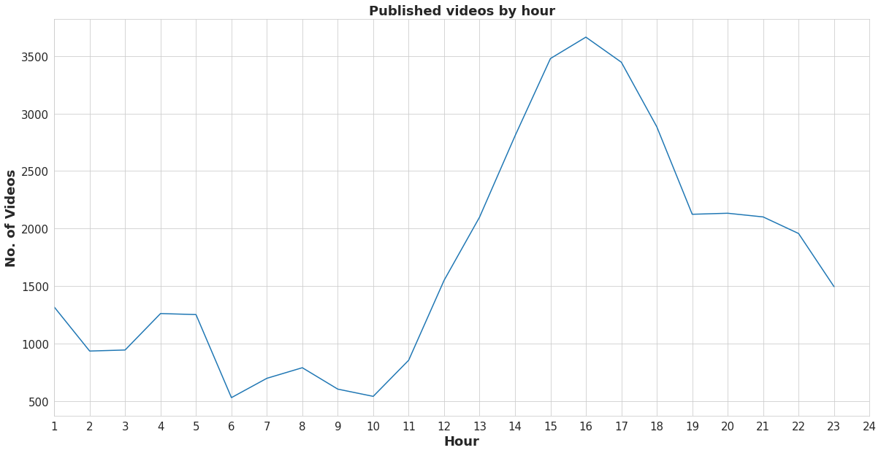
AT WHAT HOUR THE VIDEOS WAS PUBLISHED ?
Neville Agnel Santamaria

Slide 9
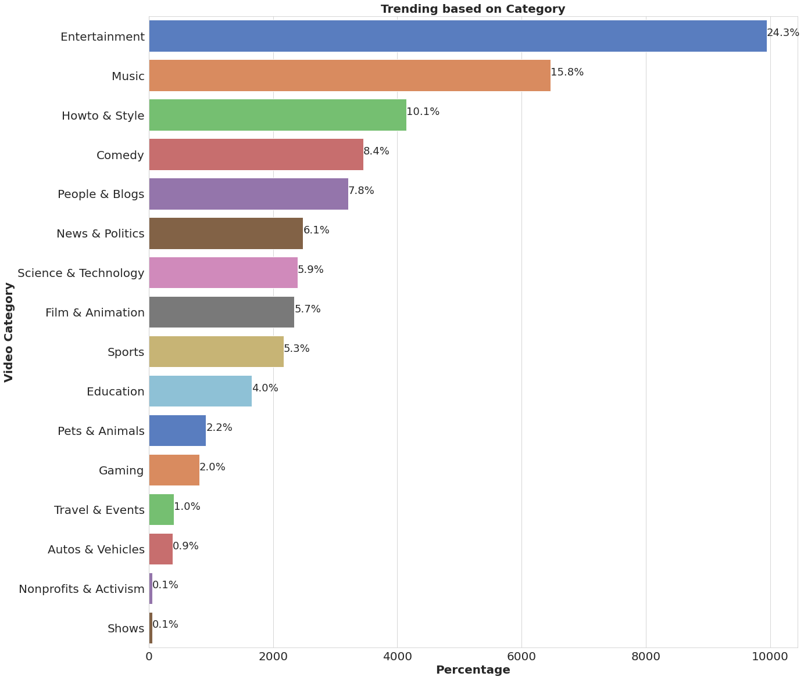
TRENDING CATEGORIES
Neville Agnel Santamaria

Slide 10
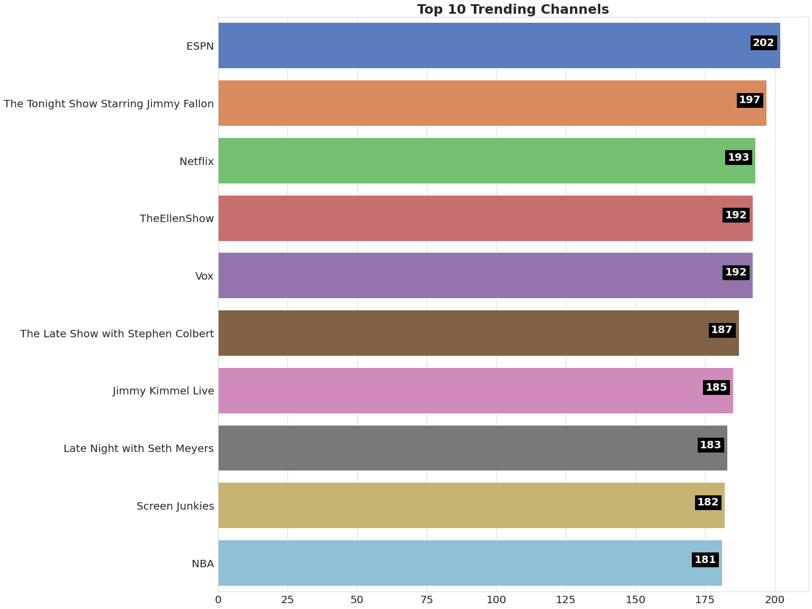
TOP 10 TRENDING CHANNELS
Neville Agnel Santamaria

Slide 11
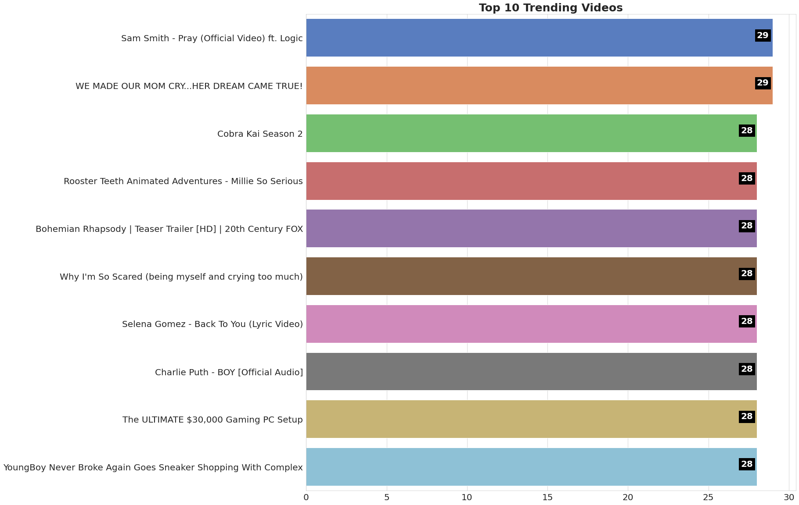
TOP 10 TRENDING VIDEOS FROM THE TRENDING LIST
Neville Agnel Santamaria

Slide 12
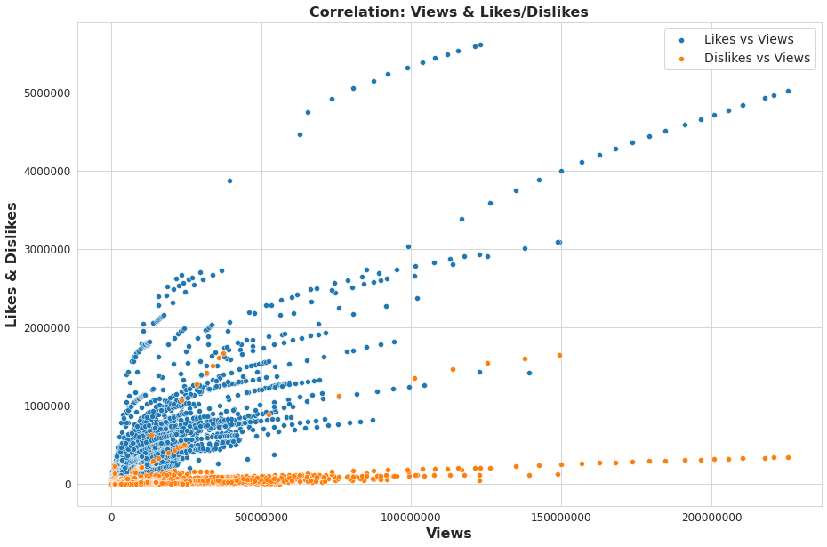
LIKE vs VIEWS & DISLIKES vs VIEWS
Neville Agnel Santamaria

Slide 13
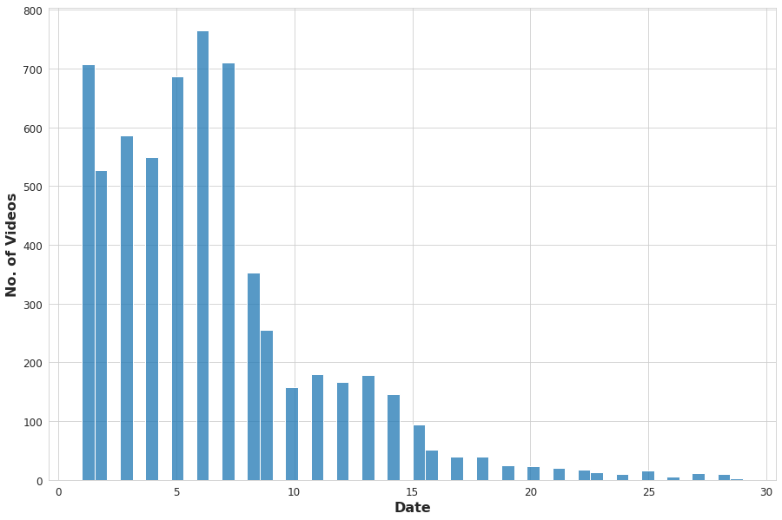
MOST OF THE VIDEOS PUBLISHED
Neville Agnel Santamaria

Slide 14
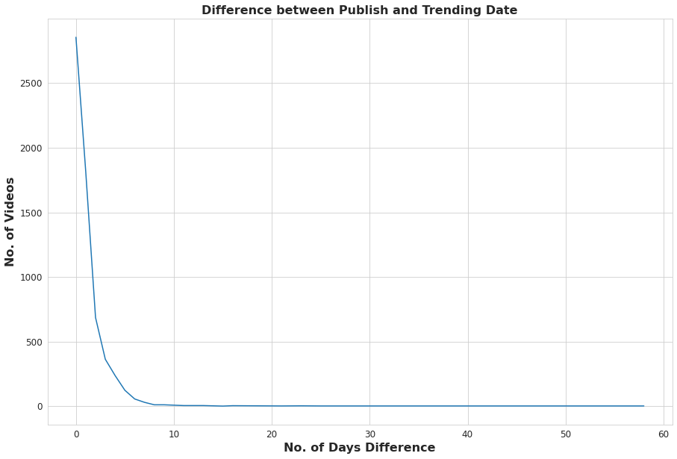
WAITING TIME FOR A VIDEO TO BE TRENDED
Neville Agnel Santamaria

Slide 15

SUMMARY
Most of the videos were published in the between 1st and 10th of the month.
Most of the videos were published between 12 PM to 11 PM during the day.
Most of the videos were uploaded during weekdays.
Waiting time for a video to get trended is 10 days.
Views, Likes & Comments are the key factors in-order to get the video trended.
Entertainment followed by Music categories holds the highest number of trending videos.
Neville Agnel Santamaria

Slide 16
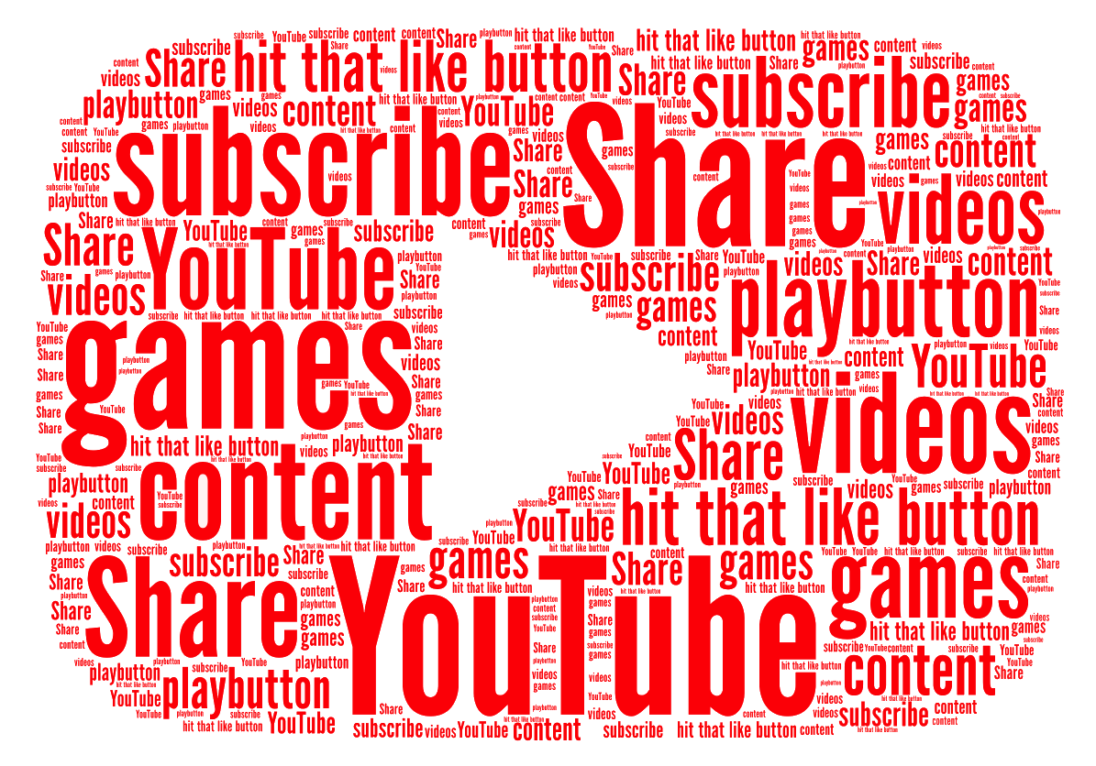
THANK YOU
Neville Agnel Santamaria

