Slide 1
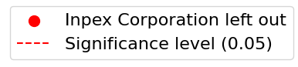
Excluding INPEX Corporation
Including INPEX Corporation
(a)
(b)
Continuous Credit Number
(c)
(d)
Binary Credit Indicator

