Slide 1
Travelers Analytics: U of M Stats 8051 Insurance Modeling Problem
November 23rd, 2015
Nathan Hubbell, FCAS
Gang Cheng, Ph.D.

Slide 2
Agenda
Travelers: Who Are We & How Do We Use Data?
Insurance 101
Basic business terminology
Insurance Modeling Problem
Introduction
Exploratory Data Analysis
Assignment Walk-through

Slide 3
How is data used at Travelers?
Loss, Premium, and Financial Data
Research & Development
Unstructured
Traditional Actuarial Usage
Univariate analysis
Includes external data
Multivariate analysis
Example: GLMs allow for a non-linear approach in predictive modeling.
Future development
Continued use of sophisticated statistical methods
3

Slide 4
Insurance 101
4

Slide 5
Basics of Insurance
Insurance companies sell insurance policies, which are the promise to pay in the event that a customer experiences a loss.
The unique challenge in insurance is that we don’t know what the cost of insuring a customer is when we sell the policy.
Example: The cost to insure an auto customer
It’s impossible to predict if someone is going to
Get into an accident
The type of accident (hit a telephone pole, hit another vehicle, bodily injury)
How bad (cost) the accident will be
5
Notes:
5

Slide 6
Business Impact of Loss Experience
To estimate the cost of insuring policyholders, we must predict losses
Two fundamental questions we must answer are:
Ratemaking: looking to the future
Setting rates for policies
How much do we need to charge customers for a policy in order to reach our target profit? Basic idea: price = cost + profit
Reserving: looking at the impact of past experience
Setting aside reserve money
How much money do we need to set aside to pay for claims?
Note: We cannot precisely predict losses for each individual or business. However, if we group our customers together, we can build statistical models to predict average loss over a group.
6

Slide 7
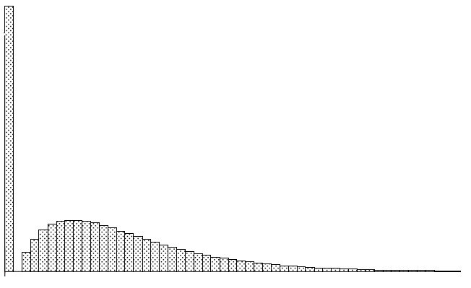
Model Building
Generalized Linear Models (GLMs)
Potential response variables:
Claims – Frequency (# claims / exposure) (e.g. Poisson, Negative Binomial)
Loss – Severity (loss $ / claim) (e.g. Gamma, Inverse Gaussian)
Pure Premium = Frequency * Severity = loss $ / exposure
A common link function is g(x) = ln(x).
Probability distribution: Tweedie
Compound distribution of a Poisson claim #
And a Gamma claim size distribution
Large spike at 0 for policies with no claims
Wide range of amount in the claims
Challenges include:
Variable selection
Bias-variance trade-off
So what is an example of an actual modeling problem in insurance?
* Source: “A Practitioner's Guide to Generalized Linear Models”
7

Slide 8
What questions do you have about:
Travelers?
Insurance?
Statistics at Travelers?
8

Slide 9

Business Problem
Refer to the one page hand out “Kangaroo Auto Insurance Company Modeling Problem” for more details
You, as a statistician, work for Kangaroo Insurance, an Australian insurance company
The underwriter in your company would like you to build a pricing model (pure premium) for the auto insurance product.
The pricing needs to be competitive.
accurately reflect the risk your company is taking.
enough segmentation among customers.
The data from policies written in 2004 and 2005 is provided.

Slide 10
Data Information
Losses for each vehicle from policies written in 2004 and 2005.
Each policy was written as one-year originally.
There are 67,856 policies (vehicles) in the data.
Ten (10) variables in the data.

Slide 11
Variable Information – veh_value
vehicle value, in $10,000s, a numerical variable.

Slide 12
Variable Information – exposure
The covered period, in years, a numerical variable (always between 0 and 1)
The amount of time a vehicle was “exposed” to potential accidents.

Slide 13
Variable Information – clm
An indicator whether the vehicle/driver had at least one claim during the covered period, 0=No, 1=Yes.
4,624/67,856 had at least one claim.

Slide 14
Variable Information – numclaims
Number of claims during covered period, integer values.
4,624/67,856 had at least one claim.
Number of Claims | Frequency
0 | 63,232
1 | 4,333
2 | 271
3 | 18
4 | 2

Slide 15
Variable Information – claimcst0 (target variable)
The total amount of the claims, in dollars, numeric values.

Slide 16
Variable Information – veh_body
CONVT = convertible
HBACK = hatchback
HDTOP = hardtop
MCARA = motorized caravan
MIBUS = minibus
PANVN = panel van
RDSTR = roadster
STNWG = station wagon
UTE - utility
The vehicle body code, a character string.

Slide 17
Variable Information – veh_age
The age group of insured vehicle, coded as 1, 2, 3, and 4, with 1 being the youngest.

Slide 18
Variable Information – gender
The gender of driver, F (female) or M (male)
Gender | Frequency
F | 38,603
M | 29,253

Slide 19
Variable Information – area
Driver’s area of residence, a character code.
Area Code | Frequency
A | 16,312
B | 13,341
C | 20,540
D | 8,173
E | 5,912
F | 3,578

Slide 20
Variable Information – agecat
Driver’s age category, coded as 1, 2, 3, 4, 5 and 6, with 1 being the youngest.
Driver Age Category | Frequency
1 | 5,742
2 | 12,875
3 | 15,767
4 | 16,189
5 | 10,736
6 | 6,547

Slide 21
Kaggle Style
Data arrangement
The 67,856 policies had been divided into three splits: T, V and H
All information for T is provided
The response variables in V and H are omitted
Notice: This dataset is modified from a classic dataset. Please treat it as a different dataset
Final Model performance measure
Please provide your model prediction on H as part of your final submission
The final model performance will be based on its performance on H
Getting feedback before final submission
You are encouraged to submit your predictions on V before final submission. We will provide feedback on how well your model performs on V
No more than 2 rounds of the submission-and-feedback
Allow about 3-5 days to get the feedback after your submission

Slide 22
Questions May Be Asked
What models did you fit?
what is your assumption(s)?
is your assumption reasonable?
how do you check your assumption(s)?
What is the impact of each variable?
are all variables equally important?
if not, which ones are more important? How do you measure it?
How do you check your model actually works (genaralizability)?
What questions do you have about the
“Kangaroo Insurance Company Modeling Problem”?

Slide 23
Timeline
November 23rd (today) ⁻ Project begins
First model submission (optional)
Final model submission
December 7th – group presentations

Slide 24
References and Resources
Contacts
Nathan Hubbell – NHUBBELL@travelers.com
Gang Cheng– GCHENG2@travelers.com
Travelers Careers
http://www.travelers.com/careers
Actuarial and Analytics Research Internship and Full Time
A Practitioner's Guide to Generalized Linear Models
http://www.towerswatson.com/assets/pdf/2380/Anderson_et_al_Edition_3.pdf

