Slide 1
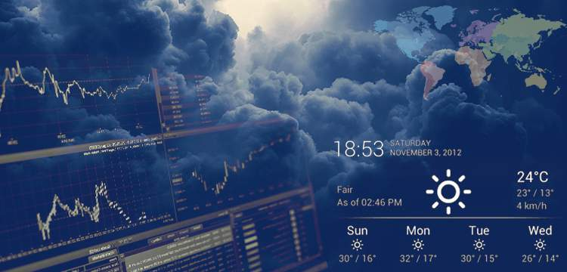

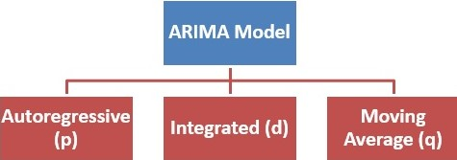
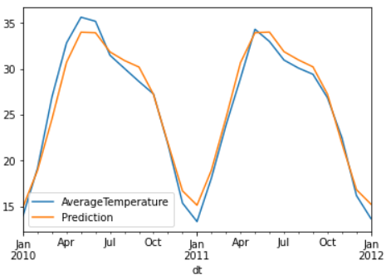
Weather Prediction Using ARIMA And SARIMA Models
- Sumit Dangi(19312), Data Science and Engineering

