Slide 1
BPG Metrics for Wide-Area Internet Exchange Points

Slide 2
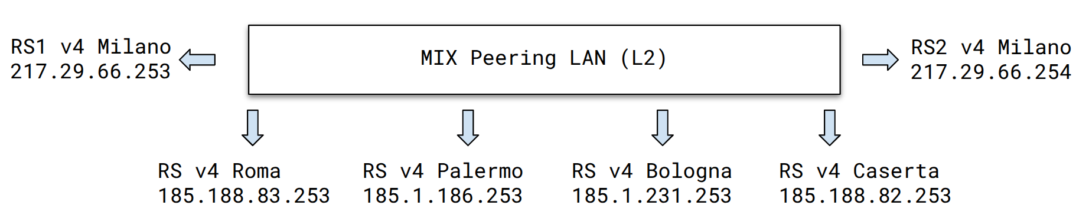
Introduction
The MIX implements a Layer 2 switching infrastructure that, through Virtual LAN Emulation techniques, gives users the impression of a single shared LAN, even though it is geographically distributed across multiple locations (Milan, Rome, Bologna, Palermo, and Caserta).
Notes:
Utilizzare sempre i modelli di elenco forniti dal programma, quindi non realizzare elenchi solamente inserendo trattini, numeri o punti, affinché una sintesi vocale possa leggerli in ordine e proprio come elenchi.

Slide 3
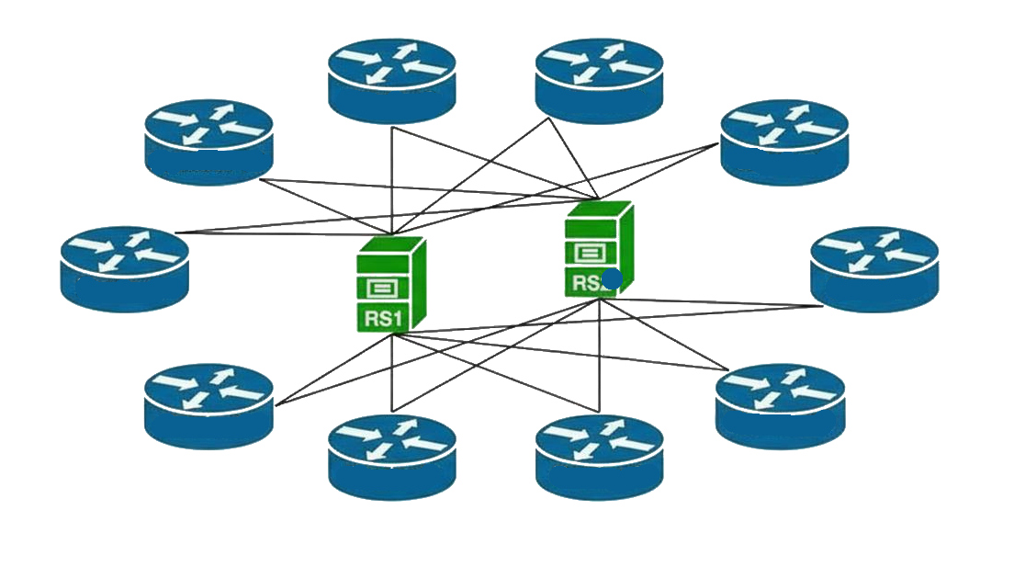
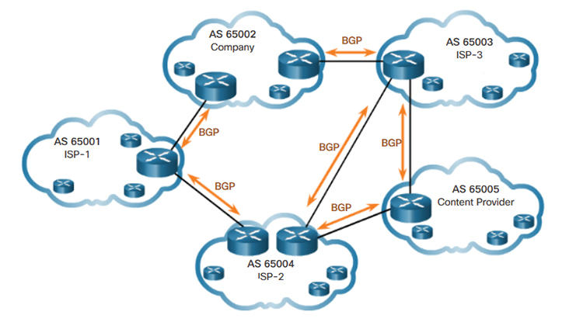
Route server
Through EBGP sessions, each network participating in this type of interconnection—referred to as a “route server client”—sends the RS information regarding the reachability of its network prefixes. The route server does not directly carry data traffic: all routes learned from peers are stored in an internal RS database called the Loc-RIB (Local Routing Information Base).
Notes:
Utilizzare sempre i modelli di elenco forniti dal programma, quindi non realizzare elenchi solamente inserendo trattini, numeri o punti, affinché una sintesi vocale possa leggerli in ordine e proprio come elenchi.

Slide 4
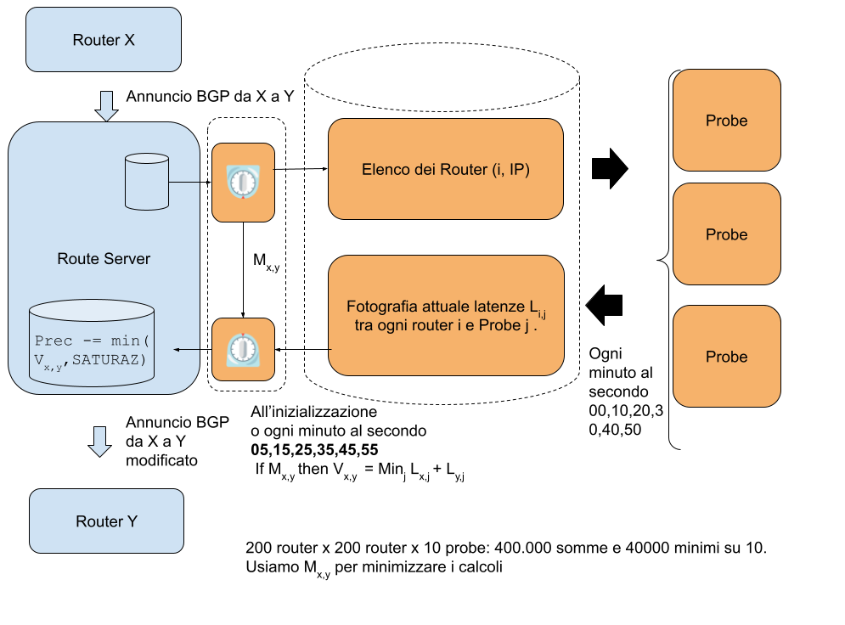
Solution Developed
BIRD is a routing daemon: a non-interactive program that communicates with other routers and calculates routing tables.
Notes:
Utilizzare sempre i modelli di elenco forniti dal programma, quindi non realizzare elenchi solamente inserendo trattini, numeri o punti, affinché una sintesi vocale possa leggerli in ordine e proprio come elenchi.

Slide 5
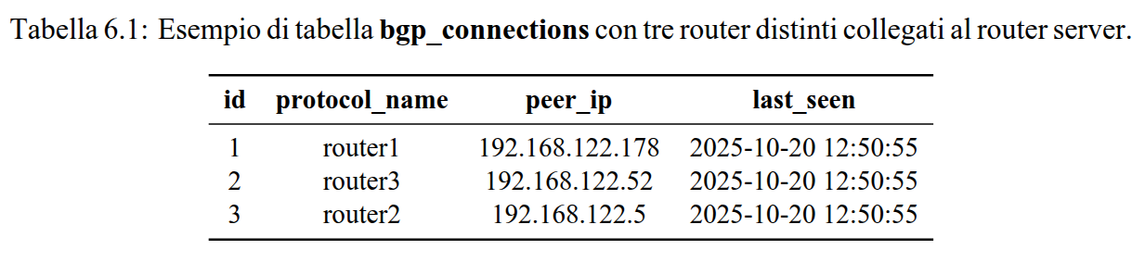
I retrieve data on the routers connected to the route server (IP address and protocol name) by querying Bird’s configuration file;
I save this data in a table named “bgp_connections,” which is synchronized between the probe and the route server.
Notes:
Utilizzare sempre i modelli di elenco forniti dal programma, quindi non realizzare elenchi solamente inserendo trattini, numeri o punti, affinché una sintesi vocale possa leggerli in ordine e proprio come elenchi.

Slide 6
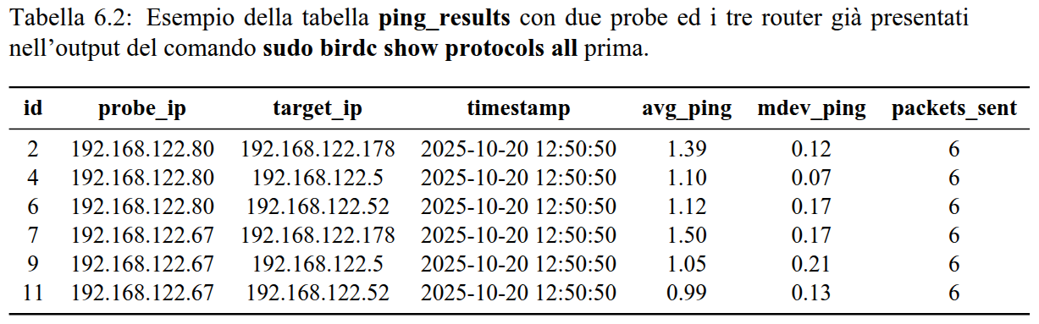
Each probe, acting completely independently, pings every router listed in “bgp_connections” and loads the ping results into the “ping_results” table, which is also synchronized between the probes and the route server;
I obtain the list of exports between peer routers from Bird in order to significantly optimize the peer-to-peer calculation of latency for each probe;
For each router, I select the lowest latency time and adjust the preference value accordingly.
Notes:
Utilizzare sempre i modelli di elenco forniti dal programma, quindi non realizzare elenchi solamente inserendo trattini, numeri o punti, affinché una sintesi vocale possa leggerli in ordine e proprio come elenchi.

Slide 7
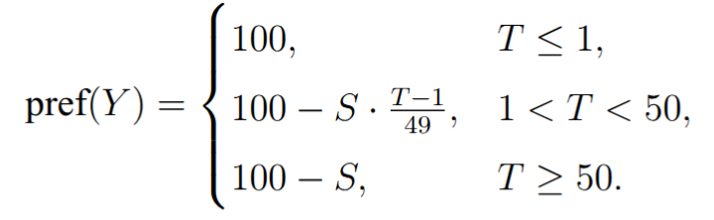
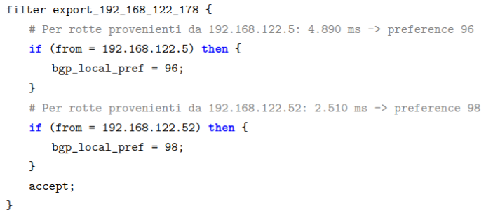
BGP local preference
S = the maximum penalty to be applied (increase this value to make the preference values more spread out).
T = total latency.
BGP Local Preference is a standard BGP attribute used to indicate “how much to prefer this route over other BGP routes” within the AS.
Notes:
Utilizzare sempre i modelli di elenco forniti dal programma, quindi non realizzare elenchi solamente inserendo trattini, numeri o punti, affinché una sintesi vocale possa leggerli in ordine e proprio come elenchi.

Slide 8
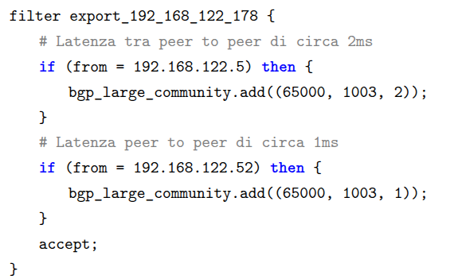
Alternative to BGP large communities
In 2018, Euro-IX attempted to standardize large BGP communities. Of particular interest to us is the community RS:1003:ms, which stands for “IXP measured round-trip time for peer in ms.”
Notes:
Utilizzare sempre i modelli di elenco forniti dal programma, quindi non realizzare elenchi solamente inserendo trattini, numeri o punti, affinché una sintesi vocale possa leggerli in ordine e proprio come elenchi.

Slide 9
Route flapping
Frequent routing fluctuations (route flapping) cause network instability by increasing the load on routers and degrading performance due to constant route changes. This phenomenon occurs in scenarios such as comparable latencies between routes, unstable nodes, or periodic load fluctuations. Although the described algorithm uses moving averages, it lacks a hysteresis mechanism to prevent fluctuations caused by minor variations. Furthermore, a dynamic latency-based `local_pref` conflicts with existing routing policies, risking the prioritization of performance over business priorities, reliability, or capacity, which could lead to contract violations and indirect costs.
Notes:
Utilizzare sempre i modelli di elenco forniti dal programma, quindi non realizzare elenchi solamente inserendo trattini, numeri o punti, affinché una sintesi vocale possa leggerli in ordine e proprio come elenchi.

Slide 10
Conclusions
There are many advantages to this implementation:
The gains achieved by each router are reflected across the entire path of packets and requests;
Reduced operating costs thanks to optimized hardware utilization;
Better load balancing across the network infrastructure;
An evolution of the BGP protocol that is easily adoptable by peer routers (they do not need to make substantial changes) and they can still choose whether or not to ignore the suggested preference.
Notes:
Utilizzare sempre i modelli di elenco forniti dal programma, quindi non realizzare elenchi solamente inserendo trattini, numeri o punti, affinché una sintesi vocale possa leggerli in ordine e proprio come elenchi.

