Slide 1
The Generations of Computer History

Slide 2
Table of Contents
Slide 3: 1st generation (vacuum tubes)
Slide 4: 1st generation continued
Slide 5: pictures of vacuum tubes
Slide 6: 2nd generation (transistors)
Slide 7: 3rd generation (integrated circuits)
Slide 8: 4th generation (microprocessor)
Slide 9: 5th generation (present-beyond)
Slide 10: Pictures of Artificial Intelligence

Slide 3
Evolution of Mechanical Computers
A computer is An electronic device for the storage and processing of information
a programmable machine that inputs, processes and outputs data
A functional unit that can perform substantial computation, including numerous arithmetic operations or logic operations, without human intervention during a run time

Slide 4
Early Developments
Charles Babbage
born December 26, 1791 in Teignmouth, Devonshire UK, Died 1871, London; Known to some as the "Father of Computing" for his contributions to the basic design of the computer through his Analytical machine. His previous difference engine was a special purpose device intended for the production of tables.
Ada Byron
Ada suggested to Babbage writing a plan for how the engine might calculate Bernoulli numbers. the first "computer program." A software language developed by the U.S. Department of Defense was named "Ada" in her honor in 1979.
Geissler Tubes
One of the first to experiment with vacuum tubes was a German scientific instrument manufacturer, Heinrich Geissler (1814-1879). In the mid-1800's, Geissler found that a current passed through an enclosed gas tube, which contained a partial vacuum and one of a series of gases, would produce a brightly colored glow.
Konrad Zuse
German inventor in the 1930’s develop Z1 in secret, Z2, Z3, z4 is developed in Zurich, creates a basic programming system known as "Plankalkül"

Slide 5
1st Generation Vacuum Tube (1939-1954)
1937 -John V. Atanasoff designed the first digital electronic computer
1941 - Konrad Zuse in Germany developed in secret the Z3, the first fully functional general purpose computer
1943 - In Britain, the Colossus was designed in secret at Bletchley Park to decode German messages
1944 - Howard Aiken developed the Harvard Mark I mechanical computer for the Navy
1945 - John W. Mauchly and J. Presper Eckert built ENIAC at U of PA for the U.S. Army
1951 - Remington Rand successfully tested UNIVAC March 30, 1951, and announced to the public its sale to the Census Bureau June 14, 1951, the first commercial computer to feature a magnetic tape storage system, the eight UNISERVO tape drives that stood separate from the CPU and control console on the other side of a garage-size room. Each tape drive was six feet high and three feet wide, used 1/2-inch metal tape of nickel-plated bronze 1200 feet long, recorded data on eight channels at 100 inches per second with a transfer rate of 7,200 characters per second. The complete UNIVAC system weighed 29,000 pounds, included 5200 vacuum tubes, and an offline typewriter-printer UNIPRINTER with an attached metal tape drive. Later, a punched card-to-tape machine was added to read IBM 80-column and Remington Rand 90-column cards.

Slide 6
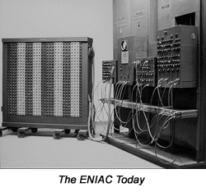
1st Generation(1946-58) vacuum tubes (ENIAC)
America got its first glimpse of ENIAC in 1946.
ENIAC was built by Eckert and Mauchly.
ENIAC was announced on February 14th,1946.
It was first introduced to the Army.
The ENIAC museum online

Slide 7
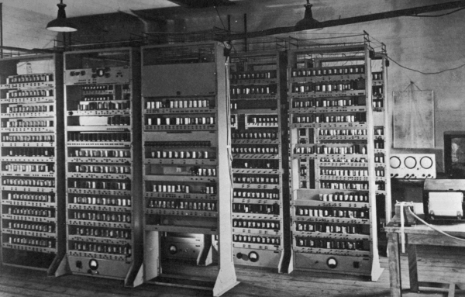
1st Generation (con’t)
The EDSAC
In 1949 Wilkes assembled the EDSAC.
Mark 1 Computer used Williams memory in 1949.
Forrester installed magnetic memory in 1953.
The 701 was shipped in 1953.
www.dcs.warwick.ac.uk/~edsac/

Slide 8



Different examples of vacuum tubes

Slide 9
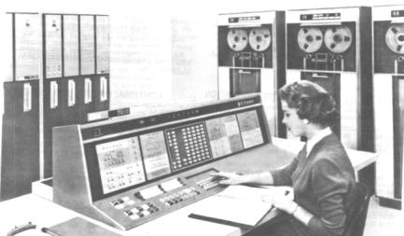
2nd Generation (1959-64) Transistors
IMB’s 7000seris,the first transistorized computers.
IMB had an 81.2% share of the computer market.
IMB announced the System/360.

Slide 10
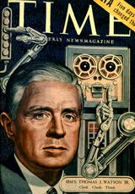
2nd Generation Transistor (1954-1959)
Transistors are tiny electrical devices that can be found in everything from radios to robots. They have two key properties: 1) they can amplify an electrical signal and 2) they can switch on and off, letting current through or blocking it as necessary.
1953 - Tom Watson, Jr., led IBM to introduce the model 604 computer, its first with transistors, that became the basis for many computer models, the first solid-state computer for the commercial market. Transistors were expensive at first, cost $8 vs. $.75 for a vacuum tube. But Watson was impressed with the new transistor radios and gave them to his engineers to study. IBM also developed the 650 Magnetic Drum Calculator, the first by IBM to use magnetic drum memory rather punched cards, and began shipment of the 701 scientific "Defense Calculator" that was the first of the Model 700 line that dominated main frame computers for the next decade .
1959 - General Electric Corporation delivered its Electronic Recording Machine Accounting (ERMA) computing system to the Bank of America in California; the ERMA system employed Magnetic Ink Character Recognition (MICR) to capture data from the checks and introduced automation in banking that continued with ATM machines in 1974.

Slide 11
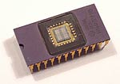
3rd Generation (1965-70) Integrated Circuits
nobelprize.org/educational_games/physics/integrated_circuit/history/index.html
Digital Equipment Corp. introduced the PDP-8.
The PDP-8 was the 1st commercially successful mini-computer.
PARC invented the personal computer graphical user interface.

Slide 12


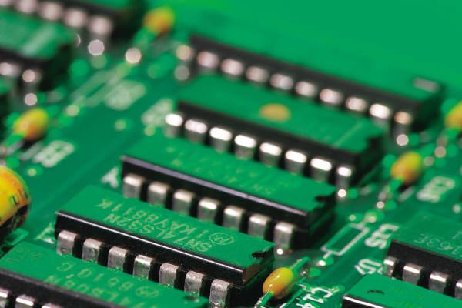

3rd Generation IC (1959-1971)
IC= integrated circuit.
1959 - Jack Kilby of Texas Instruments patented the first integrated circuit in Feb.
1964 - IBM produced SABRE, the first airline reservation tracking system for American Airlines.
1968- first mini computer(pdp8)
1971 - Intel produced large scale integrated (LSI) circuits that were used in the digital delay line, the first digital audio device.

Slide 13
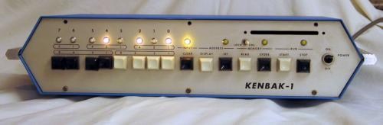

4th Generation(1971-present) Microprocessor
Kenbak-1, 1st personal computer.
Ray Tomlinson sent the first e-mail.
IMB invented the 8in. Floppy disk.
1986 Pixar is founded

Slide 14
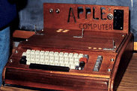
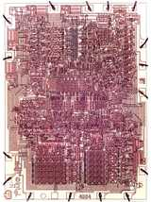
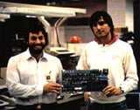
4th Generation Microprocessor (1971-Present)
1971 - Gilbert Hyatt at Micro Computer Co. patented the microprocessor; Ted Hoff at Intel in February introduced the 4-bit 4004, IBM introduced the first 8-inch "memory disk", as it was called then, or the "floppy disk" later; Hoffmann-La Roche patented the passive LCD display for calculators and watches; in November Intel announced the first microcomputer, the MCS-4; Nolan Bushnell designed the first commercial arcade video game "Computer Space”
1972 - Intel made the 8-bit 8008 and 8080 microprocessors; Bushnell created Atari and introduced the successful "Pong" game
1974 - Xerox developed the Alto workstation at PARC, with a monitor, a graphical user interface, a mouse, and an ethernet card for networking
1976 - Jobs and Wozniak developed the Apple personal computer; Alan Shugart introduced the 5.25-inch floppy disk
1980 - IBM signed a contract with the Microsoft Co. of Bill Gates and Paul Allen and Steve Ballmer to supply an operating system for IBM's new PC model. Microsoft paid $25,000 to Seattle Computer for the rights to QDOS that became Microsoft DOS, and Microsoft began its climb to become the dominant computer company in the world.

Slide 15
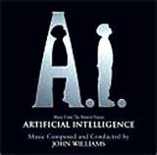
5th Generation (present and beyond) Artificial Intellengence
A.I. is trying to comprehend intelligence.
A.I is still being created today.
Alan Turing developed the Turing Test in 1950.
www.essortment.com

Slide 16
5th Generation Still Being Developed
Natural Language
This language is designed to give people a more human connection with computers.
Uses multi-media has also defined this generation.
There is a great deal of “bundled software” with this generation.

Slide 17
Internet Citations
Computer History Museum. Computers. www.computerhistory.org.2006. October 23, 2008
Artificial Intelligence.www.essotment.com.2005. November.13,2008
Microsoft office clipart
www.encylepedia.com.2008, November 14,2008
www.flicker.com.2008. november14,2008
www.gosai.com. 2008. Nov ,14 2008
www.engadget.com. 2008 .Nov,14 2008

