Slide 1

A+ Guide to Hardware:
Managing, Maintaining, and Troubleshooting, Sixth Edition
Chapter 5
Supporting Hard Drives

Slide 2
Objectives
Learn about the technologies used inside a hard drive and how a computer communicates with a hard drive
Learn how to select and install a hard drive
Learn about tape drives and floppy drives
A+ Guide to Hardware, Sixth Edition

Slide 3
Hard Drive Technologies and Interface Standards
Hard disk drive (HDD) or hard drive sizes
  2.5" size for laptop computers
  3.5" size for desktops
  1.8" size for low-end laptops, other equipment
Hardware Technologies inside the drive
  Solid State
    No moving parts
    Built using nonvolatile flash memory stored on EEPROM (Electronically Erasable Programmable Read Only Memory) chips
    Lifespan is based on the number of write operations to the drive
    Expensive technology, but faster, more reliable, last longer, and use less power than magnetic drives
  Magnetic
  Hybrid (Uses both technologies and must be supported by OS)
A+ Guide to Hardware, Sixth Edition

Slide 4
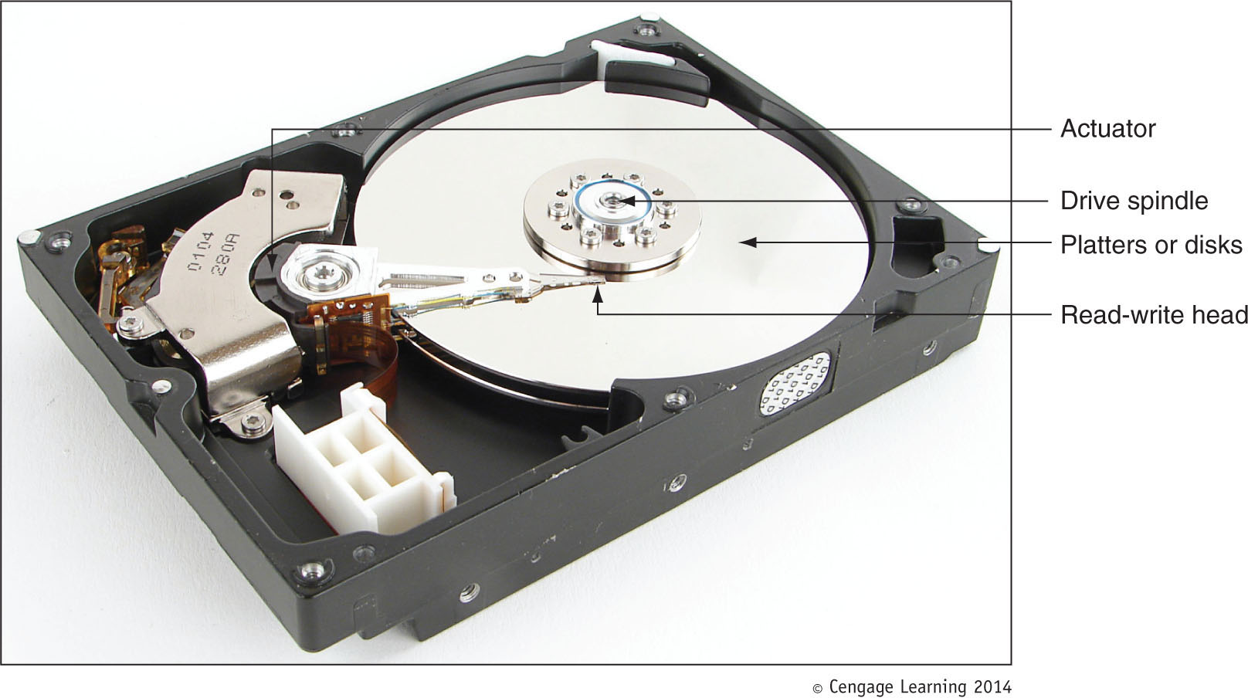
Magnetic hard drive
  One, two, or more platters, or disks
    Stacked together, spinning in unison inside a sealed metal housing
  Firmware controls data reading, writing and motherboard communication
  Read/write heads are controlled by an actuator
Figure 5-3 Inside a magnetic hard drive
A+ Guide to Hardware, Sixth Edition

Slide 5
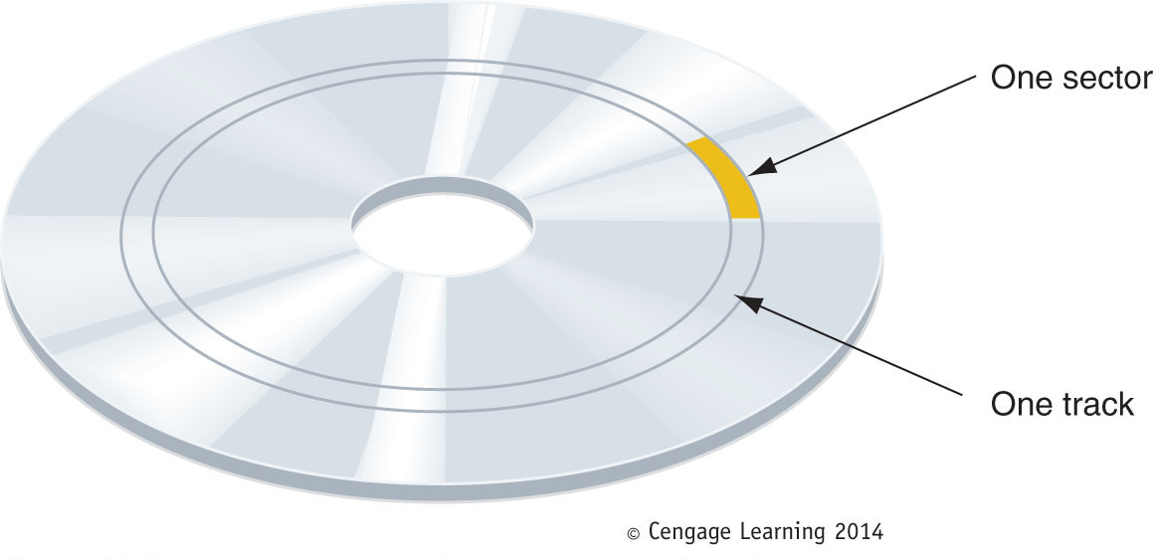
Data is organized in concentric circles, called tracks
  Tracks are divided into segments called sectors
Most current drives use 4096-byte sectors (Up from 512-byte sectors of the past)
Today’s drives use Zone Bit Recording, when writing sectors to the drive
Figure 5-4 A hard drive or floppy disk is divided into tracks and
sectors
A+ Guide to Hardware, Sixth Edition

Slide 6
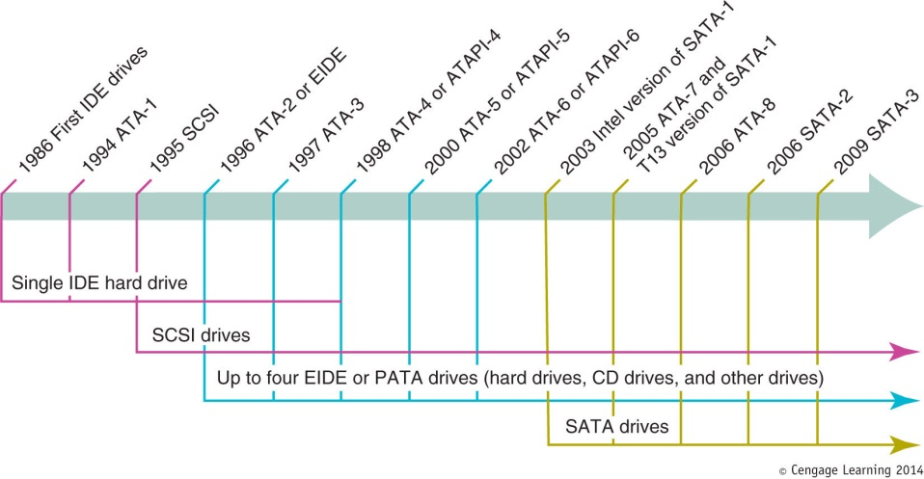
Interface Standards Used By a Hard Drive
Current internal hard drives methods
  Parallel ATA (PATA) and Serial ATA (SATA)
External hard drive methods
  External SATA (eSATA), SCSI, FireWire, USB, Fibre Channel
Figure 5-5 Timeline of interface standards used by internal drives
A+ Guide to Hardware, Sixth Edition

Slide 7
Interface Standards Used by a Hard Drive
Interface standards define data speeds and transfer methods with a computer system
  Also define types of cables and connectors
Standards
  Developed by Technical Committee T13
  Published by American National Standards Institute (ANSI)
A+ Guide to Hardware, Sixth Edition

Slide 8
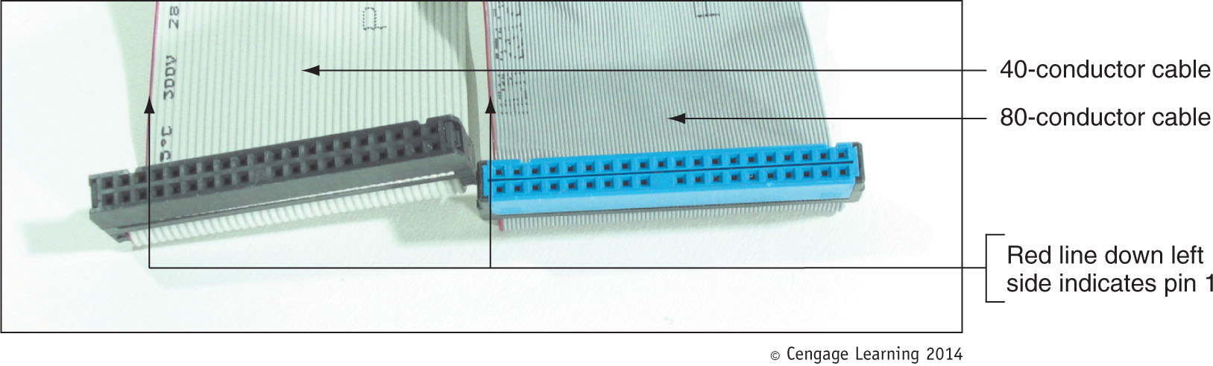
Parallel ATA or EIDE Drive Standards
Figure 5-9 In comparing the 80-conductor cable to the 40-conductor cable, note they are
about the same width, but the 80-conductor cable has many more and finer wires
A+ Guide to Hardware, Sixth Edition

Slide 9
Parallel ATA or EIDE Drive Standards
Parallel ATA or EIDE drive standards or Integrated Drive Electronics (IDE)
  Allows one or two IDE connectors on a motherboard
    Each use 40-pin data cable
Types of PATA ribbon cables
  Older cable
    40 pins and 40 wires
  80-conductor IDE cable
    40 pins and 80 wires (to reduce/prevent crosstalk)
  Maximum recommended length of either is 18”
A+ Guide to Hardware, Sixth Edition

Slide 10
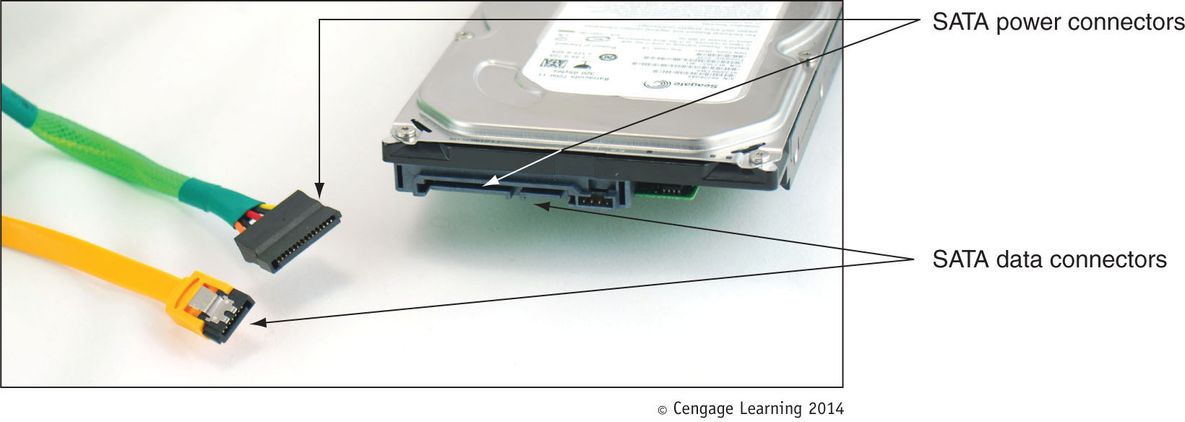
Serial ATA Standards
Figure 5-12 A SATA data cable and SATA power cable
A+ Guide to Hardware, Sixth Edition

Slide 11
Serial ATA Standards
Serial ATA standards
  Uses serial data path rather than traditional parallel data path
  Advantages
    Faster than PATA interfaces and used by all drive types
    Multiple connectors are easy to configure
    Internal cable length: up 1 meter
      Cable does not hinder airflow (narrower than PATA)
    Motherboard or expansion card can provide external SATA (eSATA) ports for external drives
      eSATA drives use special external shielded serial ATA cable up to 2 meters long
    Supports hot-swapping (hot-plugging)
      Connect and disconnect drive while system is running
A+ Guide to Hardware, Sixth Edition

Slide 12
SCSI Technology
Small Computer System Interface standards
  Used primarily in servers
  Support either 7 or 15 devices (standard dependent)
  Provides better performance than ATA standards
SCSI subsystem
  SCSI controller types: embedded or host adapter
  Host adapter supports internal and external devices
  Daisy chain: combination of host adapter and devices
  Each device on bus assigned SCSI ID (0 - 15)
  A physical device can embed multiple logical devices
    Assigned a Logical Unit Number (LUN)
A+ Guide to Hardware, Sixth Edition

Slide 13
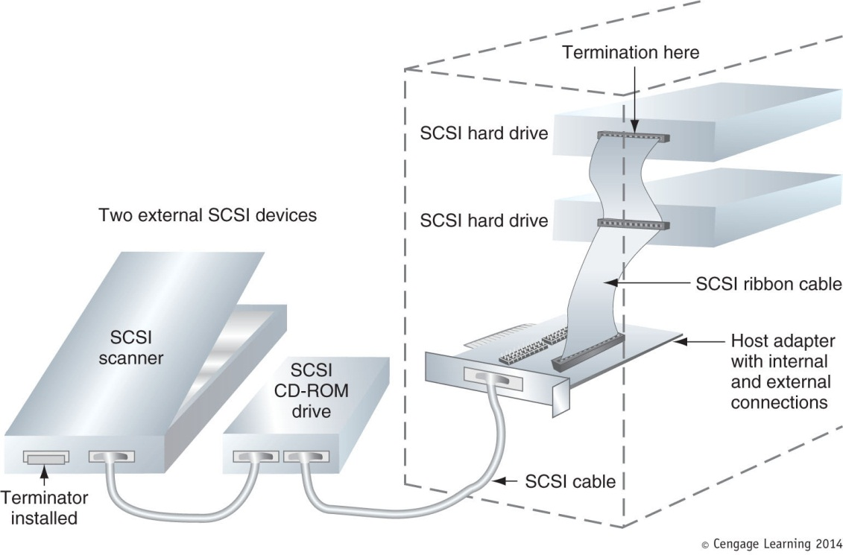
Figure 5-15 Using a SCSI bus, a SCSI host adapter card can support internal and external SCSI devices
A+ Guide to Hardware, Sixth Edition

Slide 14
SCSI Technology
Terminating resistor
  Plugged into last device at end of the chain
  Reduces electrical noise or interference on the cable
Various SCSI versions
  SCSI-1, SCSI-2, and SCSI-3
    Also known as regular SCSI, Fast SCSI, Ultra SCSI
Serial attached SCSI (SAS)
  Allows for more than 15 devices on single chain
  Uses smaller, longer, round cables
  Uses smaller hard drive form factors, larger capacities
  Compatible with serial ATA
A+ Guide to Hardware, Sixth Edition

Slide 15
Selecting a Hard Drive
Considerations:
  Drive capacity
    Today’s desktop hard drives range from 60 GB – 4 TB
  Spindle speed
    Most common is 7200 RPM
    The higher the RPMs, the faster the drive
  Interface standard
    Use standards the motherboard supports
  Features such as S.M.A.R.T – Self-Monitoring Analysis ad Reporting Technology
    Used to predict when a drive is likely to fail
A+ Guide to Hardware, Sixth Edition

Slide 16
Steps to Install a Serial ATA Drive
Step 1: Know your starting point
  How is your system configured?
  Is everything working properly?
  Write down what you know about the system
Step 2: Read the documentation and prepare your work area
  Read all installation instructions first
  Visualize all the steps
  Protect against ESD and avoid working on carpet
A+ Guide to Hardware, Sixth Edition

Slide 17
Steps to Install a Serial ATA Drive
Step 2: Read the documentation and prepare your work area (cont’d)
  Handle the drive carefully
  Do not touch any exposed circuitry
  Drain static electricity from the package and from your body by touching metal for at least 2 seconds
  Do not place the drive on the computer case or on a metal table
A+ Guide to Hardware, Sixth Edition

Slide 18
Steps to Install a Serial ATA Drive
Step 3: Install the drive
  Turn off the computer and unplug it
  Decide which bay will hold the drive
  Slide drive in the bay and secure it (use two screws on both sides)
  Use correct motherboard serial ATA connector
  Connect a 15-pin SATA or 5-pin Molex power connector from the power supply to the drive (Not both)
  Check all connections and power up the system
  Verify drive recognized correctly via BIOS setup
A+ Guide to Hardware, Sixth Edition

Slide 19
Steps to Install a Serial ATA Drive
Now ready to prepare the hard drive for first use
  Boot from Windows setup CD or DVD
    Follow directions on the screen to install Windows on the new drive
  If installing a second hard drive with Windows installed on first drive use Windows Disk Management utility to partition and format the second drive
A+ Guide to Hardware, Sixth Edition

Slide 20
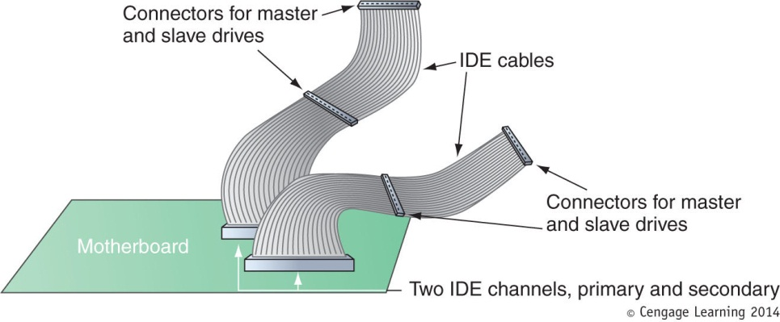
Steps to Configure and Install a Parallel ATA Drive
Configurations for four EIDE devices in a system:
  Primary IDE channel, master device
  Primary IDE channel, slave device
  Secondary IDE channel, master device
  Secondary IDE channel, slave device
Figure 5-35 A motherboard supporting PATA has two IDE channels; each can support a master and slave drive using a single EIDE cable
A+ Guide to Hardware, Sixth Edition

Slide 21
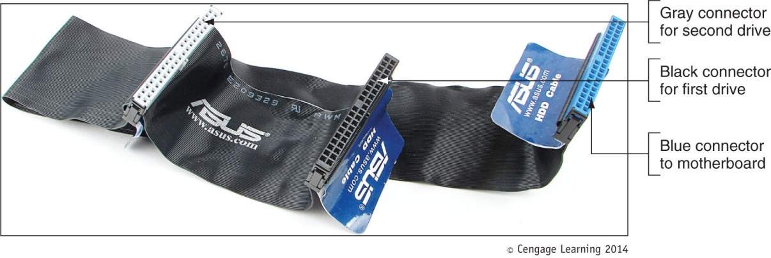
Steps to Configure and Install a Parallel ATA Drive
Master or slave designations are made by:
  Setting jumpers or DIP switches
  Use special cable-select data cable
  Color-coded connectors
    Blue end connects to motherboard; black end connects to drive
Figure 5-36 80-conductor cable connectors are color-coded
A+ Guide to Hardware, Sixth Edition

Slide 22
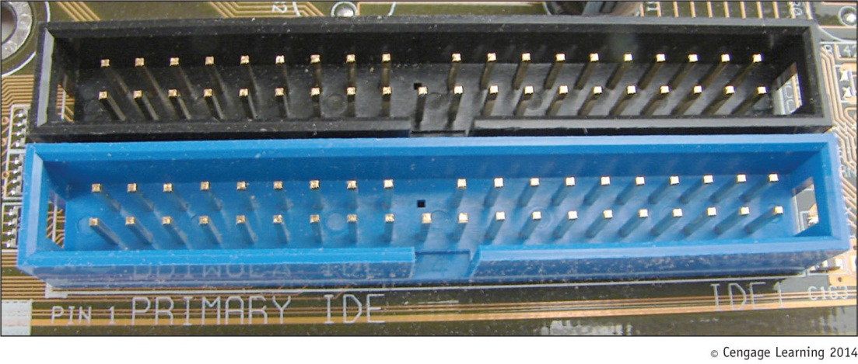
Steps to Configure and Install a Parallel ATA Drive
Motherboard color-coding
  Primary channel connector: blue
  Secondary channel connector: black
Figure 5-37 The primary IDE channel connector is often color-coded as blue
A+ Guide to Hardware, Sixth Edition

Slide 23
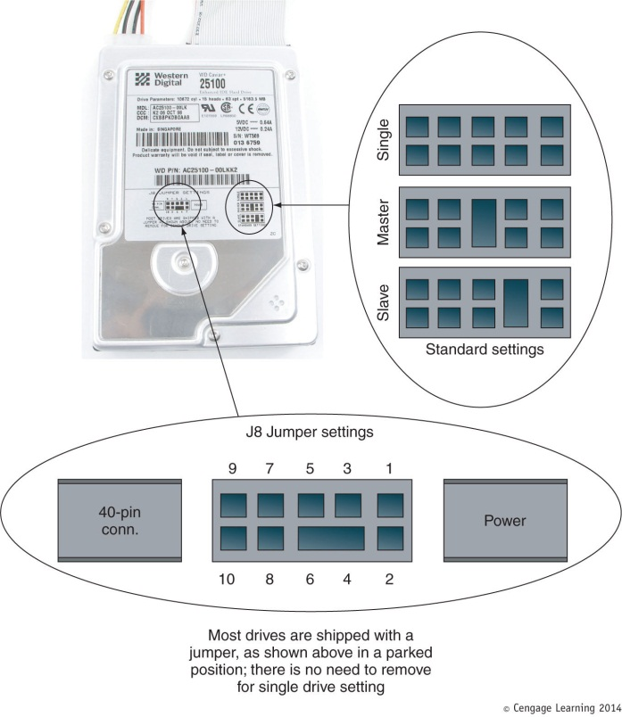
Steps to Configure and Install a Parallel ATA Drive
Step 1: Open case, decide how to configure drives
Step 2: Set the jumpers on the drive
Step 3: Mount the drive in the bay
Figure 5-38 A PATA drive most likely will have diagrams of jumper settings for master and slave options printed on the drive housing
A+ Guide to Hardware, Sixth Edition

Slide 24
Setting Up Hardware RAID
RAID (Redundant Array of Inexpensive Disks)
  Also: Redundant Array of Independent Disks
  A technology that configures two or more hard drives to work together as an array of drives
Why use RAID?
  To improve fault tolerance by writing two copies of it, each to a different hard drive (prevent data loss)
  To improve performance by writing data to two or more hard drives to that a single drive is not excessively used (more spindles=more speed)
A+ Guide to Hardware, Sixth Edition

Slide 25
Types of RAID
Spanning – sometimes called JBOD (just a bunch of disks)
  No Fault Tolerance and No Increased Performance
  Uses two hard drives to hold a single Windows volume
  When one drive is full, data is written to second drive
RAID 0 – uses two or more physical disks
  Performance (Two Spindles)
  Writes to physical disks evenly across all disks so that no one disk receives all activity
  Windows calls RAID 0 a striped volume
A+ Guide to Hardware, Sixth Edition

Slide 26
Types of RAID
RAID 1: Mirroring
  Duplicates data on one drive to another drive and is used for fault tolerance (mirrored volume)
RAID 5: uses three or more drives
  Stripes data across drives and uses parity checking
  Data is not duplicated but there is fault tolerance, as well as performance increase
RAID 10: RAID 1+0 (pronounced RAID one zero)
  Combination of RAID 1 and RAID 0
  Takes at least 4 disks
A+ Guide to Hardware, Sixth Edition

Slide 27
How to Implement Hardware RAID
Hardware implementation
  Hardware RAID controller or RAID controller card
    Motherboard does the work, Windows unaware of hardware RAID implementation
Software implementation uses operating system
Best RAID performance
  All hard drives in an array should be identical in brand, size, speed, other features
If Windows installed on a RAID hard drive RAID must be implemented before Windows installed
A+ Guide to Hardware, Sixth Edition

Slide 28
About Tape Drives and Floppy Drives
Tape drives can use a SATA, PATA, or SCSI interface
As a technician, you may be called on to support old floppy drives
Both tape drives and floppy drives are covered in this section
A+ Guide to Hardware, Sixth Edition

Slide 29
Tape Drives
Tapes drives – an inexpensive way of backing up a hard drive
When selecting a tape drive, consider:
  How many and what type of cartridges the drive can use
  How it interfaces with the computer
External drives can connect to a computer using a USB, FireWire, SCSI, SAS, or eSATA port
Disadvantage: data is stored by sequential access
  To read data from anywhere on the tape, you must start at the beginning of the tape and read until you find the data you want
  Slow and inconvenient
A+ Guide to Hardware, Sixth Edition

Slide 30
Floppy Drive
Floppy disk drive (FDD)
  3 ½” floppy disk format
  Holds only 1.44 MB of data
  Floppy drive subsystem
    Floppy drive, 34 pin ribbon cable, power cable, connections
    Today’s floppy drive cables have a connector at each end to accommodate a single drive
    Older cables have an extra connector or two in the middle of the cable (with a twist) for a second floppy drive
A+ Guide to Hardware, Sixth Edition

Slide 31
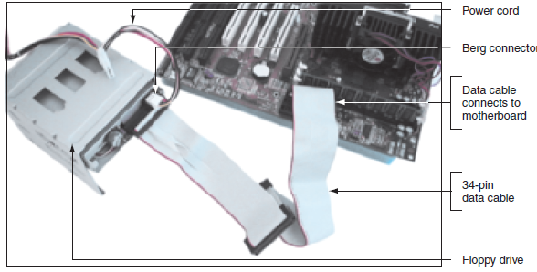
How Floppy Drives Work
Like hard drives, a floppy drive uses a controller to communicate with the system bus. Data travels from the drive, through the cable, to the controller, to the CPU, and back again.
Figure 6-17 Floppy drive subsystem: floppy drive, 34-pin data cable, and power connector
A+ Guide to Hardware
<number>/31

Slide 32
A+ Guide to Hardware, Sixth Edition

Slide 33
Summary
A hard disk drive (HDD) comes in 3.5” for desktop and 2.5” for laptops
A hard drive can be magnetic, solid-state, or hybrid
Most hard drives use the ATA interface standards
Two ATA categories are parallel ATA and serial ATA
S.M.A.R.T is a self-monitoring technology whereby the BIOS monitors the health of a hard drive
SCSI interface standards include narrow and wide SCSI and can use a variety of cables and connectors
A+ Guide to Hardware, Sixth Edition

Slide 34
Summary
When selecting a hard drive, consider storage capacity, technology, spindle speed, interface standard, and buffer size
SATA drives require no configuration and are installed using a power cord and a data cable
PATA drives require you to set a jumper to determine if the drive will be the single drive, master, or slave on a single cable
RAID technology uses an array of hard drives to provide fault tolerance and/or improvement in performance
A+ Guide to Hardware, Sixth Edition

Slide 35
Summary
Hardware RAID is implemented using the motherboard BIOS or a RAID controller card
Software RAID is implemented in Windows
Tape drives are an inexpensive way to back up an entire hard drive or portions of it
Today’s floppy disks are 3.5” high-density disks that hold 1.44 MB of data
After a floppy disk drive is installed, you must configure the drive in BIOS setup
A+ Guide to Hardware, Sixth Edition

