Slide 1

A+ Guide to Hardware:
Managing, Maintaining, and Troubleshooting, Sixth Edition
Chapter 7
Satisfying Customer Needs

Slide 2
Objectives
Learn about some job roles and responsibilities of those who sell, fix, or support personal computers
Learn what customers want and expect beyond your technical abilities
Learn how to interact with customers when selling, servicing, and supporting personal computers
Learn how to customize a computer system to meet customer needs
A+ Guide to Hardware, Sixth Edition

Slide 3
Job Roles and Responsibilities
PC support technician
  Works on site, works closely with users and is responsible for ongoing PC maintenance
  Prepare for a problem by performing routine preventative maintenance, keeping good records, and making backups of data
PC service technician
  Goes to a customer site in response to a service call
  Usually not responsible for ongoing maintenance but do interact with users
  Also known as computer repair technician or field service technician
A+ Guide to Hardware, Sixth Edition

Slide 4
Job Roles and Responsibilities
Technical retail associate
  Work in a consulting role to advise customers about the best technology to meet their needs, how to apply the technology, and maybe how to configure it
Bench technician
  Works in a lab environment, might not interact with users, and is not permanently responsible for them
Help-desk technician
  Provides telephone or online support
  Remote location puts them at a disadvantage
A+ Guide to Hardware, Sixth Edition

Slide 5
Certification and Professional Organizations
Certification and advanced degrees:
  Proves competence and achievement
  Improves job opportunities
  Creates a higher level of customer confidence
  Qualifies for promotions and other training or degrees
Computing Technology Industry Associate (CompTIA) – most significant certifying organization
  A+ Certification – first choice for certification as a PC technician
Microsoft and Cisco offer vendor specific certifications to support their products
A+ Guide to Hardware, Sixth Edition

Slide 6
Record-Keeping and Information Tools
Resources, records, and information tools:
  The specific application, OS, or hardware you support must be available to you to test, observe, and study
  Digital or printed copy of the same documentation the user sees
  Any technical documentation available from manufacturer (beyond user manuals)
  Online help targeted to field technicians and help-desk technicians
  Expert system – software that is designed and written to help solve problems
  Help desk tracking software – allows you to create, edit, and close calls for help (tickets)
A+ Guide to Hardware, Sixth Edition
<number>/24

Slide 7
What Customers Want: Beyond the Technical Know-How
Traits of a competent and helpful technician:
  Trait 1: A positive and helpful attitude
  Trait 2: Listening without interrupting your customer
  Trait 3: Proper and polite language
  Trait 4: Sensitivity to cultural differences
  Trait 5: Taking ownership of the problem
  Trait 6: Dependability and reliability
  Trait 7: Credibility
  Trait 8: Integrity and honesty
  Trait 9: Know the law with respect to your work
  Trait 10: Looking and behaving professionally
A+ Guide to Hardware, Sixth Edition
<number>/24

Slide 8
Planning for Good Service
To provide good service there must be a plan that covers the entire service situation
  From the first contact with the customer to closing the call
A+ Guide to Hardware, Sixth Edition

Slide 9
Initial Contact With a Customer
Customers expect both technical and interpersonal skills
Technicians should:
  Know the problem to be addressed
  The urgency of the situation
  What computer, software, and hardware need servicing
  Arrive with a complete set of equipment needed
  Greet customer in a friendly manner and shake hands
  Listen and ask questions (Good Questions)
A+ Guide to Hardware, Sixth Edition

Slide 10
Initial Contact With a Customer
Beginning a phone call professionally
  Identify yourself and your organization
  Ask for and write down name and number of caller
  Open up the conversation for the caller to describe the problem
Interview the Customer
  What error messages or failures did you see?
  When did the problem start?
  What was the situation when the problem occurred?
  Did you move your computer system recently?
  Has there been a recent thunderstorm or electrical problem?
  Have you made any hardware, software, or configuration changes?
  Has someone else used your computer recently?
  Make no assumptions
A+ Guide to Hardware, Sixth Edition

Slide 11
Set and Meet Customer Expectations
Important to create an expectation of certainty with customers
Establish a timeline with your customer for completion of a project
  Keep customer informed of progress
Give the customer an opportunity to make decisions about repairs
  Is there some valuable data on the system that is not backed up?
    Repair or replace (Data backup might help decide)?
    Help them decide which is to their advantage
A+ Guide to Hardware, Sixth Edition

Slide 12
Working With a Customer On Site
  Use diplomacy and good manners
Avoid distractions (Phone calls, texts, etc)
  Don’t accept personal calls on your cell phone
If you must excuse yourself, explain to the customer and return as soon as possible
Be as unobtrusive as possible as you work
  You are a guest
Keep tools and papers out of customer’s way
Protect customer’s confidential materials
  Ask customer if they would like to put confidential materials away
A+ Guide to Hardware, Sixth Edition

Slide 13
Working With a Customer On the Phone
Requires more interaction with customers
Must be able to visualize what the customer sees
Patience is required if dealing with novice user
If call is disconnected, call back immediately
Don’t eat or drink while on the phone
If caller must be put on hold, tell them how long it will be before you get back to them
Speak clearly and slowly
Keep small talk upbeat and positive
A+ Guide to Hardware, Sixth Edition

Slide 14
Dealing With Difficult Customers
When trying to solve a problem over the phone and the customer is not knowledgeable:
  Be specific with your instructions. Nothing destructive
  Give the customer plenty of opportunity to ask questions, and compliment often
When the customer is overly confident:
  Compliment the customer’s knowledge, experience, or insight
  Slow the conversation down and avoid technical jargon
  Be careful not to accuse the customer of making a mistake
When the customer complains:
  Be an active listener
  Give the customer a little time to vent and don’t be defensive
  Decrease anxiety by increasing good communication
  Take ownership and reduce the problem to a manageable state
A+ Guide to Hardware, Sixth Edition

Slide 15
The Customer Decides When the Work Is Done
When you think a problem is solved, allow customer to decide when the service is finished
Complete these tasks before closing the call:
  Reboot PC to make sure you have not caused a problem with the boot
  Allow the customer enough time to be fully satisfied that all is working
  Ask user to verify any restored data
  Review service call with the customer
  Explain preventative maintenance to the customer
A+ Guide to Hardware, Sixth Edition

Slide 16
Sometimes You Must Escalate a Problem
Every technician does not know how to solve every problem with a PC
  Sometimes, a problem needs to be assigned to someone higher in the support chain
  If that happens, follow through to make sure the customer and new support person have made contact
A+ Guide to Hardware, Sixth Edition

Slide 17
The Job Isn’t Finished Until the Paperwork Is Done
Include in documentation sufficient details broken down by:
  Cost of individual parts
  Hours worked
  Cost per hour
Make detailed notes so that you can use them later when solving similar problems
  Record initial symptoms of the problem, the source of the problem, how you discovered the source, and how the problem was solved
A+ Guide to Hardware, Sixth Edition

Slide 18
Working With Co-Workers
Put business matters above personal matters
  Do not be personally offended when someone lets you down or does not please you
Keep negative opinions to yourself
Practice good organization skills
Know your limitations and be willing to admit when you can’t do something
Learn how to handle conflict at work
Never give bad news or point out a fault by email
  Speak face to face or by telephone
A+ Guide to Hardware, Sixth Edition

Slide 19
Dealing With Prohibited Content and Activity
Many organizations have a code of conduct that applies to employees and/or customers
Part of a technician’s job might include keeping track of software licensing to ensure that a company is not using pirated software
  Must ensure that unauthorized copies of original software are not being produced (software piracy)
When you start a new job, find out how to deal with prohibited or illegal activity
A+ Guide to Hardware, Sixth Edition

Slide 20
Types of Customized Systems
Graphics or CAD/CAM Workstation
Audio and Video editing workstations
Virtualization Workstation
Gaming PCs
Home Theater PC (HTPC)
Home server PC
A+ Guide to Hardware, Sixth Edition
<number>/24

Slide 21
Customizing Computer Systems
Important principles to keep in mind when customizing a system for a customer:
  Meet application requirements – consider any special hardware the applications might require
    Such as digital tablet for graphics applications
  Balance functionality and budget
    Put the most money on hardware components that are most needed for primary purpose
  Consider hardware compatibility
A+ Guide to Hardware, Sixth Edition

Slide 22
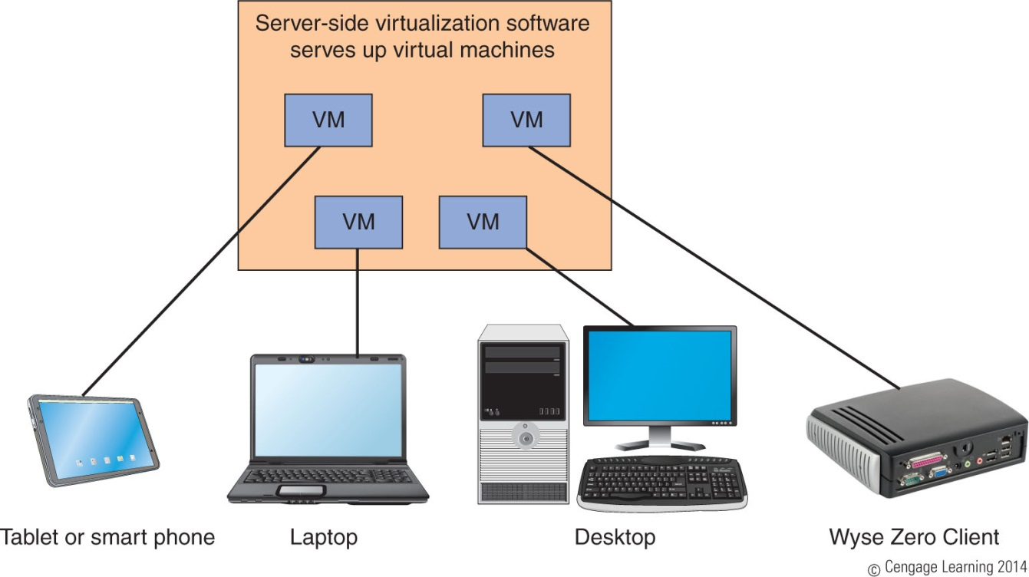
Virtualization
Virtualization: one physical machine hosts multiple activities that are normally done on multiple machines
A virtualization server provides a desktop to each client computer or appliance
A+ Guide to Hardware, Sixth Edition

Slide 23
Thick Client and Thin Client
Thick client (also called fat client): regular desktop computer or laptop that is used as a client by a virtualization server
Thin client: a computer that has an OS but has little computer power and might only need to support a browser used to communicate with the server
  Server does most of the processing
  To reduce costs, configure it to meet only the minimum requirements for Windows
A+ Guide to Hardware, Sixth Edition

Slide 24
A+ Guide to Hardware, Sixth Edition

Slide 25
Summary
Five key job roles of a PC technician include PC support technician, PC service technician, technical retail associate, bench technician, and help-desk technician
A+ Certification by CompTIA – most recognized certification for PC repair technician
Customers want more than just technical know-how
Customers expect their first contact to be professional and friendly
Set and meet customer expectations with good communication
A+ Guide to Hardware, Sixth Edition

Slide 26
Summary
Deal confidently and gracefully with customers who are difficult
Be aware of documented code of conduct for your organization
A chain-of-custody document provides a paper trail of how evidence in a criminal case is handled
As a technician you might be called upon to customize a system for a customer including a graphics or CAD/CAM workstation, audio and video editing workstation, virtualization workstation, gaming PC, Home Theater PC, home server PC, thick or think client
A+ Guide to Hardware, Sixth Edition

