Slide 1
Chapter 1
Introducing Hardware

Slide 2
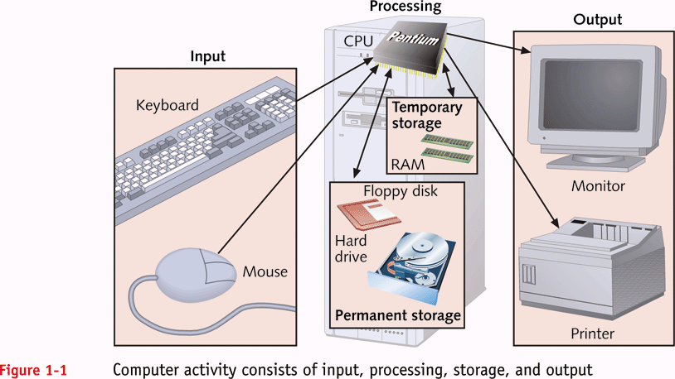
Functions of a Computer
A+ Guide to Managing and Maintaining Your PC, Fifth Edition

Slide 3
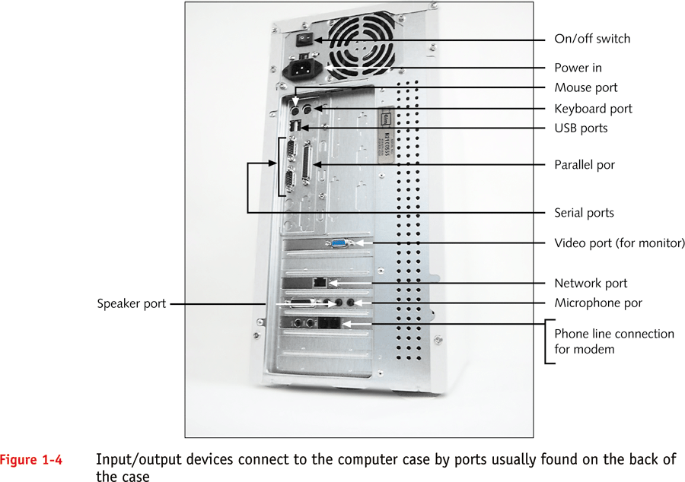
Ports
A+ Guide to Managing and Maintaining Your PC, Fifth Edition

Slide 4
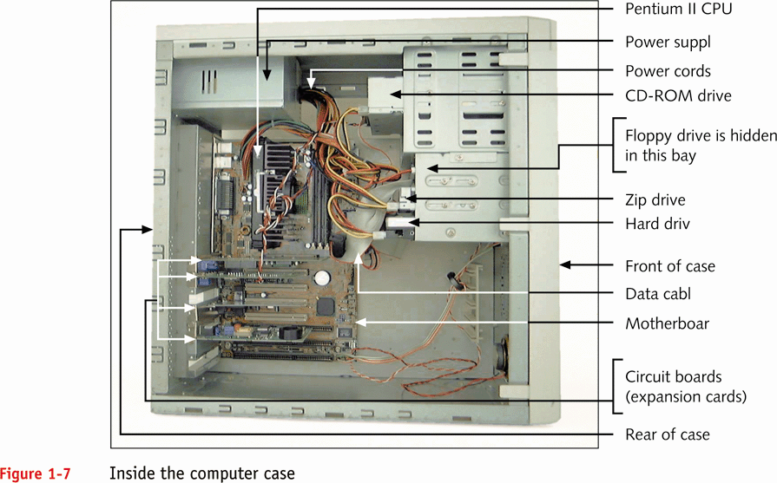
Hardware Inside the Case
A+ Guide to Managing and Maintaining Your PC, Fifth Edition

Slide 5
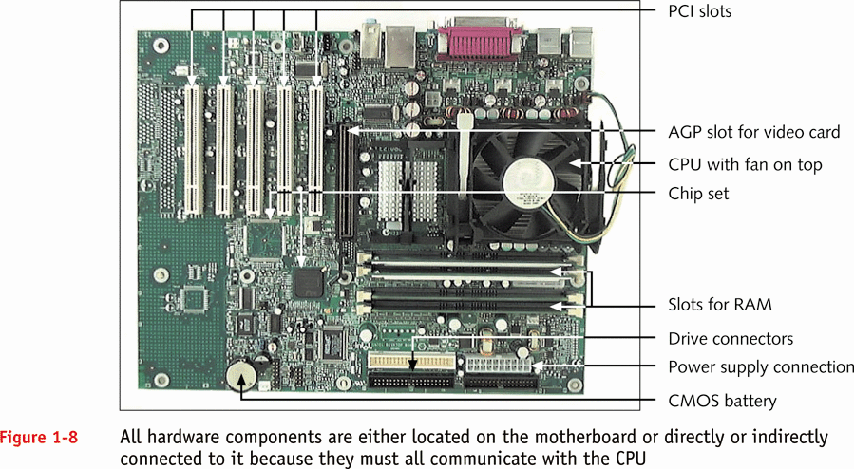
The Motherboard
A+ Guide to Managing and Maintaining Your PC, Fifth Edition

Slide 6
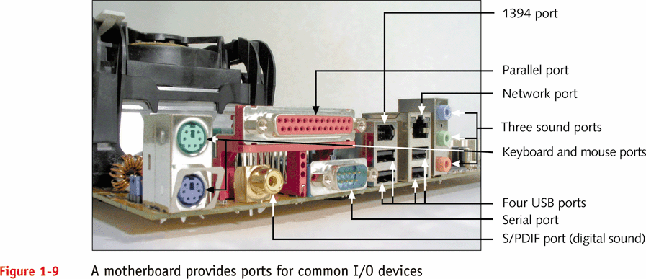
The Motherboard (continued)
A+ Guide to Managing and Maintaining Your PC, Fifth Edition

Slide 7
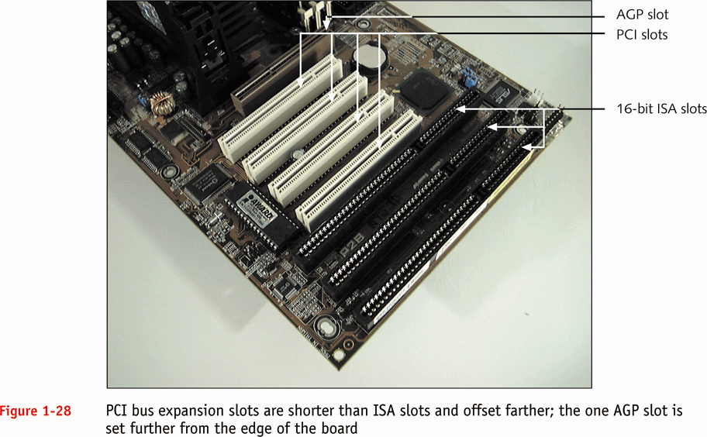
Types of Expansion Slots
A+ Guide to Managing and Maintaining Your PC, Fifth Edition

Slide 8
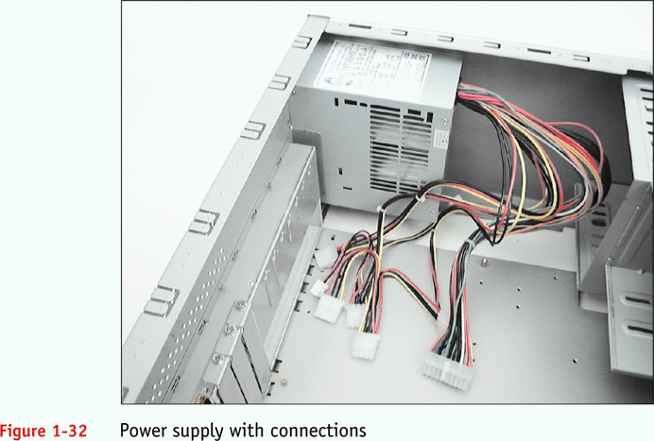
The Electrical System (continued)
A+ Guide to Managing and Maintaining Your PC, Fifth Edition

Slide 9
Instructions Stored on the Motherboard
ROM BIOS (most are flash ROM)
  System BIOS
  Startup BIOS
  CMOS setup
Motherboard BIOS supports ACPI, APM, and Plug and Play technologies
A+ Guide to Managing and Maintaining Your PC, Fifth Edition

Slide 10
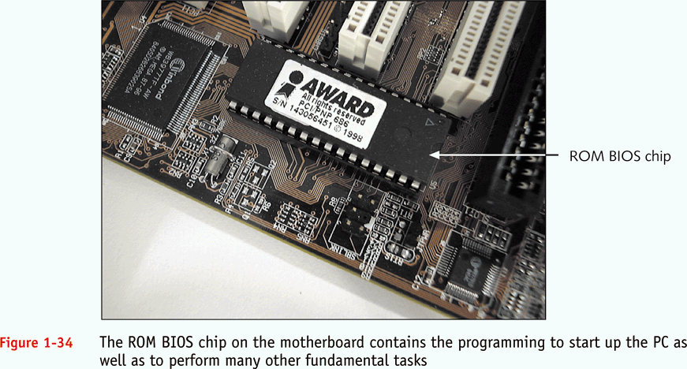
ROM BIOS Chip
A+ Guide to Managing and Maintaining Your PC, Fifth Edition

Slide 11
Motherboard Configuration Settings
CMOS chip
  Stores setup (configuration) information
  Powered by a battery on motherboard when power is off
Setup information can also be set by jumpers and DIP switches
A+ Guide to Managing and Maintaining Your PC, Fifth Edition

Slide 12
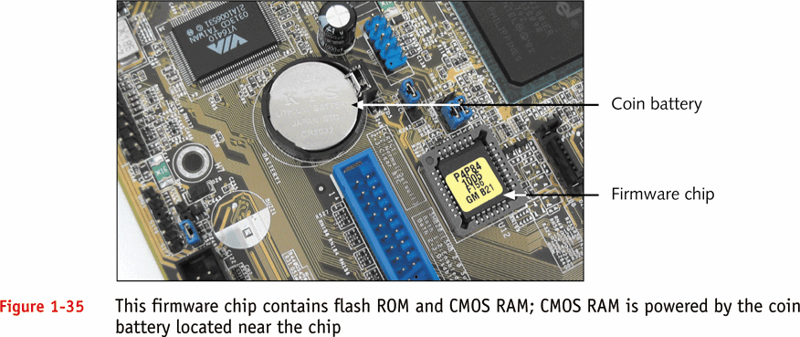
CMOS Configuration Chip
A+ Guide to Managing and Maintaining Your PC, Fifth Edition

Slide 13
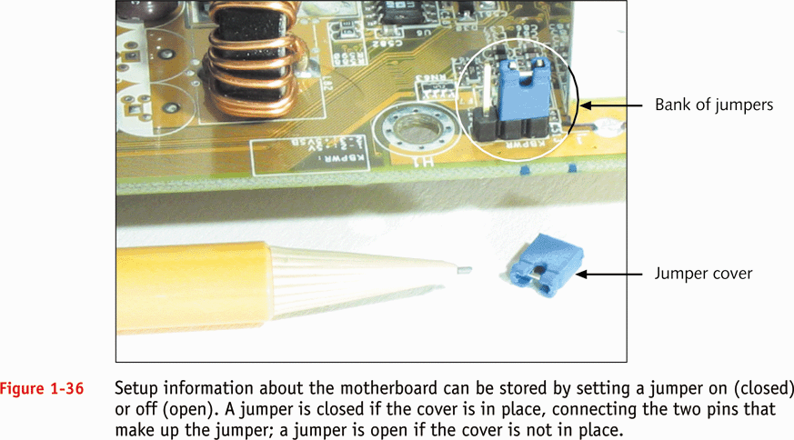
Setting Jumpers
A+ Guide to Managing and Maintaining Your PC, Fifth Edition

Slide 14
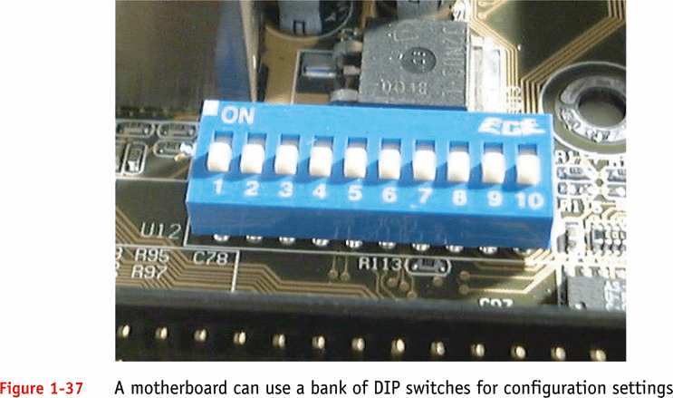
Using DIP Switches
A+ Guide to Managing and Maintaining Your PC, Fifth Edition

Slide 15
Chapter 2
How Hardware and Software Work Together

Slide 16
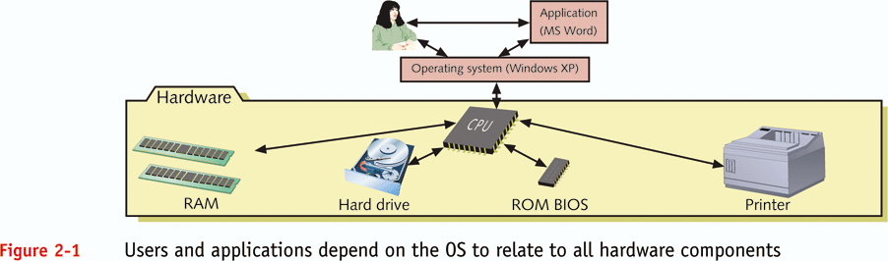
OS as a Middleman
A+ Guide to Managing and Maintaining Your PC, Fifth Edition

Slide 17
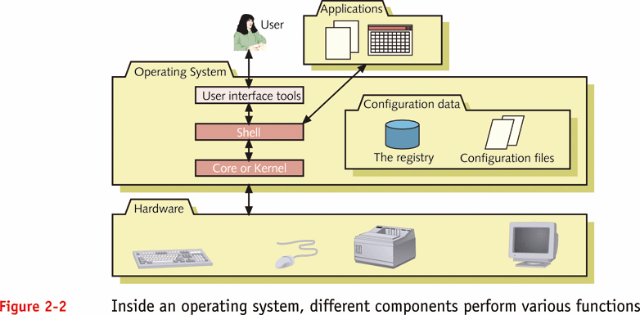
The Shell and the Kernel
A+ Guide to Managing and Maintaining Your PC, Fifth Edition

Slide 18
Common Operating Systems
DOS
Windows 9x
Windows NT, Windows 2000, and
Windows XP
Unix
Linux
OS/2
Mac OS
A+ Guide to Managing and Maintaining Your PC, Fifth Edition

Slide 19
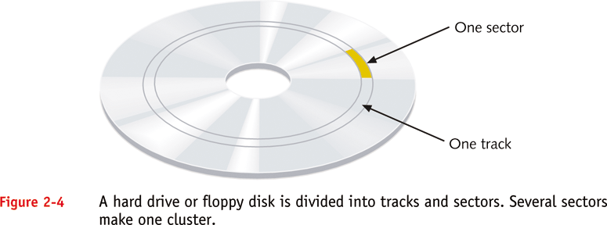
Tracks, Sectors, and Clusters
A+ Guide to Managing and Maintaining Your PC, Fifth Edition

Slide 20
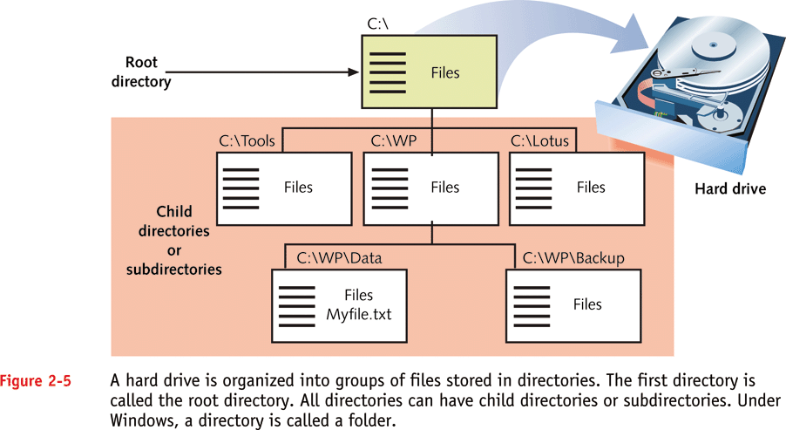
Files and Directories
A+ Guide to Managing and Maintaining Your PC, Fifth Edition

Slide 21
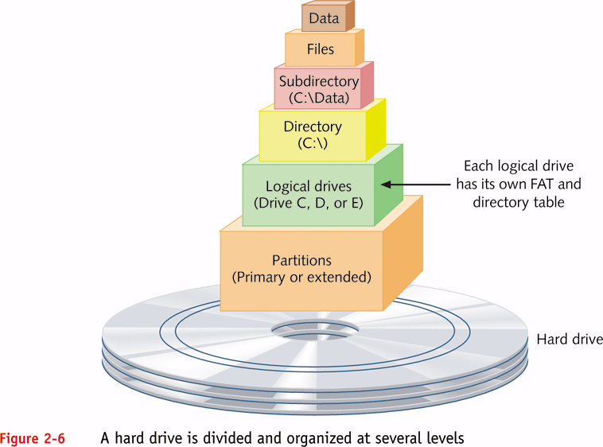
Partitions and Logical Drives
A+ Guide to Managing and Maintaining Your PC, Fifth Edition

Slide 22
How an OS Uses Device Drivers to Manage Hardware
Device drivers provide OS with software necessary to control devices
16-bit real-mode drivers
  Supported by Windows 95/98
32-bit protected-mode drivers
  Supported by Windows 95/98, Windows Me, and Windows NT/2000/XP
A+ Guide to Managing and Maintaining Your PC, Fifth Edition

Slide 23
OS Tools to Examine a System
Device Manager
System Information utility
Microsoft Diagnostic Utility (MSD)
A+ Guide to Managing and Maintaining Your PC, Fifth Edition

Slide 24
Chapter 5
The Motherboard

Slide 25
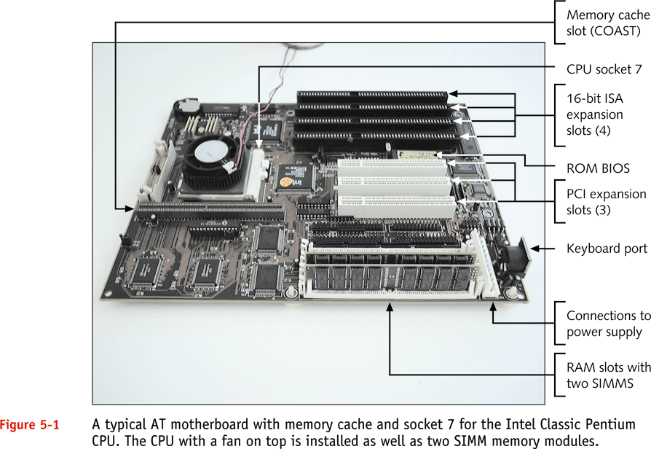
Typical AT Motherboard
A+ Guide to Managing and Maintaining Your PC, Fifth Edition

Slide 26
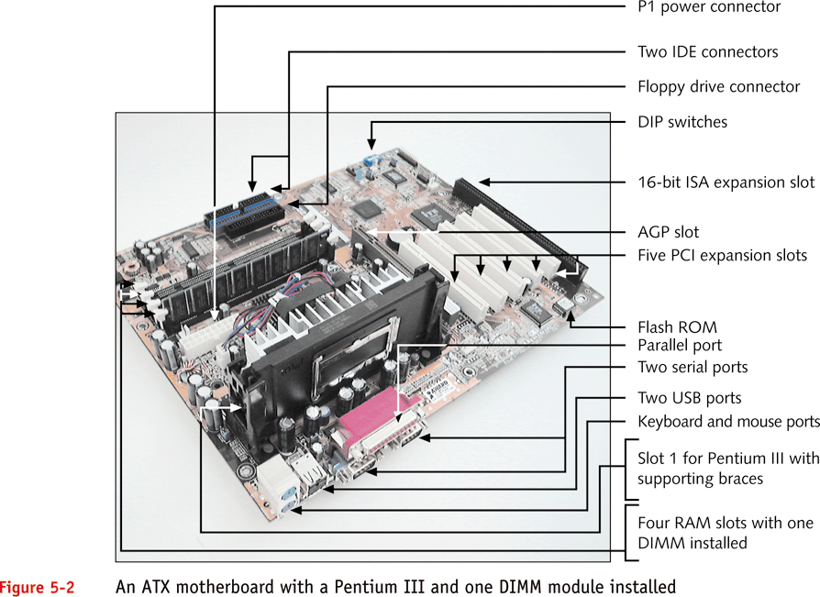
Typical ATX Motherboard
A+ Guide to Managing and Maintaining Your PC, Fifth Edition

Slide 27
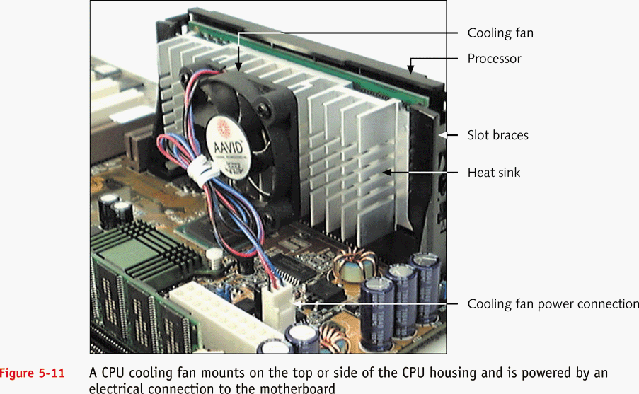
CPU Heat Sinks and Cooling Fans
A+ Guide to Managing and Maintaining Your PC, Fifth Edition

Slide 28
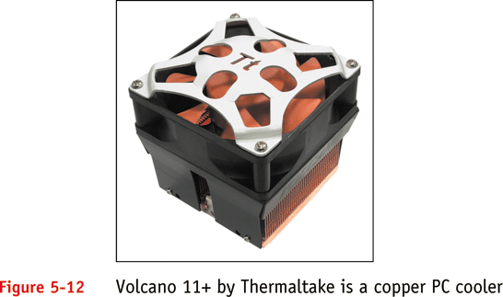
Combination Heat Sink and Cooling Fan
A+ Guide to Managing and Maintaining Your PC, Fifth Edition

Slide 29
Hardware Configuration
Setup data stored by DIP switches
Setup data stored by jumpers
Setup data stored in CMOS memory
A+ Guide to Managing and Maintaining Your PC, Fifth Edition

Slide 30
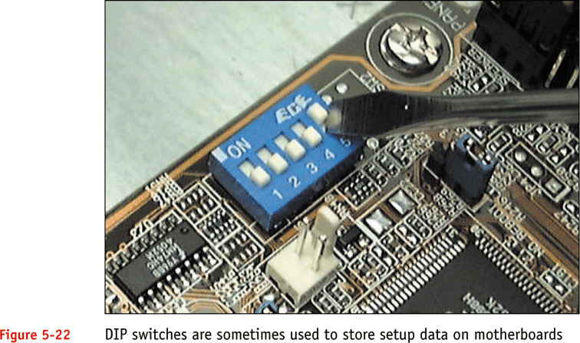
Setup Data Stored by DIP Switches
A+ Guide to Managing and Maintaining Your PC, Fifth Edition

Slide 31
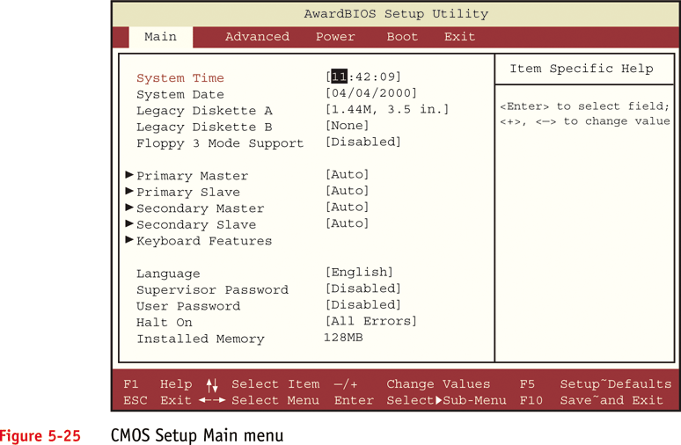
CMOS Setup Main Menu
A+ Guide to Managing and Maintaining Your PC, Fifth Edition

Slide 32
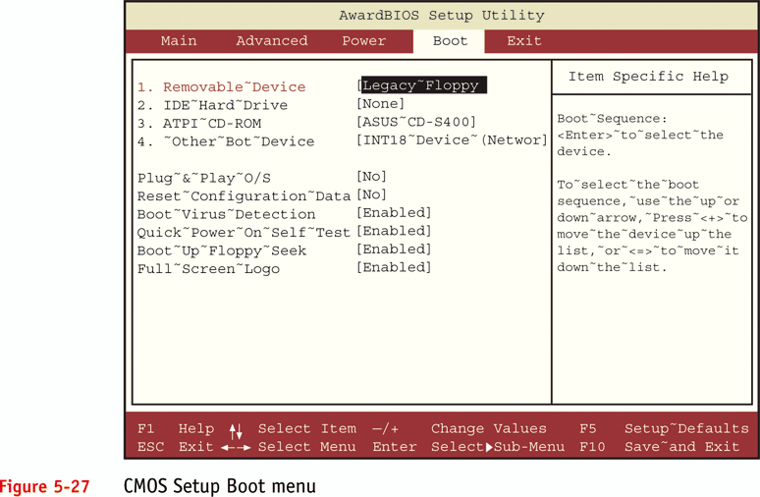
CMOS Setup Boot Menu
A+ Guide to Managing and Maintaining Your PC, Fifth Edition

Slide 33
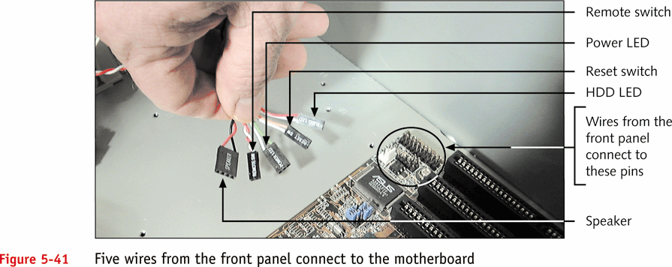
Wire Connectors
A+ Guide to Managing and Maintaining Your PC, Fifth Edition

Slide 34
Troubleshooting the Motherboard and CPU
Look for clues from POST
  Reports errors as beep codes
Cautiously substitute good hardware components for those you suspect are bad.
Make Sure Power Supply is not bad!!!
A+ Guide to Managing and Maintaining Your PC, Fifth Edition

