Slide 1

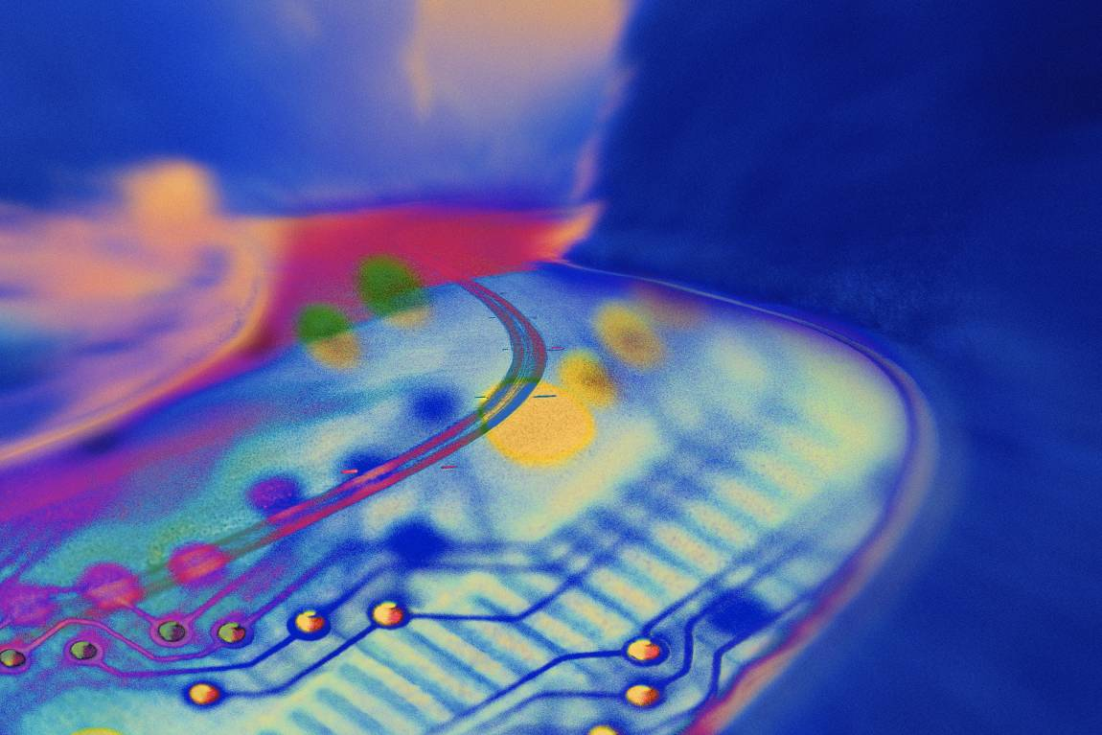
The Path of the PC Tech
Chapter 1

Slide 2
Overview
In this chapter, you will learn how to
  Explain the importance of CompTIA A+ Certification
  Describe the structure and contents of the CompTIA A+ Certification exams
  Plan a strategy to pass the exams
Notes:
Instructor Tip
When gaining attention and establishing common ground, ask questions of the class such as, “Who here has heard of A+ Certification?” “Have you noticed that advertisements for jobs frequently seek applicants who are A+ Certified Hardware Technicians?”
For a positive statement, tell the class, “In this lesson, we are going to learn what A+ Certification means, what exams are required to become certified, how to prepare to pass the exams, and what benefits you can expect from A+ Certification.”

Slide 3
Concept of Certifications
Required in many professions
  Automobile mechanic – ASE
  Accounting – CPA
Certification shows competency
  Often opens doors
  Helps get your resume noticed
  Helps you land the interview
Certified

Slide 4
Importance of A+ Certification
Validates proper skills are exhibited
  Maintain, upgrade, repair PCs
One of many other certifications
  Microsoft (such as MCSE)
  Novell (such as CNE)
  Cisco (such as CCIE)
  Many, many more

Slide 5
What is A+ Certification?
Industry-wide, vendor-neutral
Sponsored by CompTIA
Wide recognition in computer industry
Covers nine months of knowledge
More than 600,000 A+ certified techs worldwide

Slide 6
Who is CompTIA?
Non-profit, industry trade association
More than 20,000 members in 102 countries
Virtually every company of consequence in the IT industry is a member
Offers certifications such as A+, Network+, Security+, and more
See www.comptia.org for details

Slide 7
The Path to Other Certifications
CompTIA Network+
  Shows competency as a network technician
Microsoft Certified Professional
  Various certifications show competency in Microsoft 2000, 2003, XP, and Vista operating systems
Cisco
  Various certifications show competency in routing and switching technologies

Slide 8
A+ Certification
How to become A+ certified
  Pass two computer-based, multiple-choice exams
    Requires that you pay a fee
Basic exam structure
  CompTIA A+ Essentials (everyone must pass)
    Terminology and Technology
    Basic Tasks
  CompTIA Technician Exam (pass one of these three)
    IT Technician (220-602)
    Help Desk Technician (220-603)
    Depot Technician (220-604)
Notes:
Exercise
Examining the CompTIA Website
If your facility has computers that have Internet access, you can allow the students to examine the CompTIA Website (www.comptia.org) for more information about the A+ exams and some sample questions. You might also have them find the nearest testing centers, if your facility does not have its own testing center. If your facility has a testing center, you should go over the process or getting discount vouchers.

Slide 9
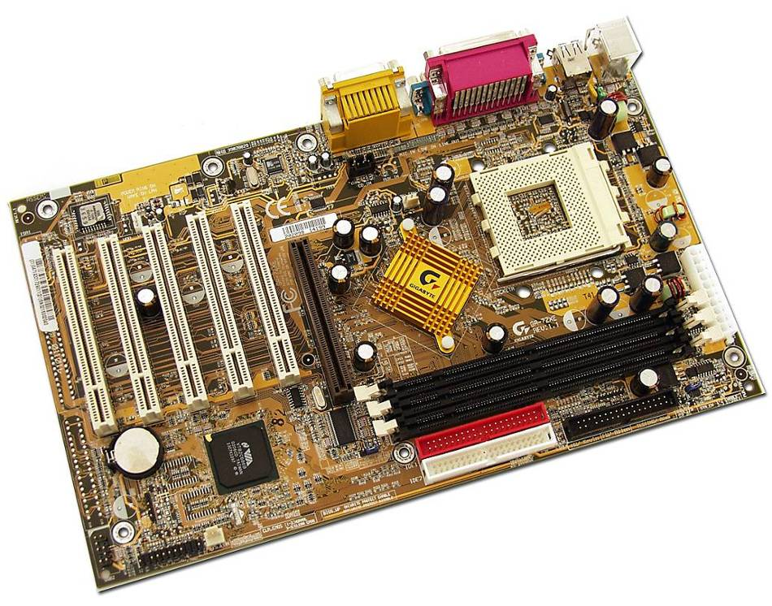
Basic Exam Structure
Multiple choice such as
  A dot-matrix print is printing blank pages. What should you check first?
    Printer drivers
    Platen
    Print head
    Ribbon
  Click on the location
  of the processor in
  the picture

Slide 10
Essentials (220-601)
Everyone must take this test
Domain | Percentage
1.0 Personal Computer Components | 21%
2.0 Laptop and Portable Devices | 11%
3.0 Operating Systems | 21%
4.0 Printers and Scanners | 9%
5.0 Networks | 12%
6.0 Security | 11%
7.0 Safety and Environmental Issues | 10%
8.0 Communication and Professionalism | 5%

Slide 11
IT Technician (220-602)
Most common second exam
Domain | Percentage
1.0 Personal Computer Components | 18%
2.0 Laptop and Portable Devices | 9%
3.0 Operating Systems | 20%
4.0 Printers and Scanners | 14%
5.0 Networks | 11%
6.0 Security | 8%
7.0 Safety and Environmental Issues | 5%
8.0 Communication and Professionalism | 15%

Slide 12
Help Desk Technician (603)
A lot more OS and communication
Domain | Percentage
1.0 Personal Computer Components | 15%
2.0 Operating Systems | 29%
3.0 Printers and Scanners | 10%
4.0 Networks | 11%
5.0 Security | 15%
6.0 Communication and Professionalism | 20%

Slide 13
Depot Technician
Heavy on hardware
Light on operating system and interaction with customers
Domain | Percentage
1.0 Personal Computer Components | 45%
2.0 Laptop and Portable Devices | 20%
3.0 Printers and Scanners | 20%
4.0 Security | 5%
5.0 Safety and Environmental Issues | 10%

Slide 14
Comparing the Tests
Different tests have different focus
Domain | 601 | 602 | 603 | 604
PC Components | 21% | 18% | 15% | 45%
Laptops/Portables | 11% | 9% | - - | 20%
Operating Systems | 21% | 20% | 29% | - -
Printers & Scanners | 9% | 14% | 10% | 20%
Networks | 12% | 11% | 11% | - -
Security | 11% | 8% | 15% | 5%
Safety & Environment | 10% | 5% | - - | 10%
Communication & Professionalism | 5% | 15% | 20% | - -

Slide 15
Which Exam Should I Take?
Everyone must take the Essentials exam
  220-601
Unless an employer tells you otherwise, take the IT Technician exam
  220-602
The other tests are more difficult

Slide 16
What Chapters Cover Each Exam?
Objective map in Appendix B
  Shows exactly where objectives are covered
Book focuses on tech skills
  Expect the chapter to teach you the material fully
  Different exams will test at different depths
  PowerPoint slide icons identify beginning of sections
CompTIA A+
Essentials
CompTIA A+
Technician

Slide 17
How Do I Take the Tests
Offered by Prometric at testing sites worldwide
  800-776-4276 or www.prometric.com
Offered by Pearson/VUE at testing sites worldwide
  877-551-PLUS (7587) or www.vue.com
Cost of the exams
  $158 (U.S.) per exam – pass or fail
  Discount vouchers widely available
  Total Seminars 800-446-6004 or www.totalsem.com
Notes:
Optional Exercise (may be completed in class or out of class)
Testing Students’ Current Knowledge of A+ Certification Tests
Your textbook comes with a CD that contains practice exams for both the core and the operating system. You may ask the students to take one of each of those tests to determine their current level of knowledge.

Slide 18
How to Pass the
CompTIA A+ Exams
Set a date as your goal
Set aside enough time for study and lab
Use the practice exams on the CD that came with the book
Use good study strategies
  Write down information in your own handwriting
  Make flash cards
  Set aside a special time for study each day

Slide 19
Understanding the Book Layout
Chapters have four sections
Historical/Conceptual
  Provides background information
  Experienced techs may choose to skip
Essentials
  Targeted at Essentials exam
Technician
  Targeted at each of the
  Technician exams
Beyond A+
CompTIA A+
Essentials
CompTIA A+
Technician

Slide 20


