Slide 1
Chapter 1:
How Computers Work

Slide 2
Objectives
In this chapter, you will learn:
That a computer requires both hardware and software to work
About the many different hardware components inside and connected to a computer
A+ Guide to Hardware: Managing, Maintaining, and Troubleshooting, Third Edition

Slide 3
Hardware Needs Software to Work
Hardware: the computer’s physical components
Software: the set of instructions that directs hardware to accomplish a task
Software uses hardware for input, processing, output and storage
All letters and numbers are stored in a computer as a series of bits
A+ Guide to Hardware: Managing, Maintaining, and Troubleshooting, Third Edition

Slide 4
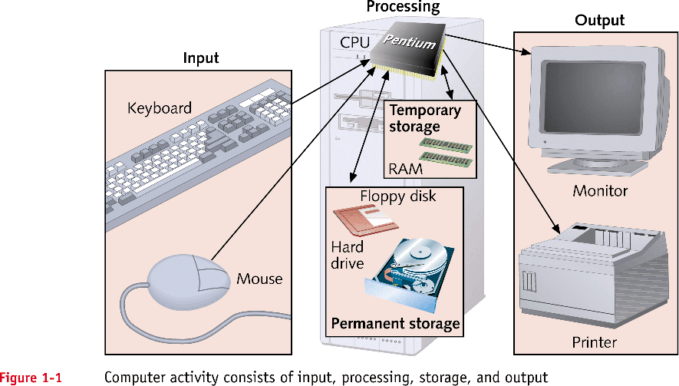
Hardware Needs Software to Work (continued)
A+ Guide to Hardware: Managing, Maintaining, and Troubleshooting, Third Edition

Slide 5
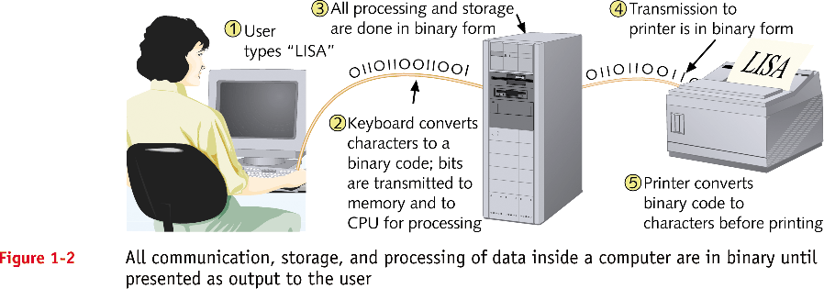
Hardware Needs Software to Work (continued)
A+ Guide to Hardware: Managing, Maintaining, and Troubleshooting, Third Edition

Slide 6
What controls Hardware
Hardware can be controlled by other Hardware.
  E.g. Network card receives info from the Internet, then stores that info on the Hard Disk.
    The Network card must tell the main computer that there is info ready to be store.
    The Network card must then transfer the data (info) to the Hard Disk.
  All communication is done in binary.
    Data is transferred
    Control signals sent and received.
A+ Guide to Managing and Maintaining your PC, 6e

Slide 7
Software controls Hardware
A High Level Language
  X = X + 1
A compiler will convert this instruction to Assembly code. It might look something like.
  Load R1,X --Load x from memory to register 1
  Add R1,1 --Add 1 to R1
  Store X,R1 --Store R1 to memory location X
Hardware does not understand English, it understands binary. So the computer might see:
  100 01 101
  010 01 001
  101 101 01
These instructions tell the system to perform a simple arithmetic operation, in binary.
A+ Guide to Managing and Maintaining your PC, 6e

Slide 8
Binary and Hex
Binary is difficult for humans to communicate in. When we wish to describe binary it is often easier to use Hexadecimal.
  E.g. Decimal 21 = 1*2⁴ + 0*2³ + 1*2² + 0*2¹ + 1x2⁰
  = 16 + 0 + 4 + 0 + 1
  = 21
  = 10101
Hexadecimal or Hex represents binary as groups of 4 bits.
  10101
  0001 0101
  15 in Hex, often written as 0x15 to differentiate it from decimal.
  1*16¹ + 5*16⁰
A+ Guide to Managing and Maintaining your PC, 6e

Slide 9
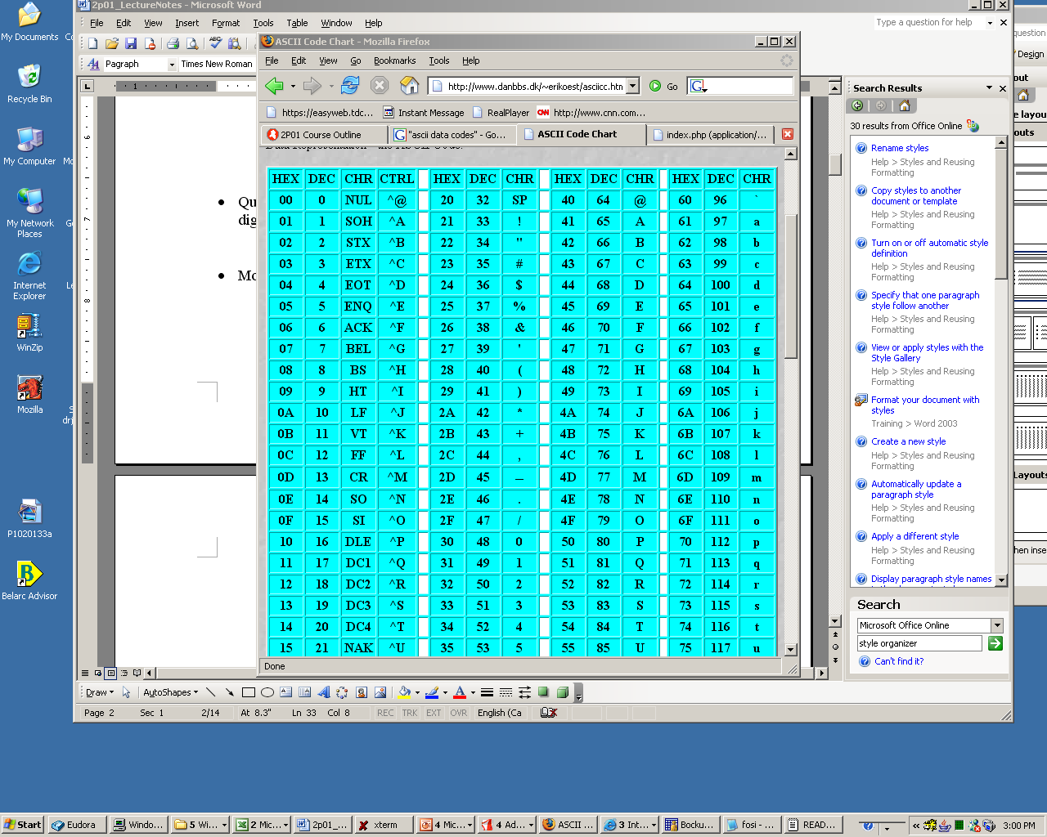
ASCII Character Set
A+ Guide to Managing and Maintaining your PC, 6e

Slide 10
PC Hardware Components
Most input/output (I/O) devices are external to case
Most processing and storage devices are internal
Central processing unit (CPU)
  Also called the processor or microprocessor
  Reads input, processes data, writes data to storage
Elements required by I/O and storage devices
  A method for CPU to communicate with the device
  Software to instruct and control the device
  Electricity to power the device
A+ Guide to Managing and Maintaining your PC, 6e

Slide 11
Hardware Used for Input and Output
Connections to the case can be cabled or wireless
Port: access point located in back or front of case
Chief input devices:
  Keyboard: enhanced type holds 104 keys
  Mouse: pointing device used to select screen items
Chief output devices:
  Monitor: visually displays primary output of computer
  Printer: produces output on paper (hard copy)
A+ Guide to Managing and Maintaining your PC, 6e

Slide 12
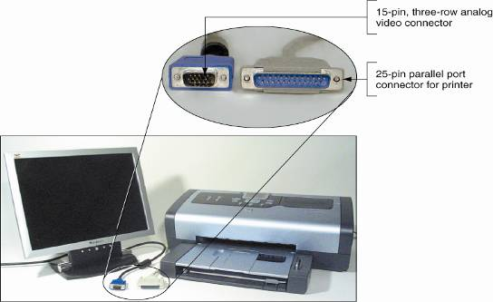
Figure 1-6 The two most popular output devices are the monitor and the printer
A+ Guide to Managing and Maintaining your PC, 6e

Slide 13
Hardware Inside the Computer Case
Most storage and processing occurs in the case
Internal devices common to most computers:
  Motherboard containing CPU, memory, other parts
  Floppy drive, hard drive, CD drive for persistent storage
  Power supply with power cords supplying electricity
  Circuit boards for internal and external communication
  Cables to connect devices to all circuit boards
Expansion cards are installed in expansion slots
Two types of cables: data (communication) and power
A+ Guide to Managing and Maintaining your PC, 6e

Slide 14
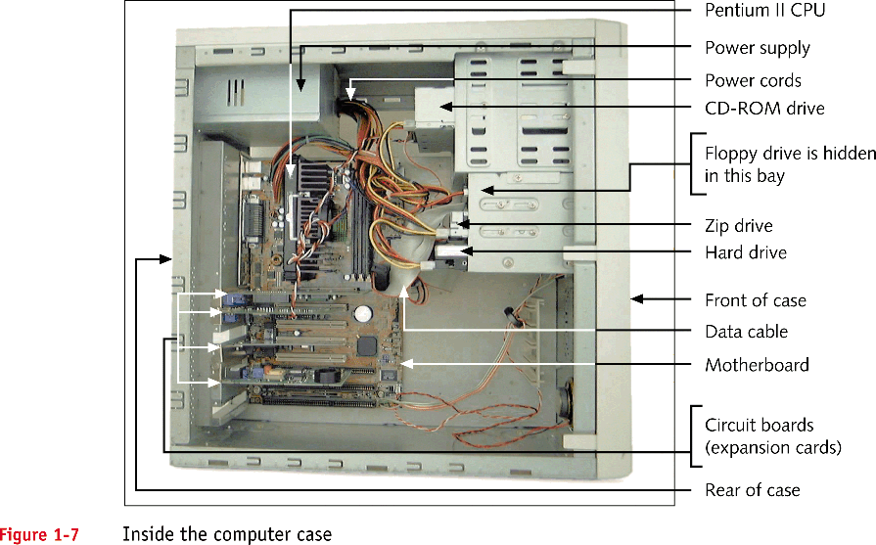
Hardware Inside the Computer Case (continued)
A+ Guide to Hardware: Managing, Maintaining, and Troubleshooting, Third Edition

Slide 15
The Motherboard
The largest and most important circuit board
  Also called the main board
Contains the CPU, where most processing takes place
All devices
  Communicate with the motherboard
  Are either installed directly on it or linked by a cable
A+ Guide to Hardware: Managing, Maintaining, and Troubleshooting, Third Edition

Slide 16
The Motherboard (continued)
Processing: CPU and the chip set that supports the CPU
Storage: RAM and cache memory
Communication: traces, expansion slots and the system clock
The electrical system: the power supply
Programming and setup data: Flash ROM, CMOS
A+ Guide to Hardware: Managing, Maintaining, and Troubleshooting, Third Edition

Slide 17
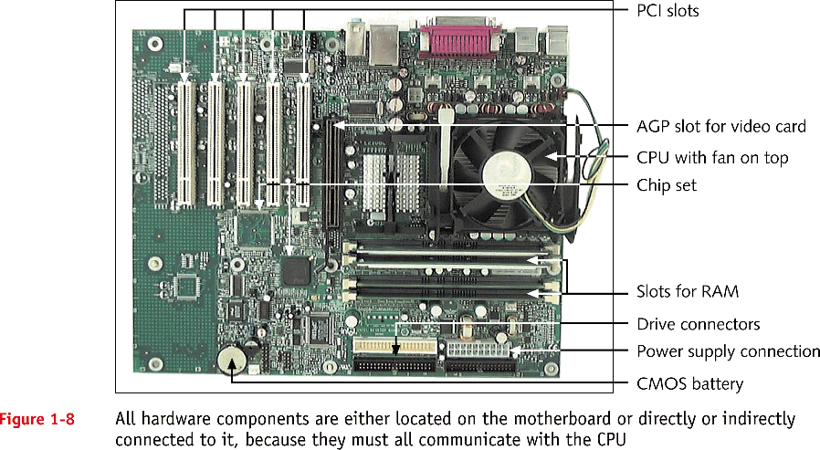
The Motherboard (continued)
A+ Guide to Hardware: Managing, Maintaining, and Troubleshooting, Third Edition

Slide 18
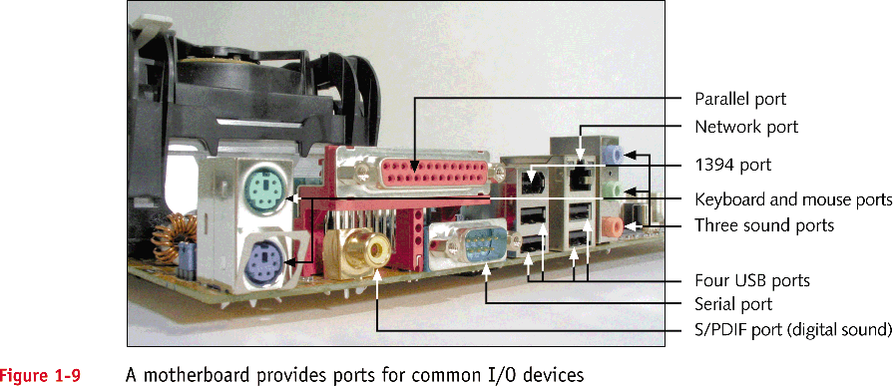
The Motherboard (continued)
A+ Guide to Hardware: Managing, Maintaining, and Troubleshooting, Third Edition

Slide 19
The CPU and the Chip Set
CPU – a chip inside the computer that performs most of the actual data processing
Chip set – microchips on the motherboard
  Control the flow of data and instructions to and from the CPU
A+ Guide to Hardware: Managing, Maintaining, and Troubleshooting, Third Edition

Slide 20
Von Neumann
memory
(store)
CPU
control
address
data
Input/Output unit
A+ Guide to Managing and Maintaining your PC, 6e

Slide 21
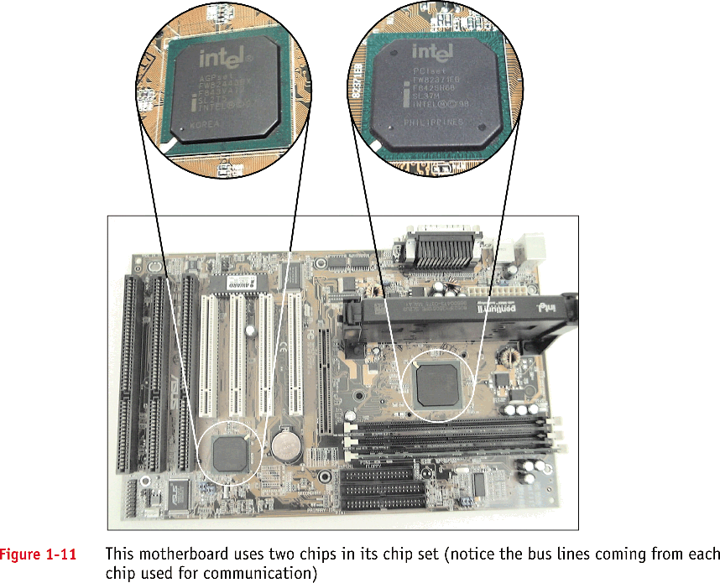
The CPU and the Chip Set (continued)
A+ Guide to Hardware: Managing, Maintaining, and Troubleshooting, Third Edition

Slide 22
Storage Devices
Primary storage (main memory):
  Temporary storage used by the processor
  Example: RAM (random access memory)
Secondary storage (permanent storage):
  Enables data to persist after the machine is turned off
  Examples: hard drive, CD, floppy disk
Analogy to primary-secondary memory relationship
  Book stacks in a library are like permanent storage
  Books can be moved to a desk (temporary storage)
A+ Guide to Managing and Maintaining your PC, 6e

Slide 23
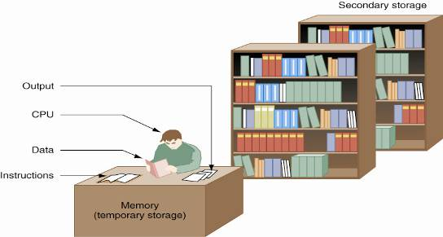
Figure 1-13 Memory is a temporary place to hold instructions and data while the CPU processes both
A+ Guide to Managing and Maintaining your PC, 6e

Slide 24
Primary Storage
RAM (random access memory):
  Device providing temporary storage
  Located on motherboard and on other circuit boards
Three types of RAM boards (memory modules):
  DIMM (dual inline memory module)
  RIMM (Rambus inline memory module)
  SIMM (single inline memory module)
RAM is volatile (data does not persist)
ROM (read-only memory) is nonvolatile
A+ Guide to Managing and Maintaining your PC, 6e

Slide 25
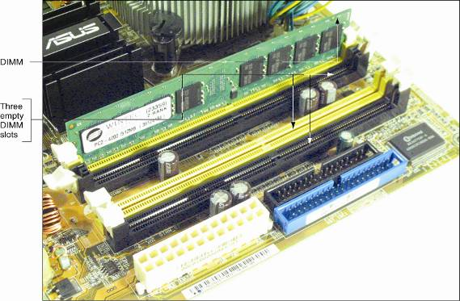
Figure 1-14 A SIMM, DIMM, or RIMM holds RAM and is mounted directly on a motherboard
A+ Guide to Managing and Maintaining your PC, 6e

Slide 26
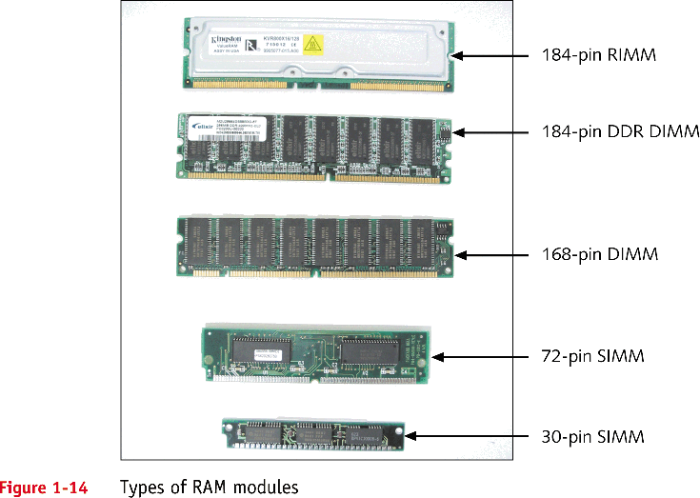
Primary Storage (continued)
A+ Guide to Hardware: Managing, Maintaining, and Troubleshooting, Third Edition

Slide 27
Secondary Storage
Hard drive
  Case containing disks that rotate at high speeds
  An arm with a read/write head traverses the platter
Integrated Drive Electronics (IDE)
  Technology used internally by a hard drive
ATA (AT Attachment) standard
  Specifies motherboard-hard drive interface
  Types: Serial ATA or parallel ATA (Enhanced IDE)
Parallel ATA accommodates up to four IDE devices
A+ Guide to Managing and Maintaining your PC, 6e

Slide 28
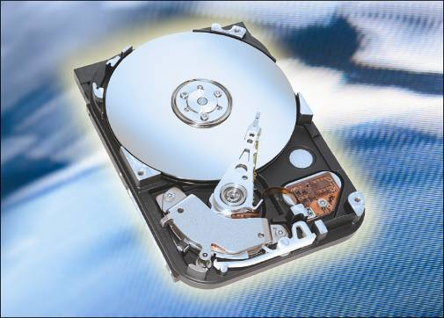
Figure 1-16 Hard drive with sealed cover removed
A+ Guide to Managing and Maintaining your PC, 6e

Slide 29
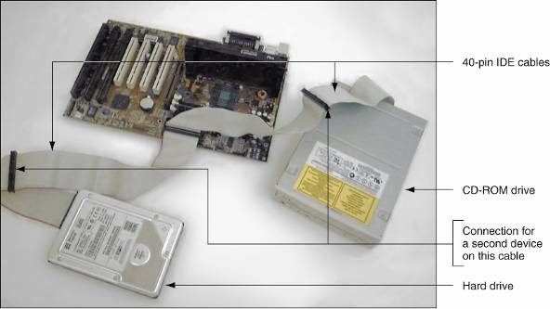
Figure 1-18 Two IDE devices connected to a motherboard using both IDE connections and two cables
A+ Guide to Managing and Maintaining your PC, 6e

Slide 30
Secondary Storage (continued)
Serial ATA standard
  Allows for more than four drives in a system
  Applies only to hard drives and not to other drives
Some IDE devices: hard drives, Zip drives, CD drive, floppy drives
Floppy drive
  3.5-inch disk holding 1.44 MB of data
  Floppy drive connector is distinct from IDE connectors.
CD-ROM (compact disc read-only memory) drive
  Standard equipment for reading software distributions
A+ Guide to Managing and Maintaining your PC, 6e

Slide 31
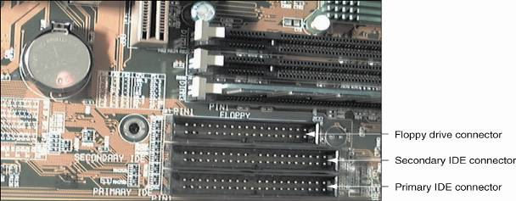
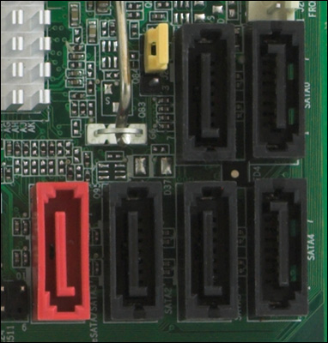
Figure 1-22 A motherboard usually provides a connection for a floppy drive cable
A motherboard with SATA connectors
A+ Guide to Managing and Maintaining your PC, 6e

Slide 32
Motherboard Components Used For Communication Among Devices
Traces: circuits or paths that move data and power
Bus: system of pathways and transmission protocols
Data bus
  Lines in a bus that carry the data
  Binary bits correspond to voltage values of on or off
  Data path sizes: 8, 16, 32, 64, or 128 bits wide
Main bus on motherboard (system bus, memory bus)
  Communicates with CPU, memory, and chipset
Pulse of system clock carried by line on motherboard
A+ Guide to Managing and Maintaining your PC, 6e

Slide 33
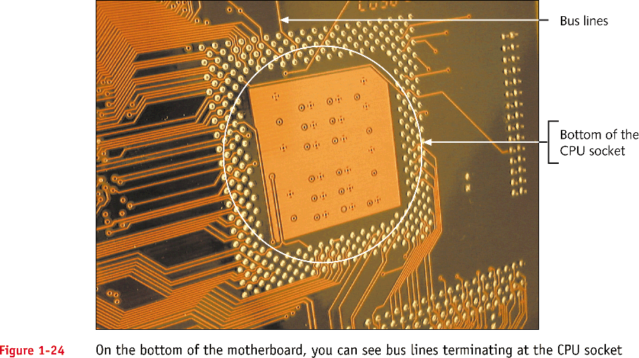
Motherboard Components Used for Communication Among Devices (continued)
A+ Guide to Hardware: Managing, Maintaining, and Troubleshooting, Third Edition

Slide 34
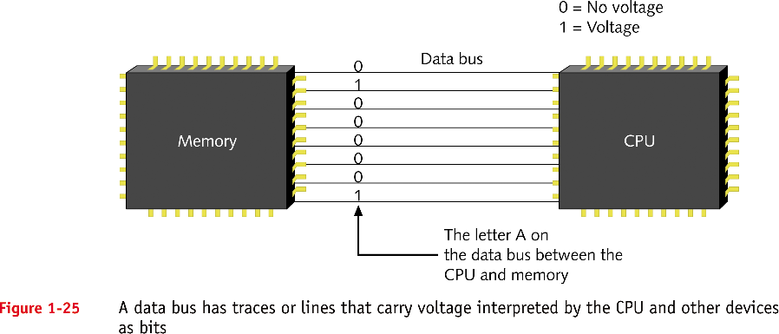
Motherboard Components Used for Communication Among Devices (continued)
A+ Guide to Hardware: Managing, Maintaining, and Troubleshooting, Third Edition

Slide 35
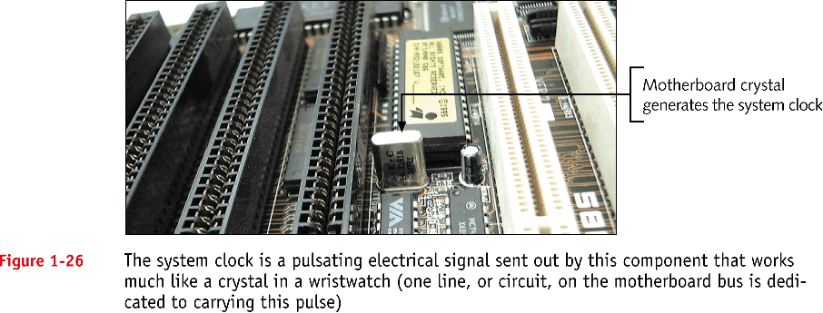
Motherboard Components Used for Communication Among Devices (continued)
A+ Guide to Hardware: Managing, Maintaining, and Troubleshooting, Third Edition

Slide 36
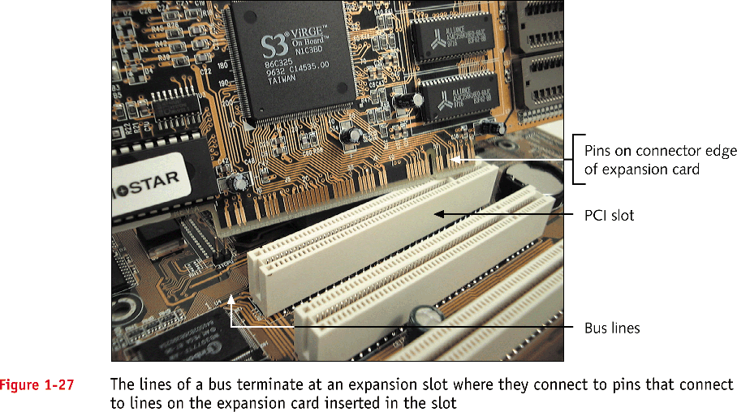
Motherboard Components Used for Communication Among Devices (continued)
A+ Guide to Hardware: Managing, Maintaining, and Troubleshooting, Third Edition

Slide 37
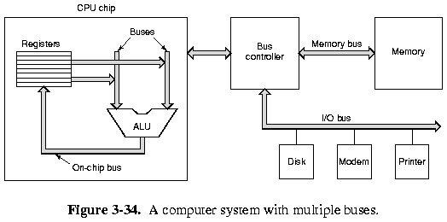
Buses
A+ Guide to Managing and Maintaining your PC, 6e

Slide 38
Motherboard Components Used For Communication Among Devices (continued)
Devices work according to beats (or cycles)
Clock speed is measured in hertz (cycles/second)
  One megahertz (MHz): one million cycles per second
  One gigahertz (GHz): one billion cycles per second
Common ratings for motherboard buses
  1066 MHz, 800 MHz, 533 MHz, or 400 MHz
Range of CPU speeds: 166 MHz to 4 GHz
Buses for expansion slots: PCI, AGP, ISA, PCI express
A+ Guide to Managing and Maintaining your PC, 6e

Slide 39
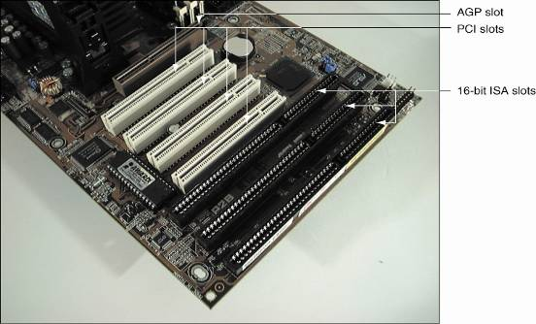
Figure 1-29 PCI bus expansion slots are shorter than ISA slots and offset farther; the one AGP slot is set farther from the edge of the board
A+ Guide to Managing and Maintaining your PC, 6e

Slide 40
Interface (Expansion) Cards
Some names for circuits mounted in expansion slots:
  Circuit cards, adapter boards, expansion cards, cards
Cards that connect the CPU to an external device:
  Video: provides a port for the monitor
  Sound: provides ports for speakers and microphones
  Network: provides a port for a network cable
  Modem: provides ports for phone lines
Determine a card’s function by identifying its port
A+ Guide to Managing and Maintaining your PC, 6e

Slide 41
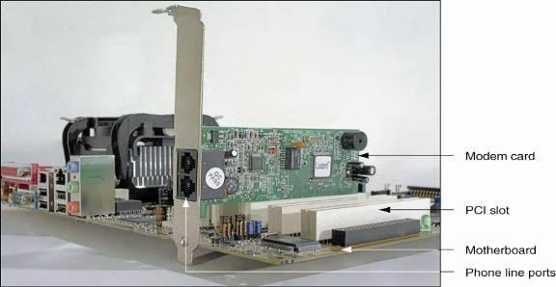
Figure 1-31 This circuit board is a modem card and is mounted in a PCI slot on the motherboard
A+ Guide to Managing and Maintaining your PC, 6e

Slide 42
The Electrical System
Power supply
  Most important electrical component
  Converts AC voltage external source to DC voltage
  Reduces voltage from 110-120 volts to 12 volts or less
  Runs a fan to cool the inside of the computer case
Temperatures > 185° F can cause component failure
Motherboard has 1 or 2 connections to power supply
A+ Guide to Managing and Maintaining your PC, 6e

Slide 43
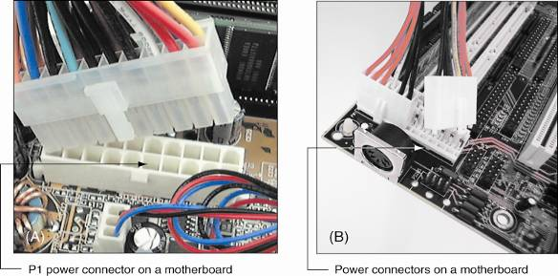
Figure 1-35 The motherboard receives its power from the power supply by way of one or more connections located near the edge of the board or near the processor
A+ Guide to Managing and Maintaining your PC, 6e

Slide 44
Instructions Stored on the Motherboard and Other Boards
BIOS (basic input/output system)
  Data and instructions stored on ROM chips
  ROM BIOS chips are a type of firmware
Three purposes served by motherboard ROM BIOS:
  System BIOS: used to manage simple devices
  Startup BIOS: used to start the computer
  CMOS setup: used to change motherboard settings
CMOS RAM: includes date, time, port configurations
Flash ROM: ROM chips the can be overwritten
A+ Guide to Managing and Maintaining your PC, 6e

Slide 45
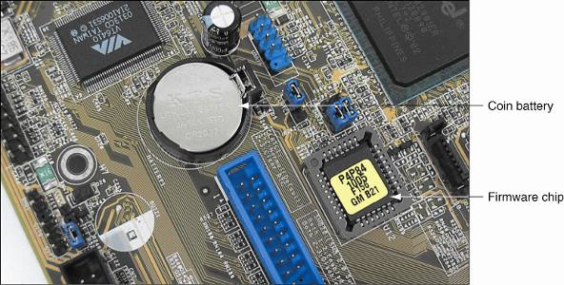
Figure 1-36 This firmware chip contains flash ROM and CMOS RAM; CMOS RAM is powered by the coin battery located near the chip
A+ Guide to Managing and Maintaining your PC, 6e

Slide 46
Advanced Configuration and Power Interface
Also known as ACPI
Standards specifying a power saving feature
Enables a system to power up by a keyboard
Supported by most systems, such as Windows XP
Advanced Power Management (APM)
  Older BIOS power management standard
A+ Guide to Managing and Maintaining your PC, 6e

Slide 47
Plug and Play
Also known as PnP
Standard simplifying installation of hardware devices
PnP BIOS begins process of configuring devices
PnP-compliant operating system completes configuration
ESCD (extended system configuration data) Plug and Play BIOS
  Enhanced version of PnP
  Stores manual configuration steps
A+ Guide to Managing and Maintaining your PC, 6e

Slide 48
Summary
A computer comprises hardware and software
Main functions: input, output, processing, storage
Data is stored in a binary format (1 or 0, on or off)
Input/output devices: keyboard, mouse, printer, monitor
Motherboard (system board): contains the CPU, access to other circuit boards and peripherals
A+ Guide to Managing and Maintaining your PC, 6e

Slide 49
Summary (continued)
Primary storage (RAM) is volatile (temporary)
Secondary storage is nonvolatile (permanent)
Parallel and serial ATA standards: enable secondary storage devices to interface with the motherboard
Computer bus: system of communication pathways and protocols
ROM BIOS helps start PCs, manage simple devices, and change some motherboard settings
A+ Guide to Managing and Maintaining your PC, 6e

