Slide 1

Windows 7 and A+
By Jean Andrews
jeanandrews@mindspring.com
www.facebook.com/JeanKnows

Slide 2
Agenda
What’s new with Windows 7
A+ exam changes for Windows 7
Quick coverage of the Windows 7 A+ content

Slide 3
What’s New with Windows 7?
Better performing and less problems than Vista
Not many changes in tools and screens:
  Desktop changes (Jump List, Aero Peek, Shake, and Snap)
  Libraries (a collection of folders)
  Windows XP Mode
  Action Center (convenient location for tools)
  Homegroups
  Windows Live Essentials and Security Essentials
  Rescue disc
  Improved Backup and Restore utility

Slide 4
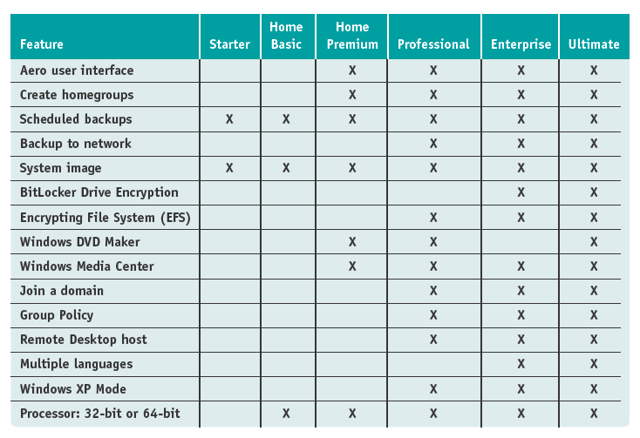
Editions of Windows 7

Slide 5
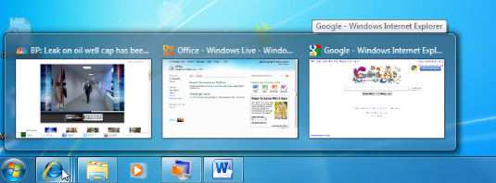
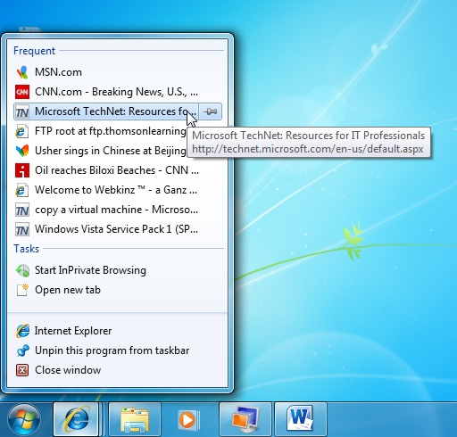
Windows 7 Jump List

Slide 6
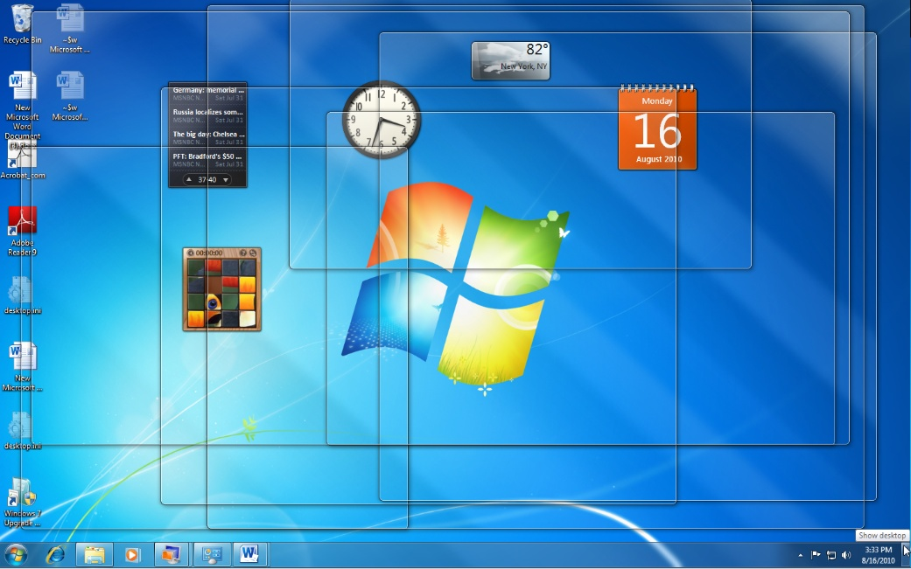
Aero Peek

Slide 7
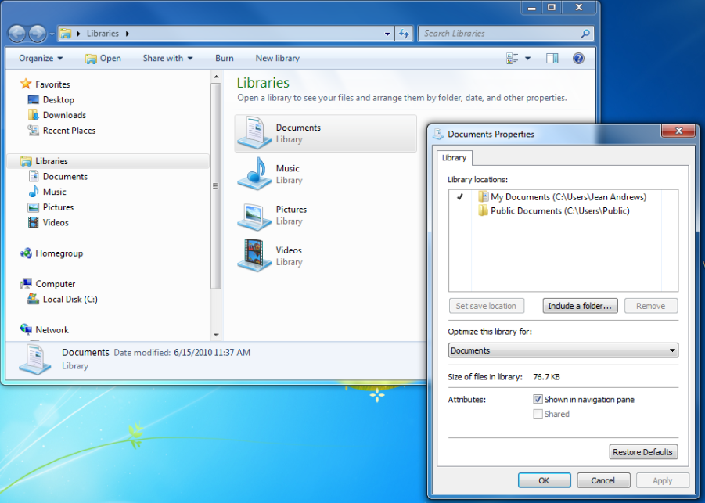
Windows 7 Libraries

Slide 8

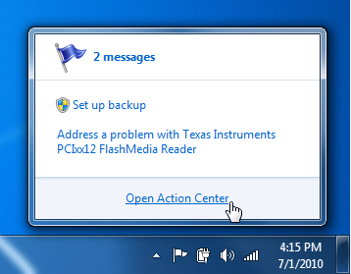
Action Center flag in taskbar

Slide 9
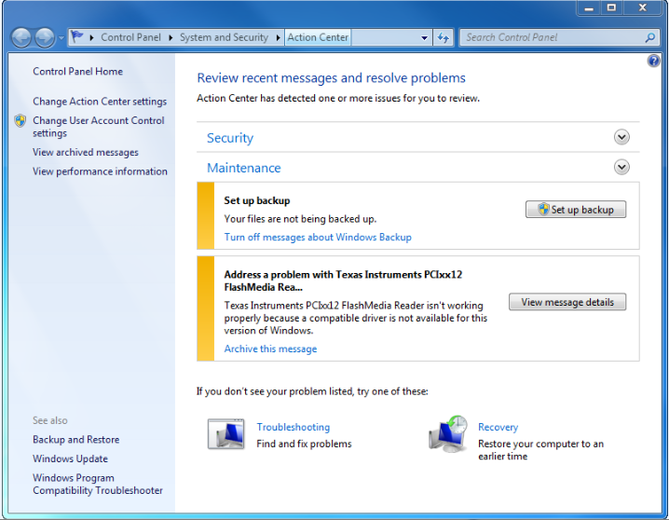
Action Center Window

Slide 10
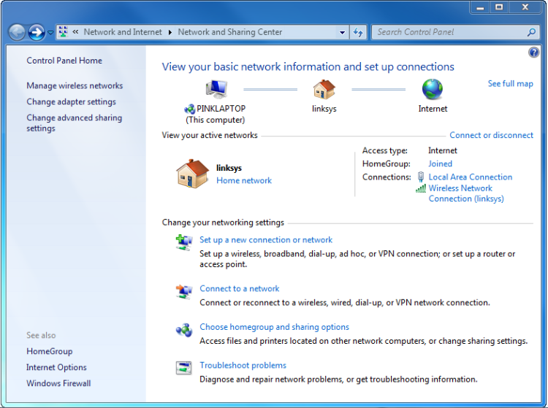
Network and Sharing Center

Slide 11
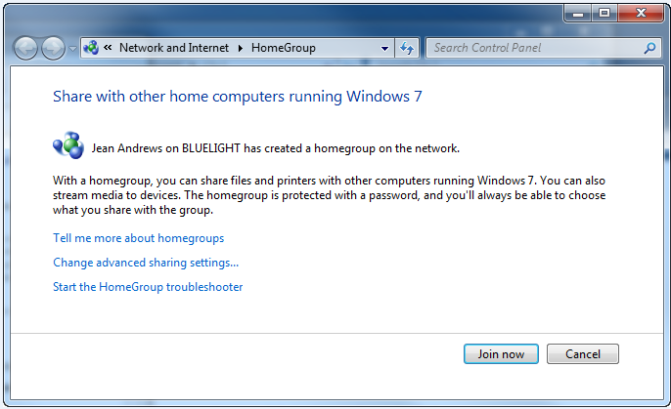
Homegroup

Slide 12
Rescue Disc
Used to launch Windows RE
Create the bootable disc using the Backup and Restore window
Three ways to launch Windows RE:
  From the hard drive (press F8 at startup)
  From the Windows 7 setup DVD
  From the rescue disc

Slide 13
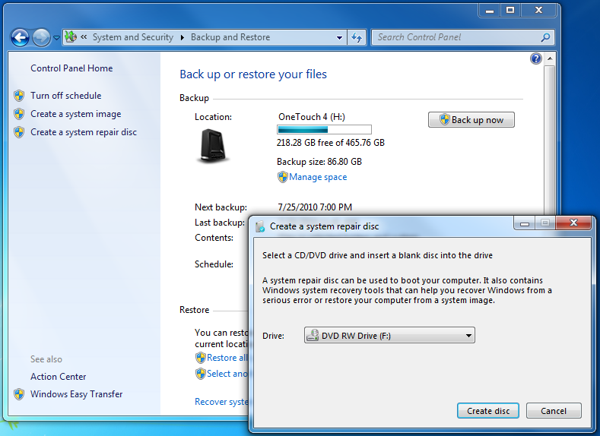
Backup and Restore

Slide 14
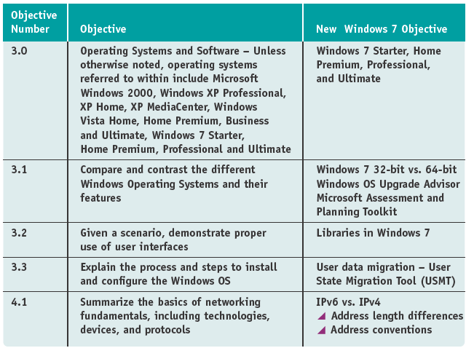
A+ Changes Effective Jan, 2011
2009 A+ 220-701 Essentials Exam

Slide 15
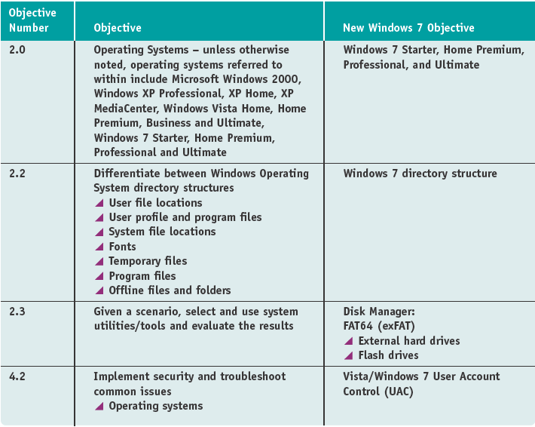
2009 A+ 220-702 Practical Application Exam

Slide 16
Microsoft Assessment and Planning (MAP) Toolkit
Software to automatically query multiple computers on the network to verify compatibility with Windows 7 before deployment
Used for lite-touch or zero-touch deployments
Recommended by Microsoft for deployments of more than 200 computers

Slide 17
User State Migration Tool (USMT)
Used to transfer user settings, application settings, and user data files to a new installation of Windows 7
Included in the Windows Automated Installation Kit (AIK)

Slide 18
User State Migration Tool (USMT)
Order of operation:
  Download and install the AIK software on the technician computer
  Copy USMT program files to the source computer
  Run ScanState command to copy data from source computer to file server
  Install Windows 7 and apps on destination computer
  Run LoadState command to apply from server to destination computer
  (USMT 4.0 uses hard-link migration to improve speed)

Slide 19
IPv6
IPv6 address has 128 bits written in 8 blocks of hex numbers like this:
  2001:0000:0B80:0000:0000:00D3:9C5A:00CC
Four zeroes can be eliminated like this:
  2001::0B80:0000:0000:00D3:9C5A:00CC
  Or this:
  2001:0000:0B80::00D3:9C5A:00CC
  The second method is preferred

Slide 20
IPv6 continued
IPv6 terms:
A link or local link is a network bounded by routers
A subnet is one or more links that have the same 64 bits in the prefix of the address
Neighbors are two or more nodes on the same link
An interface is a node’s attachment to a link

Slide 21
IPv6 continued
More terms:
Using a unicast address, packets are delivered to a single node on a network
Using a multicast address, packets are delivered to all nodes on a network
An anycast address is used by routers. The closest router using the address gets the packet.

Slide 22
IPv6 continued
Three kinds of unicast addresses:
A global unicast address can be used on the Internet (similar to public IP addresses)
A link-local unicast address is used on the local link (similar to private IP addresses)
A unique local unicast address is used on multiple local links within an intranet. (A hybrid between a global unicast and a link-local unicast address, routable on the intranet but not routable on the Internet)
  Note: The first 48 bits or 3 blocks of a global unicast address specifies the organization’s site. (publicly leased bits from IANA)

Slide 23
IPv6 continued
Interface concepts:
An IPv6 address identifies an interface, not a node
Two types of interfaces:
  A physical attachment (such as a network adapter)
  A logical attachment (such as a tunneling interface)
The last 64 bits or 4 blocks of an IP address identify the interface.
For a physical interface, Vista and XP use the MAC address to generate these 64 bits, but Windows 7 uses random generation.
These last 64 bits are called the interface ID.

Slide 24
IPv6 continued
Parts of a global unicast address:
  Note: The first 48 bits or 3 blocks of a global unicast address specifies the organization’s site and is called the global routing prefix. (publicly leased bits from IANA)
Global routing prefix
(48 bits)
Subnet ID
(16 bits)
Interface ID
(64 bits)

Slide 25
IPv6 continued
Parts of a link-local address:
  Example of a link-local address: FE80::9C13:4983:CCEA
FE80:0:0:0
Link-local prefix
(64 bits)
Interface ID
(64 bits)

Slide 26
IPv6 continued
Parts of a unique local unicast address:
FD00::/8
Unique local prefix
(8 bits)
Global ID within site
(40 bits)
Subnet ID
(16 bits)
Interface ID
(64 bits)

Slide 27
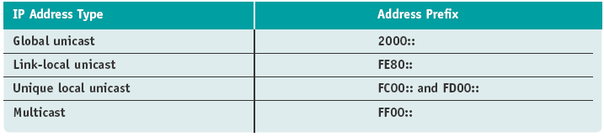
IPv6 Address Space
Unknown address is written as ::
Loopback address is written as ::1
For more prefixes, see the IP address space registry at www.iana.org

Slide 28
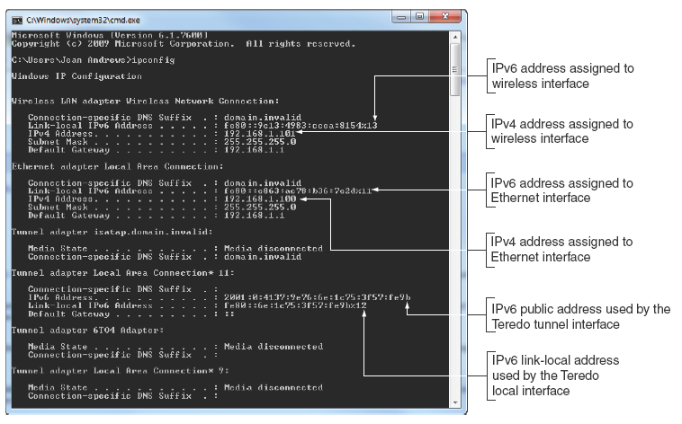
IP address assignments

Slide 29
Further Study of IPv6
Windows 7 Resource Kit by Microsoft Press
Search the Microsoft site:
  Google “Site:microsoft.com IPv6”

Slide 30
Other A+ content new to Windows 7
Directory structures are the same as Vista
Use the exFAT file system for USB flash drives and other removable drives
exFAT is compatible with Mac OS and Linux

Slide 31
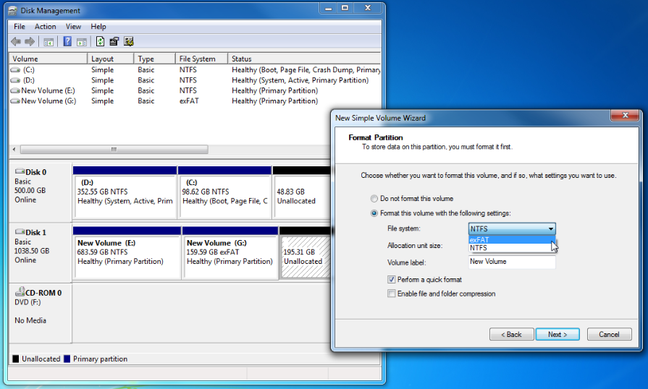
exFAT or FAT64

Slide 32
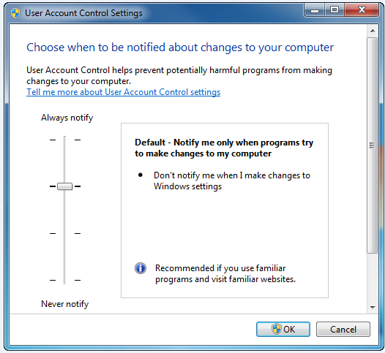
More control over the UAC box

