Slide 1

A+ Guide to Managing and Maintaining Your PC, 7e
Chapter 3
Working with People in a Technical World

Slide 2
Objectives
Learn about some job roles and responsibilities of those who sell, fix, or support personal computers
Learn what customers want and expect beyond your technical abilities
Learn how to interact with customers when selling, servicing, and supporting personal computers
A+ Guide to Managing and Maintaining Your PC, 7e

Slide 3
Job Roles and Responsibilities
PC support technician
  Works on-site and closely interacts with users
  Responsible for ongoing PC maintenance
PC service technician
  Pays service calls to customers
Technical retail associate
  Responsible for selling computers
A+ Guide to Managing and Maintaining Your PC, 7e

Slide 4
Job Roles and Responsibilities (cont’d.)
Bench technician
  Works in a lab environment
Help-desk technician
  Provides telephone or online support
A+ Guide to Managing and Maintaining Your PC, 7e

Slide 5
Certifications and Professional Organizations
Benefits of certification and advanced degrees
  Proof of competence and achievement
  Enhanced job opportunities
  A higher level of customer confidence
  Qualification for other training or degrees
A+ Guide to Managing and Maintaining Your PC, 7e

Slide 6
Certifications and Professional Organizations (cont’d.)
Computing Technology Industry Association (CompTIA)
  Most significant certifying organization for PC technicians
  Sponsors A+ Certification Program and manages exams
  CompTIA Web site: http://www.comptia.org
A+ Guide to Managing and Maintaining Your PC, 7e

Slide 7
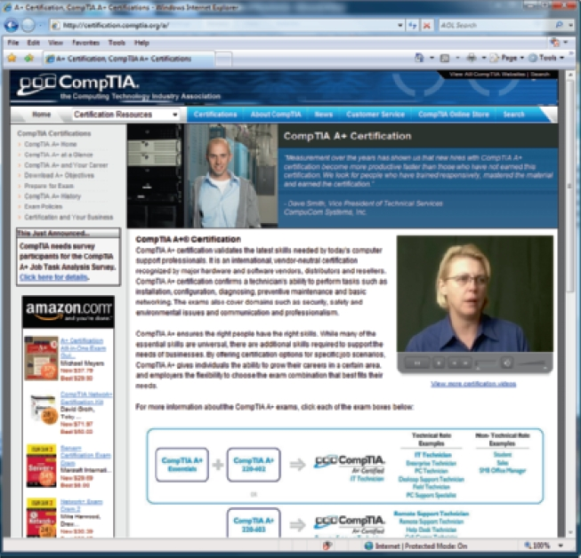
Figure 3-3 CompTIA A+ Certification Web page
Courtesy: Course Technology/Cengage Learning
A+ Guide to Managing and Maintaining Your PC, 7e

Slide 8
Certifications and Professional Organizations (cont’d.)
A+ Certification
  Pass the A+ 220-701 exam
    Covers hardware, operating systems, security, soft skills
    Validates entry-level skills
  Pass the A+ 220-702 exam
A+ Certification industry recognition
Other vendor specific certification programs
  Microsoft, Novell, Cisco product certifications
Ongoing education
  Requires staying abreast of new technology
A+ Guide to Managing and Maintaining Your PC, 7e

Slide 9
Record-Keeping and Information Tools
Working for a service organization
  Tools for the job provided
    Printed forms, online record keeping, procedures, manuals
  Software provided
    Programs supporting remote control of customers’ PCs
    Control-F1 by Blueloop: http://www.blueloop.net/
    Windows XP/Vista Remote Assistance
A+ Guide to Managing and Maintaining Your PC, 7e

Slide 10
Record-Keeping and Information Tools (cont’d.)
Other resources, records, information tools
  Specific software or hardware supported
  Copy of user documentation
  More technical software or hardware documentation
  Online help targeted to field/help-desk technicians
  Expert systems to analyze and solve problems
  Call tracking systems (electronic or paper-based)
    Ticket entered into the call-tracking system
    Ticket stays open until issue resolved
A+ Guide to Managing and Maintaining Your PC, 7e

Slide 11
What Customers Want: Beyond Technical Know-How
Two types of customers
  Internal: an associate within the company
  External: an individual outside the company
Traits of an exemplary PC technician
  Positive and helpful attitude
  Listening without interrupting your customer
  Proper and polite language
  Sensitivity to cultural differences
  Taking ownership of the problem
  Dependability
A+ Guide to Managing and Maintaining Your PC, 7e

Slide 12
What Customers Want: Beyond Technical Know-How (cont’d.)
Traits of an exemplary PC technician (cont’d.)
  Credibility
  Integrity and honesty
  Know the law with respect to your work
  Looking and behaving professionally
A+ Guide to Managing and Maintaining Your PC, 7e

Slide 13
Planning for Good Service
Customers want good service
Servicing customers on the phone, online, on site, or in a shop
  Requires good plan from beginning to end
A+ Guide to Managing and Maintaining Your PC, 7e

Slide 14
Initial Contact with a Customer
Scenarios
  Retail setting
  Travel to the customer’s site
  Customer calls on the phone
  Customer reaches technician via chat or e-mail
Always follow employer specific guidelines
A+ Guide to Managing and Maintaining Your PC, 7e

Slide 15
Initial Contact with a Customer (cont’d.)
General guidelines to begin a site visit professionally
  Be prepared: know call circumstances
  Arrive with complete set of appropriate equipment
  Greet customer in a friendly manner
    Use Mr. or Ms. and last names rather than first names when addressing the customer
  At a residence:
    Never stay at a site when only a minor is present
A+ Guide to Managing and Maintaining Your PC, 7e

Slide 16
Initial Contact with a Customer (cont’d.)
General guidelines to begin a phone call professionally
  Identify yourself and your organization
  Ask for and write down the name and phone number of the caller
  Follow company policies to obtain other specific information
  Be familiar with company customer service policies
  Open up the conversation for the caller to describe the problem
A+ Guide to Managing and Maintaining Your PC, 7e

Slide 17
Interview the Customer
Troubleshooting
  Begin by interviewing the user
    Ask questions, take notes, and keep asking questions until problem thoroughly understood
  Have customer reproduce problem
    Carefully note each step taken and the results
Questions to determine problem and its root cause
  Can you please describe the problem?
  When did the problem start?
  What was the situation when the problem occurred?
A+ Guide to Managing and Maintaining Your PC, 7e

Slide 18
Interview the Customer (cont’d.)
Questions to determine problem and its root cause (cont’d.)
  What programs or software were you using?
  Did you move your computer system recently?
  Recent thunderstorm or electrical problem?
  Any recent hardware, software, or configuration changes?
  Has someone else used your computer recently?
  Is there some valuable data on your system that is not backed up?
  Can you show me how to reproduce the problem?
A+ Guide to Managing and Maintaining Your PC, 7e

Slide 19
Set and Meet Customer Expectations
Creates expectation of certainty with customers
  Do not leave them hanging
  They should know what will happen next
Setting expectations
  Establish timeline with your customer for project completion
  Provide customer opportunity to make decisions
A+ Guide to Managing and Maintaining Your PC, 7e

Slide 20
Working with a Customer on Site
Avoiding distractions
  No personal cell phone calls
  Keep work calls to a minimum
  Be unobtrusive
  Consider yourself a guest
  Protect customer’s confidential materials
Follow general guidelines when working at user’s desk
Technician may consider themselves a support to the user
A+ Guide to Managing and Maintaining Your PC, 7e

Slide 21
Working with a Customer on the Phone
Phone support
  Requires more interaction with customers than any other PC support type
Phone support skills
  Visualize what customer sees at the PC
  Excellent communication skills, good phone manners, patience
  Drawing diagrams, taking notes when speaking with the user
Practice good phone manners
A+ Guide to Managing and Maintaining Your PC, 7e

Slide 22
Dealing with Difficult Customers
Tips for when customer is not knowledgeable
  Be specific with instructions
  Do not ask customer to do something that might destroy settings or files without backup
  Frequently ask the customer what is displayed
  Follow along at your own PC
A+ Guide to Managing and Maintaining Your PC, 7e

Slide 23
Dealing with Difficult Customers (cont’d.)
Tips for when customer is not knowledgeable (cont’d.)
  Give customer opportunity to ask questions
  Compliment customer
    To help build customer confidence
  If customer cannot help
    Tactfully request for user with more experience
A+ Guide to Managing and Maintaining Your PC, 7e

Slide 24
Dealing with Difficult Customers (cont’d.)
Tips for when customer is overly confident
  Compliment the customer’s knowledge, experience, insight when possible
  Slow the conversation down
  Do not back off from using problem-solving skills
  Be careful not to accuse customer of making a mistake
  Stick to policy of not using jargon
    Unless certain user understands
A+ Guide to Managing and Maintaining Your PC, 7e

Slide 25
Dealing with Difficult Customers (cont’d.)
Suggestions for when the customer complains
  Be an active listener
    Let customers know they are not being ignored
  Give customer time to vent
    Apologize when possible
  Do not be defensive
  Know how to handle verbal abuse
  Let customer complain about another company’s product
A+ Guide to Managing and Maintaining Your PC, 7e

Slide 26
Dealing with Difficult Customers (cont’d.)
Suggestions for when the customer complains (cont’d.)
  If the complaint against you or your product
    Identify and report underlying problem
  Sometimes simply making progress, reducing problem to a manageable state reduces anxiety
  Point out ways communication could be improved
A+ Guide to Managing and Maintaining Your PC, 7e

Slide 27
The Customer Decides When the Work Is Done
Remote support
  Customer ends call or chat session
On-site work
  Technician performs several steps
    Reboot system if necessary
    Verify equipment working
    Restore backed up data
    Review service call with customer
    Explain preventive maintenance
A+ Guide to Managing and Maintaining Your PC, 7e

Slide 28
Sometimes You Must Escalate a Problem
Escalate problem only after all options have been exhausted
Guidelines for escalation
  Include use of proper organizational channels
A+ Guide to Managing and Maintaining Your PC, 7e

Slide 29
The Job Isn’t Finished Until the Paperwork Is Done
Customer expects paper report of work completed
Use the electronic tracking system dynamically during support phone call
Compile a paper trail if no electronic tracking system
A+ Guide to Managing and Maintaining Your PC, 7e

Slide 30
Working with Coworkers
Learn not to be offended
Practice good organizational skills
Know your limitations
  Be willing to admit when you cannot do something
Learn how to handle conflict at work
A+ Guide to Managing and Maintaining Your PC, 7e

Slide 31
Summary
Five key job roles of a PC support technician
  PC support technician, PC service technician, retail sales associate, bench technician, and help-desk technician
CompTIA A+ Certification
  Most significant and most recognized certification for PC repair technicians
A+ Guide to Managing and Maintaining Your PC, 7e

Slide 32
Summary (cont’d.)
Staying abreast of new technology
  Attend trade shows, read trade magazines, research the Internet, subscribe to email newsletters, attend seminars and workshops
Customers want more than just technical know-how
  Positive and helpful attitude, respect, good communication, ownership of their problem, dependability, credibility, and professionalism
A+ Guide to Managing and Maintaining Your PC, 7e

