Slide 1
RaspiRover
Lawrence Puig
N01033296
CENG 317
2017-2018

Slide 2
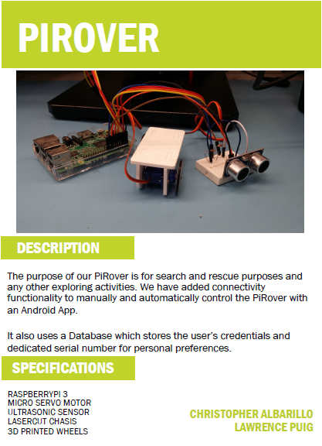
Raspberry Pi Rover
Raspberry Pi Rover, a portable Rover inspired by NASA’s moon Rover.
Uses two motor servo wheels to allow movement for the Rover.
Uses a Raspberry Pi to allow controlling through a database or terminal.
Uses 3.3V from the Raspberry Pi to operate the wheels.
Battery Pack may be implemented to use portably.

Slide 3

Demo

Slide 4
Budget
Product |  |  |  | Description |  |  |  | Quantity | Cost
Raspberry Pi 3 Starter kit |  |  |  | To operate Program and hold data |  |  |  | 1 | $99.99
Micro Servo Motor Continuous Rotation |  |  |  | To allow mobility |  |  |  | 2 | $21.99
Portable Power Bank |  |  |  | To Supply Power |  |  |  | 1 | $19.99
Electronic Learning Kit for RaspberryPi |  |  |  | Supply kit for RaspberryPi |  |  |  | 1 | $16.99
60x80Wheel's |  |  |  | Standard Wheels |  |  |  | 2 | $9.99
3D printed chasis from Humber |  |  |  | Rover's Chasis |  |  |  | 1 | n/a
Ultrasonic Sensor HC-SR04 |  |  |  | Ultrasonic sensor for detections |  |  |  | 1
Before Tax |  |  |  |  |  |  |  |  | $168.95
Tax |  |  |  |  |  |  |  |  | $21.96
Total |  |  |  |  |  |  |  |  | $190.91

Slide 5
schedule
Week 1-4
- Ordered and Bought Parts
- Prepared For Building, Gathered Parts
Week 5-8
- Building Started
- Created Terminal Controller
- Finished a basic Build
Week 9-12
Implemented Portability with Battery
Created a Controller through Android Studios

Slide 6
Skills learned and utilized
Github
Soldering
Python Coding
Organizing and Preparing a Project
Raspberry Pi 3
Build Video

Slide 7
Thank You

