Slide 1
Smart Hive
Yurii sentsiv
Ceng 317

Slide 2
Introduction (Proposal)
In the start of the semester my new team members and myself choose to work with bees, particularly create a monitoring system to help bee keepers in Humber College understand better and be able to see what is happening with the hives remotely.
As have been discussed with bee keepers previously, it was clear that they were lacking the ability to have temperature/humidity status of the hive, as well as, having an ability to locate the bee cluster in the hive during the winter.
In order to solve this problem I am using regular temperature & humidity sensors DHT11 in order to have real time readings, as well as, with help of the algorithm, to located cluster inside the hive, depending on the temperature readings.

Slide 3
Introduction (Proposal)
For more accurate readings I use 4 DHT11s on each side of the hive. Using the python script and Adafruit library I’m able to simultaneously read the data from all of the sensors using GPIO pins. Also, having the sensor hat, that was built by us, I have an LED, which I use to indicate when the data readings are happening.
In order to have automated readings from the sensors, I use crontab, which is UNIX command that schedules the prewritten scripts.
To have data visually presented, I’m using the javascript’s dygraph library to visually present the fluctuation of the temperature & humidity reading through the time.
Also, to present the location of the cluster I use regular javascript’s canvas, where I draw the cluster, with the coordinates calculated with my algorithm.

Slide 4
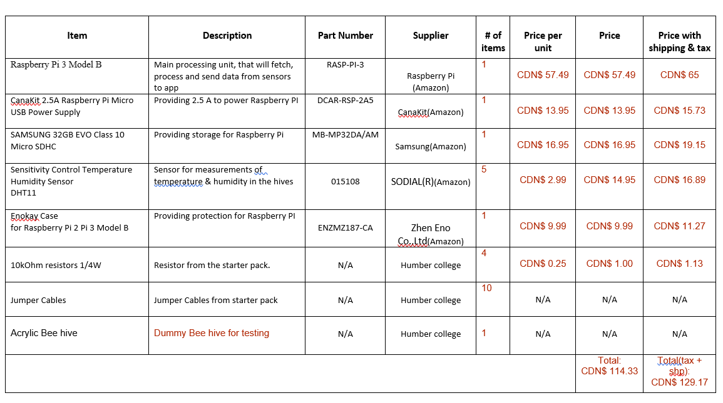
Budget

Slide 5
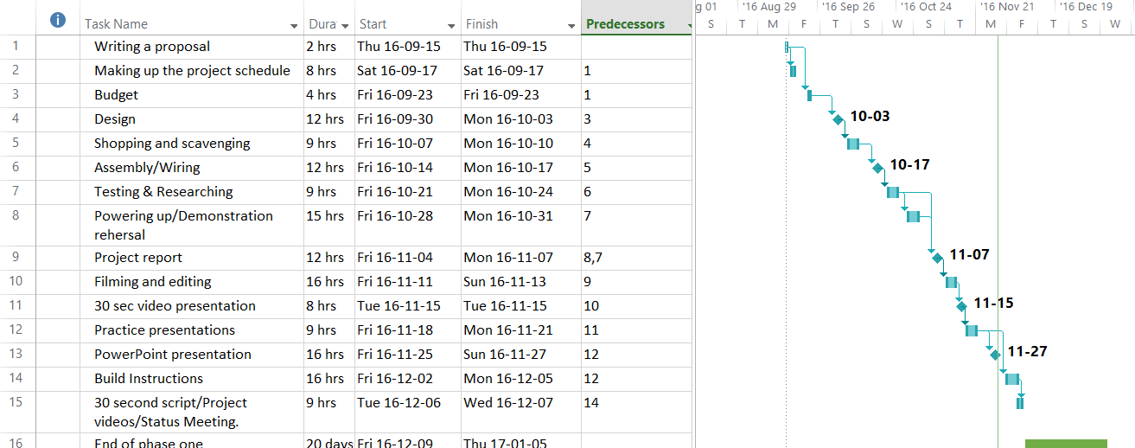
Schedule : hardware

Slide 6
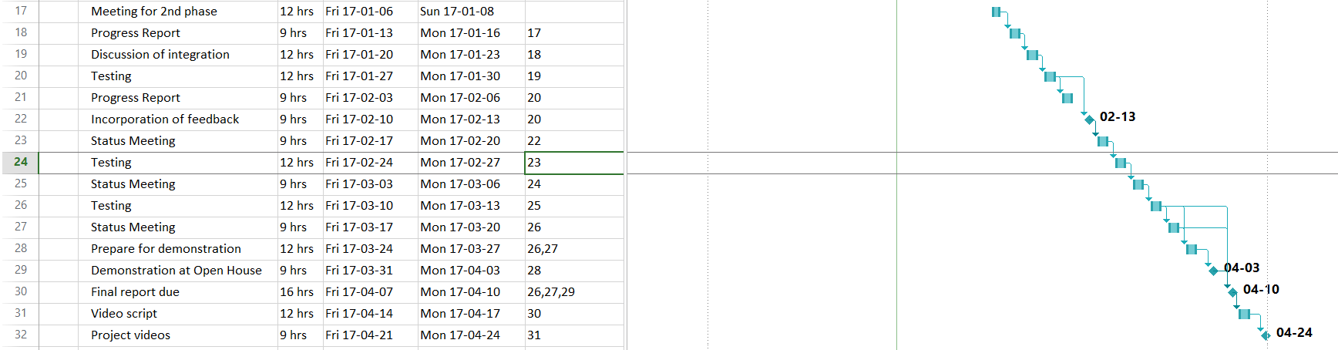
Schedule : integration

Slide 7
Course knowledge utilized from previous courses
In the Computer Engineering Technology program we have learned about the following topics from the respective relevant courses:
Construction of circuits from CENG 215 Digital And Interfacing Systems,
Rapid application development and Gantt charts from CENG 216 Intro to Software Engineering,
Micro computing from CENG 252 Embedded Systems,
SQL from CENG 254 Database With Java,
Web access of databases from CENG 256 Internet Scripting; and,
Wireless protocols such as 802.11 from TECH152 Telecom Networks.

Slide 8

Thank you!

