Slide 1
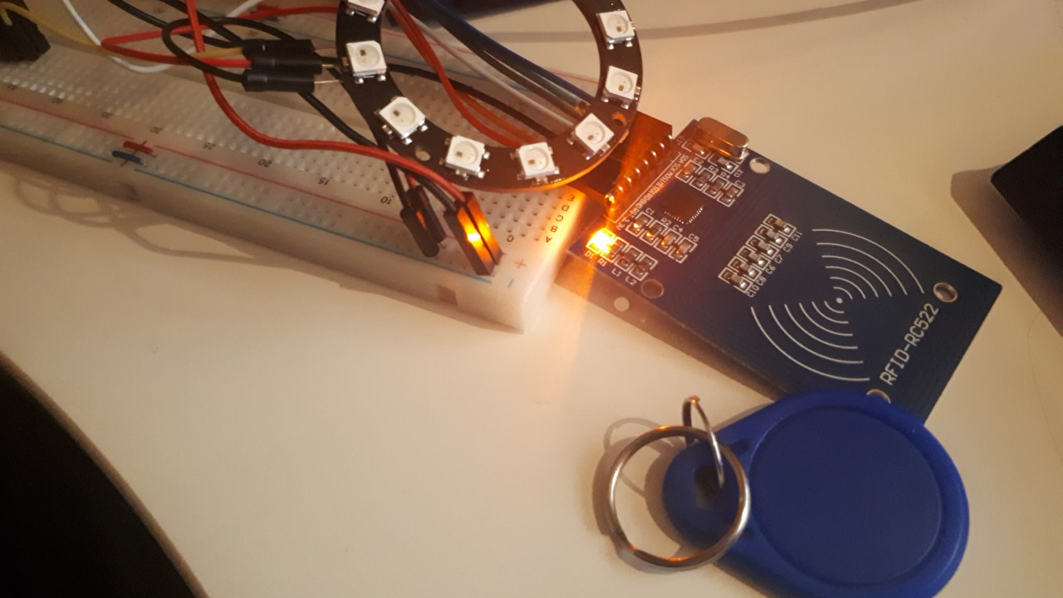
Lumi Light
Ruel John Cootauco – N01114847
CENG 317-0NB

Slide 2
Introduction
The Lumi Light is a baby nightlight that will detect signs of a baby’s behavior. It is a proximity controlled Raspberry Pi device that will produce RGB lightings based on the sensor, such as the presence of an adult inside the room.

Slide 3
Budget Plan
Parts | Source | Description | Part # | Unit Cost
CanaKit Raspberry Pi 3 Complete Starter Kit | CanaKit | Raspberry Pi including environment tools for development. | 682710991511 | $119.99
RFID Sensor Module | SainSmart | RFID sensor that will read RFID tags & cards when near the proximity sensor. | 10150141 | $15.00
NeoPixel Ring | Creatron Inc | 12 RGB LEDs produced by sensors. | LEDRG-001659 | $9.95
Electret Microphone with Cable | Creatron Inc | Used to voice control the Lumi RGB lightning. | MICCN-000002 | $1.35
5V 1A Power Supply w/ 2.1mm Female Barrel Jack Adapter | Creatron Inc | External power adapter used to power up the neopixel ring. | ADADC-400505 | $9.85
20x4 IIC/I2C/TWI LCD Module | Sainsmart | LCD screen to display the data read from the RFID tag/card. | 20011913 | $19.99
Total for parts from CAD sources |  |  |  | $144.94
Estimated GST/HST |  |  |  | $16.68
Shipping |  |  |  | FREE
Grand Total (Incl. taxes) |  |  |  | $161.62

Slide 4
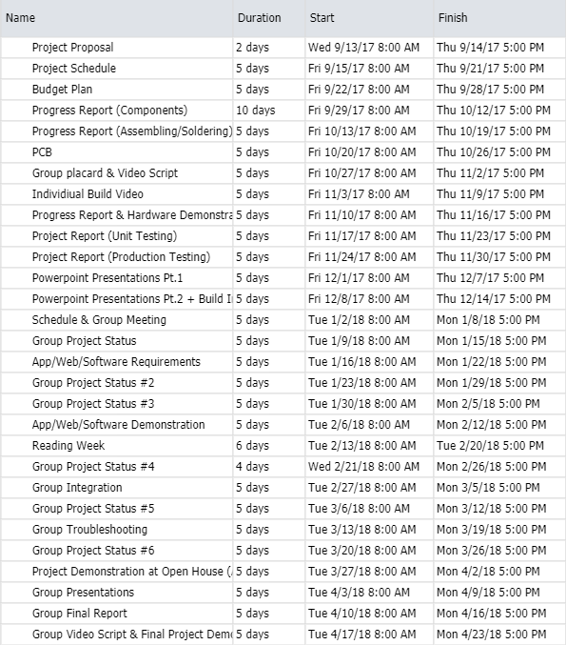
Schedule
Schedule plan has been modified due to the college strike. However, the project plan has been condensed to fit in the major segments of the project.
The project Lumi is steadily on track.

Slide 5
Course Knowledge Utilized From Previous Courses
Unix Scripting (Raspberry Pi terminal commands)
Electric Circuits & Digital and Interface Systems (Circuit wiring fundamentals)
Java Programming (Basic coding terminology to recode in Python)

Slide 6
Backup Demo
Build Video

