Slide 1
Credit Card Customer Churn Analysis
Group Members:
Ajay Panchal
Gourav Srinivas Bingi Suresh
Musab Ahmed
Nurul Chowdhury
Swaroop Natarajan N S
Dataset: www.kaggle.com/datasets/devkuttan/data-of-bank-customers

Slide 2
Approach
Age Distribution of Customer Churn
Credit Limit versus Customer (whether churned or not)
Transaction Amount versus Number of Client
Dashboards based on types of credit cards (Blue, Silver, Gold and Platinum ):
No of Products and Transaction details
Demographics of different type of Card holders
Conclusion

Slide 3
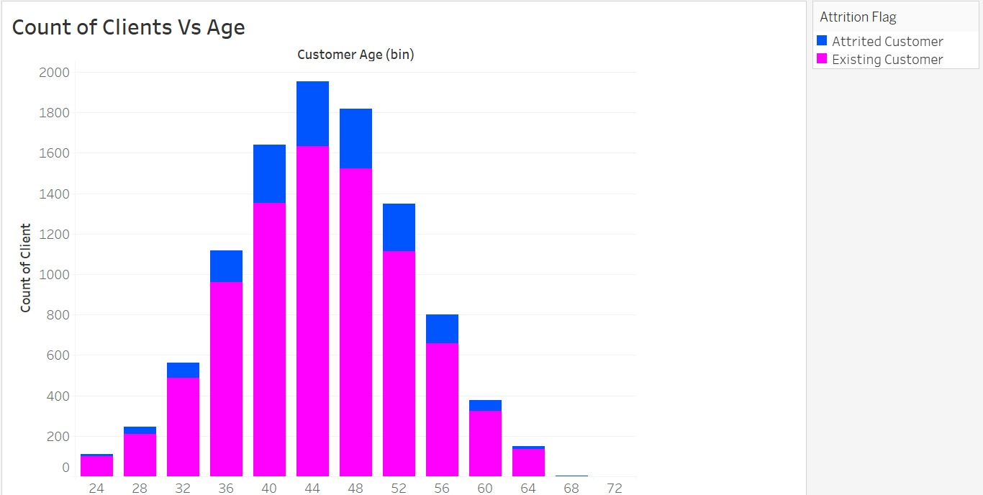
Maximum number of card holders who are leaving are of 40 to 48
Notes:
As per the above chart, customers who are in younger bracket of ages (24-36) are mostly the existing customers (as shown in pink color).
Majority of the Attrited or churned customers are falling within the age brackets between 40 and 48 (as reflected in blue color).

Slide 4
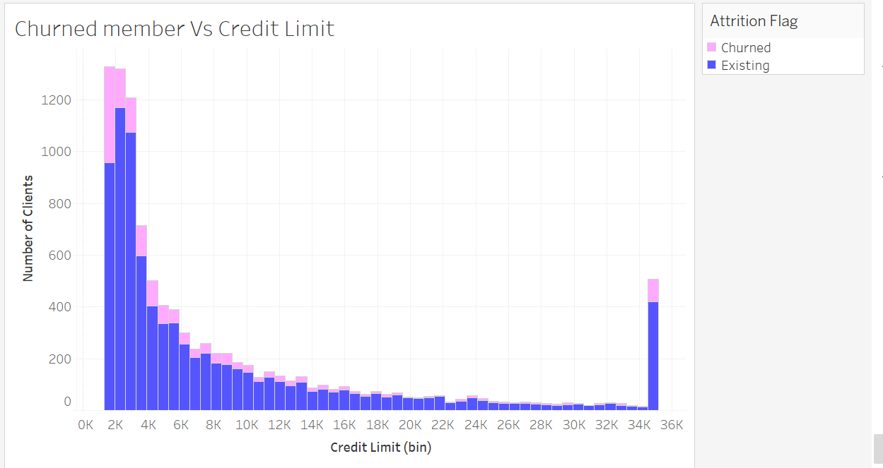
The Churned customers are greater in the lower credit limit and in the highest credit limit of 35k
Notes:
Existing customers are having greater credit limits from low to high (2k to 35k). As per last slide, these customer are mostly aged between 24 and 36. That is,
they are building their credit history and comprehending the required credit limits.
Churned customers, on the other hand, are having lower credit limits on average, except high in the higher credit limit. The reason of higher credit limit in 35k
could be linked with established credit portfolio of these customer who are already mature in their credit history (ages between 40 and 48), but leaving due to better
offer from other banks or financial institutions.

Slide 5
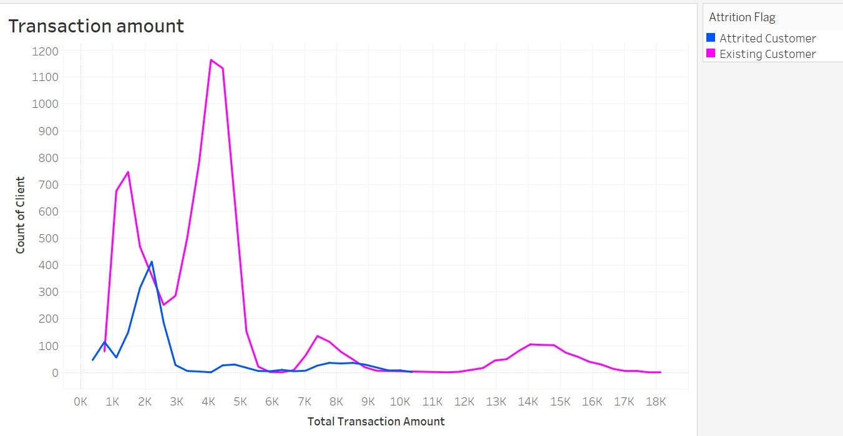
Transaction Amount is less with Attired Customers
Notes:
In congruence of previous slides, existing customers should have more transactions than those of the Attrited customers due to higher
credit limit and spending capacity. As reflected in this slide, churned customers’ transactions are significantly less than that of the existing
customers.

Slide 6
Dashboards
No of Products and Transaction details

Slide 7
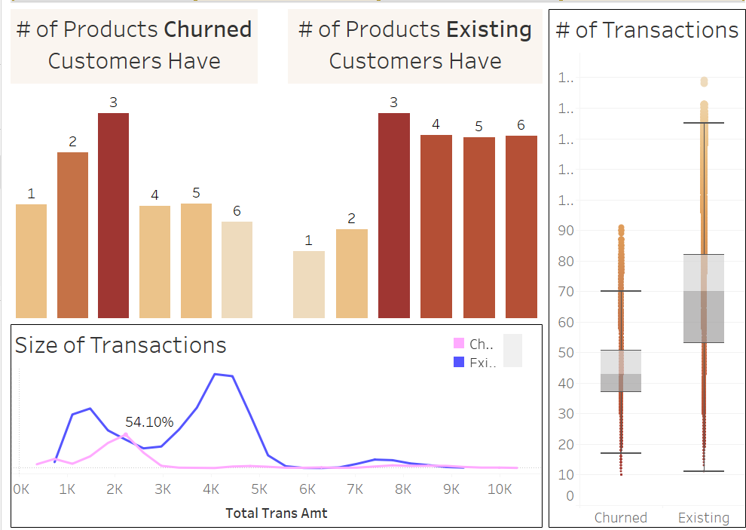
Blue

Slide 8
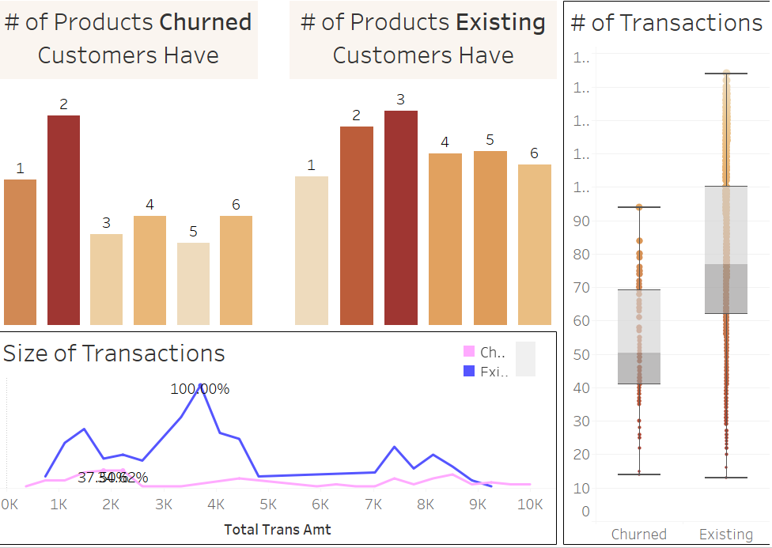
Silver

Slide 9
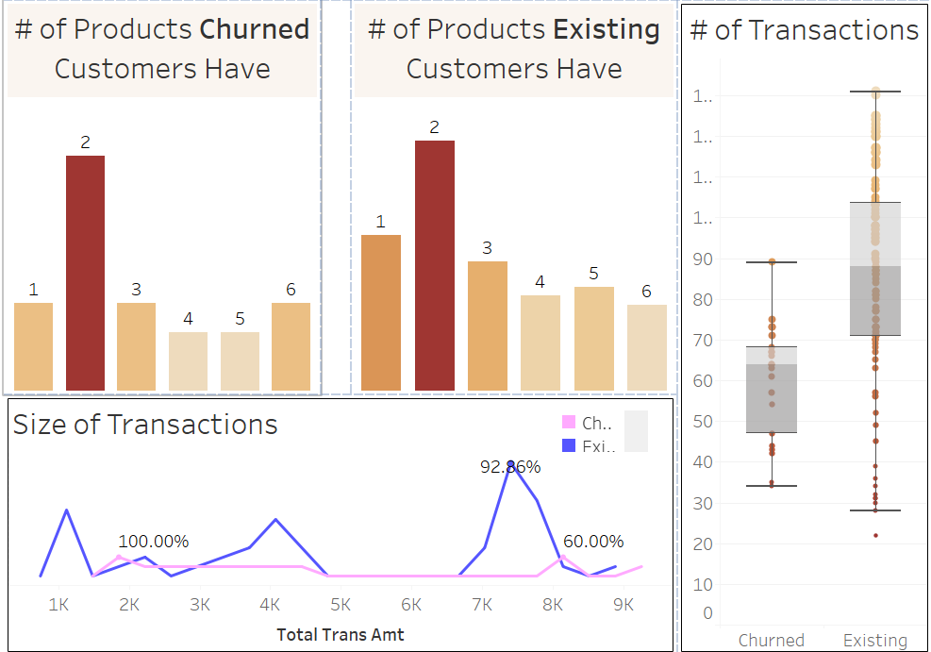
Gold

Slide 10
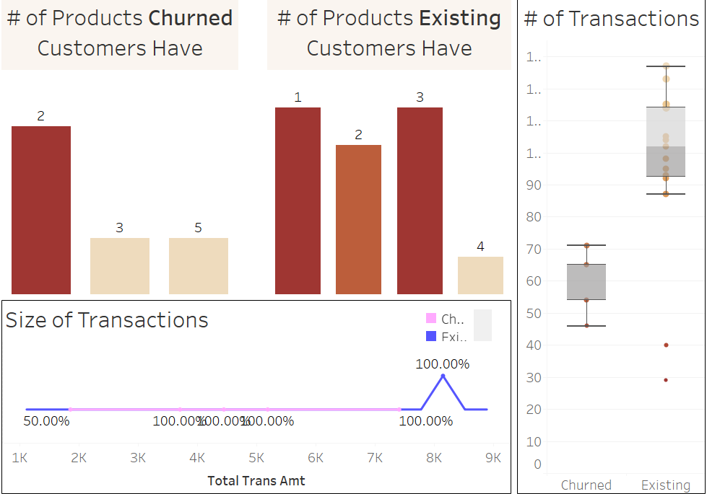
Platinum

Slide 11
Dashboards
Demographics of different type of Card holders

Slide 12
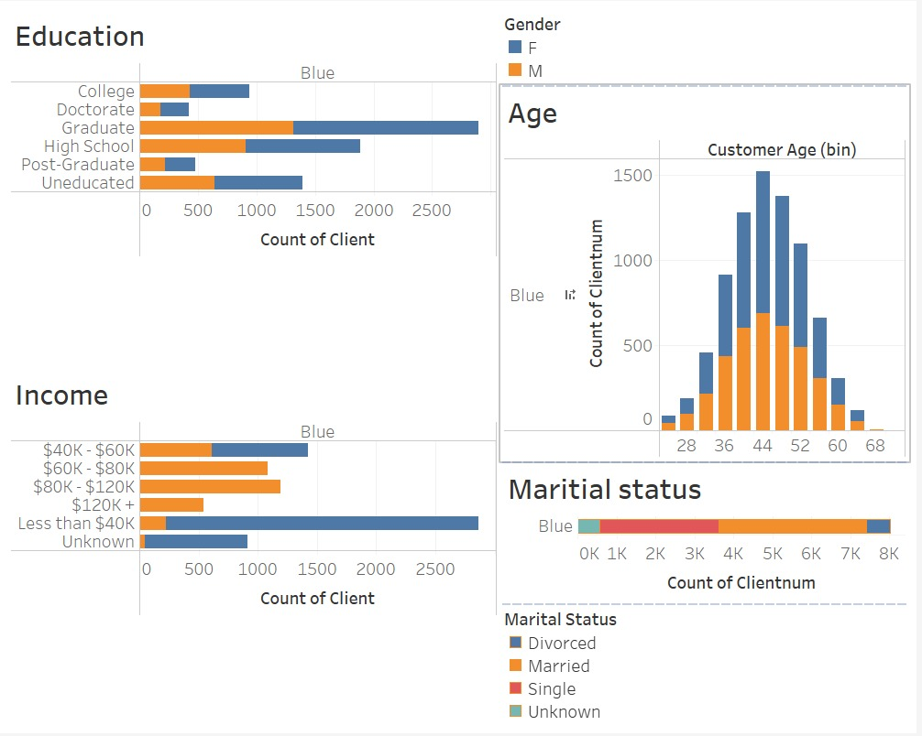
Blue

Slide 13
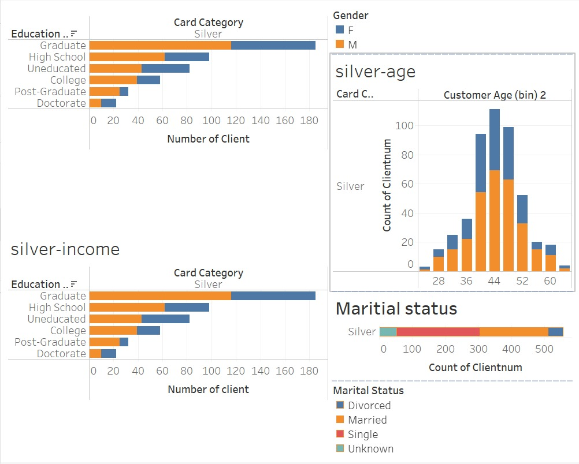
Silver

Slide 14
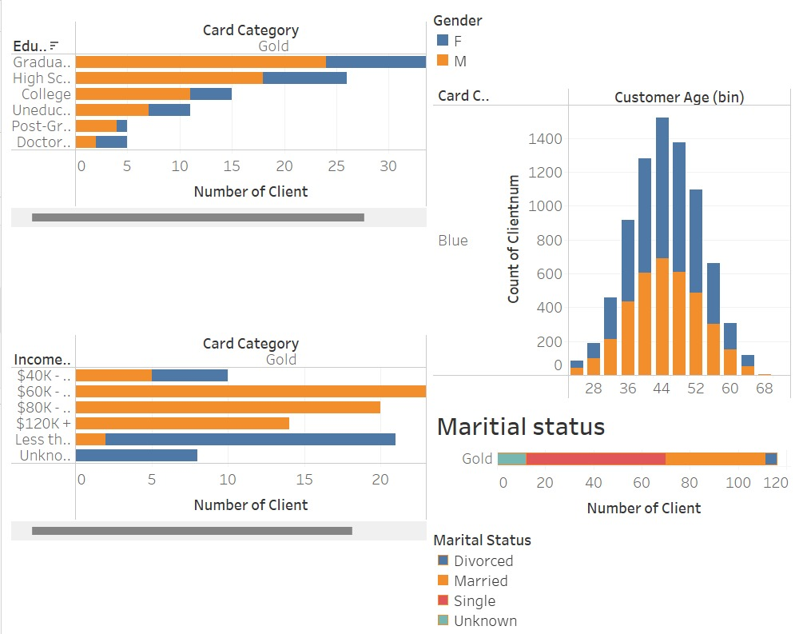
Gold

Slide 15
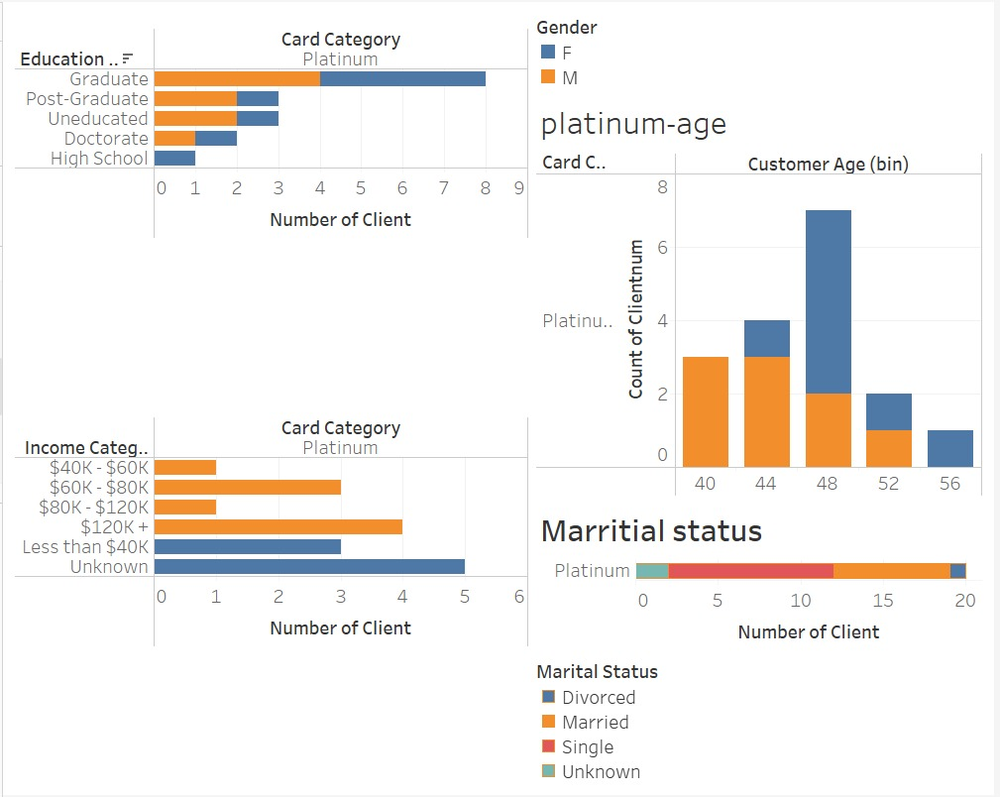
Platinum

Slide 16
Conclusion
Recommendations:
Offer interest-free periods to clients who have lain dormant for more than a month.
Provide rewards program to entice customers with minimal overall spending.
Provide consumers with the risk profile with discounts on further items.
Setbacks:
Inconsistent Data (1,600+ churned customers in 10,000+ total customers in the Dataset)
No matching date/time information
No records are kept of customers' reasons for quitting the bank.

Slide 17

Thank you

