Slide 1
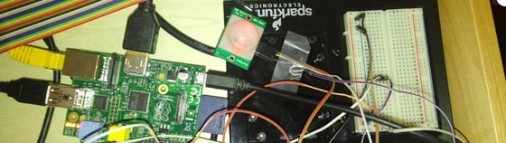
Raspberry Pi Embedded System
Matt Miccio
CPS342

Slide 2
Data Input
Use Raspberry Pi GPIO pins and an open-source Python library.
Reads data from a motion sensor.
Adds data to database each time motion sensor goes ‘high’.

Slide 3
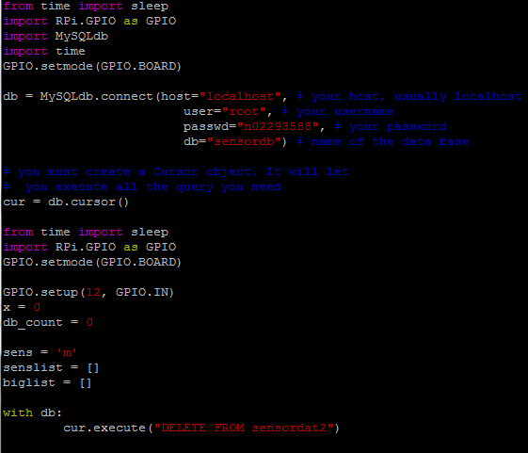
Python Script

Slide 4
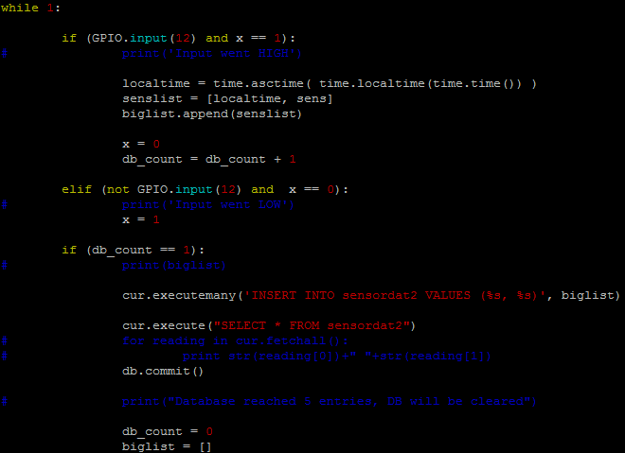
Python script (cont’d)

Slide 5
Putting it on a Website
Run the script, take data, put into database.
PHP file that prints the data as:
[time]: The motion sensor was triggered.
Put the website in a frame on another page, Refresh button to refresh the page in frame and print out new database info.

Slide 6
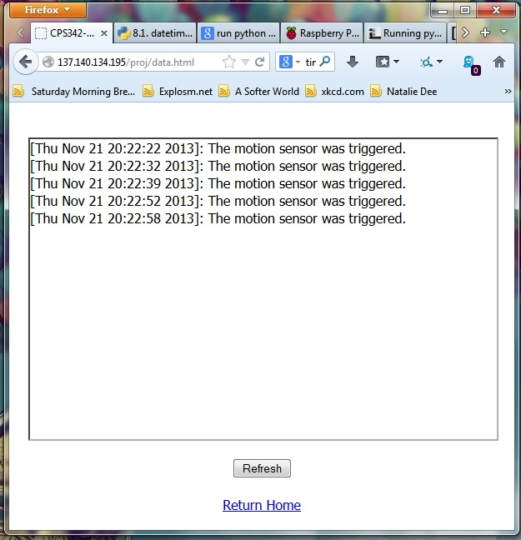

Slide 7
Next steps
Make a more efficient Python script.
CSS/HTML, make the web server better looking.

