Slide 1
Raspberry Pi and Arduino Communication
Matt Miccio
October 18, 2013

Slide 2
Changes from last presentation
No more Xbee Radio
Using PHP and MySQL (now MariaDB)

Slide 3
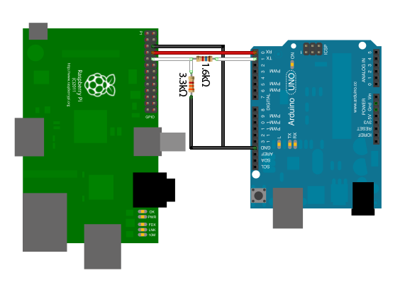
No More Xbee
Connect Arduino and Raspberry Pi through serial communication
Uses same pins and commands as Xbee

Slide 4
PHP
Focusing on learning this and MySQL
Scripting language to use in conjunction with HTML
Using different functions, can connect to a MySQL server to GET and POST data.
Make use of the buffer functions

Slide 5
MySQL
Sets up data in tables.
Data grabbed from Arduino will include the type of sensor that went off (character) and the total number of times the specific sensor went off (integer). Will force date into column.

