Slide 1
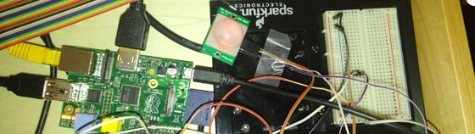
Raspberry Pi Embedded System
Matt Miccio
CPS342

Slide 2
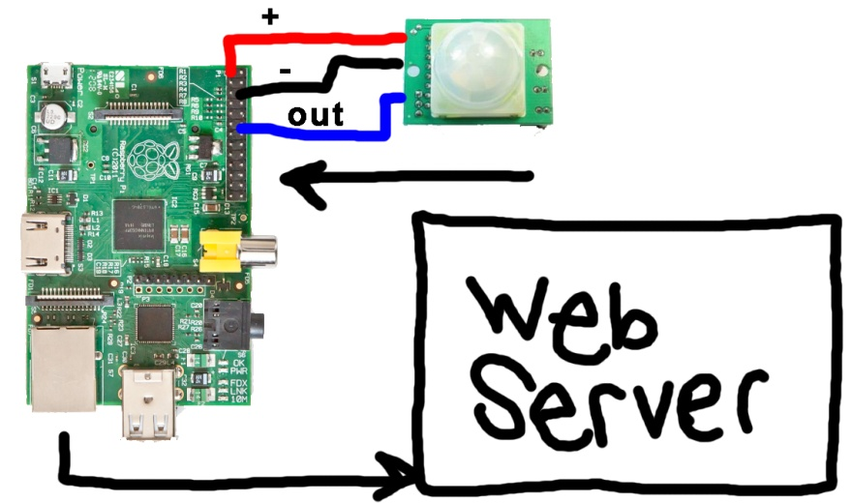
Overall Design
Components:
  Raspberry Pi
  PIR Motion Sensor
Using Raspberry Pi GPIO Pins, send data from Raspberry Pi to a web server.

Slide 3
Procedure
Install necessary packages on Raspberry Pi
Learn PHP and MySQL
Learn about Raspberry Pi’s GPIO Pins
Learn Python and how it interacts with MySQL
Display the motion sensor data.

Slide 4
Setting Up the RPi
L inux – operating system (Arch Linux)
E (nginx) – web server
M ySQL – database system (mariadb)
P HP – scripting language
Other packages:
  git
  links
  python

Slide 5
PHP and MySQL
Set up a database using MySQL
First test:
  Make a table filled with some arbitrary data.
  Display onto webpage as raw data.
  Put data into table.
Final goal – display MySQL data using PHP in an embedded frame on webpage.

Slide 6
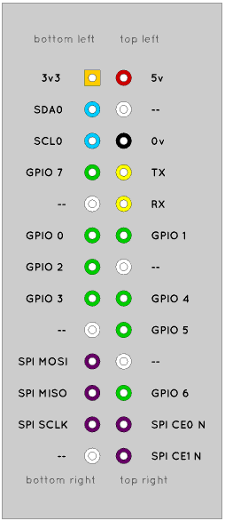
Raspberry Pi GPIO Pins
Install Rpi.GPIO, an open source Python library to control the pins.
First test:
  Print ‘HIGH’ when motion sensor went off.
  Print ‘LOW’ when motion sensor goes off.
Motion sensor stays ‘HIGH’ until motion is no longer detected.

Slide 7
Python and MySQL
Using Python script, add timestamp to a MySQL database any time the sensor goes ‘HIGH’.
Script clears old database information every time it is run.
Executes command to store an array (timestamp, sensor) into database, and commit database.

Slide 8
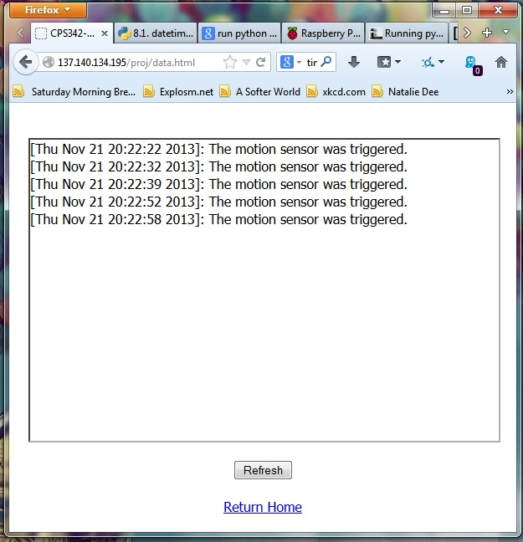
Displaying motion sensor data
Create a webpage that displays the timestamp and the sensor triggered.
Put website in a frame with a Refresh button to manually refresh database.

Slide 9
Problems Encountered
PHP Errors cause a blank page.
  SOLUTION: Add this to top of script:
    ini_set('display_errors',1);
    error_reporting(E_ALL);
  This will instead display the error that occurred.
MySQL is out of date and not supported any longer.
  SOLUTION: Use PDO instead of MySQL.
PythonV2 and PythonV3 support different functions in script.
  SOLUTION: Stick to python2, and run scripts with ‘python2’ instead of ‘python’.

Slide 10
Things Learned
Programming Languages:
  HTML
  PHP / MySQL
  CSS
  Python
Linux Command Line Interface

