Slide 1
Raspberry Pi and Arduino Communication using Xbee Radio
Matt Miccio

Slide 2

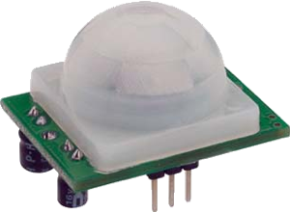
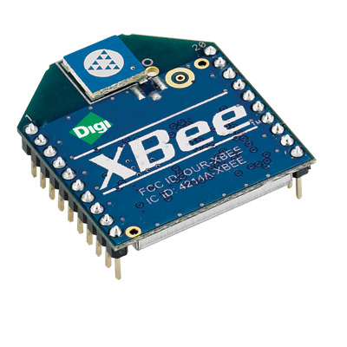
Arduino
Carrying multiple sensors
Connected to an Xbee Radio to transmit data
Send data every second
Sensors include
  Motion
  Sound
  Light
Keeps a count for how often each sensor was triggered.

Slide 3
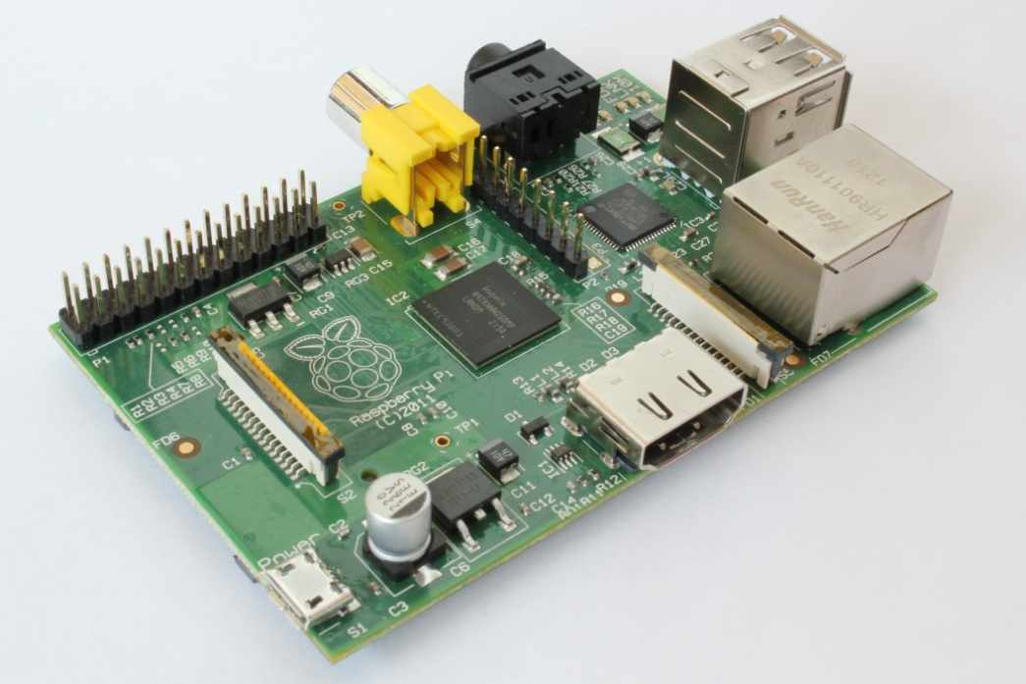
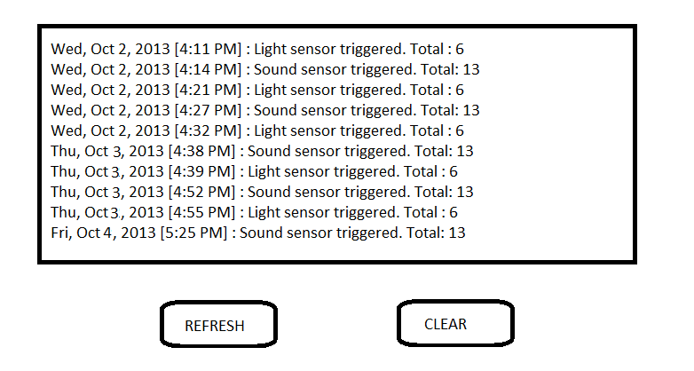
Raspberry Pi
Set up webserver (responsive, HTTP/CSS) using nginx on Arch Linux.
Get data from a radio receiver.
Push data to the webserver.
List which sensor was triggered and at what time.
Refresh button to manually reload webpage with data.
Clear button to reset data.
Show total number of times the specific sensor was triggered.

