Slide 1
Optical Character Recognition and Facial detection
Rob Christenson
Michael Tingey

Slide 2
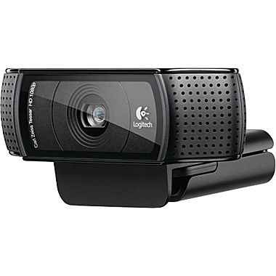
Camera unit
Image capture done with Logitech c920 webcam
Full HD 1080p allows high resolution
20 step auto focus
H.264 image and video encoding
Fully supported by raspbian operating system

Slide 3
Program Overview
Optical Character Recognition (OCR)
Facial detection
Performed using open source computer vision (OpenCV)
Executed via terminal on BeagleBone
C++ program

Slide 4

OpenCV
Has C++, C, Python, and Java interfaces
Supports Windows, Linux, Mac OS, iOS, and Android
More than 47,000 users and estimated number of downloads exceeding 9,000,000
Usage ranges from interactive art, to mines inspection, stitching maps on the web, or through advanced robotics

Slide 5
Program flow

Slide 6
Facial Detection Steps
All code contained entirely in one method (very portable functionality)
After image is taken, it is converted to grayscale from the RGB color space (if not already done so)
The image’s histogram is equalized (to improve detection)
The algorithm that actually detects the faces is a local binary pattern (LBP) cascade
If a face is detected, the user is informed before program termination

Slide 7
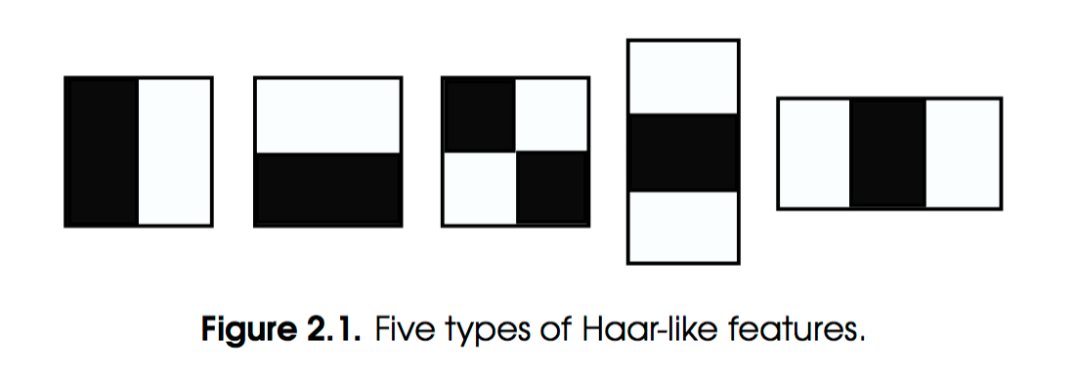
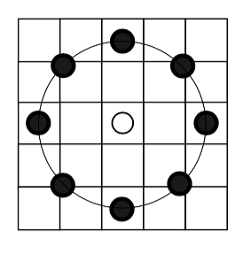
The Mechanics Behind Detecting a Face
Facial Detection is very much associated with the field of machine learning
A classifier must first be “trained” by processing a lot of positive images (images with faces) and a lot of negative images (without faces)
Then, pixel-based features can be extracted from the training materials
HAAR classifiers only gather data from the difference between 2 pixels
LBP classifiers gather data from the eight pixels that surround a target pixel

Slide 8
Optical Character Recognition (OCR) Steps
Image captured
Area with text found
Image cropped to just text
Cropped image turned black and white
OCR performed on resulting image
Text retrieved

Slide 9
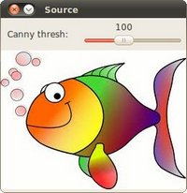
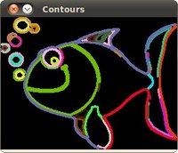
OCR: Image Cropping
OpenCV used for preprocessing
Image converted to grayscale
Contours (edges) in image found
Abrupt changes in brightness indicate a contour in image
Contour approximated to rectangle
Image cropped to approximated rectangle

Slide 10
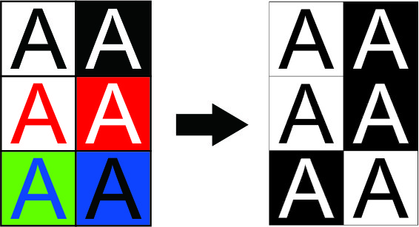
OCR: Preprocessing
Preprocessing done using thresholding
All pixels below a brightness threshold turned black
All pixels above a brightness threshold turned white
Threshold value depends on lighting in image

Slide 11
Performing the OCR
Google’s Tesseract OCR
C++ Application Programming Interface (API)
Image passed to API
Text extracted from image
Text detected returned
Returned text displayed in terminal

Slide 12
Summary
Our project has been eye-opening to the relative ease of harnessing computer vision available to anyone with enough funds for a simple webcam and a Raspberry Pi
This project has really only scratched the surface of what OpenCV is capable of (machine learning, object tracking, 3D reconstruction)
There is still a lot left to research in these areas of computer science, as the technology is not perfect but the advantage for OpenCV is the open-source model, which allows the best minds to contribute
Anyone interested in creating their own OpenCV Pi project can check out GREAT tutorials at http://www.pyimagesearch.com/

