Slide 1

Big Data Machine Learning_02
BUILDING A PREDICTION MODEL
FLIGHT DELAYS
GROUP 01

Slide 2

MEMBER
MSSV
Nguyễn Trí Dũng
20133029
Nguyễn Khoa Quang Thắng
20133090
Trương Gia Vỷ
20133115
Lê Huy Hoàng
20133044

Slide 3
I. INTRODUCING THE TOPIC
The topic "Analyzing historical flight data to build a model to predict whether a flight will be delayed or not" is an important field in data analysis and machine learning. Using historical data on flights, the goal is to build a model that predicts the probability of a flight being delayed
Some questions arise
- What factors are closely correlated to each other that affect the delay?
- What factors have a strong impact on delay?

Slide 4
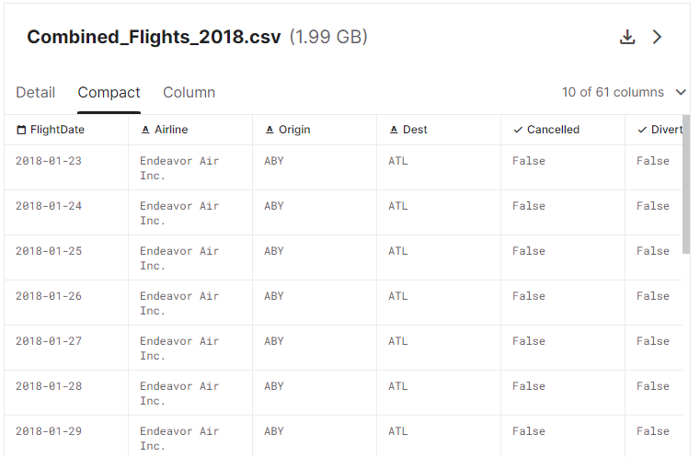
II. DATASET, INPUT, OUTPUT
Historical data of flight information around the world from January 2018
(4078318 rows, 47 columns)
Source – Kaggle: https://www.kaggle.com/code/robikscube/flight-delay-exploratory-data-analysis-twitch/notebook

Slide 5
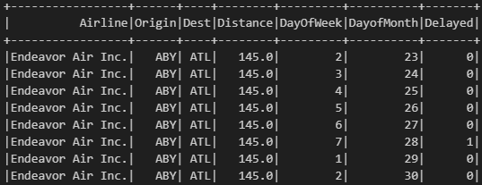
II. DATASET, INPUT, OUTPUT
INPUT:
- Airline
- FlightNumber
- DepTime: 1202 (12h02p)
- ArrTime: 1402 (12h02p)
- Distance: 145 (km)
- OriginAirport
- DestAiport
- DayOfWeek
- Month
…
OUTPUT: Delayed (Với những chuyến bay có thời gian hạ cánh ArrDelay >= 15 phút)

Slide 6
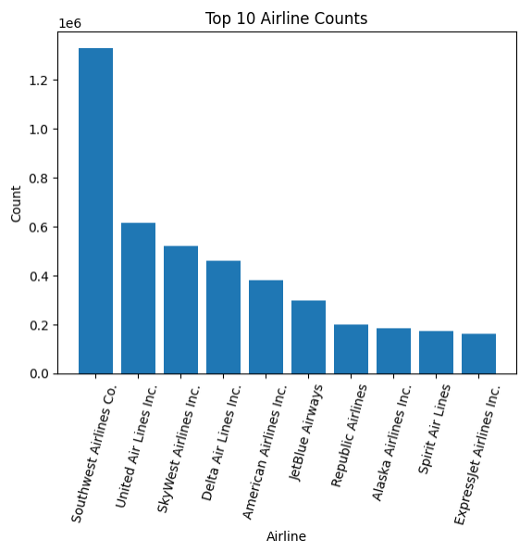
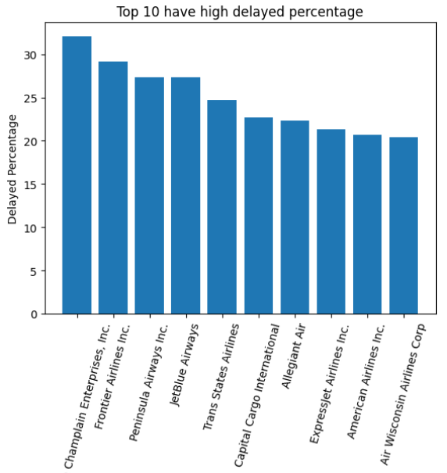
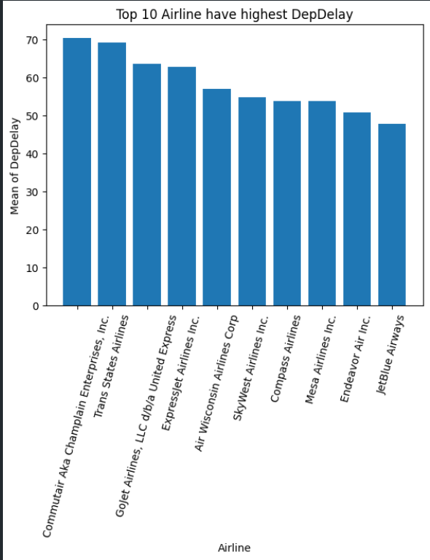
III. KẾT QUẢ PHÂN TÍCH

Slide 7
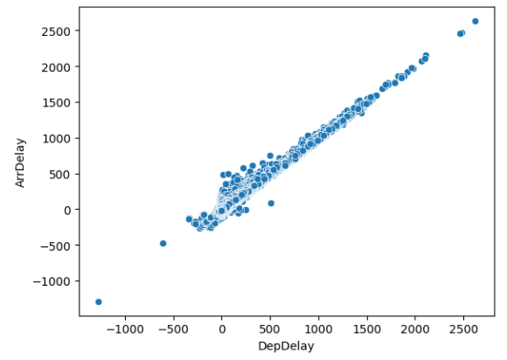
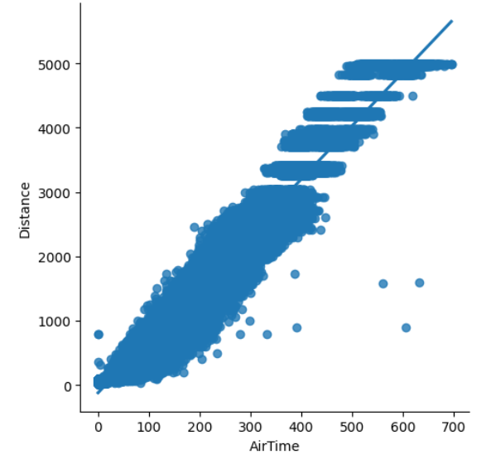
III. KẾT QUẢ PHÂN TÍCH

Slide 8
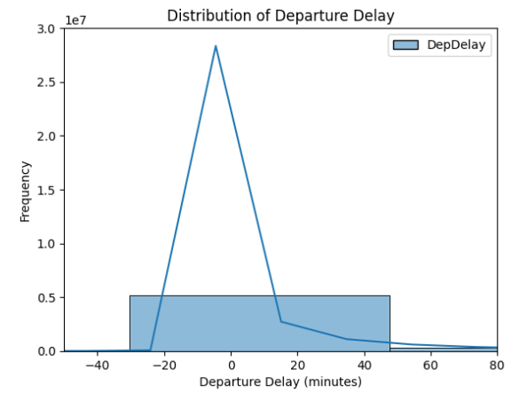
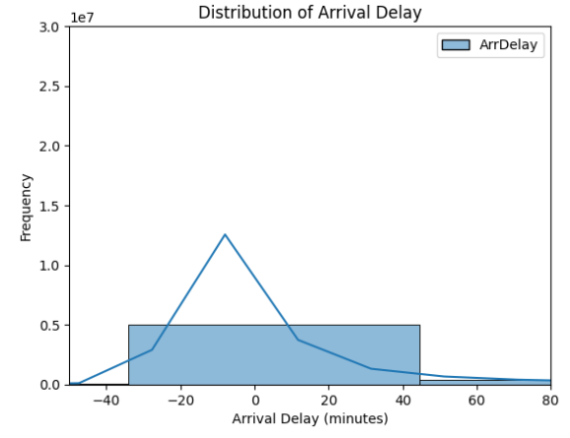
III. KẾT QUẢ PHÂN TÍCH

Slide 9
IV. MODEL
ALGORITHM | BEFORE OPTIMIZATION | SUPER PARAMETER | AFTER OPTIMIZATION
Decision tree | accuracy: 0.6962562307773889 f1: 0.5751618196018272 precision: 0.5979510596924563 recall: 0.696256230777389 | maxDepth: 12 minInstancesPerNode: 5 maxBin: 400 | accuracy: 0.6864990985258246 f1: 0.5802294658485619 precision: 0.5735570657330947 recall: 0.6864990985258246
Logistic Regression | accuracy: 0.6973167886308198 f1: 0.5729639946572906 precision: 0.48625070370639945 recall: 0.6973167886308198 | regParam: 0.1 elasticNetParam: 0.1 | accuracy: 0.6973167886308198 f1: 0.5729639946572906 precision: 0.48625070370639945 recall: 0.6973167886308198
Random forest | accuracy: 0.6969986212747905 f1: 0.5728099412388911 precision: 0.4861835279950932 recall: 0.6969986212747905 | maxDepth: 15 numTrees: 5 | accuracy: 0.6958320076360165 f1: 0.5762838227720252 precision: 0.6000581937700639 recall: 0.6958320076360165
Naive Bayes | accuracy: 0.5940184537066497 f1: 0.5962549617720538 precision: 0.5986518359718374 recall: 0.5940184537066497 | smoothing: 0.1 | accuracy: 0.5955032347014529 f1: 0.5979146592650929 precision: 0.6005162149442512 recall: 0.5955032347014529

Slide 10
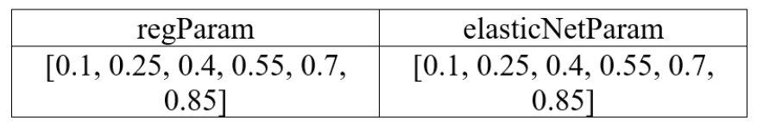
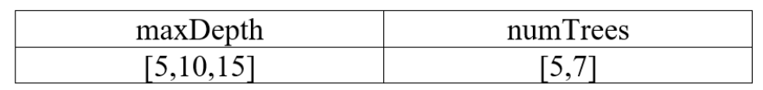

V. EXPERIMENT AND EVALUATION
Experiment: Using cross-validation
Decision tree:
Logistic Regression:
Random forest:
Naive Bayes:

Slide 11
V. EXPERIMENT AND EVALUATION
Evaluate:
- Regarding optimization:
According to the team, the Decision Tree algorithm is not really optimized, because after passing hyperparameters, the Decision Tree measures decrease instead of improving.
Logistic regression has measures that remain the same after passing the hyperparameters, because the initial hyperparameters are the most optimal compared to the parameters passed later.
Random forest has a slight increase in F1 measure, precision increases sharply. Model optimization is considered successful.
Naive Bayes increased slightly in all indicators. Therefore, the model optimization is considered successful.

Slide 12
VI. CONCLUSION AND DEVELOPMENT DIRECTION
Conclude:
The team decided to choose the Random Forest model after optimization as the best model because Accuracy, Precision, and Recall are mostly higher than the remaining models.
Development:
- Optimize the model by passing more hyperparameters.
- Test more other algorithms.
- Improve the data set for the following years such as 2019, 2020, 2021, ...

Slide 13
VII. CONTRIBUTION AND PLANNING
Thành viên | Công việc
Nguyễn Trí Dũng | Chuẩn bị, làm sạch data. Thực nghiệm và đánh giá mô hình. Kết luận và hướng phát triển.
Nguyễn Khoa Quang Thắng | Tìm hiểu lý thuyết về phần đánh giá mô hình. Làm powerpoint. EDA: Trực quan hoá dữ liệu.
Trương Gia Vỷ | Tìm thuật toán tối ưu. Tìm hiểu lý thuyết về phần học máy. Tìm hiểu nguồn gốc tập dữ liệu. EDA: Nhận xét biểu đồ.
Lê Huy Hoàng | Tìm và phát ra nguồn dữ liệu cho đề tài. Kiểm thử và đánh giá mô hình, tập hợp kết quả đánh giá. Làm powerpoint.

Slide 14
VIII. REFERENCES
Flight-Delay-prediction using Spark : https://www.kaggle.com/code/gunashankars/flight-delay-prediction-project-using-pyspark/notebook
…
Dataset: https://www.kaggle.com/code/robikscube/flight-delay-exploratory-data-analysis-twitch/notebook

Slide 15
THE END

