Slide 1



Final Project
R For Analysis – Instructor: Quach Dinh Hoang
Group 2:
Nguyen Khoa Quang Thang– 20133090
Nguyen Tri Dung – 20133029
Le Minh Dang - 20133034

Slide 2





Content
01
Introduce Dataset
02
Options for project
02
Reasons and interesting things
03
03

Slide 3

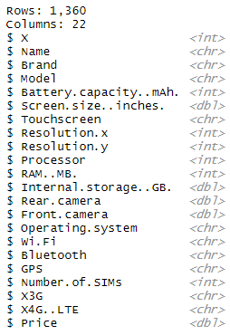
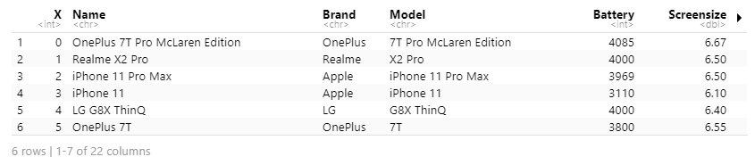
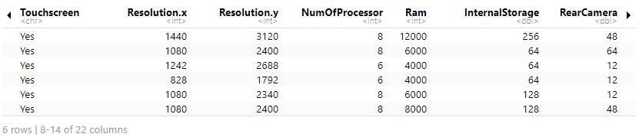
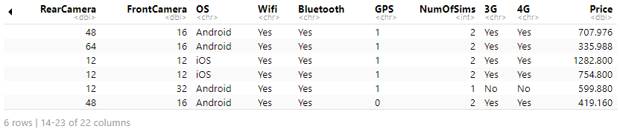
1. Introduce Dataset:
Glimpse

Slide 4
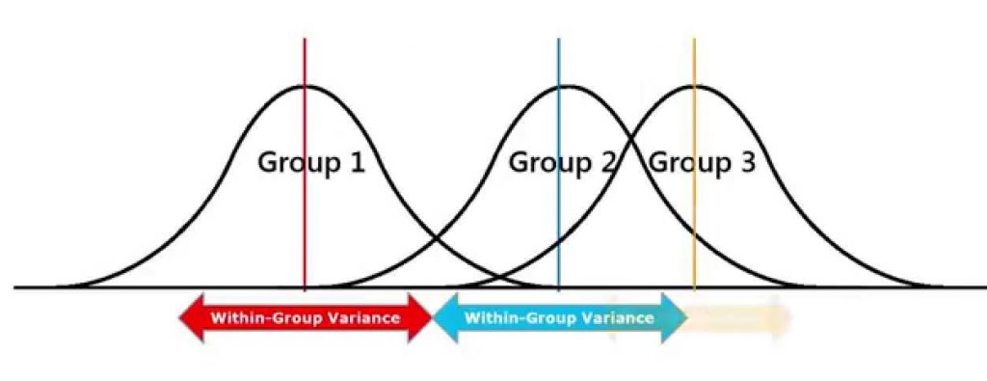
2. Options for project
- Analysis Tool:
For nominal and continuous variable:
+ Brand: Apple, Asus, Realme,…
+ Operating system: Android, IOS,…
One-way ANOVA F-test

Slide 5



2. Options for project
- Analysis Tool:
One-way ANOVA F-Test for Operating System:
+ H0: there is no difference between mean phone’s price with difference OSs
+ H1: there is difference between mean phone’s price with difference OSs
Pr(>F) is very small (< 0.05)
-> reject H0

Slide 6
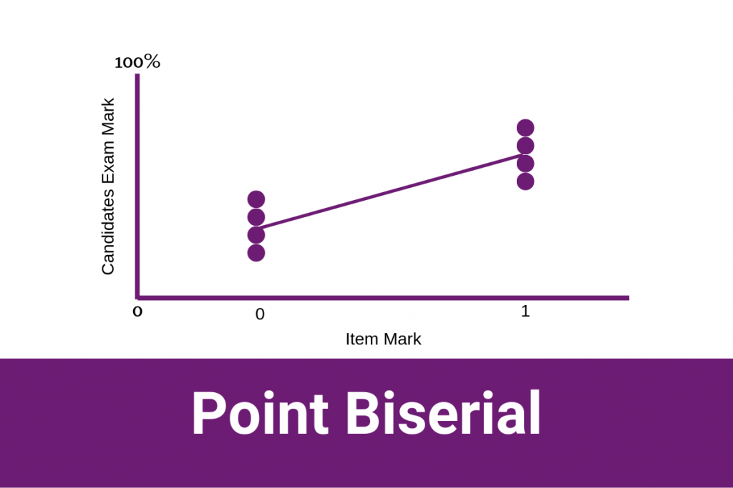
2. Options for project
- Analysis Tool:
For binary and continuous variable:
+ GPS: Yes, No
+ 3G: Yes, No
+ TouchScreen: Yes, No

Slide 7


2. Options for project
- Analysis Tool:
Point Biserial for 4G:
+ H0: there is no linear relationship between 4G and price
+ H1: there is a linear relationship between 4G and price
Cor != 0
-> reject H0

Slide 8
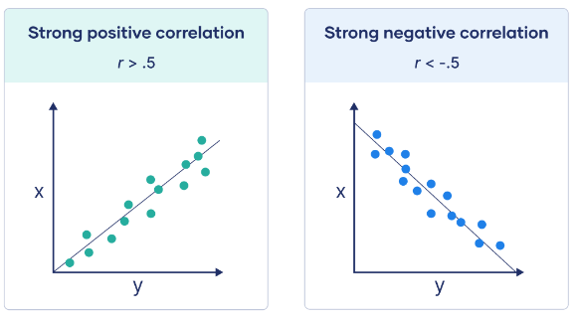
2. Options for project
- Analysis Tool:
For two continuous variables:
+ Battery Capacity: 3000, 3200,… (mAh)
+ Screensize: 6.1, 6.5,… (inch)
+ Ram: 0.5, 1, 2, 4,… (GB)
+ Internal storage: 8, 16, 32,… (GB)
…
Pearson Correlation

Slide 9


2. Options for project
- Analysis Tool:
Pearson for RAM:
+ H0: there is no linear relationship between RAM and price
+ H1: there is a linear relationship between RAM and price
Cor != 0
-> reject H0

Slide 10
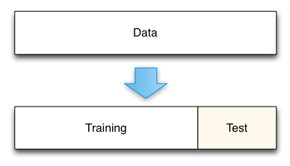
2. Options for project
- Algorithms and functions for data modeling:
Spilit Dataset into 2 parts:
+ training_data: uses for generating regression model
+ testing_data: model predicts result based on testing_data input

Slide 11
2. Options for project
- Algorithms and functions for data modeling:
* We use half of the data as the training set and the other half as the testing data

Slide 12
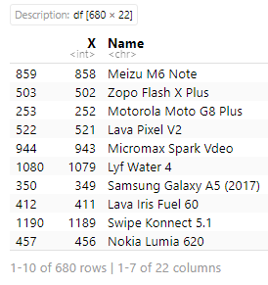
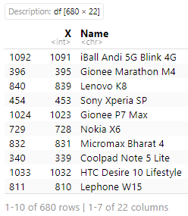
2. Options for project
- Algorithms and functions for data modeling:
680 rows of train_data
680 rows of test_data

Slide 13
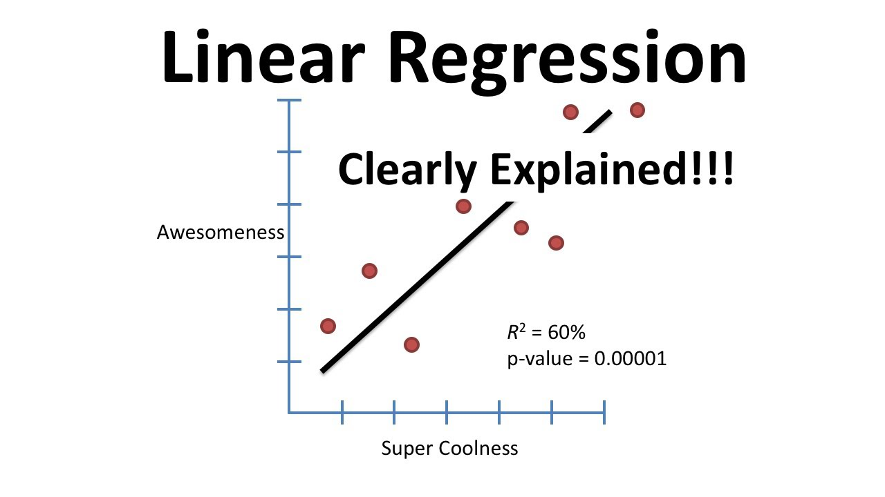
2. Options for project
- Algorithms and functions for data modeling:
Supported functions in R:
+ lm(): generates a regression model
+ predict(): predicts values based on the input data
+ t.test(): computes a confidence interval for the desired confidence level
Linear Regression Algorithm

Slide 14
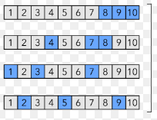

2. Options for project
- Algorithms and functions for data modeling:
Repeated Holdout
Cross-Validation
* Compute confidence interval of mean difference between the predicted and measured price $

Slide 15
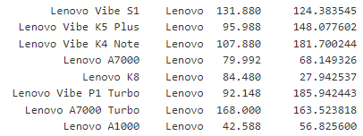





2. Options for project
- Algorithms and functions for data modeling:
Regression Model for All Phones
Regression Model for each Brands
MSE on train
MSE on train
MSE on test
MSE on test
* Both models are over-fitting

Slide 16


2. Options for project
- Algorithms and functions for data modeling:
Mean error
Mean error
Regression Model for All Phones
Regression Model for each Brands
* Left is better than Right

Slide 17
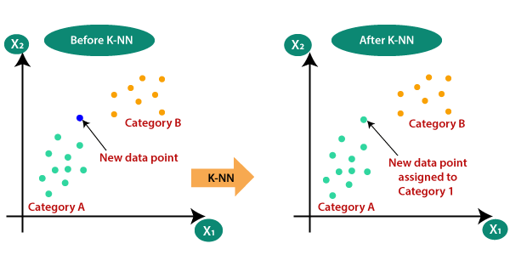
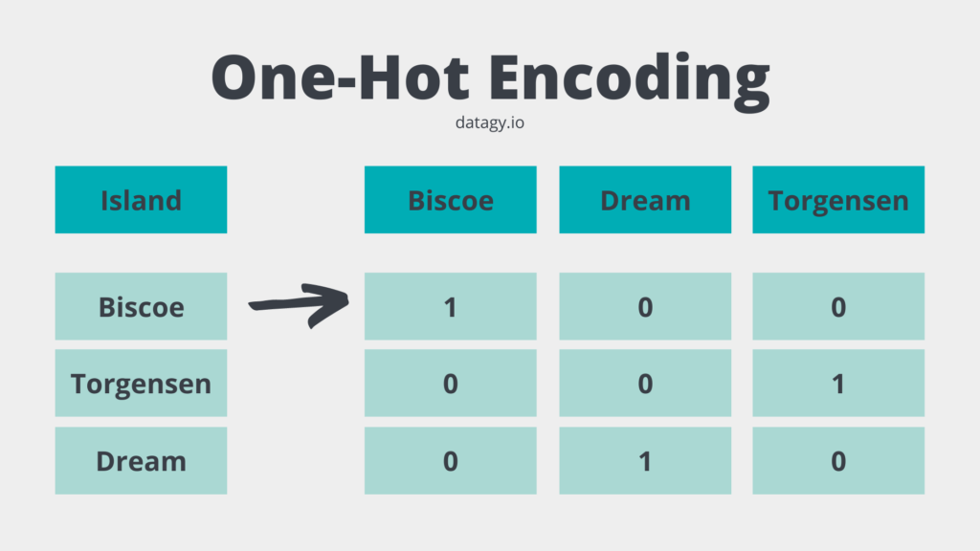
2. Options for project
- Algorithms and functions for data modeling:
KNN

Slide 18


2. Options for project
- Algorithms and functions for data modeling:
Regression Model for All Phones
K – Nearest Neighbors
MSE on train
MSE on train
MSE on test
MSE on test
KNN and regression model for all phone have the same mean error.
KNN is better than Regression Model for All Phones

Slide 19
3. Reason and interesting things
- Reasons:
+ Build a model for predicting price by phone’s informations
+ Compare between traditional model and machine learning model
We realize machine learning model is better than traditional model
New phones are more expensive than predicted price of model because they’re new

