Slide 2
Powershell basic scripting we will start at 9:00 AM…
Jan Marek | Cyber Rangers
CEH | CHFI | CompTIA Pentest+ | CEI | MVP | MCT | MCC | MCSA | MCSE
Ethical Hacker, Forensic Investigator & Security Engineer
jan@cyber-rangers.com | www.cyber-rangers.com

Slide 3
Powershell basic scripting module 0: course introduction
Jan Marek | Cyber Rangers
CEH | CHFI | CompTIA Pentest+ | CEI | MVP | MCT | MCC | MCSA | MCSE
Ethical Hacker, Forensic Investigator & Security Engineer
jan@cyber-rangers.com | www.cyber-rangers.com

Slide 4
whoami
Jan Marek
Co-founder, Ethical Hacker and Forensic Investigator | Cyber Rangers
Trainer | GOPAS
Cyber Security Engineer | KPCS CZ
Pentesting, red teaming, engineering, training,…
CompTIA Pentest+, CEH, CHFI, CEI, eJPT, Microsoft MVP, MCC, MCSE, …
Working with PowerShell since 2008, wrote more than 11 millions lines of code

Slide 5
What are your expectations?
What do you want to learn? What’s your current knowledge?

Slide 6
facilities
Training hours
Meals
Phones & Messages
Online presence
Please mute
Would be great to see you, but not required
Ask questions directly or “Raise your hand”
Focus on the training content
Practice, practice, practice

Slide 7
Audience and requirements
Already experienced in Windows administration
Want to automate their everyday work and/or enhance their administration skills
No previous experience or knowledge of PowerShell
Entry level training for everyone

Slide 8
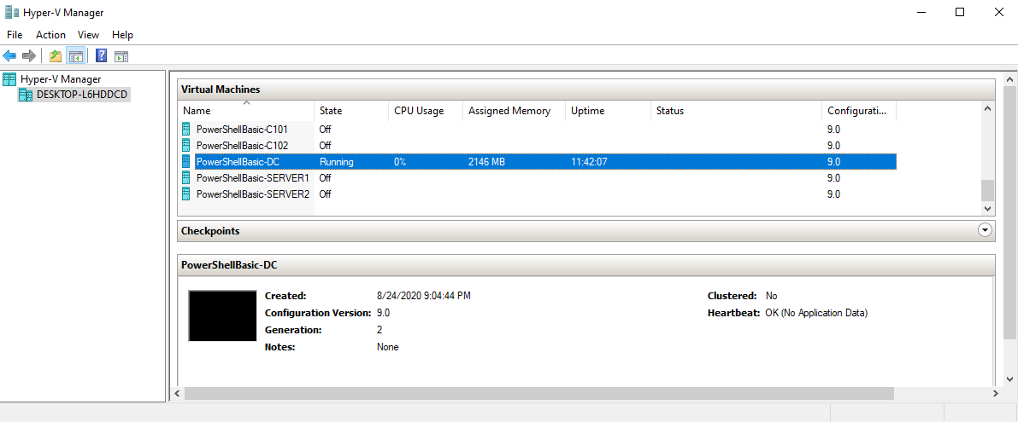
Course materials
PowerPoint slides
Scripts
Lab
Microsoft Hyper-V

Slide 9
Course content
Module 1: PowerShell Introduction
Module 2: PowerShell Pipeline
Module 3: PSDrives and PSProviders
Module 4: PowerShell Remoting
Module 5: PowerShell and WMI
Module 6: Background Jobs and Scheduled Jobs
Module 7: Scripting prerequisites
Module 8: From oneliner to script
Module 9: Functions and modules

Slide 10
Related courses
PowerShell – Advanced Techniques (3 days)
PowerShell – Security (2 days)

Slide 11
Powershell basic scripting module 0: course introduction
Jan Marek | Cyber Rangers
CEH | CHFI | CompTIA Pentest+ | CEI | MVP | MCT | MCC | MCSA | MCSE
Ethical Hacker, Forensic Investigator & Security Engineer
jan@cyber-rangers.com | www.cyber-rangers.com

