Slide 2
Powershell basic scripting module 1: powershell introduction
Jan Marek | Cyber Rangers
CEH | CHFI | CompTIA Pentest+ | CEI | MVP | MCT | MCC | MCSA | MCSE
Ethical Hacker, Forensic Investigator & Security Engineer
jan@cyber-rangers.com | www.cyber-rangers.com

Slide 3
agenda
What is PowerShell
How to run PowerShell on Windows, Linux and MacOS
How to find needed commands and help for these commands
Some examples of very useful cmdlets
Console and Script Editors
PowerShell Profile

Slide 4
What is powershell
Scripting engine and scripting language
Windows integrated
Application integrated
Cloud integrated
Automation and administration

Slide 5
How to run PowerShell on Windows, Linux and MacOS
Windows
Windows PowerShell [built-in]: powershell.exe
PowerShell (6) Core [installation required]: pwsh.exe
PowerShell 7 [installation required]: pwsh.exe
Linux
PowerShell 7 [installation required]: pwsh
MacOS
PowerShell 7 [installation required]: pwsh

Slide 6
Commands, cmdlets, parameters
Cmdlet vs. command vs. function vs. …
Parameters
Positional
Named
Required
Optional

Slide 7
How to find needed commands and get help
http://docs.microsoft.com
Get-Command
Get-Command -Name *service*
Get-Command -Verb get
Update-Help
Update-Help -Module dism
Save-Help -Module dism -DestinationPath C:\temp
Update-Help -SourcePath C:\temp
Get-Help
Get-Help -Name Get-Service
Get-Help -Name Get-Process -Online
Get-Help About_Pester

Slide 8
alias
Get-Alias
Get-Alias -Definition Get-ChildItem
New-Alias -Name psdir -Value Get-ChildItem

Slide 9
Some examples of very useful cmdlets
# Verb-Noun
Out-File
Get-Service
Get-Process
Get-EventLog
Get-WinEvent -LogName Application -MaxEvents 10
Get-Volume
Get-Disk
Get-ADUser -Filter *
Set-Service -Name Spooler -StartupType Automatic
Get-Certificate
Get-DnsClientCache
Get-NetRoute
Get-NetIPAddress
New-NetIPAddress -InterfaceAlias Ethernet -IPAddress 10.0.0.1 -PrefixLength 24 -DefaultGateway 10.0.0.254
And so and so…

Slide 10
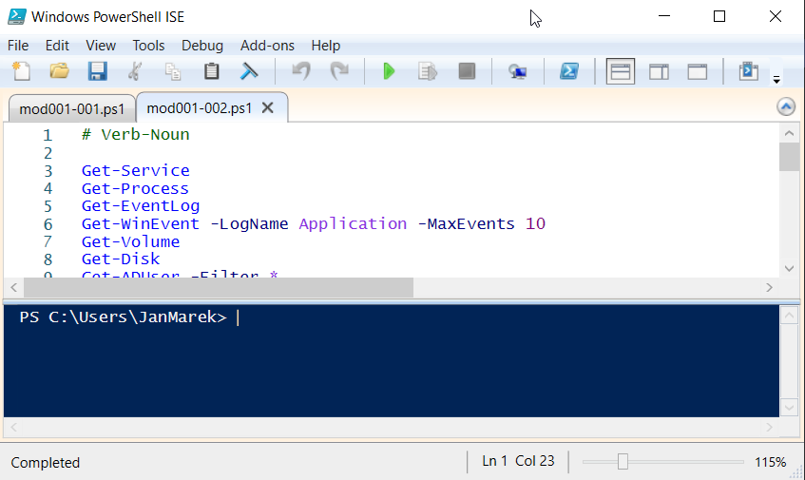
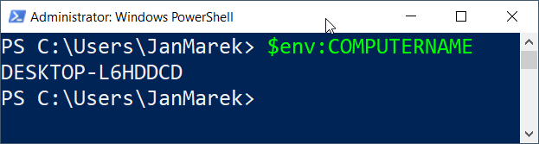
Console and script editors (1/3)

Slide 11
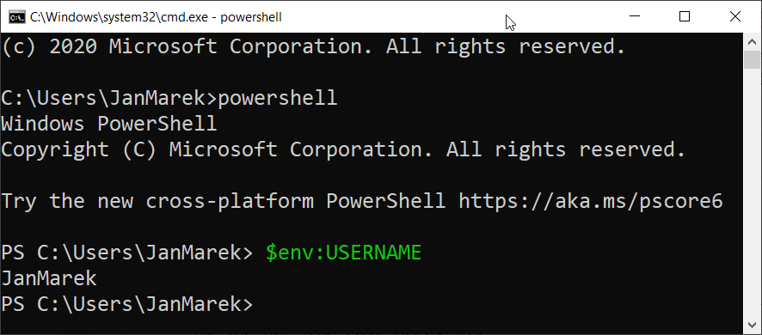
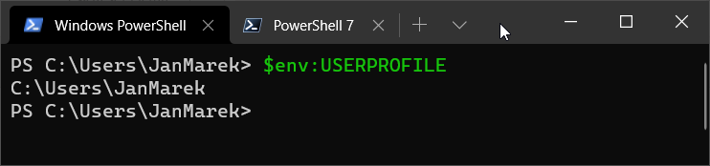
Console and script editors (2/3)

Slide 12
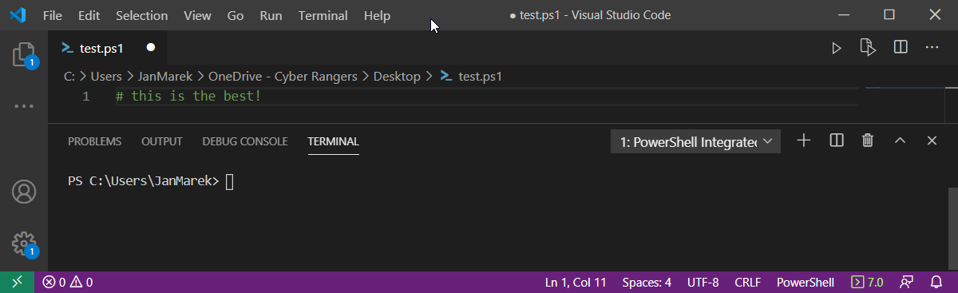
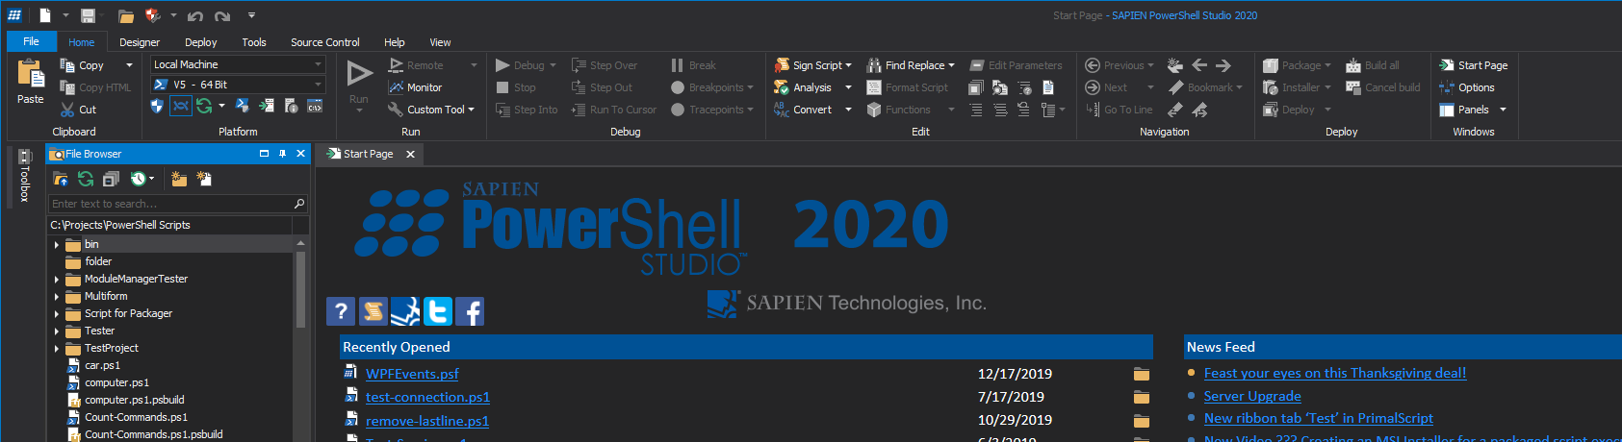
Console and script editors (3/3)

Slide 13
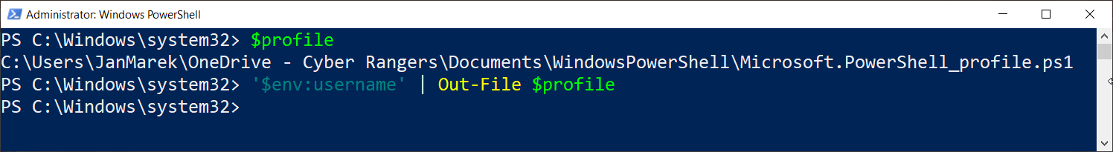
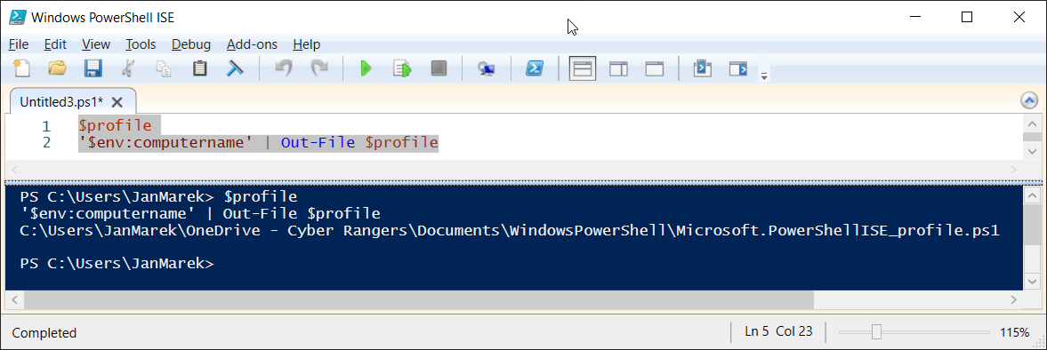
Powershell profile

Slide 14
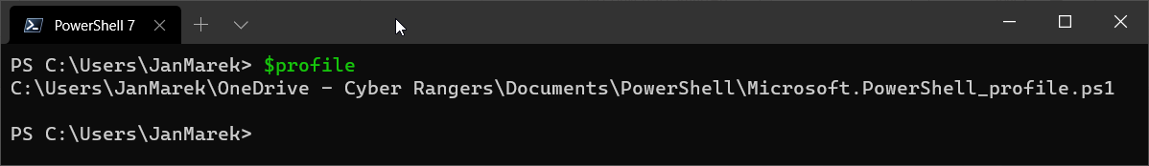
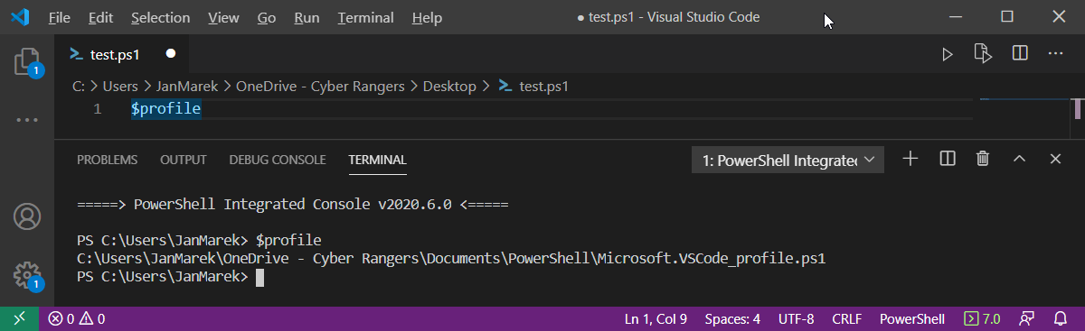
Powershell 7 profile

Slide 15
Powershell 101
Strings (single quotes vs double quotes)
'text'
"text"
Escape character
Get-Command `
-Verb Get `
-Noun Service
Comments
#this is comment
<# this is block
comment
#>
Tab key, shorten parameters Get-Command -na get-help

Slide 16
Find commands
Find help
Use found commands
Create your own PowerShell profile

Slide 17
Powershell basic scripting module 1: powershell introduction
Jan Marek | Cyber Rangers
CEH | CHFI | CompTIA Pentest+ | CEI | MVP | MCT | MCC | MCSA | MCSE
Ethical Hacker, Forensic Investigator & Security Engineer
jan@cyber-rangers.com | www.cyber-rangers.com

