Slide 2
Powershell basic scripting module 2: powershell pipeline
Jan Marek | Cyber Rangers
CEH | CHFI | CompTIA Pentest+ | CEI | MVP | MCT | MCC | MCSA | MCSE
Ethical Hacker, Forensic Investigator & Security Engineer
jan@cyber-rangers.com | www.cyber-rangers.com

Slide 3
agenda
How does pipelining in PowerShell work
How to use pipeline to sort, select, group, filter and enumerate objects
Various options of cmdlet outputs

Slide 4
How does pipelining in PowerShell work (1/2)
Commands run in pipeline
Commands separated by the pipe (|)
Left to right execution
First command output piped to next command
Output produced as object(s) => Get-Process | Get-Member
Object
Property
Collection
Pipeline output “stored” in variables
$_
$PSItem

Slide 5
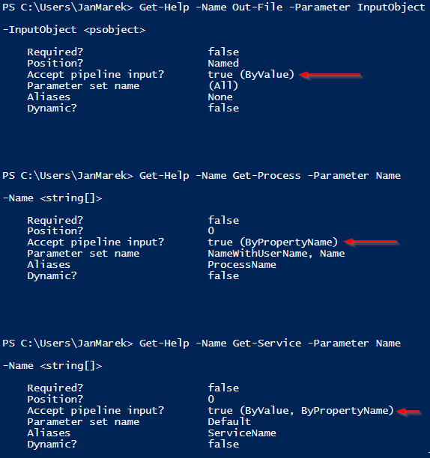
How does pipelining in PowerShell work (2/2)
Commands accept input only from one parameter
Two parameter binding types
ByValue (always tried first)
ByPropertyName (if ByValue fails)

Slide 6
Pass data byvalue
Get-Service -Name 'spooler'
'spooler' | Get-Service

Slide 7
Pass data bypropertyname
Get-Process -Name 'spoolsv' | Stop-Process
Get-Volume -DriveLetter 'C' | Optimize-Volume -Analyze

Slide 8
Parenthetical processing
'notepad' | Out-File 'C:\Temp\mod002-t1.txt'
Get-Process -Name (Get-Content 'C:\temp\mod002-t1.txt’)
Add-ADGroupMember -Identity 'Czech Users' -Members `
(Get-ADUser -Filter {City -eq 'Prague'})

Slide 9
Calculated property
Get-Process | Select-Object –Property Name,@{n='ComputerName';e={$env:COMPUTERNAME}}
Get-Process | Select-Object -Property Name,`
@{n='Virtual Memory [MB]';e={$_.virtualmemorysize/1MB}}
Get-History | Select-Object commandline, `
@{n='ExecTime';e={$_.EndExecutionTime - $_.StartExecutionTime}} | `
Sort-Object -Property ExecTime
@{name=‘Name of custom property’;expression={scriptblock for calculation}}
@{name=‘’;expression={}}
@{n=‘’;e={}}

Slide 10
Object processing
Sort
Get-Process | Sort-Object -Property Name -Descending
Select
Get-Process | Select-Object -Property Name,ID
Get-Process | Select-Object -Property Name -Unique
Get-Process | Select-Object -ExpandProperty Name
Get-Process | Select-Object -First 4
Get-Process | Select-Object -Property * -ExcludeProperty Id
Group
Get-Process | Group-Object -Property Name

Slide 11
Object processing
Filter
Get-Process -Name 'conhost'
Get-Process | Where-Object -Property Name -EQ -Value 'conhost'
Get-Process | Where-Object {$_.Name -eq 'conhost’}
Enumerate
Get-Process | ForEach-Object {Write-Host "Process name is $($_.name)"}
Get-ChildItem -Path 'C:\Temp\ToEncrypt' | ForEach-Object {$_.Encrypt()}
Get-ChildItem -Path 'C:\Temp\ToEncrypt' | ForEach-Object -MemberName Encrypt

Slide 12
Output formatting
Get-Process | Format-Table -Property Name,Id
Get-Service | Format-Table -Property Name,DisplayName,Status -AutoSize -Wrap
Get-Process | Format-List -Property *
Get-Process | Format-Wide -Property id

Slide 13
Output processing
Get-Process | Out-File 'C:\Temp\processes1.txt'
Get-Process | Out-Host -Paging
Get-Process | Out-Printer -Name 'MyPrinter1'
Get-Process | Out-GridView
Get-Process | Out-GridView -Title 'Processes' -PassThru | Out-GridView
Get-Process | ConvertTo-Csv | Out-File 'C:\temp\processes2.csv'
Get-Process | Export-CSV 'C:\temp\processes2.csv' -Delimiter "`t"
Get-Process | Select-Object -f 1 -Property name,id | ConvertTo-Json
Get-Process | Select-Object -f 3 -Property name,id | `
ConvertTo-Html -Title 'Processes' -PreContent (Get-Date) | `
Out-File 'C:\temp\processes.htm'

Slide 15
Powershell basic scripting module 2: powershell pipeline
Jan Marek | Cyber Rangers
CEH | CHFI | CompTIA Pentest+ | CEI | MVP | MCT | MCC | MCSA | MCSE
Ethical Hacker, Forensic Investigator & Security Engineer
jan@cyber-rangers.com | www.cyber-rangers.com

