Slide 1
Feeling Work
Race, Geographic, Gender, and Mood in Blue-Collar Narratives

Slide 2
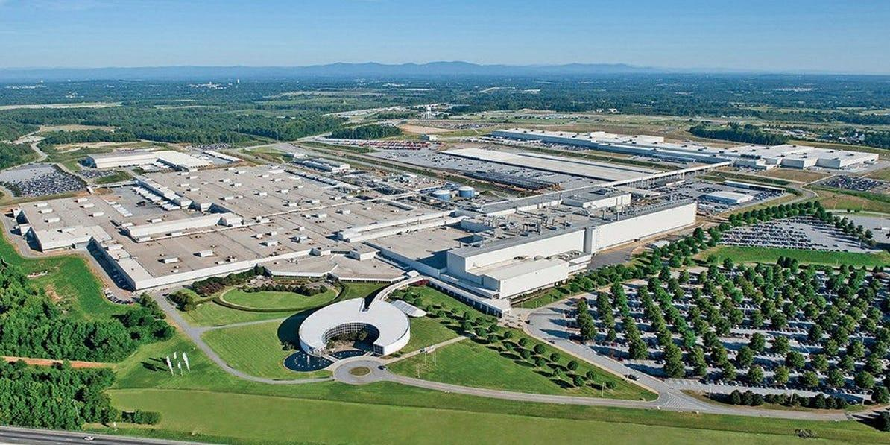
Notes:
While I was working as an intern in the factory, I realized how differently work is lived depending on what’s at stake. At one point, the person supervising me asked if I had kids. I laughed, because I was twenty-one.
But afterward, that question stayed with me. It made clear that for me, the factory was temporary, while for others it’s tied to long-term responsibility, risk, and survival. That gap helped me understand how labor decisions that seem technical from the outside are shaped by life circumstances that rarely enter the official record.

Slide 3
Research Goals
Analyze labor through race, place, gender, and mood
How these factors shape visibility and value
How work is experienced differently across lives
Treat culture and lived experience as historical evidence
Literature, images, oral history, and memory
Rethink blue-collar work beyond economics
Not only wages, productivity, or job titles
Attention to feeling, routine, and lived constraint
Examine power, erasure, and the archive
Who gets recorded as a worker
What types of labor and lives disappear
Notes:
My goal is to rethink blue-collar work not just as economic labor, but as a cultural and emotional archive. I look at how power shapes what gets recorded about work and what gets erased, and I develop a framework that reads labor through race, geography, gender, and collective mood. Finally, I argue that literature, culture, and lived experience function as real historical evidence, especially where official records fall short.”

Slide 4
How I Read Blue Collar Narratives
Archive & erasure (Hartman)
Absence, fragments, and power in historical records
Culture & imagination (Kelley)
Pleasure, creativity, and political possibility
Collective mood & feeling (Flatley)
Exhaustion, pressure, and shared emotional life
Notes:
I organize the paper around three thinkers whose work provides both a method and a vocabulary for reading blue-collar narratives. Drawing on Saidiya Hartman’s Wayward Lives, Beautiful Experiments and her essays on archival absence, I examine how blue-collar work is often preserved only through fragments, statistics, or disciplinary records, while the interior lives of workers are systematically excluded. Hartman’s method of critical fabulation allows me to treat archival silence not as a lack of evidence, but as evidence of the power structures that determine whose lives are considered worth recording.
Robin D. G. Kelley’s Race Rebels and Freedom Dreams shift my focus from absence to presence by foregrounding culture, pleasure, and imagination as central to working-class life. Kelley demonstrates how music, everyday practices, and collective creativity generate meaning and political possibility even under conditions of constraint, enabling me to read blue-collar narratives not solely as records of exploitation, but as sites of dignity, community, and futurity.
Finally, Jonathan Flatley’s Affective Mapping provides a way to analyze how labor produces shared moods rather than simply individual emotions. Flatley’s theory of collective affect helps me understand exhaustion, pressure, and pride as socially produced conditions that circulate through workplaces and communities, rather than as personal psychological states.
Together, these approaches allow me to read blue-collar narratives as cultural archives shaped by race, geography, gender, and affect—archives that preserve what official records often flatten or erase.

Slide 5
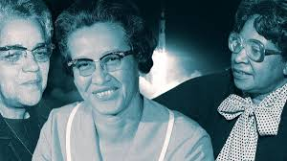
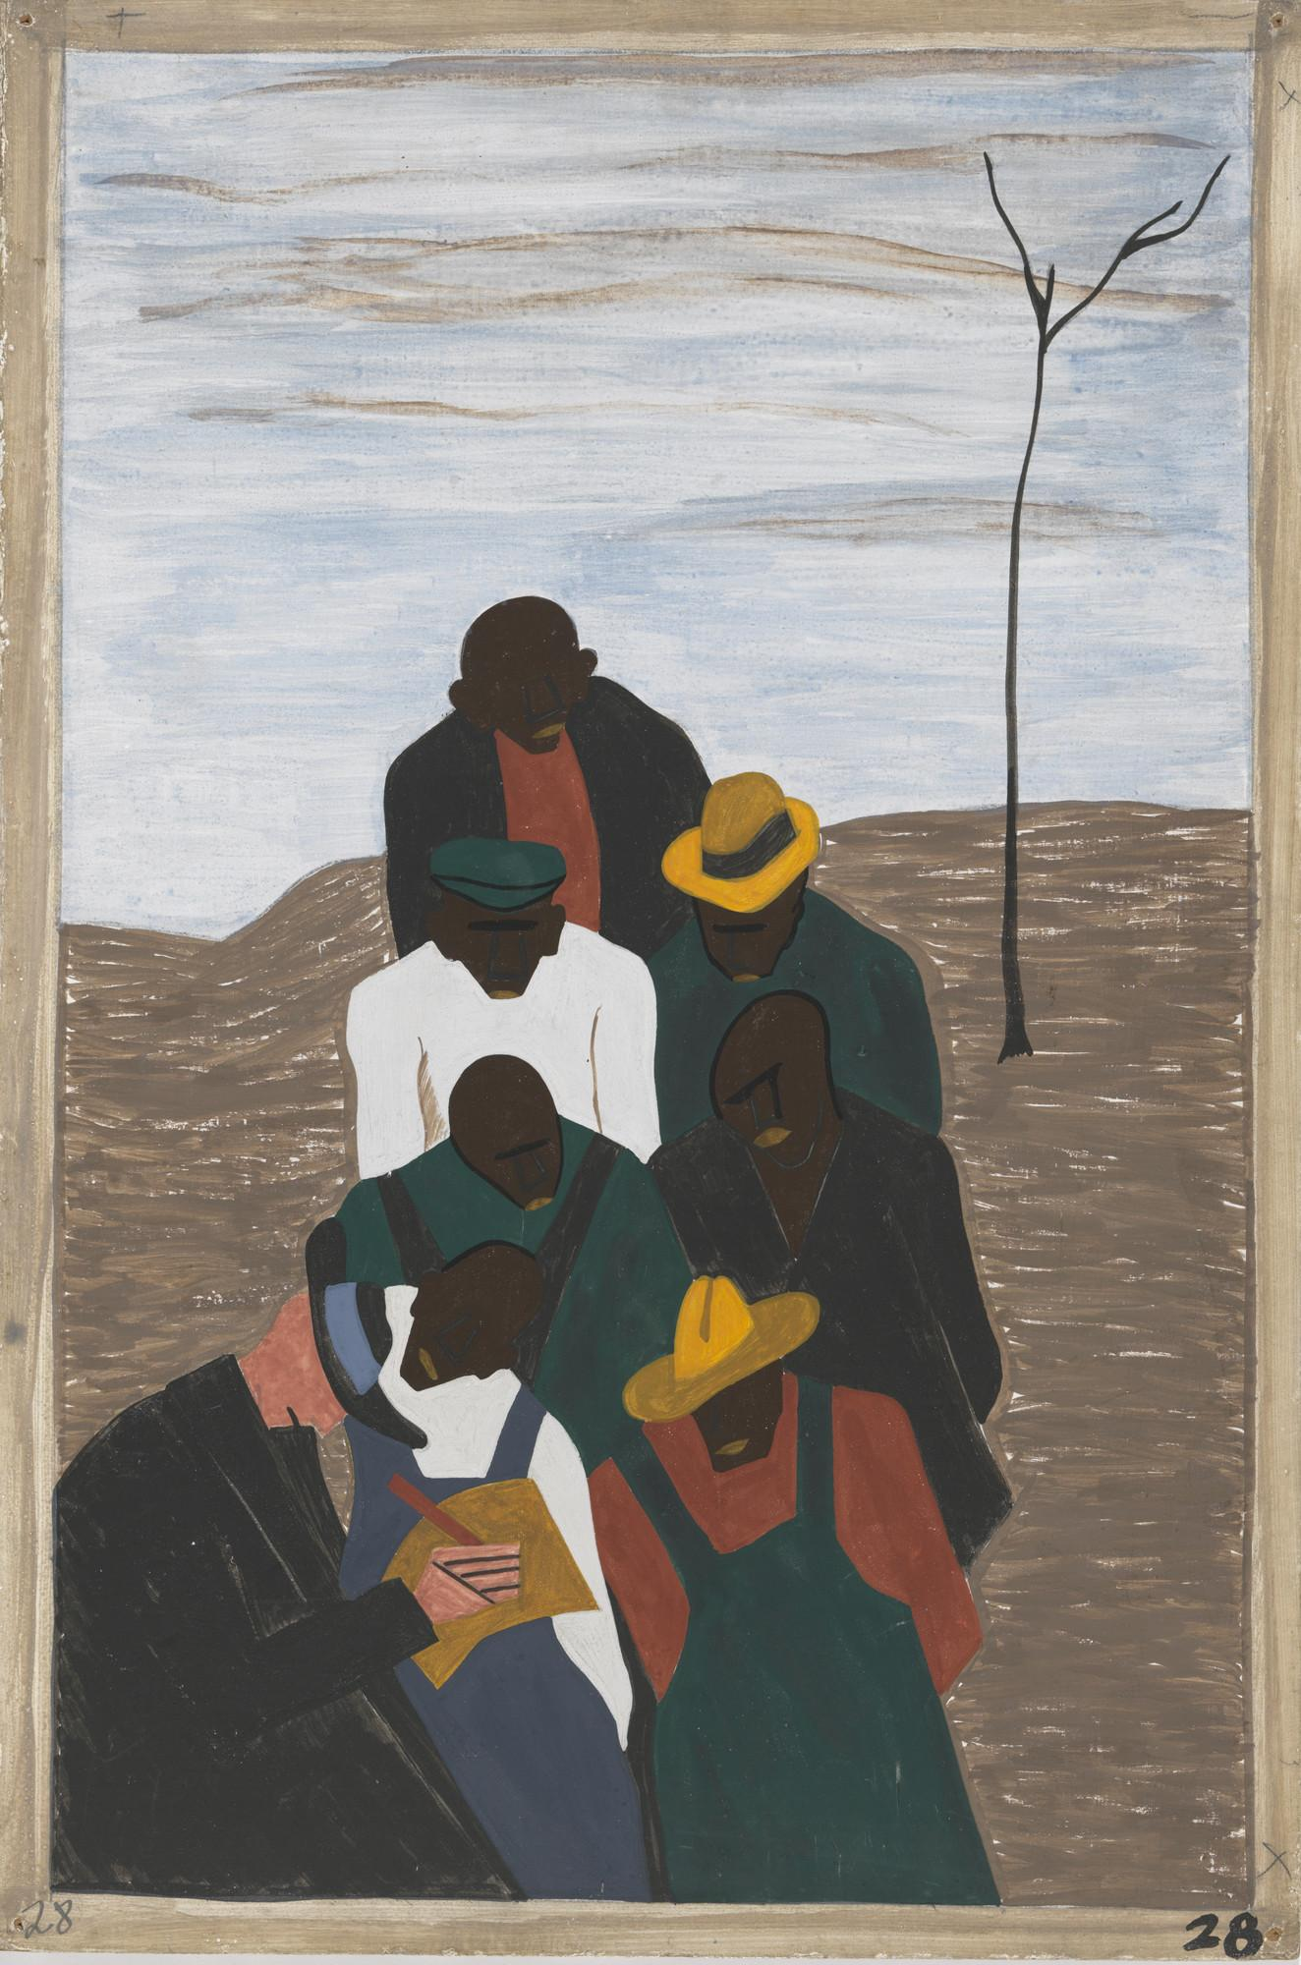
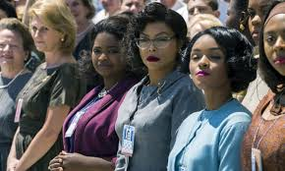
Personal Escape - Migration Series
Critical Fabulation - Hidden Figures
Notes:
This slide brings together the two ways race shapes blue-collar labor in the archive.
On the left, we see Black women whose labor was essential but historically minimized. Their work survived, but their inner lives and presence were largely erased. This reflects what Saidiya Hartman calls archival absence — not the absence of evidence, but the absence of care in recording certain lives.
On the right, Jacob Lawrence’s Migration Series shows how Black labor is also preserved collectively, rather than individually. Migration is presented not as personal escape, but as organized labor movement shaped by industrial demand and racial constraint.
Together, these images show how racialized labor oscillates between invisibility and collective representation, rather than full recognition as individual historical subjects.

