Slide 1





Hear My Thoughts
Helping deaf people
L E A R N

Slide 2

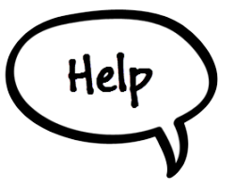
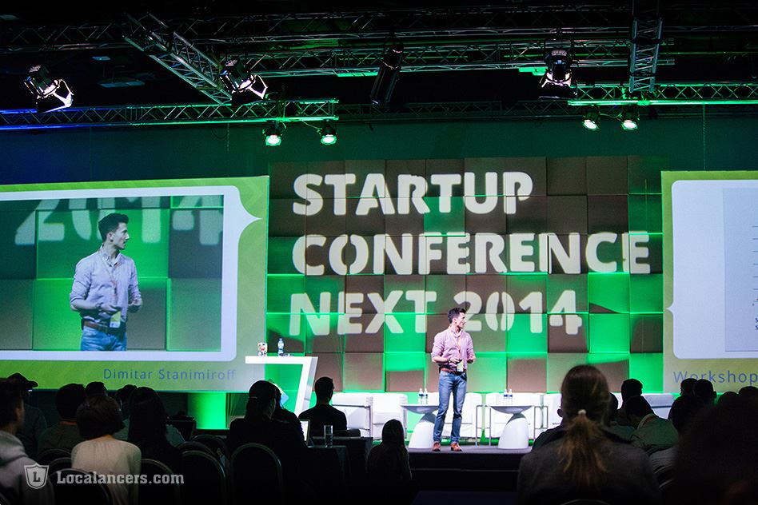
the Idea

Slide 3

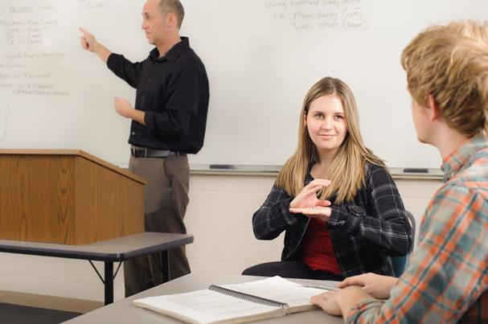
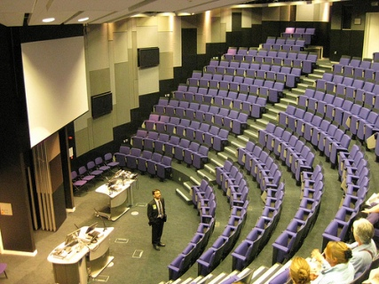
Universities
Expectations
Reality

Slide 4
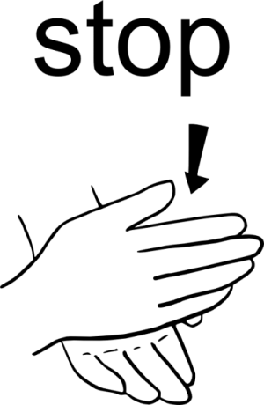
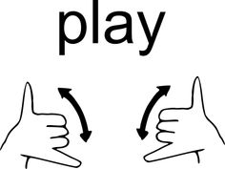

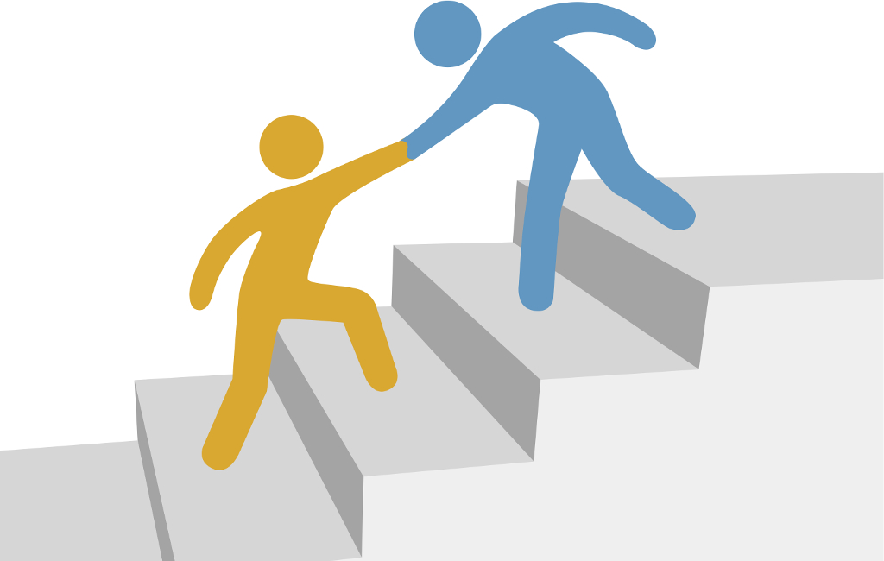
How to help?
TRANSLATIONS
WORDS

Slide 5
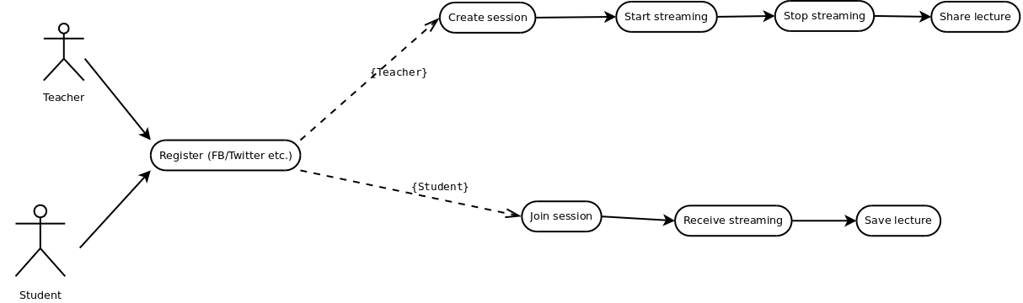


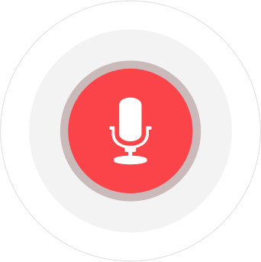
App diagram
(Next trimester)

Slide 6
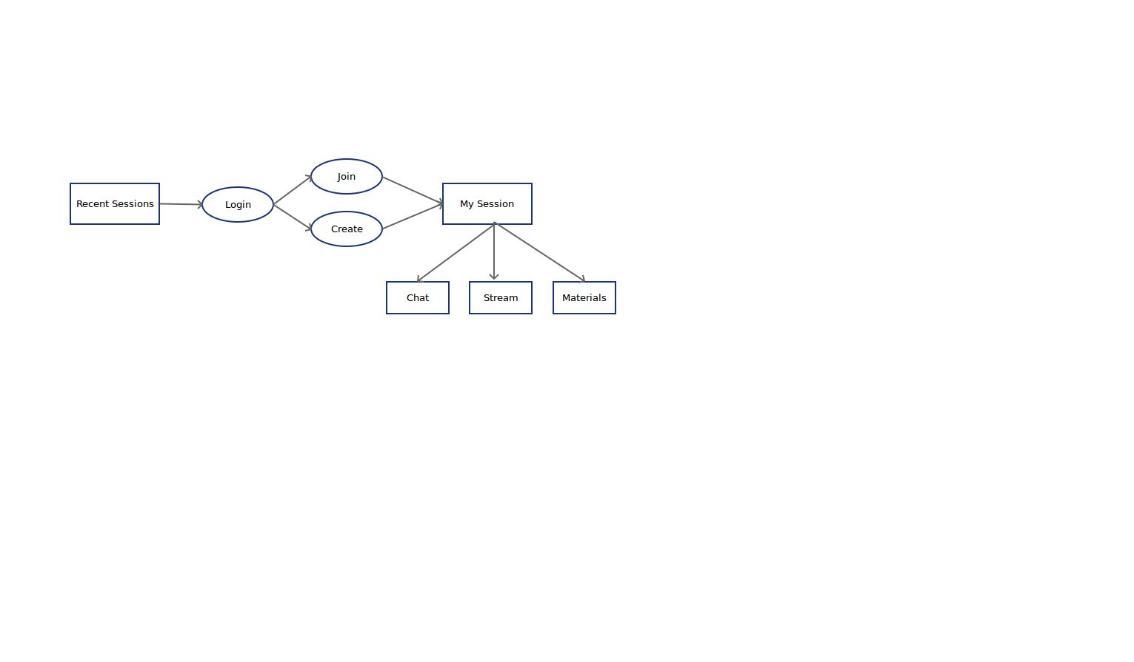





Screens

Slide 7
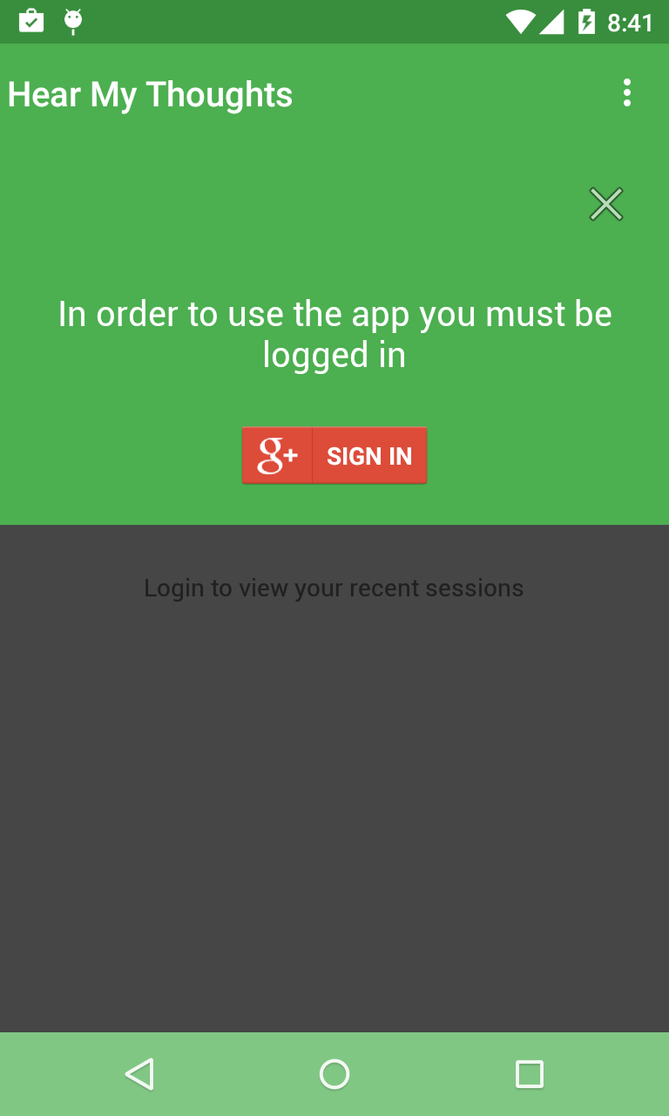
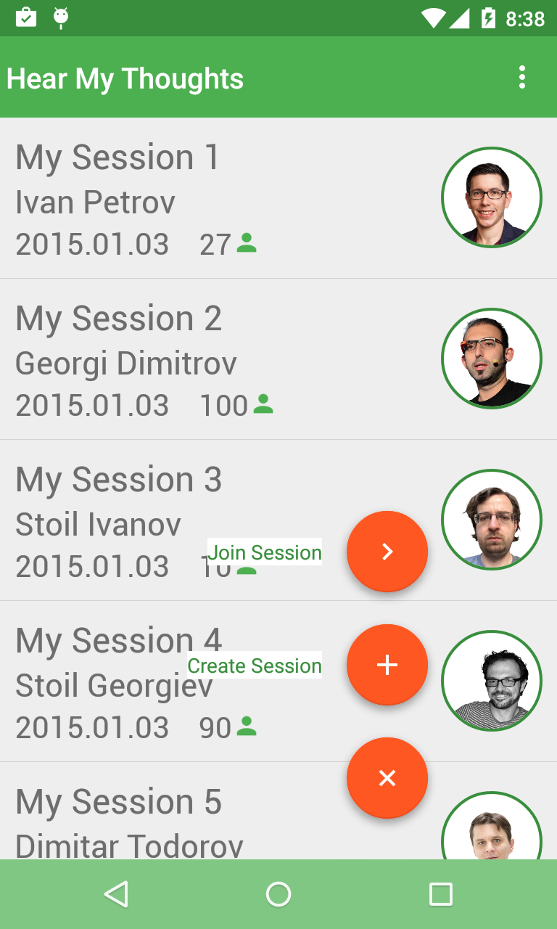
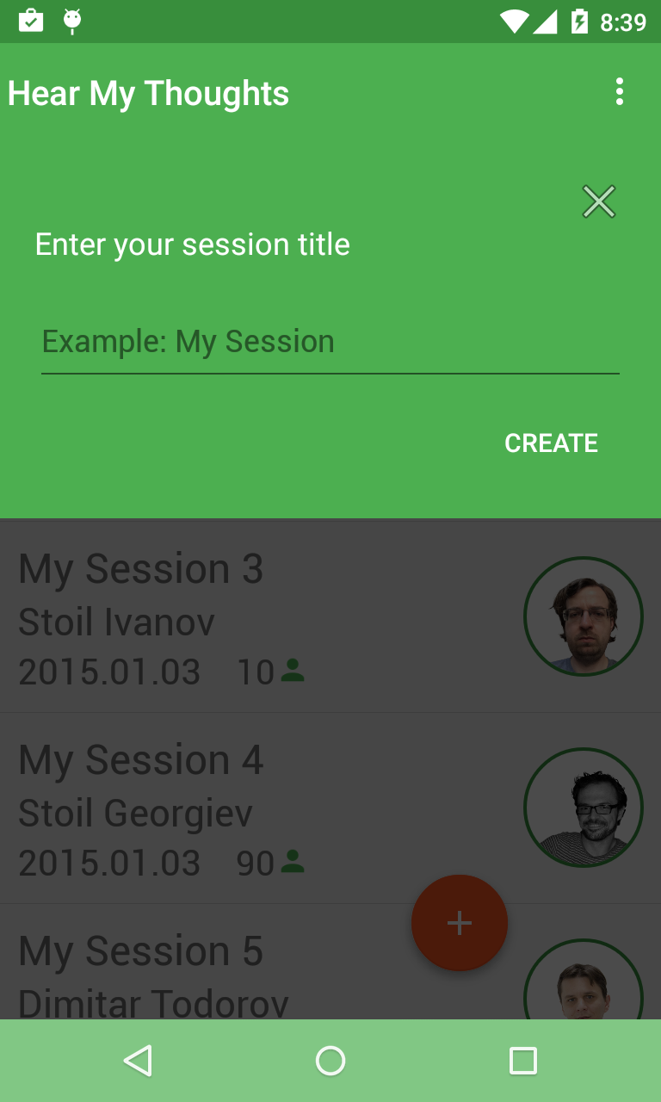
Recent Sessions

Slide 8
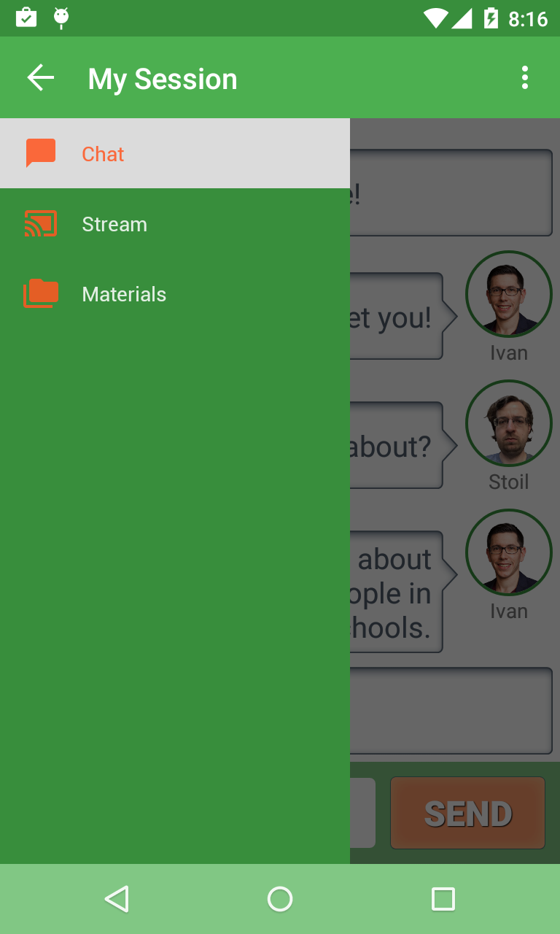
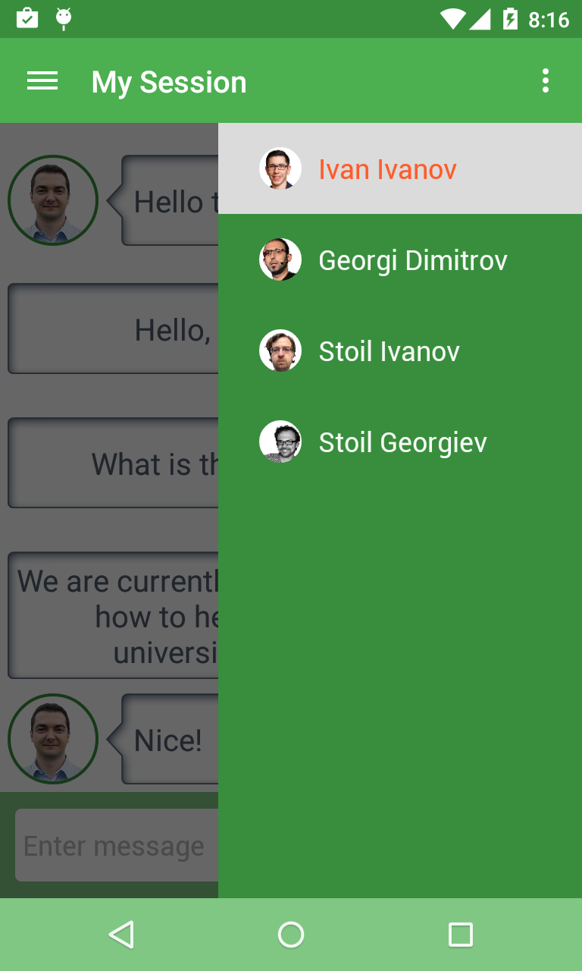
Session

Slide 9
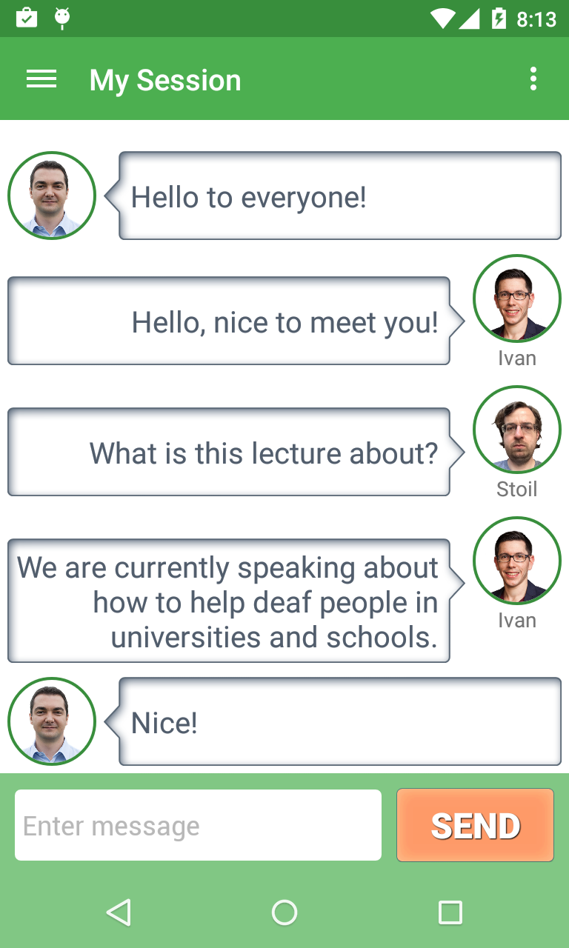
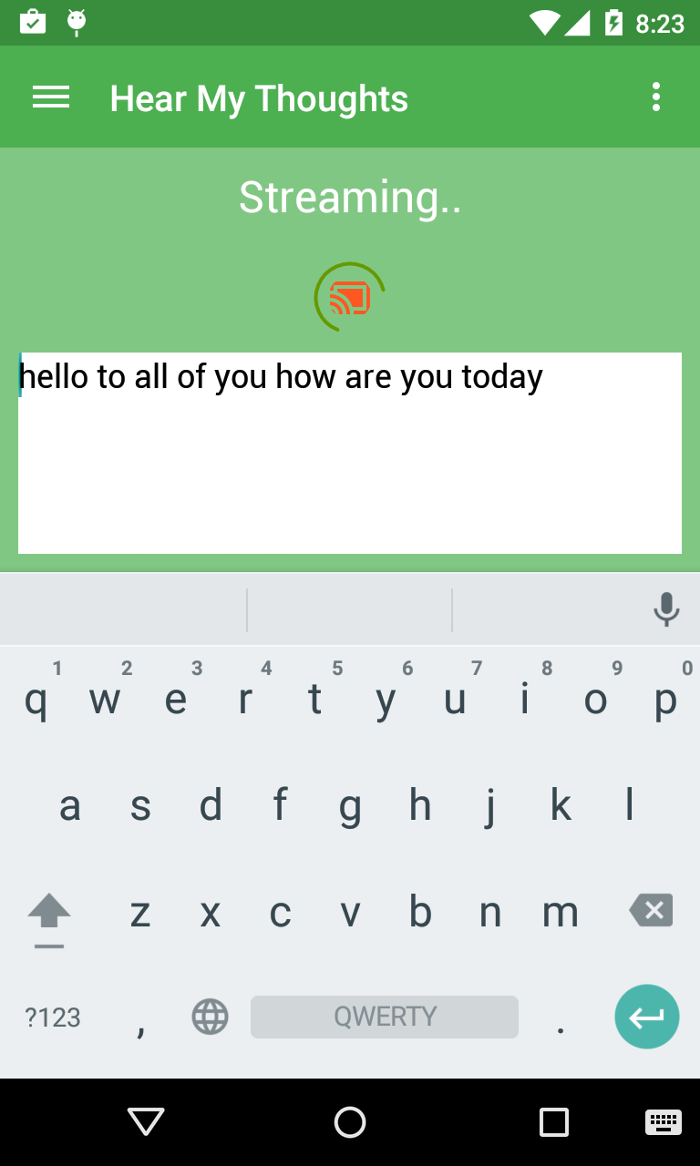
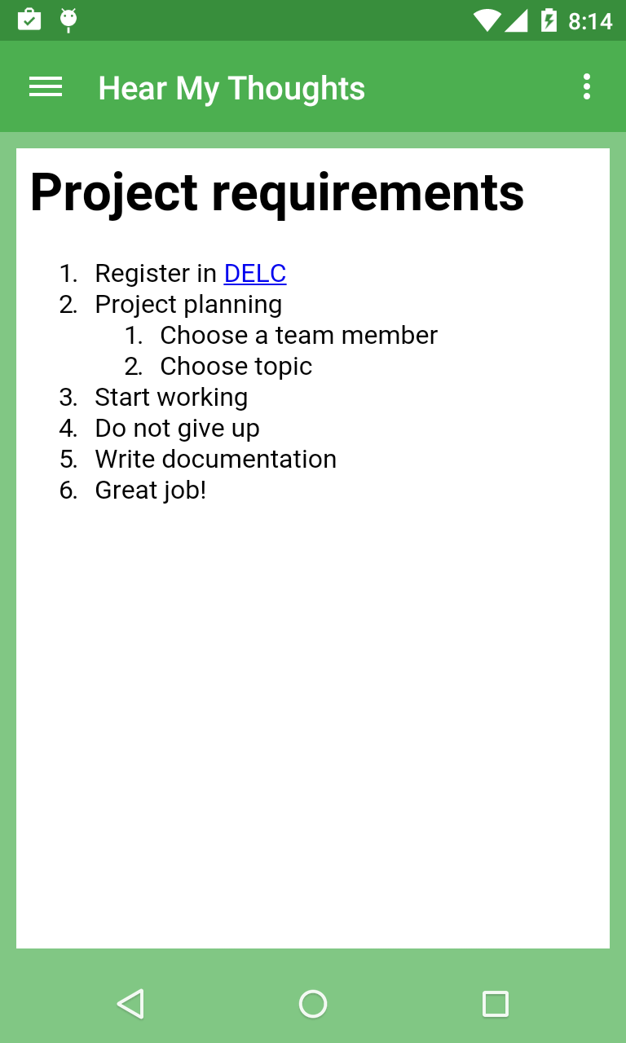
Teacher
Chat
Stream
Materials

Slide 10
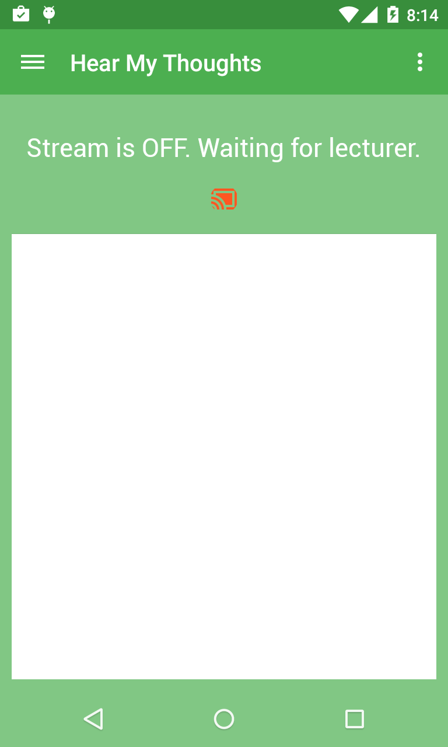
Student
Chat
Stream
Materials

Slide 11
Architecture
Recent Session Activity
My Session Activity
Recent Session Fragment
Chat Fragment
Stream Fragment
Login Fragment
Materials Fragment
Join Fragment
Left Drawer Fragment
Create Fragment
Right Drawer Fragment
BaseNotificationFragment
Screens

Slide 12
Architecture - 2
Events – Otto
Network Requests – Volley & Android Async
Local DB – Realm
Social Login – Google Plus
SpeechRecognitionProvider
SyncAdapters - (Future)
NSD - (Future)
Communication

Slide 13



Libraries
Otto
Realm
Picasso

Slide 14



Project Locations

