Slide 1

Introduction to PySpark
Alex Hagerman

Slide 2
What are we going to learn about
What is Spark
Core components of Spark
How to use Dataframes and RDDs with PySpark
Spark SQL
Spark and the file system

Slide 3
Spark
Apache Spark is a fast and general-purpose cluster computing system. It provides high-level APIs in Java, Scala, Python and R, and an optimized engine that supports general execution graphs. It also supports a rich set of higher-level tools including Spark SQL for SQL and structured data processing, MLlib for machine learning, GraphX for graph processing, and Spark Streaming.
Source: https://spark.apache.org/docs/latest/index.html

Slide 4

Spark Components
Source: https://www.oreilly.com/library/view/learning-spark/9781449359034/ch01.html

Slide 5
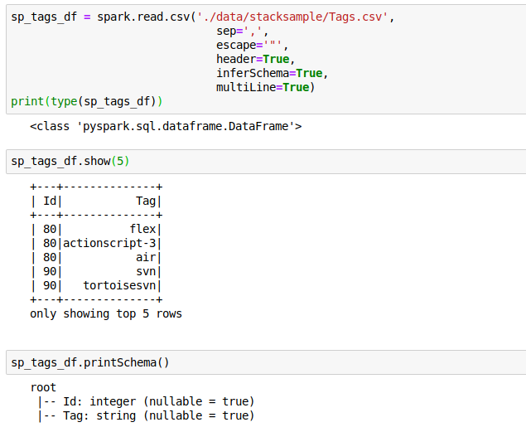
Spark Dataframes
https://databricks.com/glossary/what-are-dataframes

Slide 6
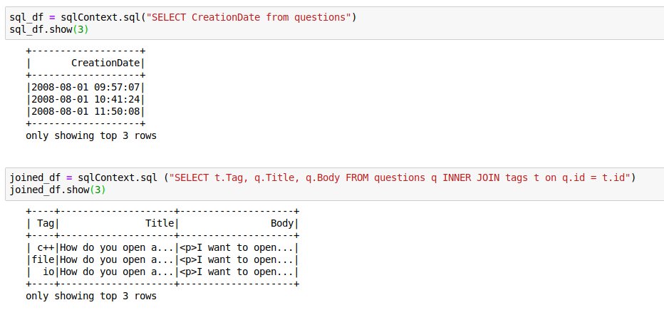
Spark SQL
https://databricks.com/glossary/what-is-spark-sql

Slide 7
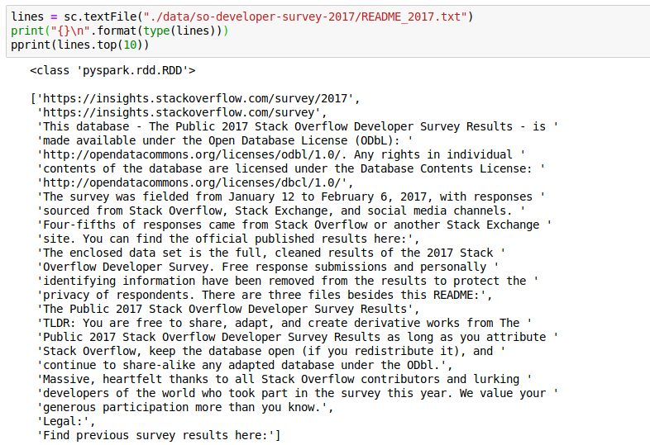
Spark RDDs
https://databricks.com/glossary/what-is-rdd

Slide 8

Accessing data with Spark
Source: https://databricks.com/blog/2015/02/17/introducing-dataframes-in-spark-for-large-scale-data-science.html

Slide 9
Questions?

Slide 10
Coming Soon Part 2
Execution Model
  Drivers and Executors
  Cluster Mode
  Py4J
Tuning
  Memory and Cores
  Serialization
  Data Locality

Slide 11
Sources and Resources
https://spark.apache.org/docs/latest/index.html
https://github.com/jupyter/docker-stacks
https://adamdrake.com/command-line-tools-can-be-235x-faster-than-your-hadoop-cluster.html
https://dorianbg.wordpress.com/2017/08/17/spark-vs-pandas-benchmark-why-you-should-use-spark-only-with-really-big-data/
https://stackoverflow.com/questions/48815341/why-is-apache-spark-python-so-slow-locally-as-compared-to-pandas
https://galeascience.wordpress.com/2016/08/10/top-10-pandas-numpy-and-scipy-functions-on-github/
https://www.kaggle.com/stackoverflow
https://data.world/gbrener/stack-overflow-developer-survey-2017
http://shop.oreilly.com/product/0636920028512.do
http://shop.oreilly.com/product/0636920034957.do
http://shop.oreilly.com/product/0636920046967.do
http://shop.oreilly.com/product/0636920035091.do

