Slide 1
SC2001 Project 1
Integration of Merge Sort
& Insertion Sort
Handwritten Python algorithms
Measured inputs from 1,000 to 10,000,000 integers
Notes:
0:00-0:35. State the question: can insertion sort at small recursive leaves reduce Python CPU time? We implemented both algorithms, counted key comparisons and measured CPU separately. Explain that S is a leaf-size threshold, and that we chose it from experiments. Requirements: Project1.pdf p.1. Presentation format: info.pdf p.1-2. No student names or contributions are assumed.

Slide 2
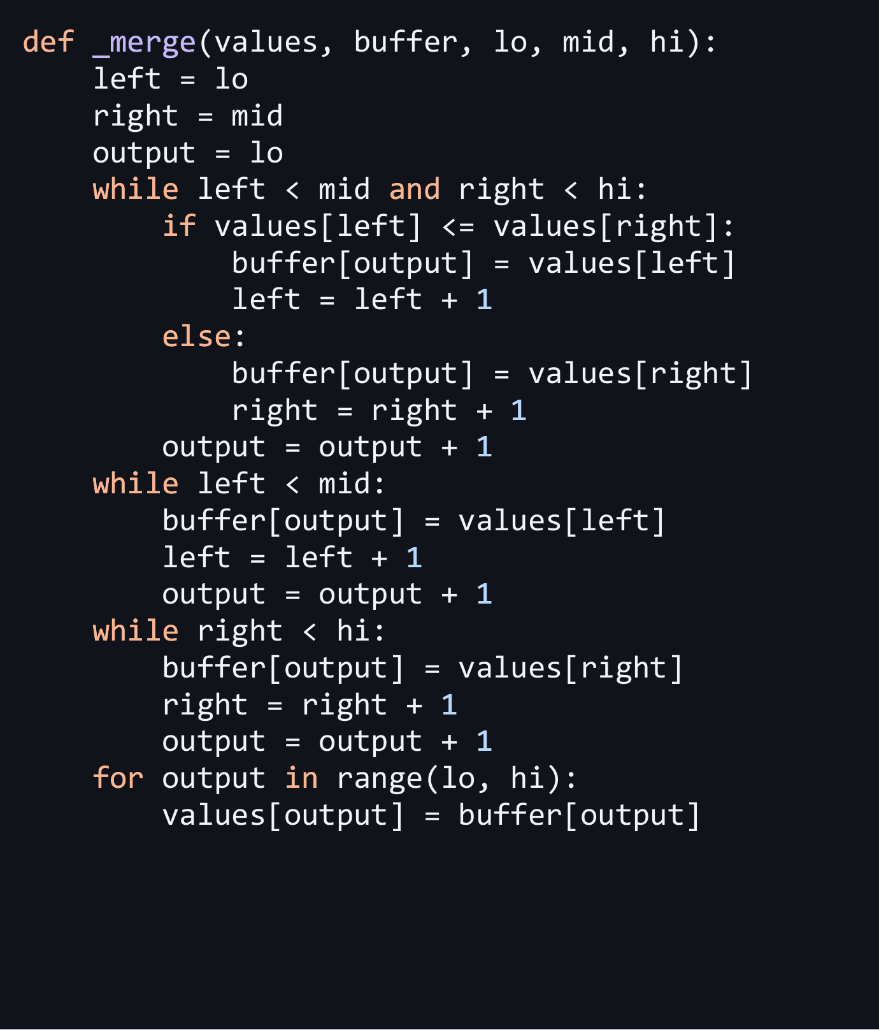
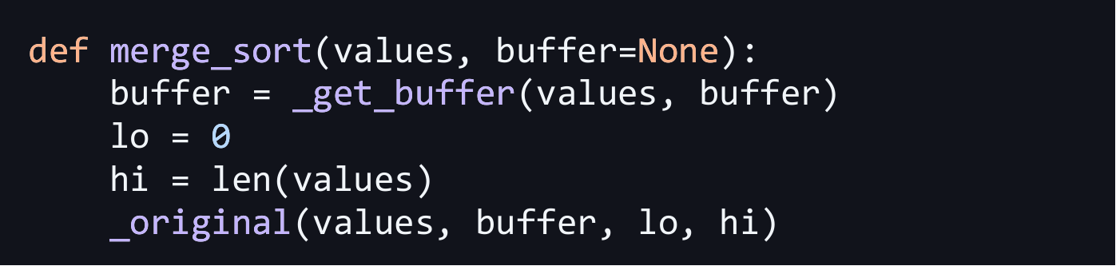
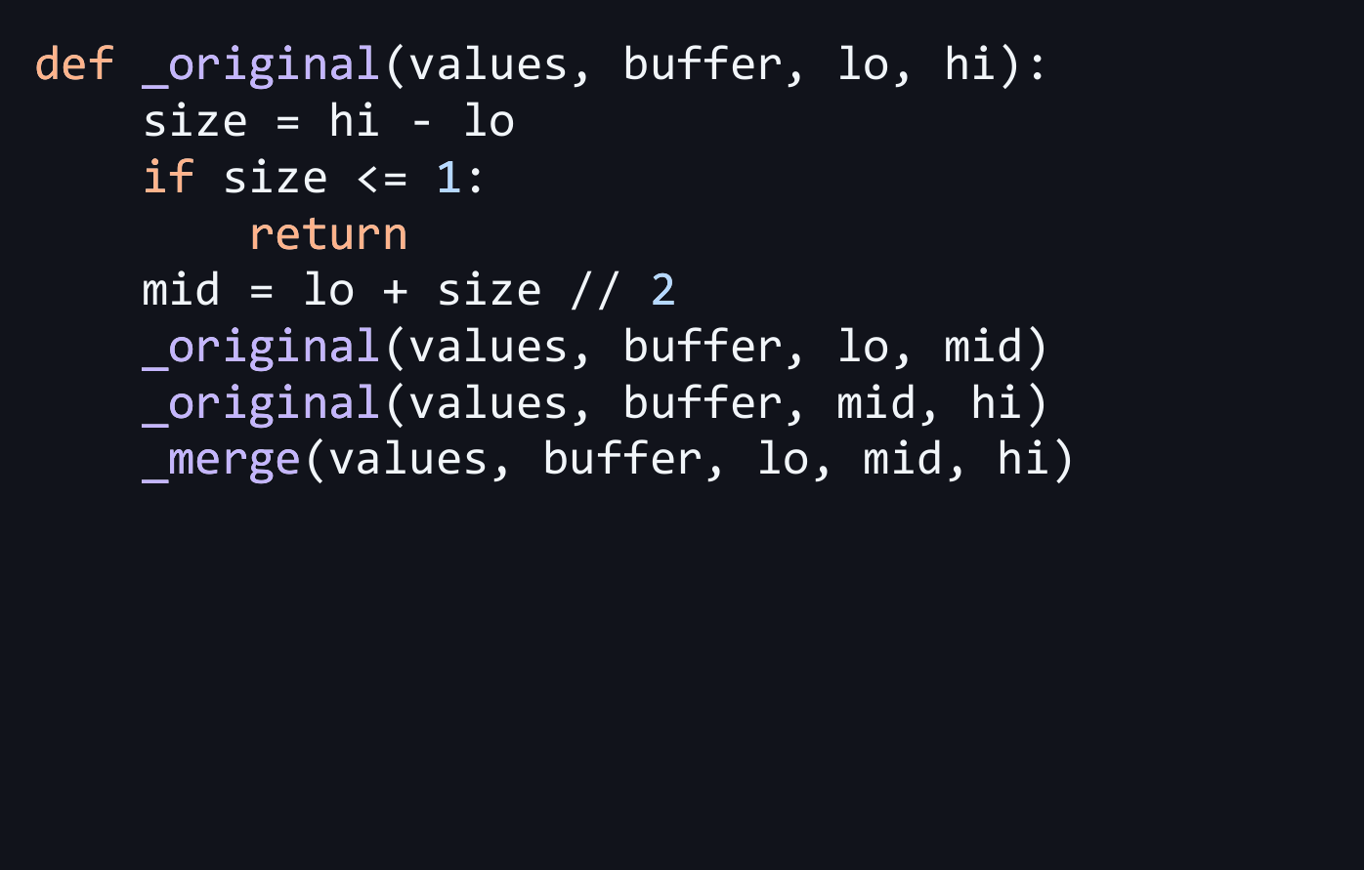
Merge function
The merge sort algorithm
Split first, then merge
2
Notes:
Suggested time: 25 seconds. Read merge_sort first: prepare one reusable buffer, set lo=0 and hi=len(values), then call _original. The range [lo, hi) includes lo but excludes hi. _original stops at size 0 or 1, recursively sorts both halves, and merges them. In _merge, left and right are the indices of the next unused items in each half. output is the index of the next buffer slot to fill. Taking the left item when values are equal keeps the sort stable. Copying leftovers needs no ordering comparisons. Code source: current algorithms.py, using left, right and output. Historical full benchmark results were measured before the readability rewrite (commit 25fc591).

Slide 3
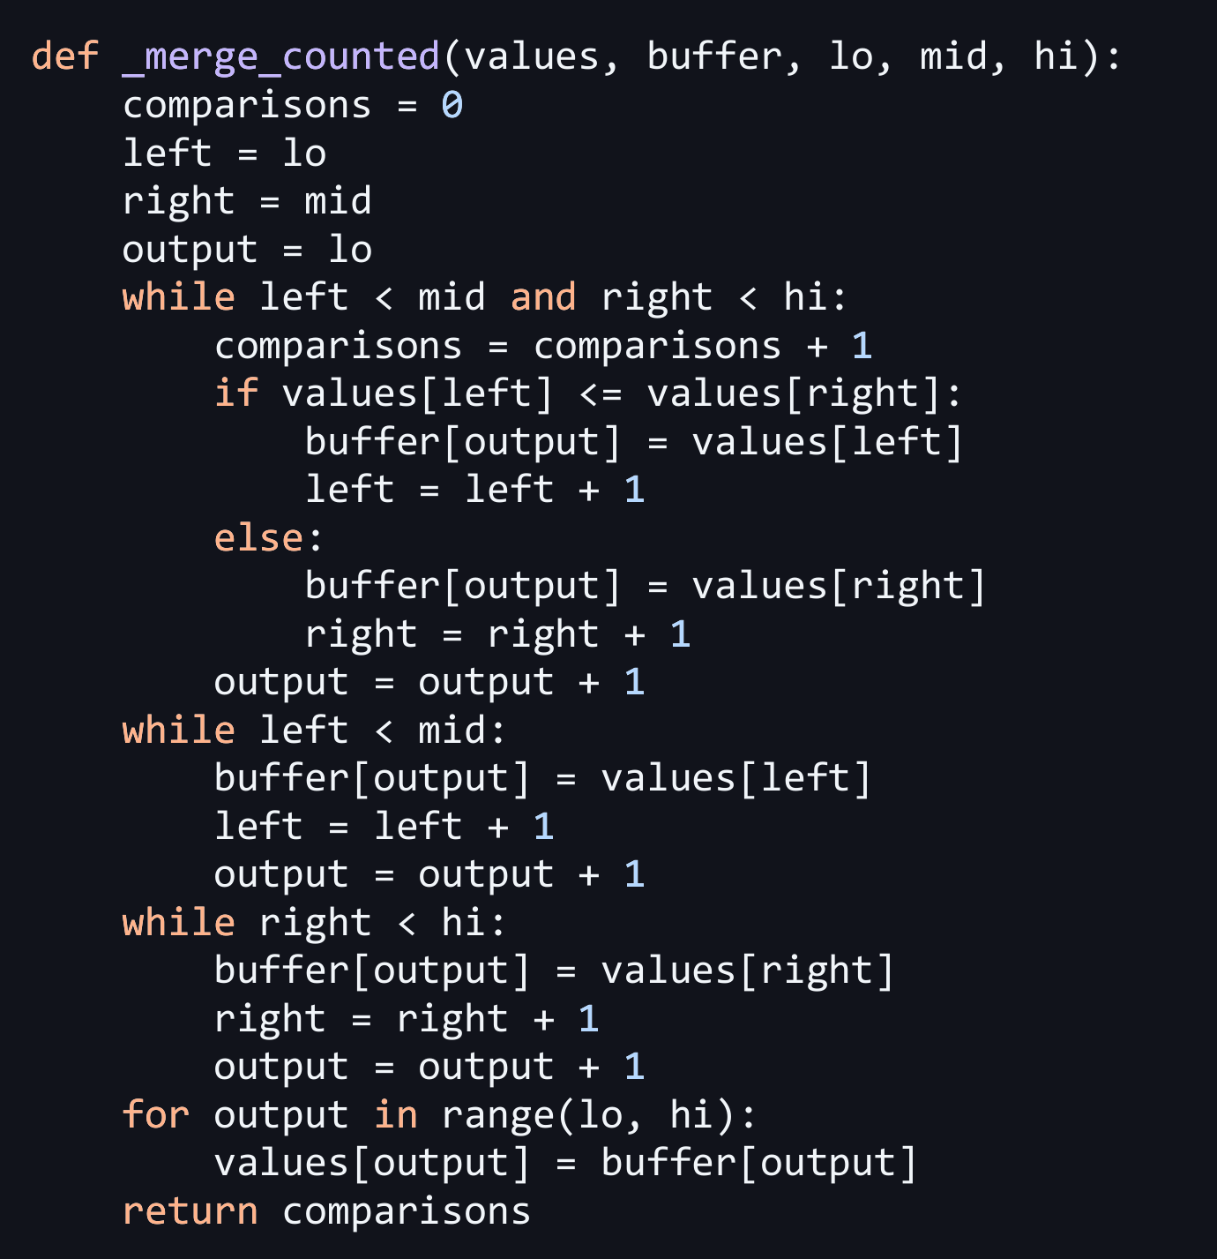
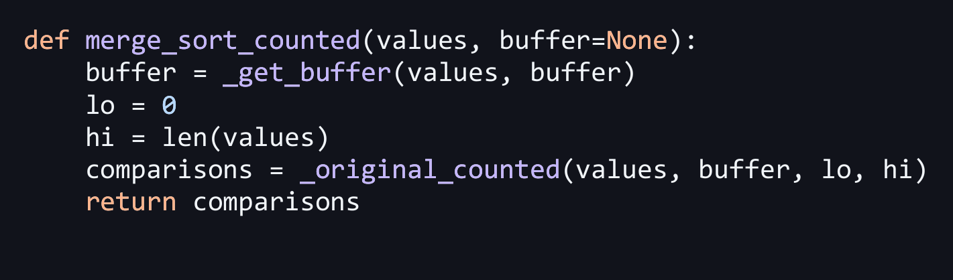
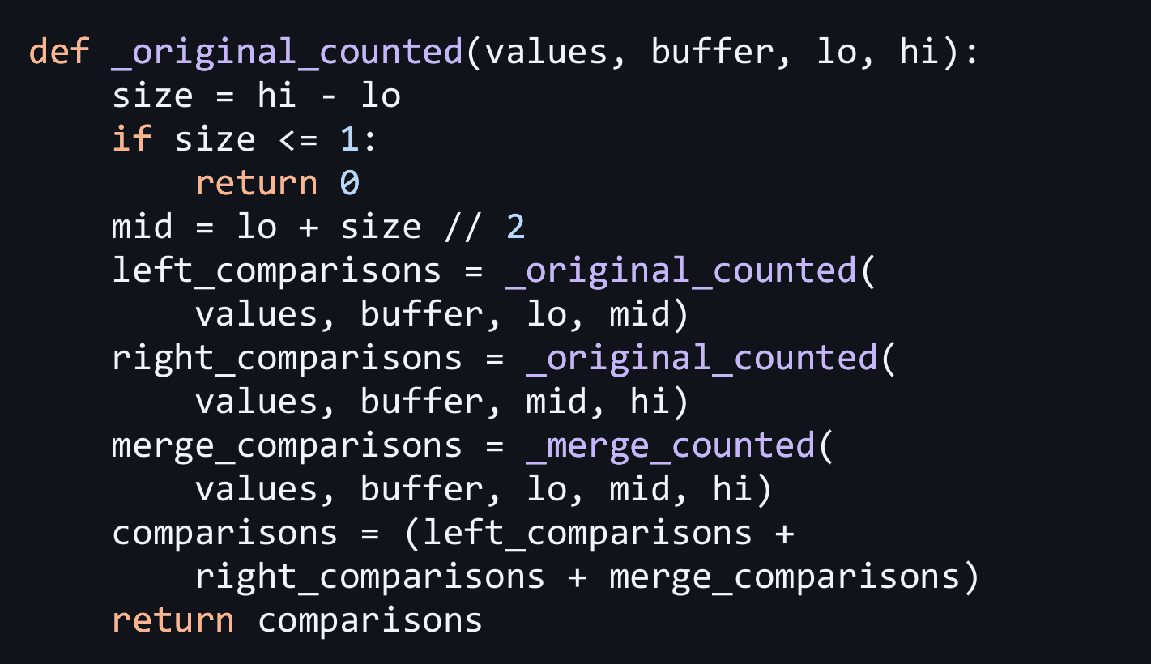
The merge sort algorithm (with key comparisons)
Merge function
Split first, then merge
2
Notes:
Suggested time: 20 seconds. The counted version makes the same sorting decisions as the uncounted version. A key comparison compares data values for ordering. In _merge_counted, increment comparisons immediately before evaluating values[left] <= values[right]. Count either outcome, true or false. left and right index the two halves, and output indexes the buffer. Do not count index checks, copying, or the stopping condition. _original_counted adds left_comparisons, right_comparisons and merge_comparisons. The base case returns zero. Timing uses the separate uncounted version so the counter does not distort sorting CPU time. Code source: current algorithms.py with the shorter index names.

Slide 4
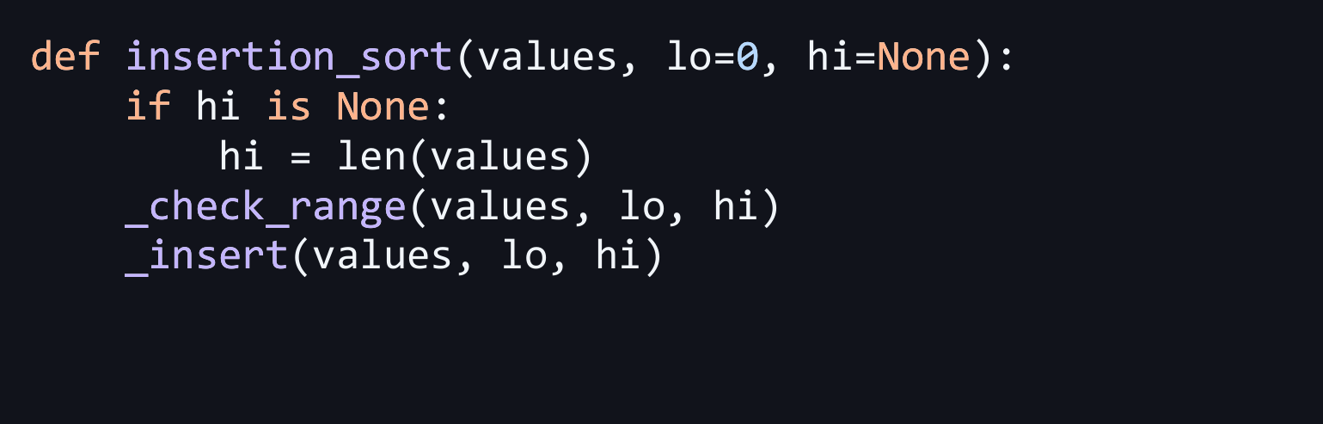
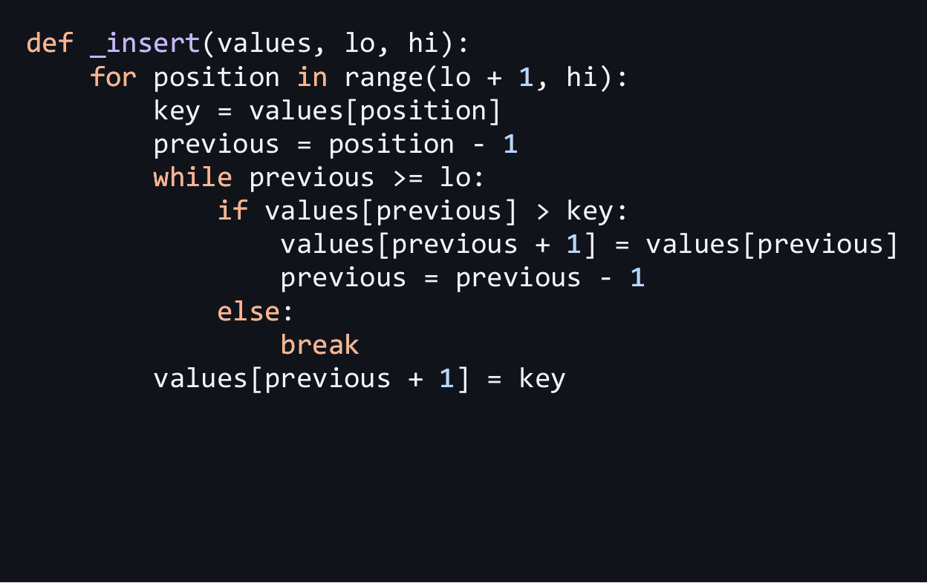
The insertion sort algorithm
Check ranges first, ensure it is valid, before performing the sort
Insertion sort function
2
Notes:
Suggested time: 25 seconds. If hi is None, no end index was supplied, so set hi to len(values). _check_range verifies 0 <= lo <= hi <= len(values). _insert starts at the second item because the first item alone is already sorted. Save the current item as key, shift earlier values that are larger than key one place right, then insert key into the gap. The prefix remains sorted after each pass. Strict > means an equal item is not moved past another equal item, preserving stability. Explicit assignments such as previous = previous - 1 replace shorthand. These panels use the current beginner-friendly algorithms.py (422d067), with comments/docstrings omitted.

Slide 5
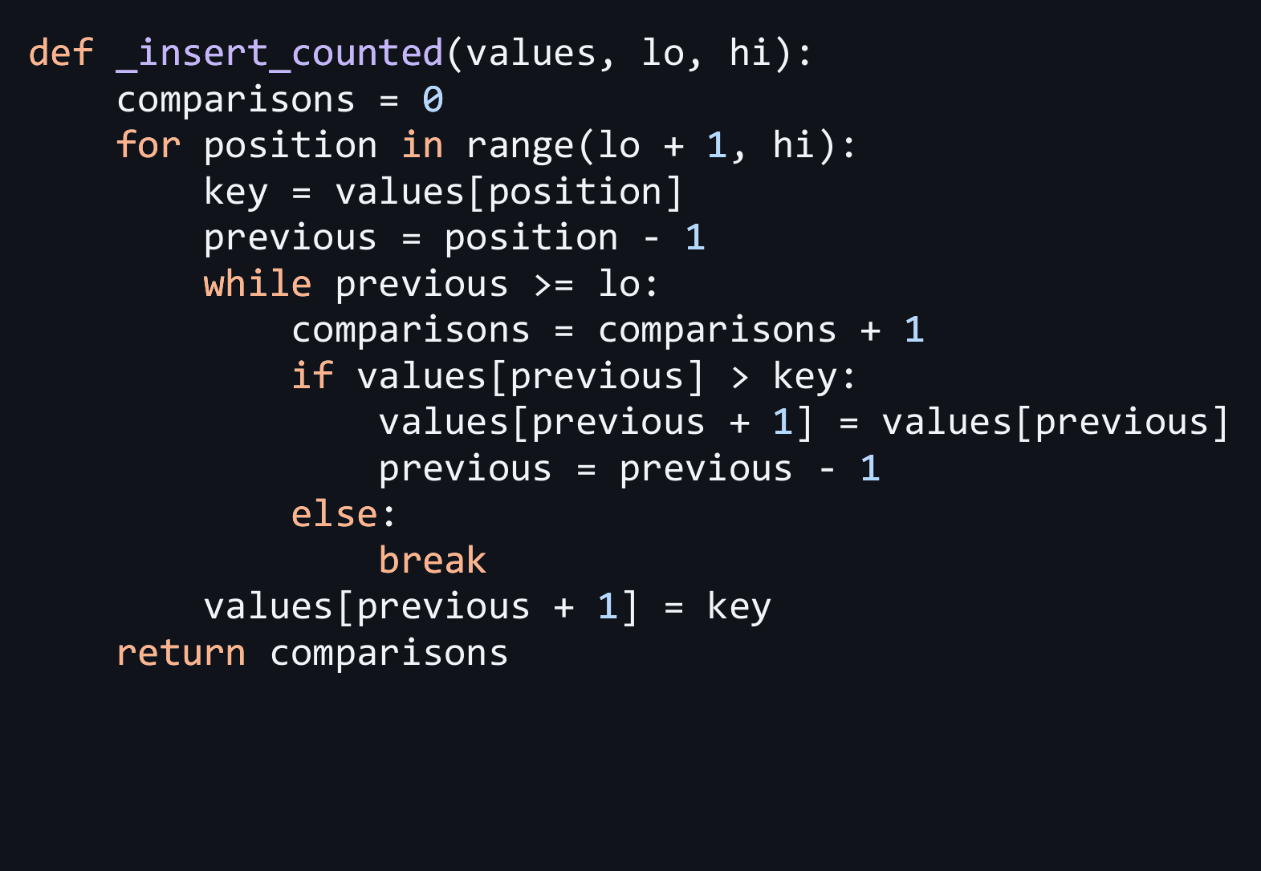
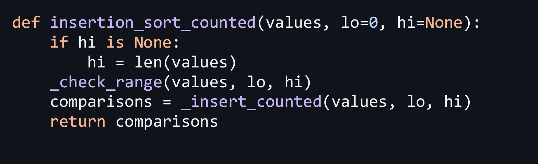
The insertion sort algorithm (with key comparisons)
Check ranges first, ensure it is valid, before performing the sort
Insertion sort function
2
Notes:
Suggested time: 20 seconds. Count one comparison whenever values[previous] > key is evaluated, including the false result that stops shifting. If previous falls below lo, the while condition stops before another data comparison; add no extra comparison. Example [5, 2, 4]: 5 > 2 is true; then 5 > 4 is true and 2 > 4 is false, giving three comparisons. [1, 3, 6] needs two false comparisons. Index checks and assignments do not count. The public counted function sorts the supplied list and returns comparisons. Source: current algorithms.py (422d067).

Slide 6
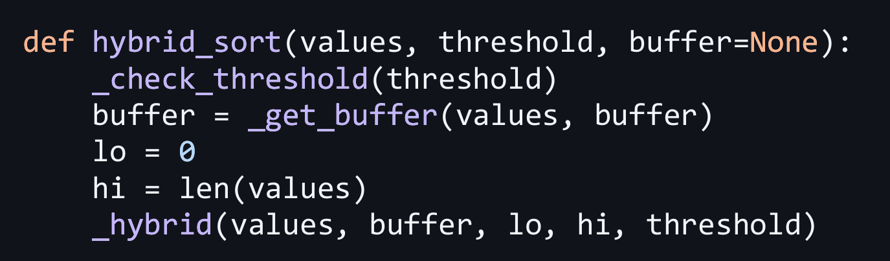
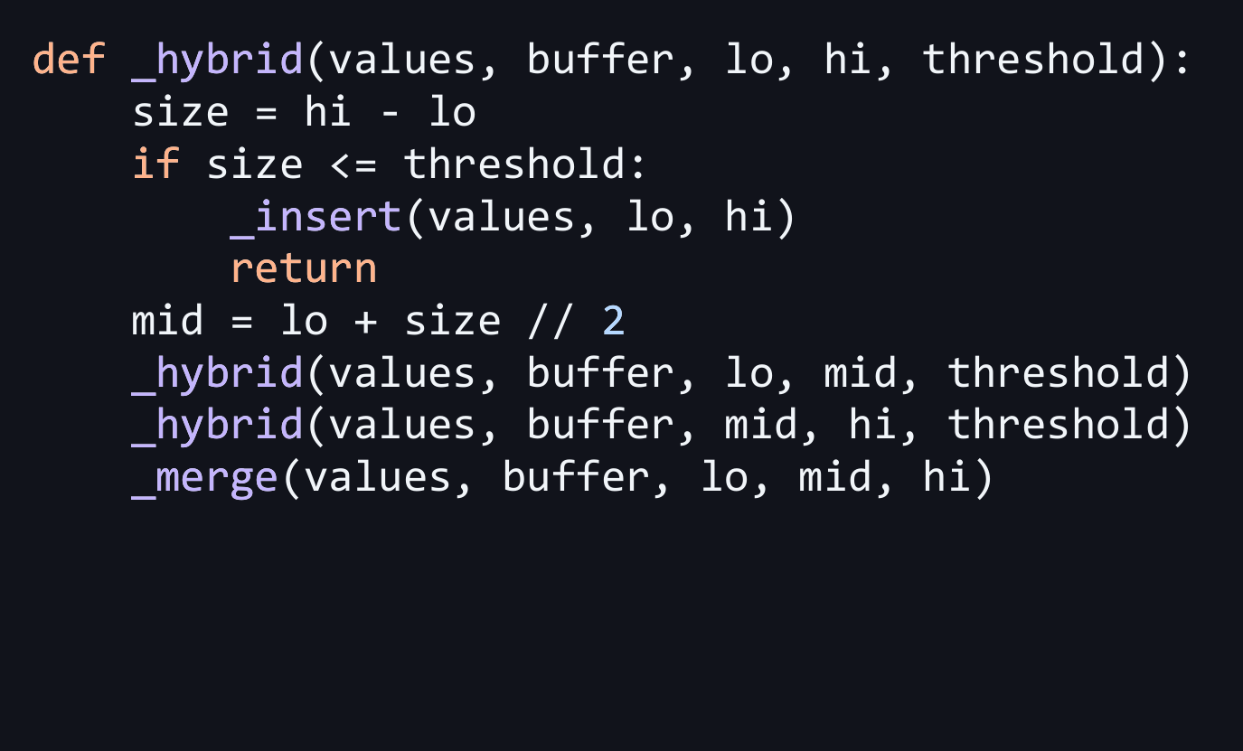
The hybrid algorithm
Stop splitting when the range has at most S items
Worked example: S=3
Input: [5, 2, 4, 1, 3, 6]
Leaves: [5, 2, 4] and [1, 3, 6]
Insertion: [2, 4, 5] and [1, 3, 6]
Merge: [1, 2, 3, 4, 5, 6]
2
Notes:
Suggested time: 35 seconds, including the worked example. S is the cutoff for the CURRENT subarray, whose size is hi - lo. If size <= threshold, use insertion sort and return; otherwise split, recursively sort both halves, and merge. The public wrapper validates S and prepares one reusable buffer. For [5, 2, 4, 1, 3, 6] with S=3, insertion sort sorts each length-three half, then merge combines the sorted halves. Source: current algorithms.py (422d067). Suggested live demo: run python demo.py on the next slide; do not start large benchmarks during the presentation.

Slide 7
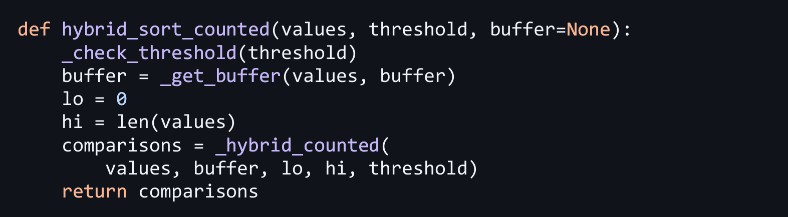
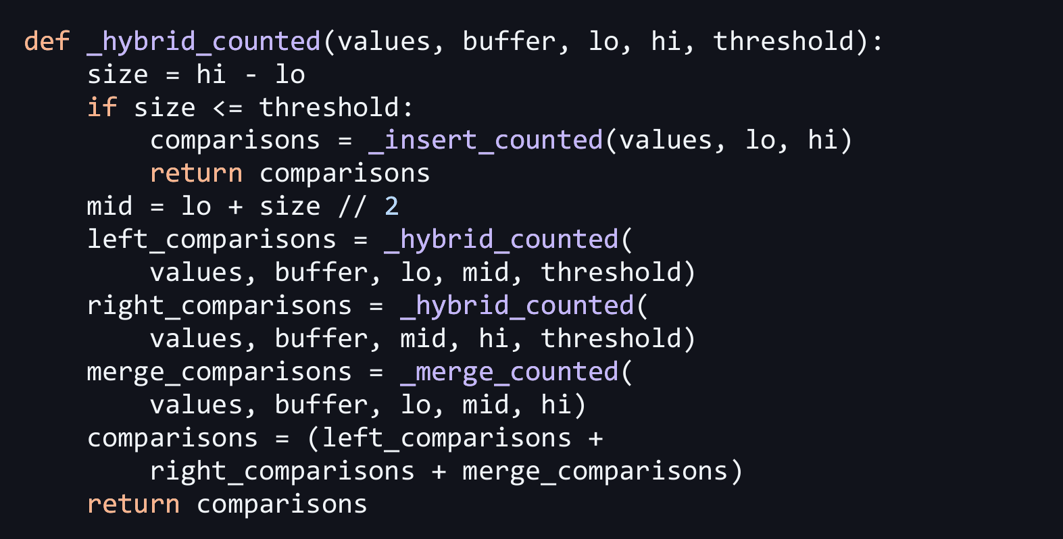
The hybrid algorithm (with key comparisons)
Stop splitting when the range has at most S items
Worked example: S=3
Input: [5, 2, 4, 1, 3, 6]
Leaves: [5, 2, 4] and [1, 3, 6]
Insertion: [2, 4, 5] and [1, 3, 6]
Merge: [1, 2, 3, 4, 5, 6]
3 + 2 + 5 = 10 key comparisons
2
Notes:
Suggested time: 35 seconds, including an optional 20-second live demo using python demo.py. A leaf returns its insertion-sort comparison count. An internal call adds the counts from the left half, right half and merge. For S=3 on [5, 2, 4, 1, 3, 6], insertion needs 3 comparisons on the left and 2 on the right. Merge compares five pairs and copies the remaining 6, giving 3 + 2 + 5 = 10 comparisons. S=1 agrees with original merge sort under this implementation; S>=n uses insertion sort on the whole list. This tiny example explains the mechanism, not a performance advantage. Panels use current algorithms.py (422d067), with equivalent wrapping of long lines. The full benchmark results were measured with the earlier implementation (25fc591); the readability rewrite has correctness tests and its own smoke run.

Slide 8
Correctness, counting and fair timing
Correctness and counting
Experiment protocol
Insertion maintains a sorted prefix.
Merge emits the smallest remaining head.
Induction gives a sorted, stable result.
Count each evaluated data comparison:
merge <= and insertion >.
Include terminating false comparisons.
Uniform integers in [1, 1,000,000].
Three seeds per case, paired inputs.
Separate counted and uncounted runs.
CPU clock: time.process_time().
Exclude RNG, copies, buffer allocation,
validation and I/O. Run sequentially.
Verify order, length and exact histogram.
3
Notes:
1:50-2:55. Explain stability: left on ties, shift only greater values. Index checks, copying and validation do not count. Tests include exhaustive ternary arrays through length 6 and S=1 equality with original counts. Large runs check exact frequency histograms and sorted order, not just checksums. Warmup is one deterministic small sort per case. Seeded shuffled order and 3 input seeds reduce systematic order bias. Timed tiny inputs use independent pre-timer batches. Metadata captures CPython/Windows/hardware. sources: tests/, experiment.py, results/full/metadata.json. Timer semantics: https://docs.python.org/3/library/time.html#time.process_time. RNG: https://docs.python.org/3/library/random.html#random.randint.

Slide 9
Input Data - Random Dataset Generation
Generation of array in increasing size from 1,000 to 10 million in the range of [1, x]
For this experiment, we set x to 1000000 (1 million). So [1, 1000000].
Random Dataset
array = [random.randint(1, 100) for _ in range(1000)]
Run 1: [51, 82, 23, 41, …, 3]
Run 2: [44, 14, 66, 59, …, 7]
WHY FIXED SEED?
Same code != same data
Different data can affect performance
Makes comparison of different S values unreliable
SOLUTION: random.seed(seed)
2
Notes:
0:35-1:50, including about 25 seconds of live demo. Explain [lo,hi): lo is included, hi excluded. Trace the left leaf: 5>2 true, 5>4 true, 2>4 false. Right leaf has two false comparisons. Merge needs five ordering checks then copies 6. Run python demo.py from the preopened terminal. Both algorithms happen to make 10 comparisons on this input. This example explains mechanics, not typical speed. If the terminal fails, use these precomputed values. Source: algorithms.py and demo.py. Lecture 01_Sorting.pdf p.12/14.

Slide 10
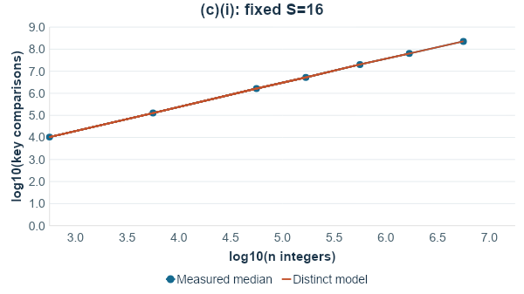
Fixed S retains n log n growth
Original
T(n) = 2T(n/2) + Theta(n)
Time: Theta(n log n)
Buffer: Theta(n)
Hybrid
About log2(n/S) merge levels
Random leaf work: Theta(nS)
Fixed S: Theta(n log n)
Both axes show log10 values. Analytical counts use actual rounded splits with no fitted scale factor.
4
Notes:
2:55-4:10. Explain the original recurrence for even n; the exact code uses floor/ceiling lengths. Merge work is linear at each of logarithmically many levels. Hybrid replaces lower merge levels with insertion leaves. With constant S it retains n log n growth. The plotted coordinates are log10(n) and log10(count), so 3 to 7 covers 1,000 through 10,000,000. The full notebook uses conventional log axes plus min-max ranges and the worst bound. The analytical random-distinct expectation is an approximation to repeated integers, not a fitted line. Similar shape does not prove complexity; the recurrence does. Source: theory.py, docs/theory.md, raw stage=scale.

Slide 11
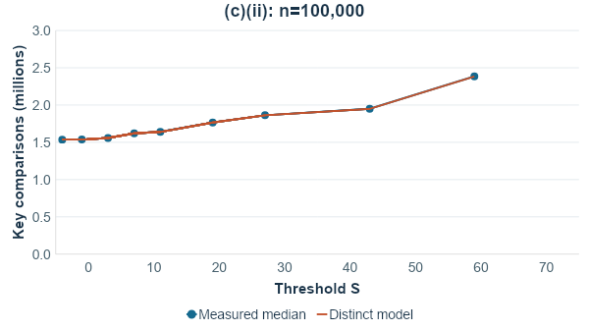
Increasing S changes the leaf work
Fewer merge levels
Larger insertion leaves
Random insertion: Theta(S^2) per leaf
About n/S leaves
Total leaf work: Theta(nS)
Some S values share the same leaves.
Plateaus are expected.
S=1 is included. Medians of three seeds. Full plots also show ranges and the worst-case bound.
5
Notes:
4:10-5:10. Fixed n separates the threshold effect from input-size growth. Merge levels shrink only when S crosses an actual recursive subarray length. Larger leaves increase insertion comparisons. Our analytical recurrence uses the real rounded leaf sizes, explaining plateaus. Both true and terminating false comparisons are included in the distinct insertion expectation m(m-1)/4+m-H_m. The curve is an approximation with ties. Source: theory.py and raw stage=tune,n=100000.

Slide 12
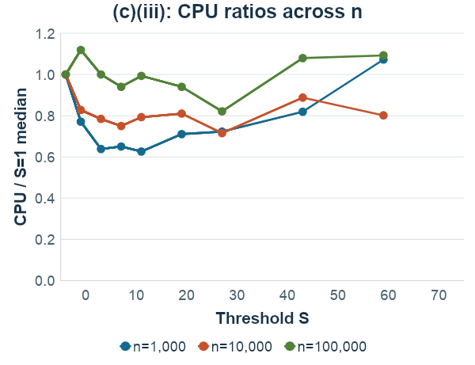
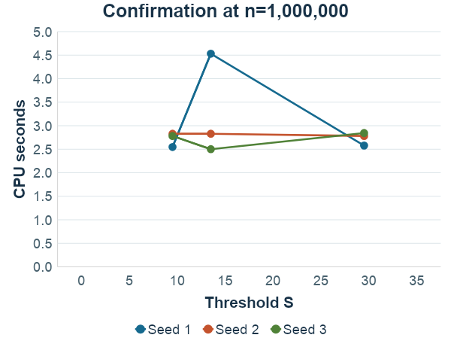
CPU tuning selected S=12 by the tie-break rule
S=12, 32 tied at 2.78125 s median. The rule chooses smaller S. Three seeds per case.
6
Notes:
5:10-6:25. CPU is the predeclared primary criterion. Shortlist the three thresholds with the lowest geometric mean of CPU ratios across the tuning sizes. Candidates: 12, 16, 32. Confirm on fresh one-million inputs. Confirmation medians: S=12: 2.78125 s; S=16: 2.82812 s; S=32: 2.78125 s. S=12, 32 tied at 2.78125 s median. The rule chooses smaller S. These overlapping/noisy results do not establish a universal optimum. The chart shows each confirmation seed, and notebook charts show ranges. Report count winners separately from CPU winners. Source: shortlist.json, selection.json and raw tune/confirm. A threshold is best only within the tested search and criterion.

Slide 13
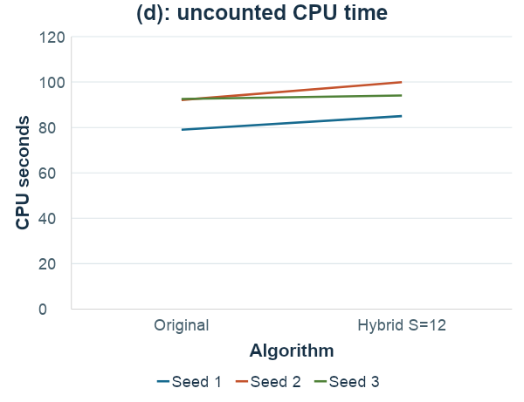
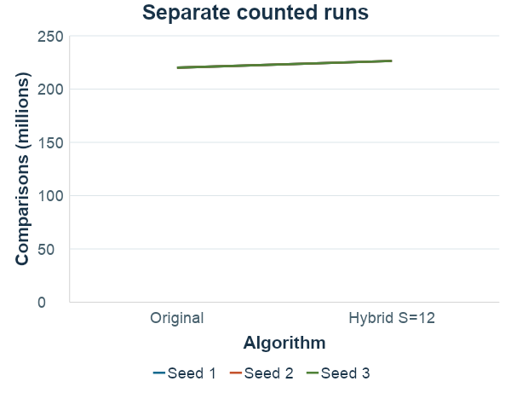
Original and hybrid on 10 million integers
Evaluated on 3 independent random seeds (n~10000000, x=1000000), optimal S=12 from Part (c)
Original median:92.09 s
Hybrid median:94.08 s
Original:~220.1 M comparisons
Hybrid:~226.4 M comparisons
Speedup: 0.929x
7
Notes:
6:25-7:30. These are real full-size runs on three fresh seeds. Each line pairs the same unsorted dataset. Speedup is original CPU divided by hybrid CPU for each seed; then take the median. Median paired speedup is 0.929x, observed range 0.922-0.983x. The ratio of medians is 0.979x, a different statistic. Median comparisons are 220,099,689 original and 226,418,149 hybrid, a +2.87% change. Counts exclude timer/counter overhead as explained. The appendix has raw values. Sources: results/full/raw.csv stage=final, plots/full/final_paired_cpu.csv and final_paired_comparisons.csv.

Slide 14
Why Hybrid Lost in Python?
High Python Loop Overhead: Insertion sort's inner while loop suffers from heavy interpreter overhead (dynamic type checks, bounds checking, pointer reassignment per shift).
Recursion Savings Nullified: Merge sort recursion is O(log n) function calls. Saving the bottom 3–4 recursion levels saves very little time compared to the cost of millions of interpreted inner-loop shifts.
Comparison Cost: In Python, executing an extra 6.32M > evaluations incurs direct CPU execution penalties.

Slide 15
Conclusions and questions
Hybrid was slower in 3 of 3 final CPU pairs.
Median paired speedup: 0.929x.
CPU time and key comparisons measure different costs.
S=12 follows a finite, noisy search and an explicit tie-break.
One interpreter, one machine, uniform integer inputs.
2 minutes of Q&A
8
Notes:
7:30-8:00. State the observed finding without promising it on other machines/distributions. Three repeats describe variability, not statistical significance. Python overhead, copies and recursion explain why count and CPU rankings can differ, but we did not profile causality. Stop at 8:00 and allow Q&A until 10:00. Every member should be ready to answer all topics. Use the appendices only when asked. Source: measured findings and info.pdf.

Slide 16
Appendix: exact comparison models
Merge sort
Hybrid regimes
Worst comparisons:
n ceil(log2 n) - 2^ceil(log2 n) + 1
Random distinct merge of lengths a,b:
a+b - a/(b+1) - b/(a+1)
Insertion expectation for m items:
m(m-1)/4 + m - H_m
H_m = 1 + 1/2 + ... + 1/m
Worst/average (random distinct):
Theta(n log(n/S) + nS), for S<=n
Fixed S: Theta(n log n)
S=log n: Theta(n log n)
S=n^alpha: Theta(n^(1+alpha))
S>=n: insertion only
Buffer O(n), recursion O(log n)
9
Notes:
Appendix, not in the 8-minute script. Explain the expected trailing run in merge: its expectation is a/(b+1)+b/(a+1), subtracted from total length. Expected insertion inversions omit false comparisons; add m-H_m. Exact discrete ties change the expectation. Public hybrid allocates a buffer even when S>=n, though insertion itself is O(1) extra space. The full expression uses B=min(S,n) to avoid negative log values. Source: docs/theory.md and theory.py.

Slide 17
Appendix: raw final measurements
Seed | Algorithm | S | CPU seconds | Key comparisons
100900100 | original | 1 | 78.968750 | 220,095,927
100900100 | hybrid | 12 | 85.000000 | 226,418,149
100900101 | original | 1 | 92.093750 | 220,099,689
100900101 | hybrid | 12 | 99.906250 | 226,424,963
100900102 | original | 1 | 92.515625 | 220,101,452
100900102 | hybrid | 12 | 94.078125 | 226,417,959
Each CPU value is from an uncounted run. Counts come from a separate run on identical unsorted data.
10
Notes:
Appendix. CPU and count are intentionally different modes. All final runs use batch size 1 and n=10,000,000. The three seeds are fresh relative to tuning. Check the raw CSV for wall time and integrity checks. Source: results/full/raw.csv. Speedup per row pair is original CPU/hybrid CPU.

Slide 18
Appendix: different criteria, different winners
Input n | Lowest median CPU S | Fewest median comparisons S
1,000 | 16 | 1
10,000 | 32 | 1
100,000 | 32 | 1
Ties use the smaller S. These are per-size descriptive winners, before shortlist confirmation.
11
Notes:
Appendix. Distinguish raw comparison minimization from practical CPU performance. Finite thresholds, three seeds, one machine. Do not use the tiny smoke run as evidence. The observed min-max CPU bars in the notebook help interpret near ties. Source: plots/full/findings.json and raw tune rows.

