Slide 1
factor = 3
27
Block 1 (Size 2 bytes) → 1B3B-2
59
237
82
Block 2 (Size 4 bytes) → 6D52177B-4
23
122
72
Block 3 (Size 2 bytes) → 4859-2
89
189
10
Block 4 (Size 3 bytes) → BD0A61-3
97
253
38
Block 5 (Size 3 bytes) → FD265C-3
92
Hash > 3: 1B3B-2 6D52177B-4 4859-2 BD0A61-3 FD265C-3

Slide 2
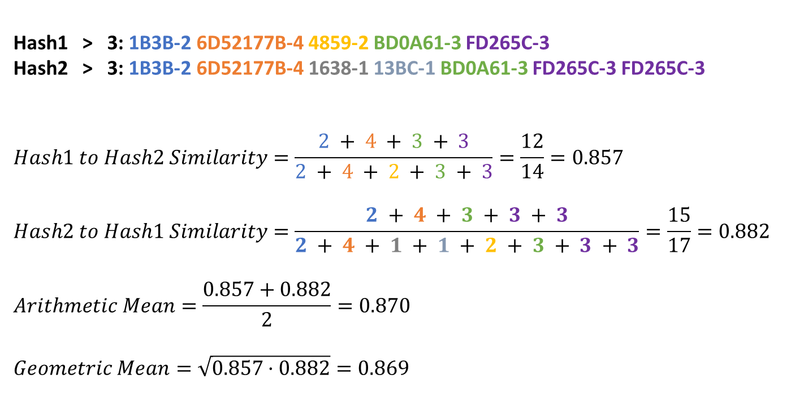
Hash1 > 3: 1B3B-2 6D52177B-4 4859-2 BD0A61-3 FD265C-3
Hash2 > 3: 1B3B-2 6D52177B-4 1638-1 13BC-1 BD0A61-3 FD265C-3 FD265C-3
$$Hash1 to Hash2 Similarity=\frac{2 + 4 + 3 + 3}{2 + 4 + 2 + 3 + 3}=\frac{12}{14}=0.857$$
$$Hash2 to Hash1 Similarity=\frac{2 + 4 + 3 + 3 + 3}{2 + 4 + 1 + 1 + 2 + 3 + 3 + 3}=\frac{15}{17}=0.882$$
$$Arithmetic Mean=\frac{0.857+0.882}{2}=0.870$$
$$Geometric Mean=\sqrt{0.857·0.882}=0.869$$

Slide 3
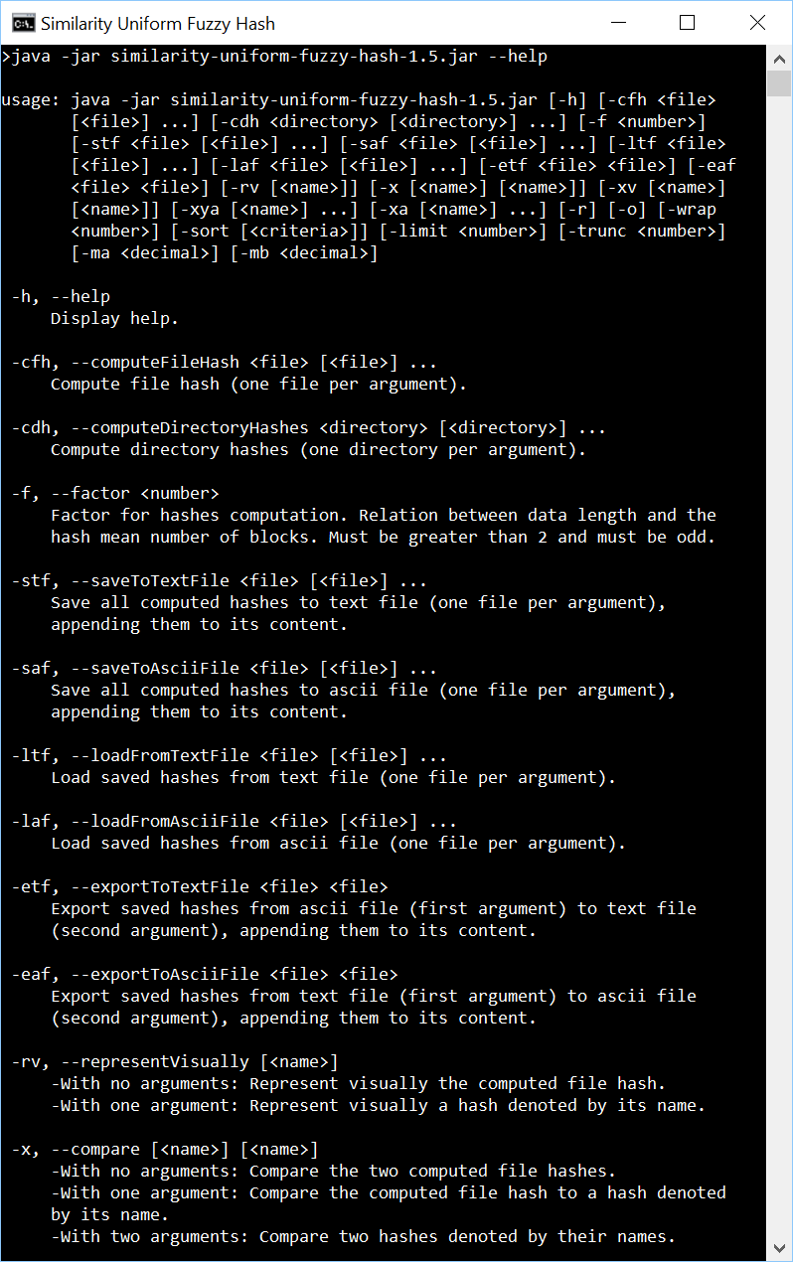
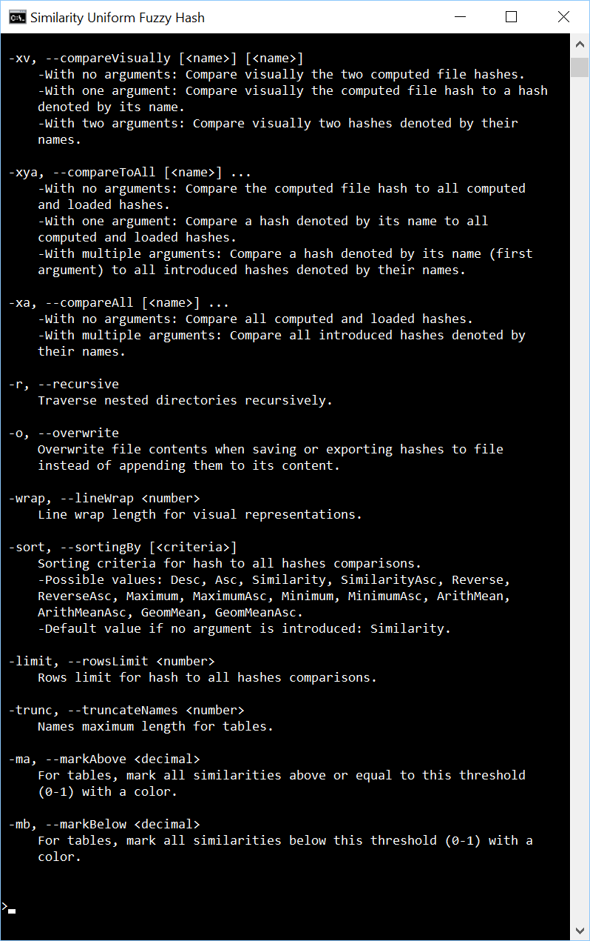

Slide 4
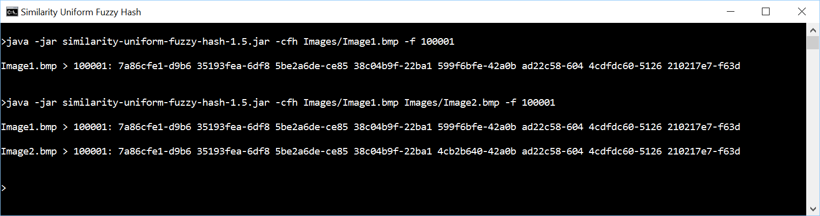

Slide 5
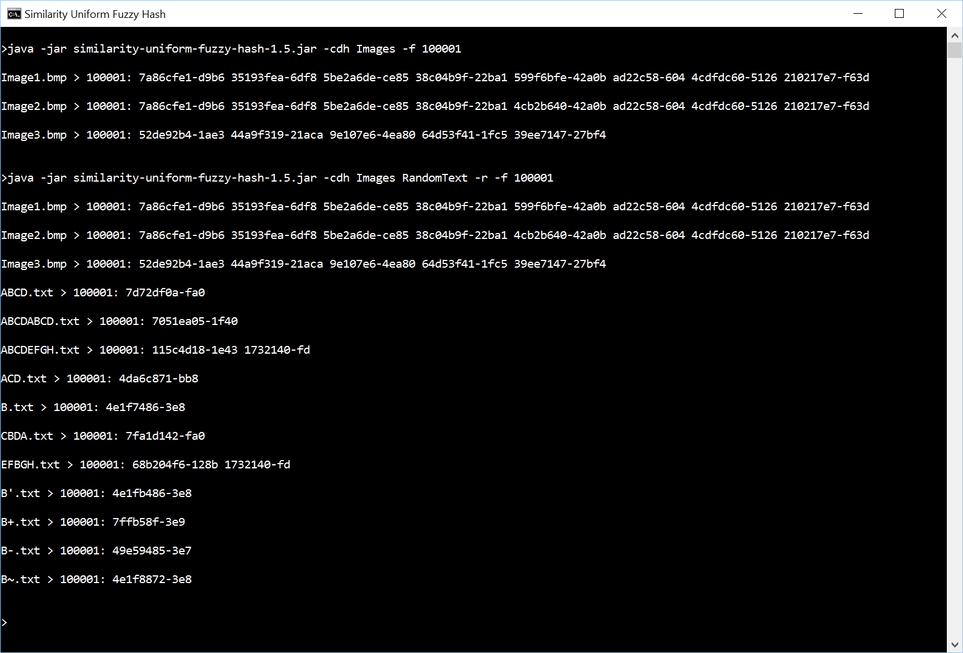

Slide 6
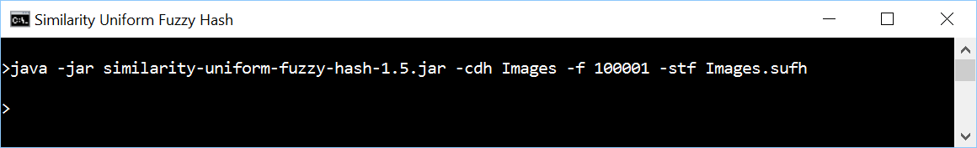
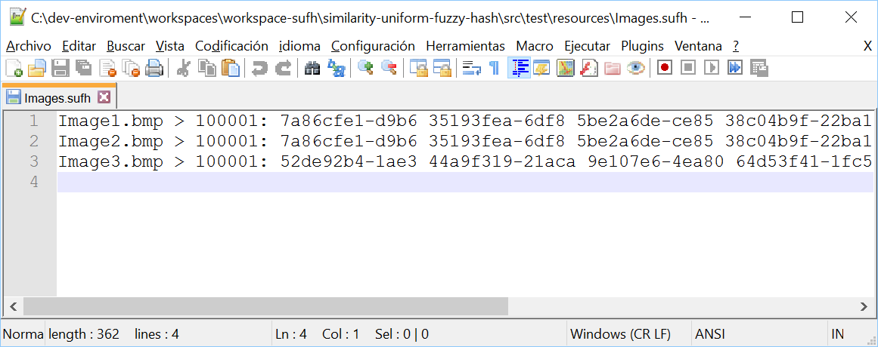

Slide 7
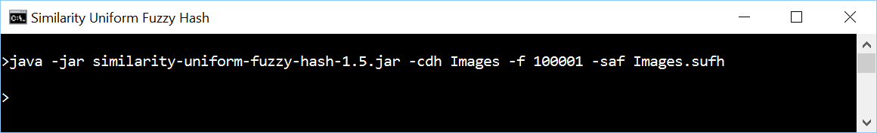
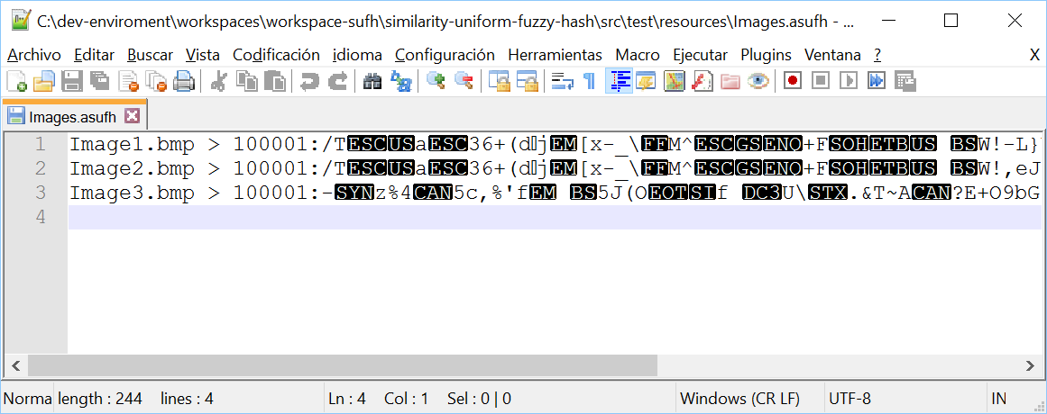

Slide 8
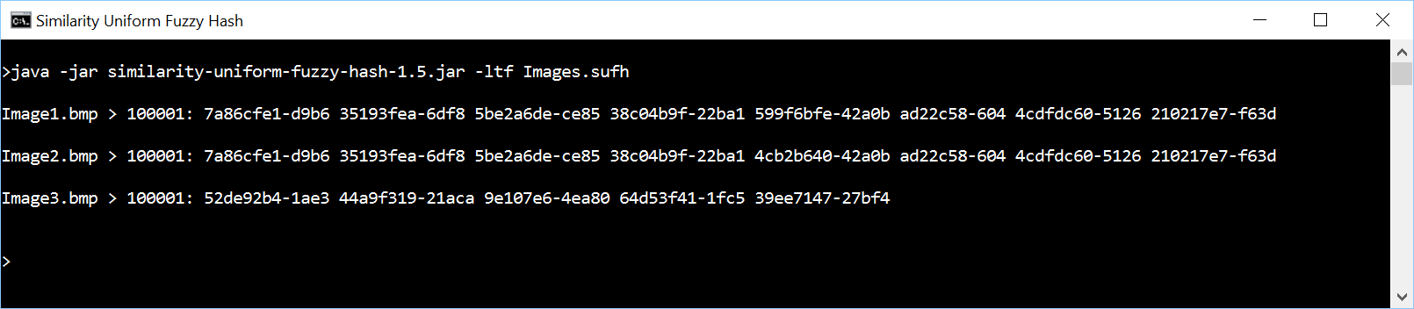

Slide 9
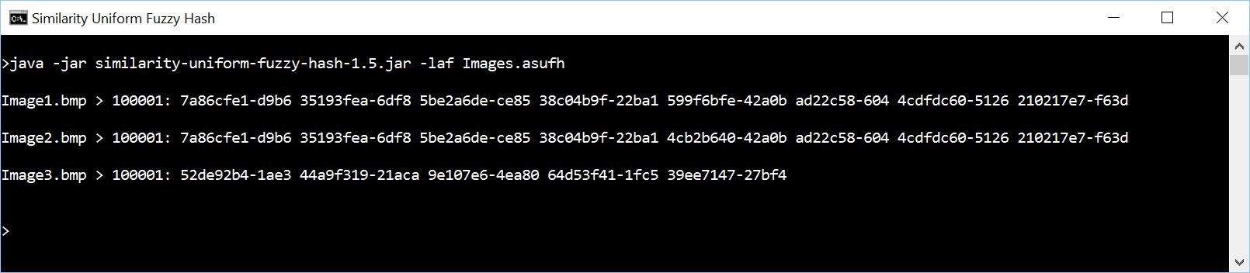

Slide 10
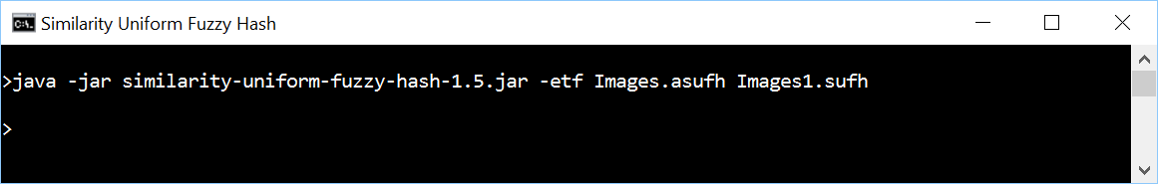



Slide 11
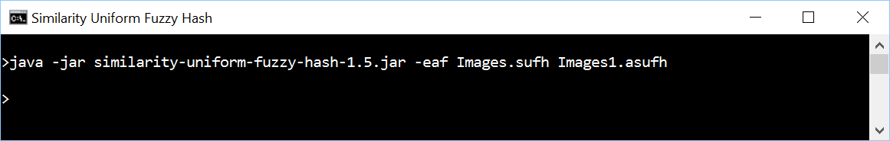
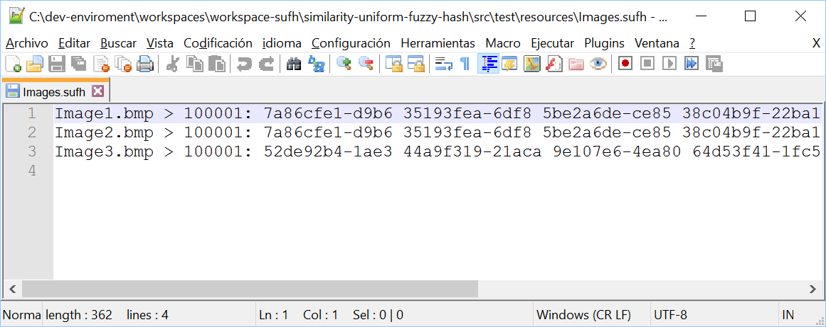
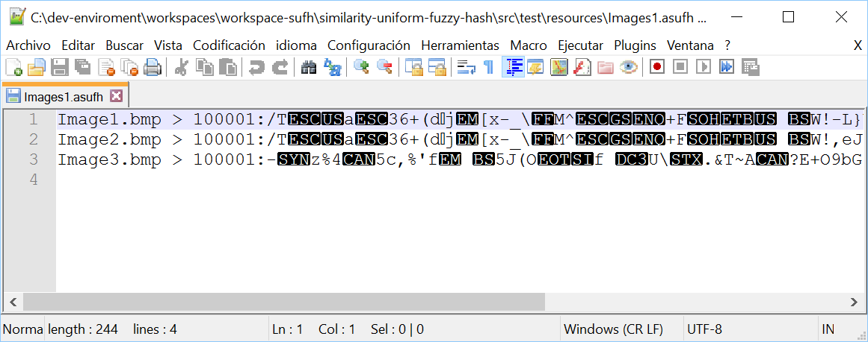

Slide 12
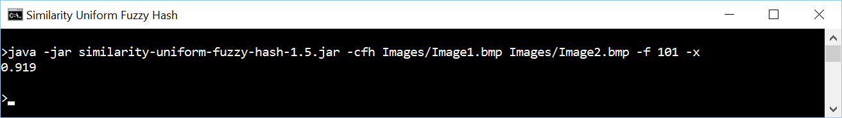
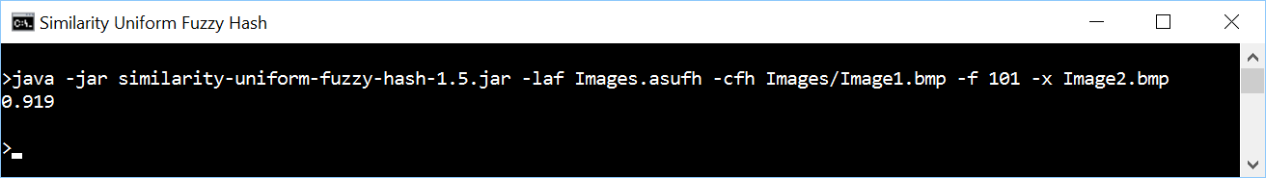
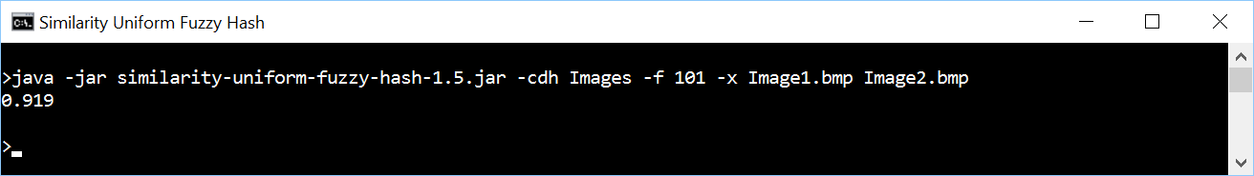

Slide 13
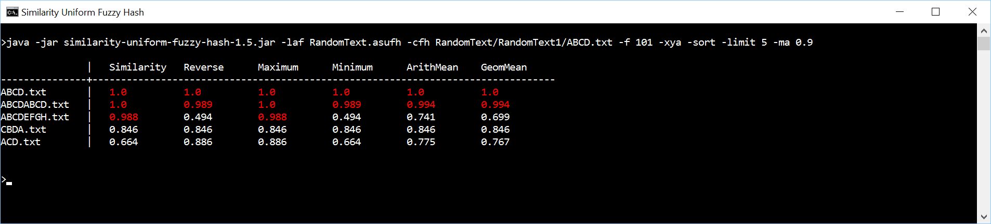
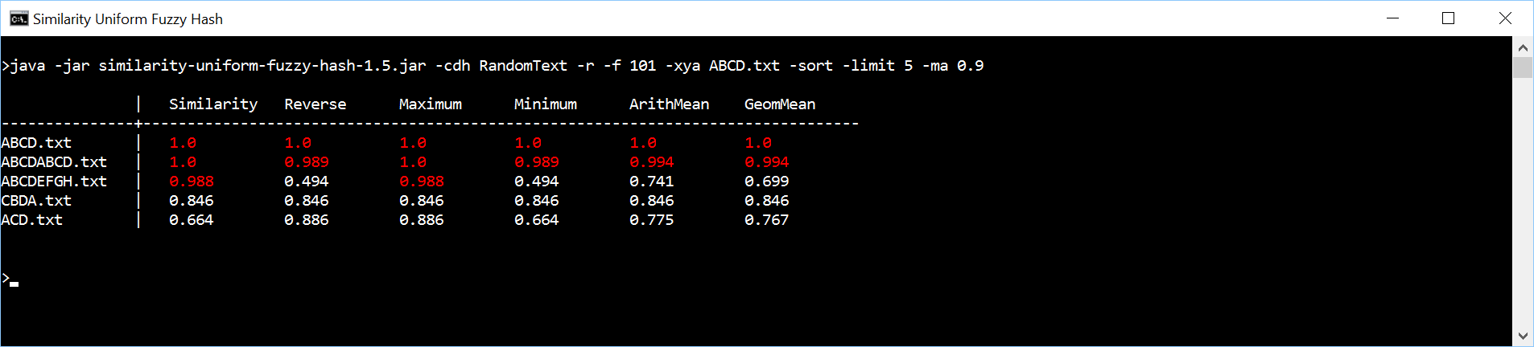
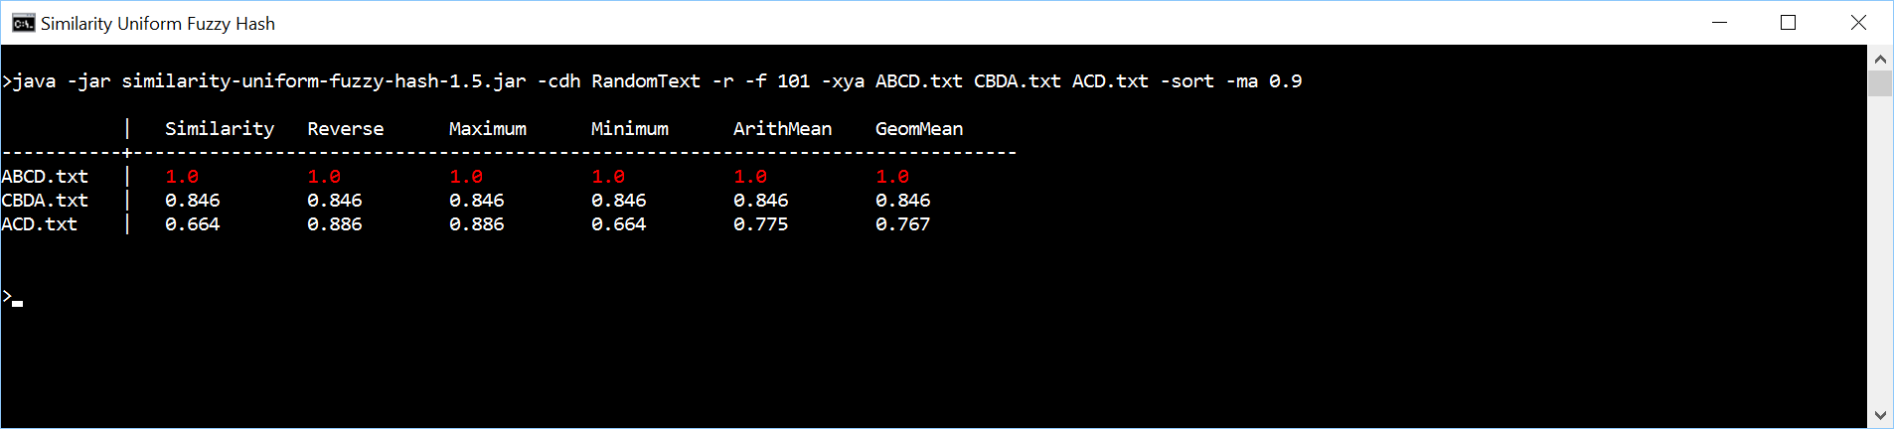

Slide 14
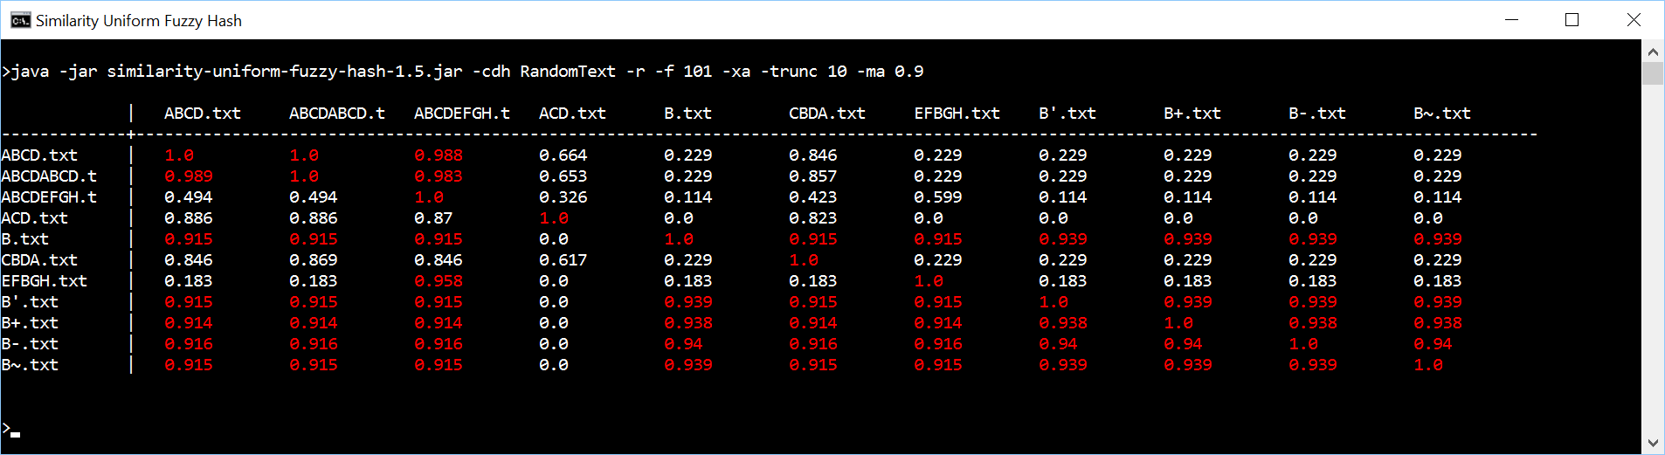
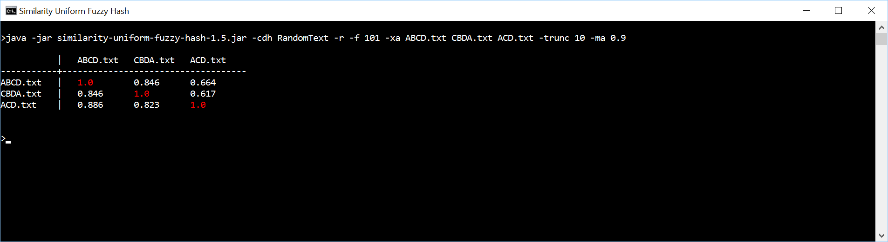

Slide 15
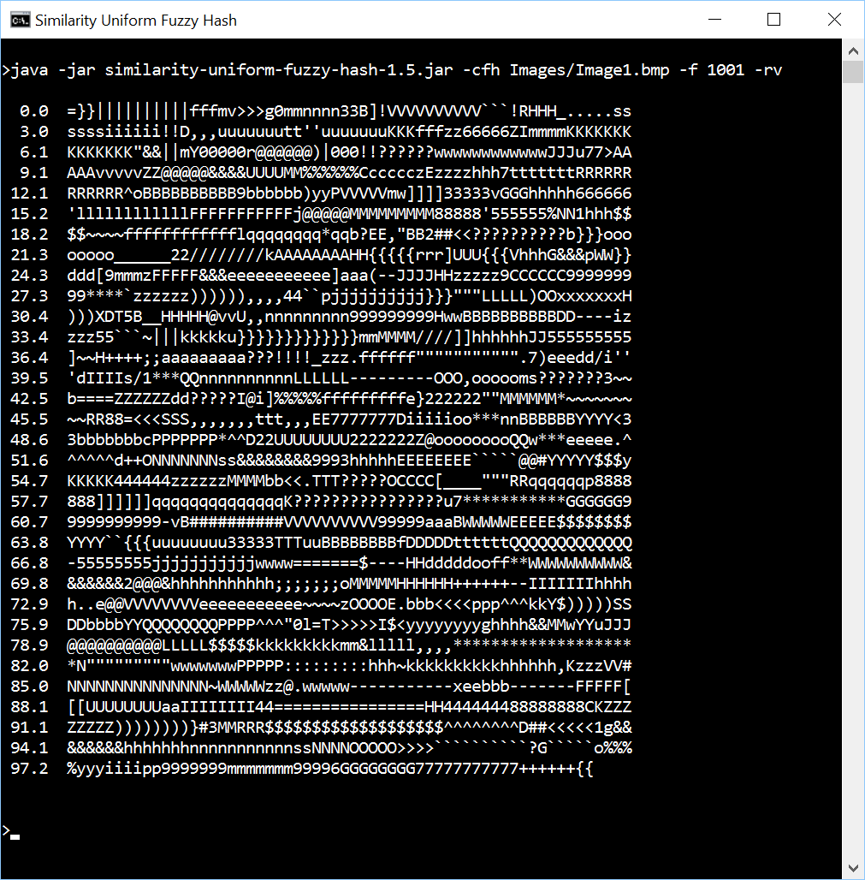


Slide 16
