Slide 1

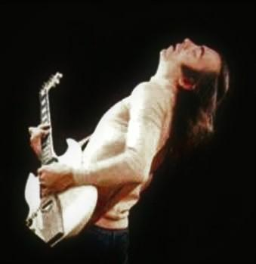
Erkin Koray

Slide 2
His Life
He was born on June 24, 1941 in Istanbul. At an early age, he learned piano from her mother, Vecihe Koray, a piano teacher, and later started playing the guitar. In the second half of the '50s, when he was educated at Istanbul German High School, he started playing the current pieces of the period with Erkin Koray and Ritimcileri, an amateur group he founded with his friends. After high school education, he continued his work as a semi-amateur and semi-professional until the early 60's. By the late 1960s, he had become a major figure in Turkish psychedelic music and Anatolian rock, beginning with his first psychedelic single Anma Arkadaş in 1967. Koray followed this with a number of singles, both by himself and in collaboration with others, that established him as a force to be reckoned with on the Turkish rock scene.

Slide 3
In the early 1970s, he formed the group Ter with the former members of the band Bunalım ("Group Depression"). Although they only recorded one single before breaking up, Hor Görme Garibi (a cover of the major Arabesque music hit by Orhan Gencebay) was a smash hit, furthering Koray's career. 1974 also saw the release of his groundbreaking album, Elektronik Türküler ("Electronic Ballads"). Finally given the freedom to record an album instead of being limited to 45 rpm singles, Koray and his band created an album that reflected both his Turkish roots and his love of psychedelic and progressive rock. The album's popularity continues to the present day, with several legitimate and non-legitimate releases on both album and CD. Now Koray lives in Vancouver Canada and in Turkish music circles he is often referred to as Erkin Baba ("Erkin the Father") for his pioneering influence on Turkish popular music.

Slide 4
