Slide 1

Use this QR to access the resources used in the presentation

Slide 2
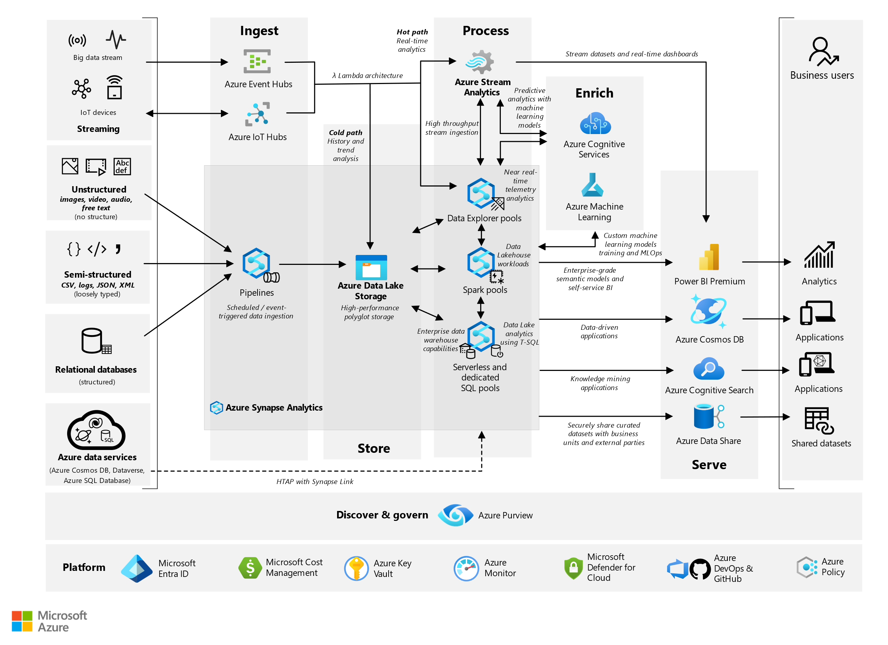
System Architecture

