Slide 1

Use this QR to access the resources used in the presentation
**If you have not filled the pre-workshop questionnaire please fill it now**
*Link is available in the QR Code

Slide 2
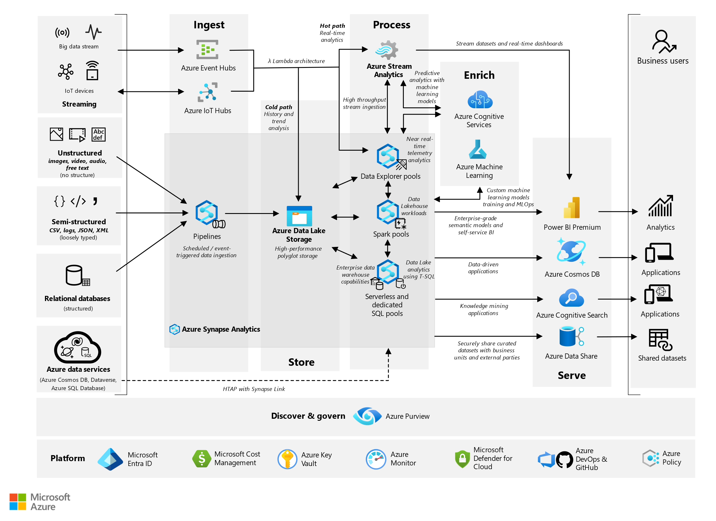
System Architecture

Slide 3




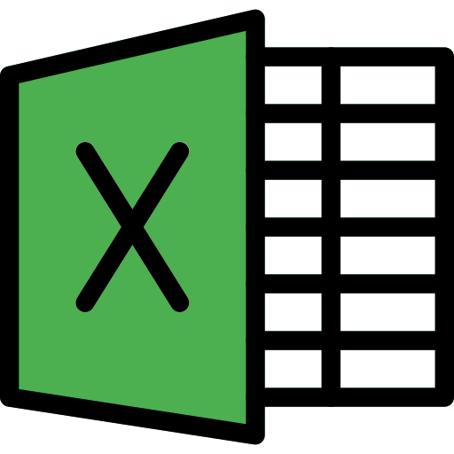
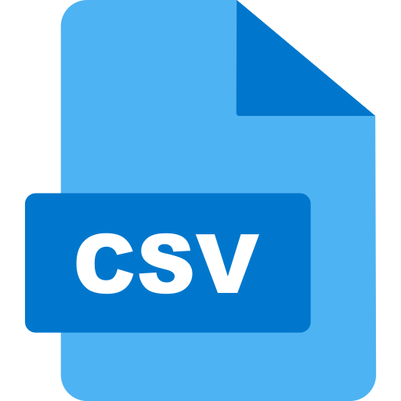








Flat File
Informatica Product Suite
Excel Worksheet
Azure Data Factory
System Architecture Simplified (Azure)
Intermediary layers of processing
Delimited File in form of CSV
Azure Data Lake Storage
Database Object
Database Tools
Staging Sources
Pre-Processing Requirements
Exposed Layer
View
Table
Microsoft PowerBI
Microsoft Fabric
Azure Data Lake Storage
Azure Machine Learning Studio
Azure Synapse Analytics
Microsoft SQL Server Services

Slide 4
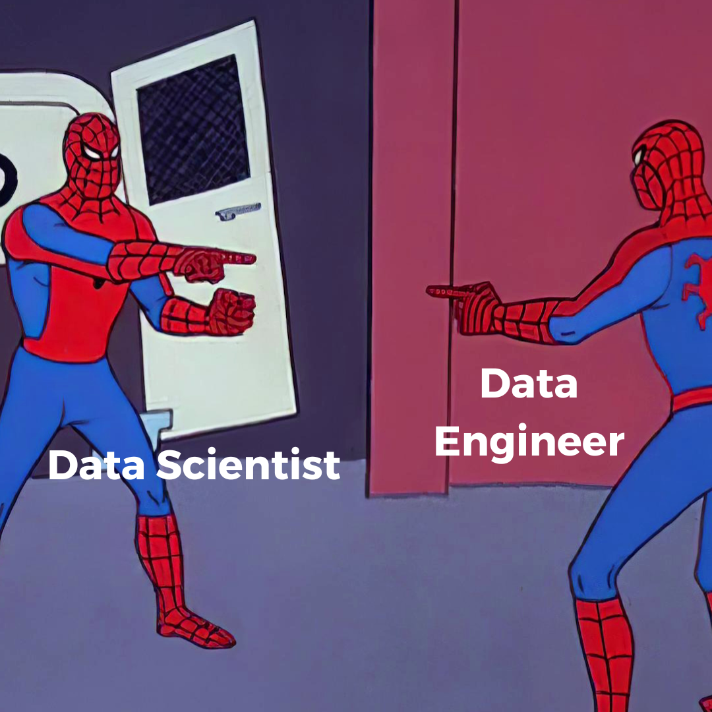
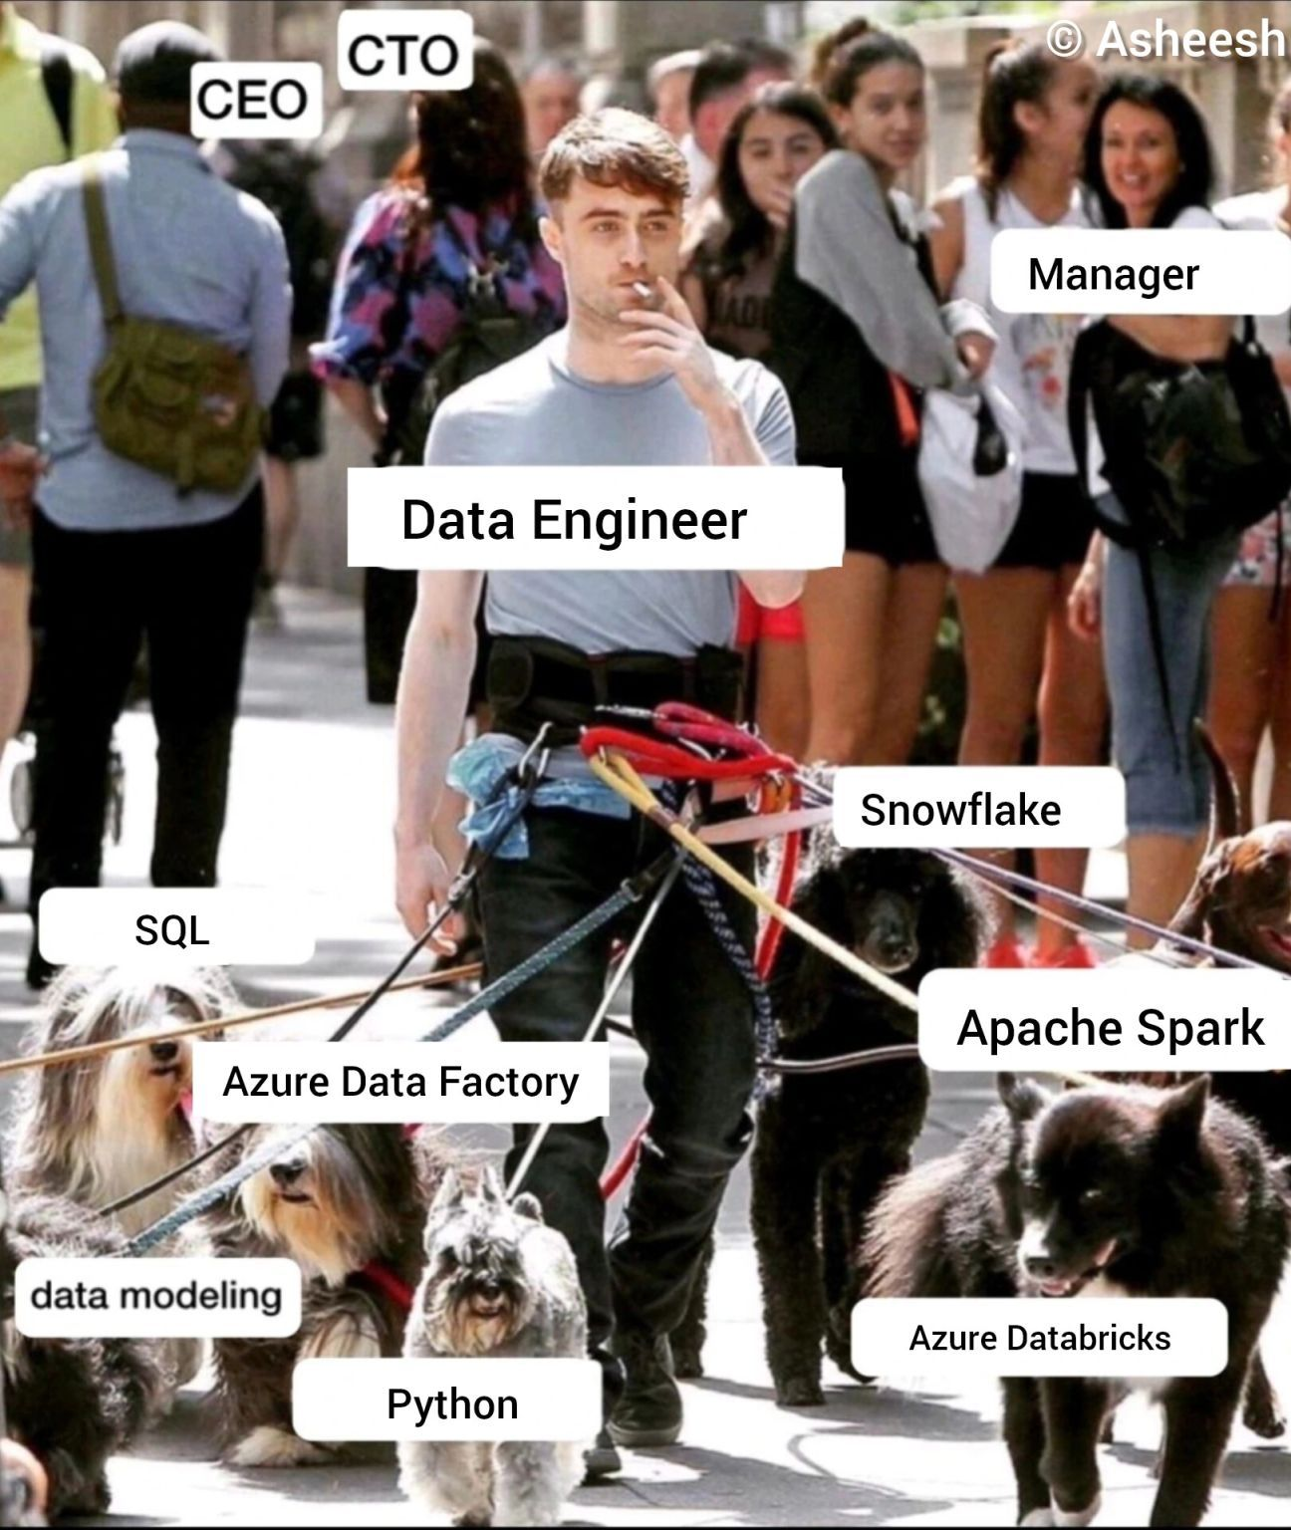
What it is like to be a Data Engineer

Slide 5
Career path based on platform of choice
Azure | Amazon Web Services | Google Cloud Platform
🔵 | 🟠 AWS Certified Cloud Practitioner (CLF-C02)* 🟠 AWS Certified Data Analytics- Specialty (DAS-C01) 🟠 AWS Certified Solutions Architect- Associate (SAA-C03)* 🟠 AWS Certified Machine Learning- Specialty(MLS-C01) 🟠 AWS Certified Big Data- Specialty ** | 🟡 Google Associate Cloud Engineer * 🟡 Google Professional Data Engineer (PDE) 🟡 Google Professional Machine Learning Engineer
* Indicates these certificate are optional and are not mandatory but are good to have skills based on certification
** Indicates the certification is either deprecated or is phased out for something newer

