Slide 1

Use this QR to access the resources used in the presentation
**If you have not filled the pre-workshop questionnaire please fill it now**
*Link is available in the QR Code

Slide 2
YouTube Transcript Generator & Summarization Tool
Developed a YouTube Transcript Generator using BART by Meta AI as a minor project (Aug 2021 – Nov 2021), later migrating to T5 & PEGASUS by Google and applying LLM techniques for improved efficiency (Jan 2023 – Nov 2023), before merging with NotebookLM for lightweight, fast responses.
Open Source Contribution
Contributed to the YouTube Transcript API, enabling snapshot-based channel recovery to identify compromised accounts (Sept 2023 – Feb 2024). Focused on providing proof of account recovery post-Linus Tech Tips hack (2023), and the tool was also used by VS Autos during his channel hijack in late 2023, while it was still under development and not yet ready for public use.
Developed a Cross-Server Spam Management System for Discord using Discord apps (formerly bots), implementing user moderation and logging to enhance server security, with moderation handled by the application (Dec 2023 – July 2024).
Contributed to driver translation optimization for borderless windowed applications (especially games), integrated into Wine and Proton by Valve (Feb 2021 – July 2021).
Bug Bounty Achievement
Identified and reported a token hijacking vulnerability in the Riot Client using packet manipulation, successfully demonstrating the ability to compromise accounts in Valorant and League of Legends lobbies (Nov 2023 – Feb 2024). This vulnerability was also identified on Windows 11, a platform that is designed to be a more secure environment due to the mandate of TPM 2.0 functionality.
Folding@home Contribution
Contributed computational power to the Folding@home project, advancing research in protein folding and disease understanding. Contributed an estimated 75 teraflops of computing power over 2 years and 9 months (Mar 2020 – Dec 2022), supporting advancements in understanding diseases like Alzheimer’s, cancer, and more.
What you won’t know about me

Slide 3
Importance of the role
Standard system architecture
Certification path based on platform of choice
Similarity with the sister role: Data Analyst
Scope and career path as data engineer
Basic skillset requirement
Most commonly used tools
How to start your career as a data engineer
Future of data engineering
Data engineering in AI
Case study: Corridor of time in Destiny 2
Live demo session
In This Session

Slide 4
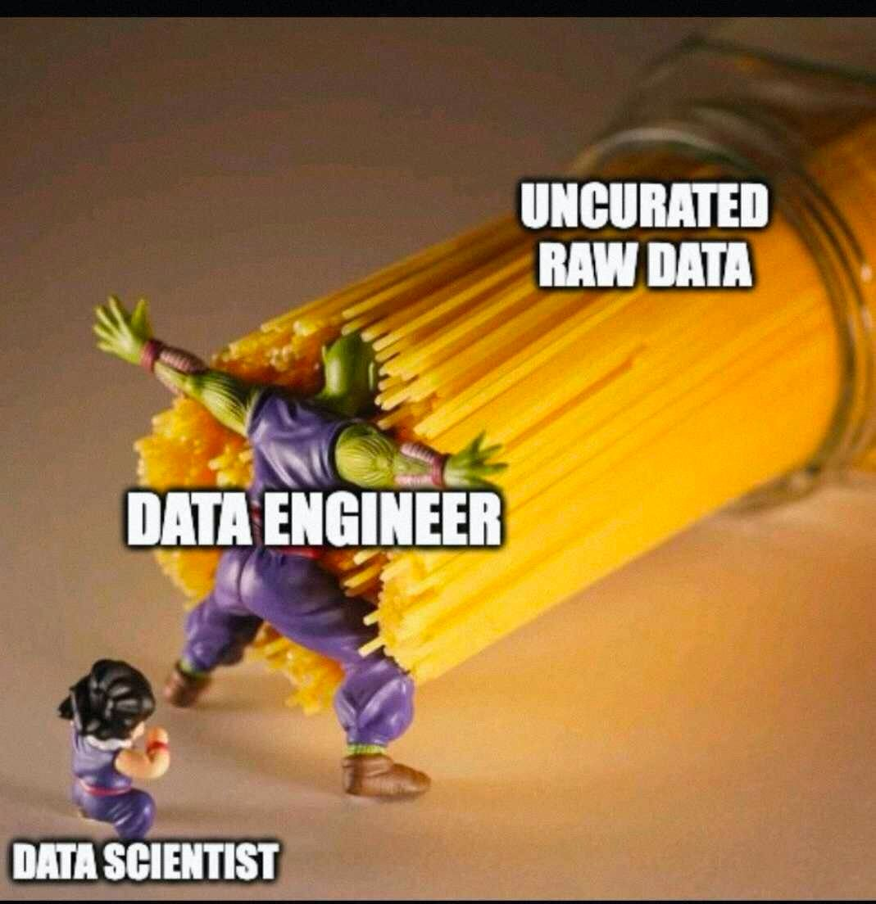
Take any sort of input and curate them according to the need of business requirement or logic.
First step in the foundation of any data related projects.
Build the necessary infrastructure to create any form of data models.
Described as a jack of all trade in the domain due to the flexibility of the role.
Example: Tomato Leaf Disease Dataset at Kaggle
(Here you can apply concepts like data pre-processing and ingestion)
Importance of Data Engineer

Slide 5
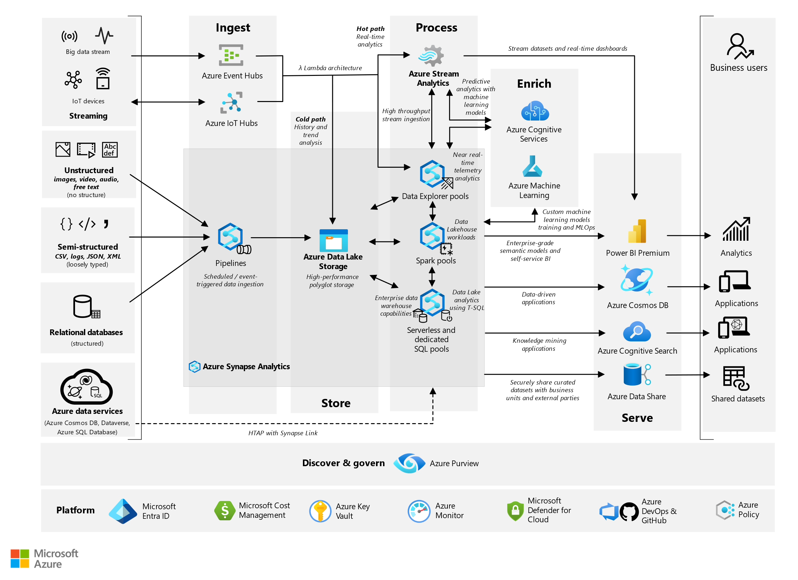
System Architecture

Slide 6



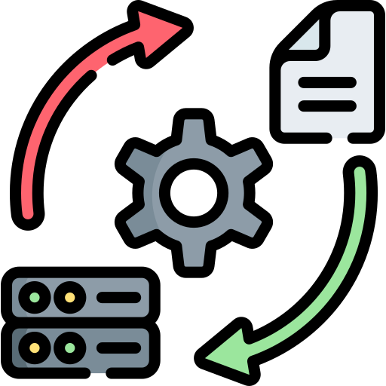
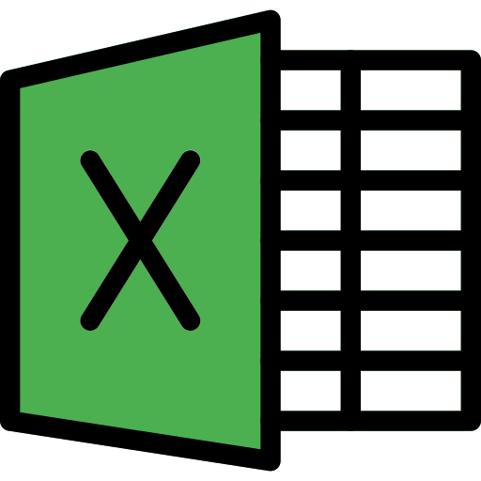



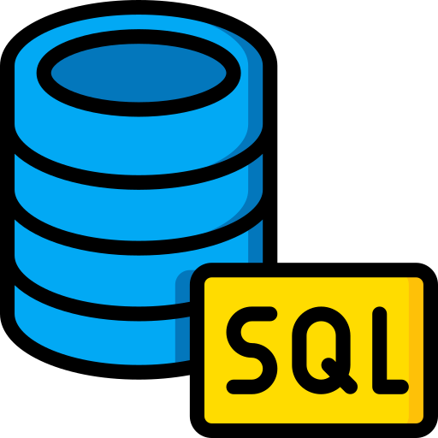







Other Sources
Informatica Product Suite
Excel Worksheet
Azure Data Factory
System Architecture Simplified (Azure)
Intermediary layers of processing
Delimited File in form of CSV
Python Scripts
Database Tools
Azure Data Lake Storage
Database Object
Staging Sources
Pre-Processing Requirements
Exposed Layer
View
Table
Microsoft PowerBI
Microsoft Fabric
Azure Data Lake Storage
Azure Machine Learning Studio
Azure Synapse Analytics
Microsoft SQL Server Services
Application Layer

Slide 7
Amazon Web Services | Azure | Google Cloud Platform
🟠 Has the most robust scaling for computation power. 🟠 One of the most affordable solutions for individual or small scale projects. 🟠 Offers coverage of most geographic without loss of flexibility. | 🔵 Best of large scale operation due to availability of wide variety of solutions. 🔵 Option to integrate with local cloud while leveraging Azure services to increase efficiency. 🔵 End user can maintain confidentiality while still using the platform for its services | 🟡 Best in analytical fields due to Google’s background in market research and data collection methods using the G-Suite. 🟡 Used in large scale projects related of large data-set processing.
Difference between the cloud platforms

Slide 8
Azure | Amazon Web Services | Google Cloud Platform
🔵 Azure Fundamentals (AZ-900) * 🔵Azure Data Fundamentals (DP-900) * 🔵Azure Data Engineer Associate (DP-203) ** 🔵 Fabric Data Engineer Associate Certification (DP-700) 🔵 Azure AI Engineer Associate (AI-102) 🔵 Azure Solutions Architect Expert (AZ-305) * | 🟠 AWS Certified Cloud Practitioner (CLF-C02) * 🟠 AWS Certified Data Analytics- Specialty (DAS-C01) 🟠 AWS Certified Solutions Architect- Associate (SAA-C03) * 🟠 AWS Certified Machine Learning- Specialty(MLS-C01) 🟠 AWS Certified Big Data- Specialty ** | 🟡 Google Associate Cloud Engineer * 🟡 Google Professional Data Engineer (PDE) 🟡 Google Professional Machine Learning Engineer
Certification path based on platform of choice
* Indicates these certificate are optional and are not mandatory but are good to have skills based on certification
** Indicates the certification is either deprecated or is phased out for something newer

Slide 9
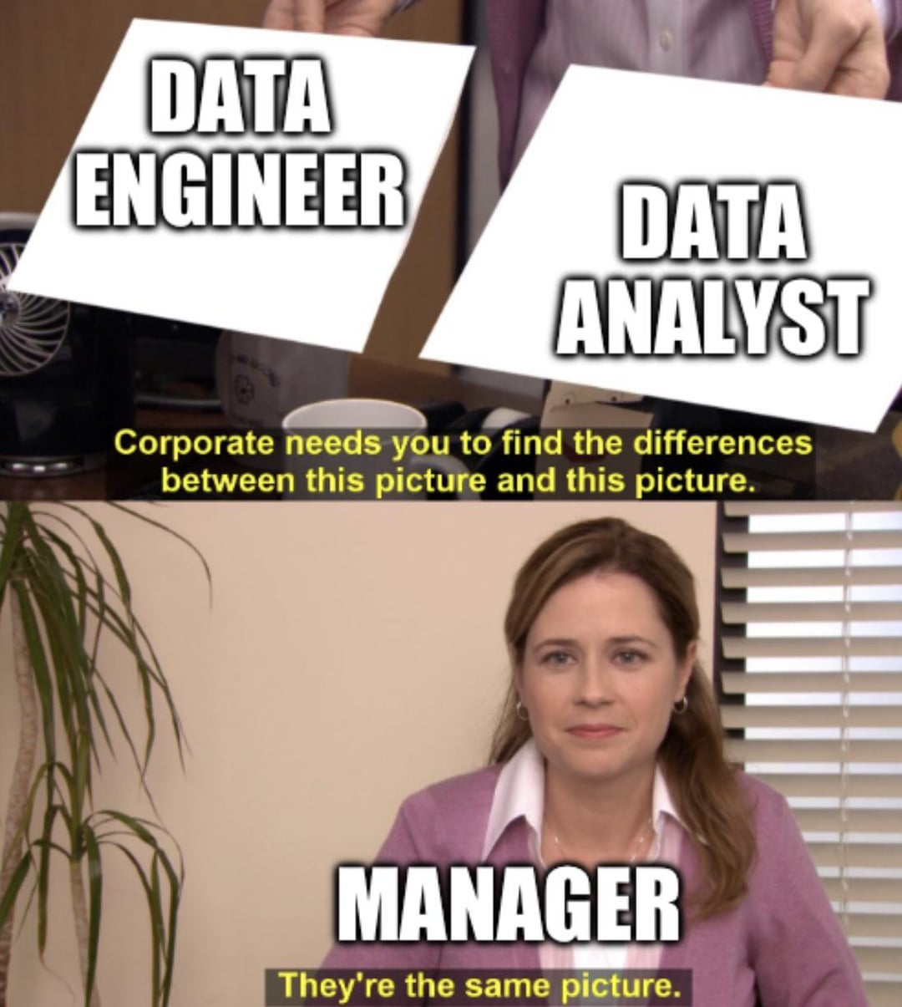
Is very commonly mistaken as the roles overlap a lot when it comes to skills
Data Engineer: Build, maintain the infrastructure for the data streams.
Data Analyst: Create valuable insights based on the data stream obtained.
Both teams work very closely with the business team to achieve the required goal which is to obtain the key point indicator called KPI in short.
Data Engineers are the unsung hero when it comes to the line of work while Data Analyst role is transform these data into presentable format obtaining the insights which drives the decision at organization level
Difference between sister role of Data Analyst

Slide 10
Data Engineer
(0-3 Years)
Senior Data Engineer
(3-9 Years)
Entry Level
Mid Level
Advanced Level
Data Warehouse Engineer
(3-7 Years)
Lead Data Engineer
(8+ Years)
Big Data Engineer
(7+ Years)
Machine Learning Engineer
(5+ Years)
Data Architect
(8+ Years)
Junior Machine Learning Engineer
(2-4 Years)
Career Path for Aspiring Data Engineer

Slide 11
Data Analyst
(0-2 Years)
Senior Data Analyst
(3-6 Years)
Data Scientist
(7+ Years)
Lead Data Scientist
(10+ Years)
Business Intelligence Analyst
(2-5 Years)
Business Solutions Manager
(6+ Years)
Entry Level
Mid Level
Advanced Level
Product Manager
(8+ Years)
Career Path for Aspiring Data Analyst
Business Analyst
(1-4 Years)
Senior Business Analyst
(3-5 Years)
Green box here represents non- technical/ low code roles where the Analyst primarily focuses on the business aspect than the technicality of building modules.

Slide 12
Programming Skill: Python, Scala, Java
Framework: Apache Spark, Apache Hadoop, Kafka
Cloud Technology like AWS, Azure and GCP
Data Modelling and Extract Transform Load (ETL) pipeline
Data Warehousing (DW)
Business Intelligence (BI)
Database management
Basic problem solving skills
Common basic skill for a Data related role
**Aspirant developer

Slide 13
Cloud platform specific
AWS
S3 for storage
Redshift for data warehousing
Lambda for data processing
Glue for ETL workflows
RDS for database management
Azure
Data Lake Storage for storage
SQL Database for database management
Synapse for data warehousing
Data Factory for ETL
GCP
BigQuery for Data warehousing
Cloud Storage for storage
Dataflow for batch processing
Dataproc for Hadoop and spark cluster
Good to have skills
Database: RDBMS, NOSQL
Data warehouse
Data pipeline for ETL
Shell Scripting for task automation
Python specifically for data pipeline and adding failsafe code
In specific skills for Data Engineers

Slide 14
Cloud platform specific
AWS
S3 for storage
Redshift Spectrum for Data querying
Lambda for data processing
QuickSight for visualization
Azure
Blob Storage for storage
SQL Database for database management
Synapse SQL Pool for data warehousing
Power BI for visualization
GCP
BigQuery for Data querying
Cloud Storage for storage
Data Studio for visualization
Good to have skills
Business Intelligence tools: Power BI, Tableau
Problem solving
Testing skill for data validation
Python specifically for data analytics (like pandas, numpy, matplotlib, plotly)
Excel
In specific skills for Data Analyst

Slide 15
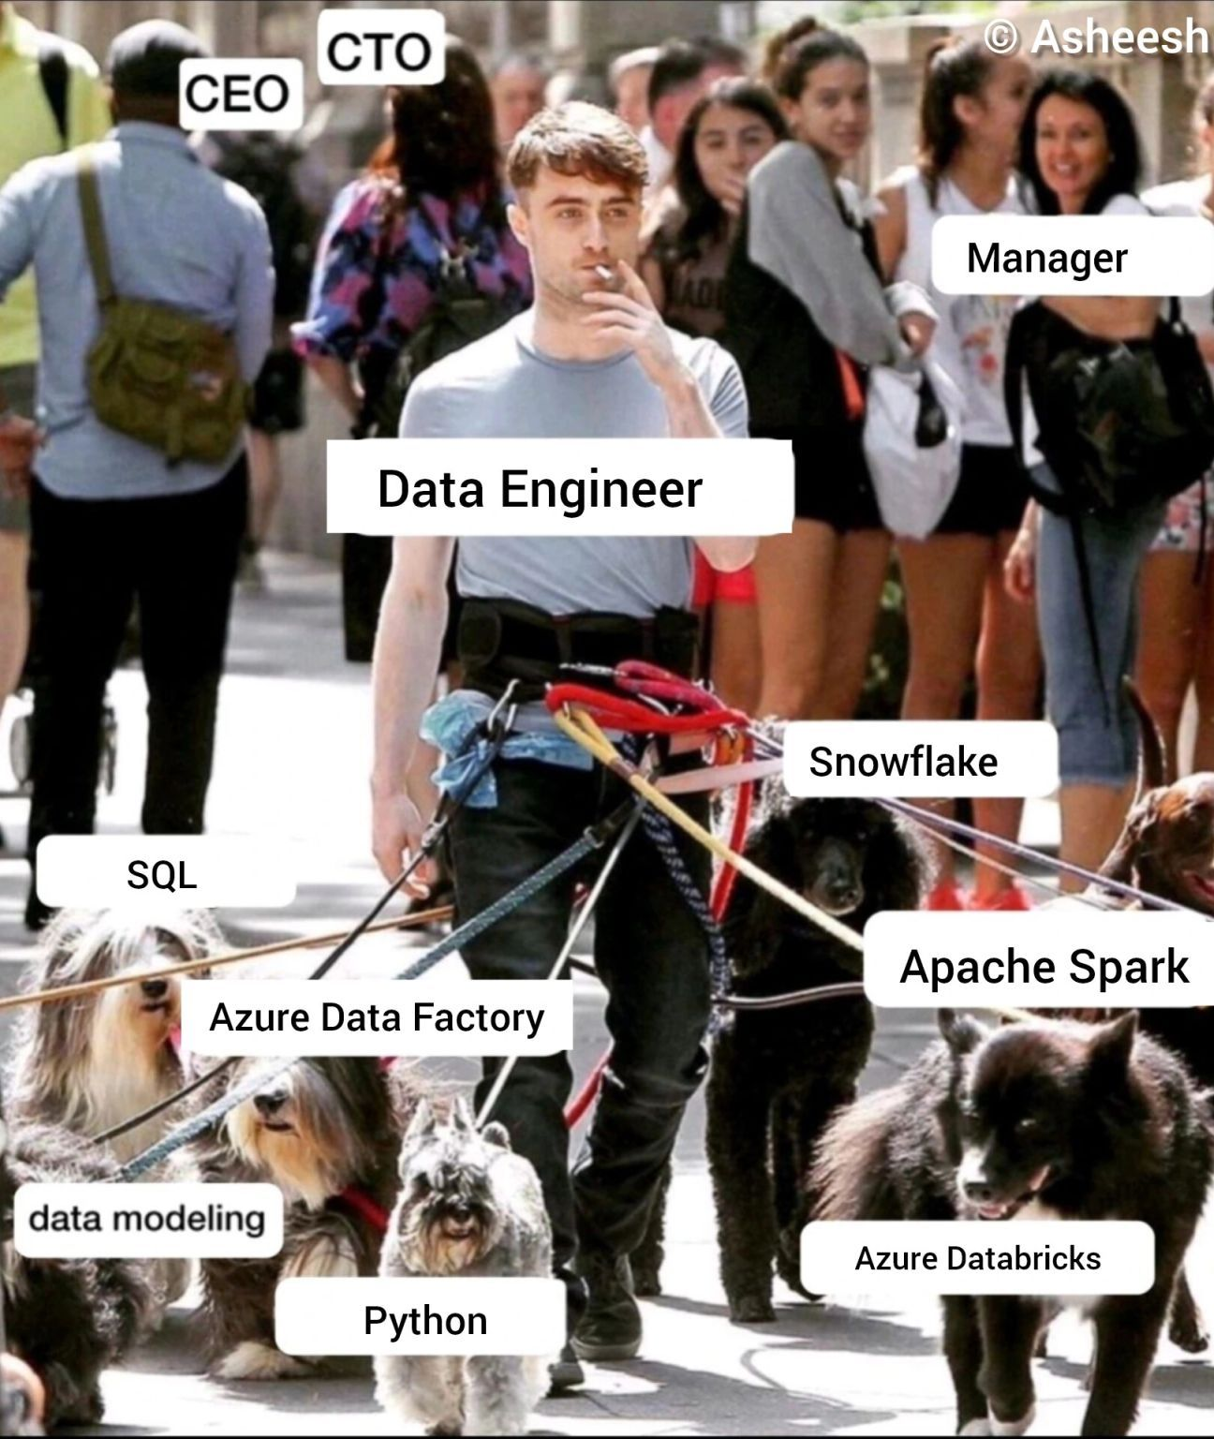
Strengthen your core skills: Programming, Scripting
DSA (YES FOCUS IS A MUST ON THIS)
Database Management: both in RDBMS and NOSQL
Big Data Tools
Cloud Platform
Try and build real time projects and real time data if possible
Get certified in the foundational skills related to your core skills
Build your portfolio
Connect with members in the industry
Get Started- College version

Slide 16
2000-2010
Transition from traditional database system to relational model and no query models like NOSQL
2010-2020
Evolution of Big Data tech by the cloud integration services
Real time data processing
2020- Present
With rise of computation power the field is moving towards merging with advancements in AI and ML
Data driven decision has become crucial in business strategies
Big Data analytics boom
Foundation of Data Engineer as a key role due to the massive volume of data being managed
AI is replacing early roles like data cleansing, optimization and filtering
Industry trends

Slide 17
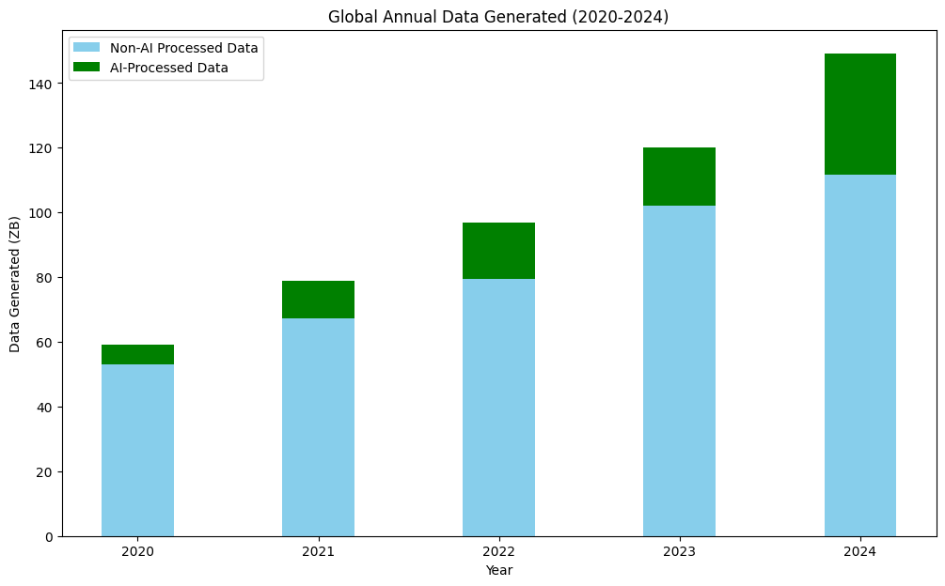
Data consolidated and generated using OpenAI GPT 3.5 Turbo along with DeepSeek V3
Data is also manually verified by checking the sources
Data Growth over years and what it means
Code for the plot available in repo
Sources for Global Data Generation:
IDC (International Data Corporation) - Reports on global data creation and storage.
Statista - Statistics and forecasts on data generation.
Cisco Annual Internet Report - Growth of internet traffic and IoT devices.
Sources for AI-Processed Data:
Gartner - AI adoption trends and enterprise data processing.
McKinsey & Company - AI adoption in industries like healthcare, finance, and retail.
Forrester - AI and automation in customer service, analytics, and operations.

Slide 18
Focus on foundation skill is not enough for both analytical role as well as a data engineer role.
Task automation and optimization.
Understanding of ML and AI modules in depth.
Theoretical knowledge is a must on cloud technology is a must even if lacking in hands one experience.
Skills good to have would be data governance and quality frameworks.
Real time analytics and processing with tools like Apache Flink and Pulsar.
Usage of AI in the workflow is encouraged (understand the key before leveraging AI even if it is your one stop solution).
Specialize in a specific sub domain if possible, it helps with getting noticed at work.
What to focus on

