Slide 1
Lab session 4
Four Bit ALU

Slide 2
Four Bit ALU block schematic
rFour Bit AU
A
B
2 2 to 1 MUX
Y
four Bit LU
select

Slide 3
Step 1Implement four bit Arithmetic circuit using Logisim
Function table
S1 | S0 | C in | Input I | Output of FA circuit | Operation
0 | 0 | 0 | B | D = A + B | Addition
0 | 0 | 1 | B | D = A + B+1 | Increment the sum by 1
0 | 1 | 0 | B’ | D = A + B’ | Subtraction with borrow
0 | 1 | 1 | B’ | D = A + B’+1 | Subtract B from A
1 | 0 | 0 | 0 (0000) | D = A | Transfer A
1 | 0 | 1 | 0(0000) | D = A + 1 | Increment A by 1
1 | 1 | 0 | 1 (1111) | D = A -1 | Decrement A by 1
1 | 1 | 1 | 1 (1111) | D = A | Transfer A

Slide 4
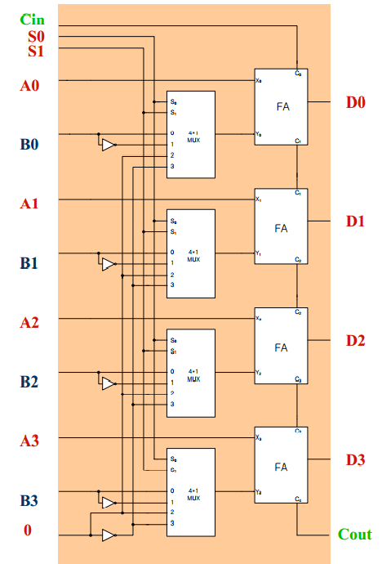
Complete circuit

Slide 5
Steps to be followed in LogiSim
Use the single bit circuit to make 4 bit arithmetic unit (AU)
Go to project → add circuit
Give circuit name
Drop 4 blocks of single bit AU to the new canvas
Drop 3 input variables each of size 4 bits, assign them proper labels ( A3A2A1A0, B3B2B1B0 and constant
Drop 3 splitters at the input side , change their attributes (Fan out = 4, bit width in =4)
Drop 3 single input pins S1, S0 and Cin
Drop one splitter at the output side, change its fan out and bit width in
Drop two output pins (single bit), name them as carry_ out and overflow
Drop one Ex-OR gate ( 2 i/p) and connect the carry_out of last two blocks
Connect the output of Ex-OR to the overflow pin
Test the circuit and verify the function table

Slide 6
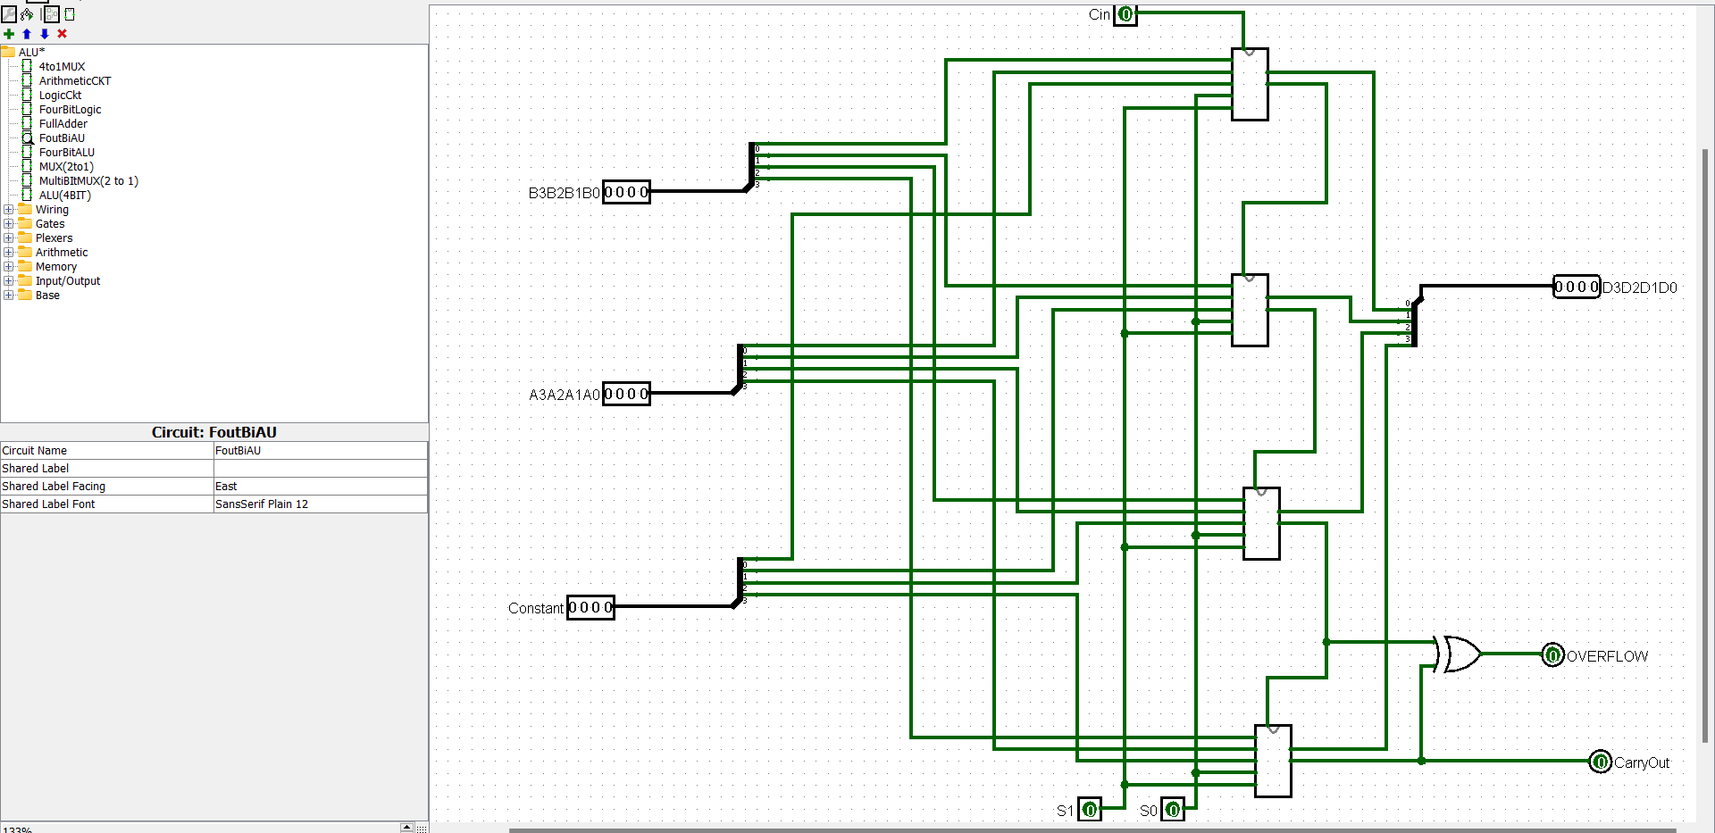

Slide 7
Step 2Four Stage Logic circuit
Go to project →Add circuit, give suitable name
Drag 4 units of single stage logic circuit
Give proper 4 bit data inputs and single bit select inputs
Connect 4 bit splitter at both input and output sides
Test the circuit

Slide 8
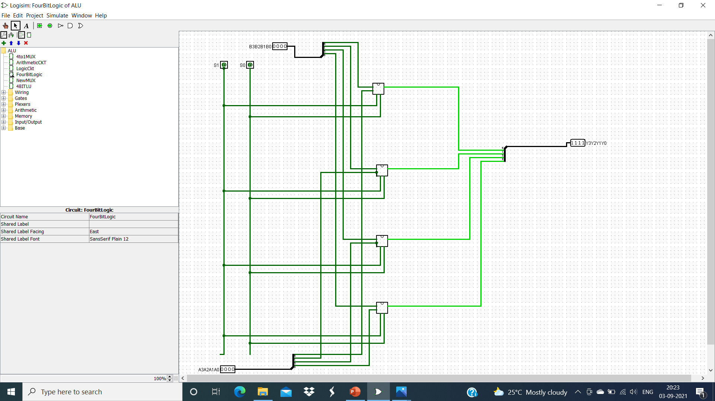
Logic unit with 4 bit data

Slide 9
Step 3:Design of 2 to 1 multibit MUX
Follow the steps for the design of 4 to 1 MUX to design 2 to 1 single bit MUX
Project → add circuit
Enter input variables, D0, D1 and S and Output Variable Y
Go to expressions, enter the expression
~S D0+S D1
Build circuit
add a new circuit and make four bit 2 to 1 MUX by dragging 4 blocks of 2 to 1 MUX

Slide 10
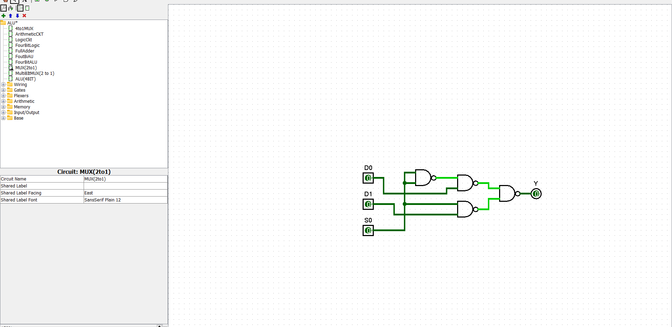
2 to 1 single bit MUX

Slide 11
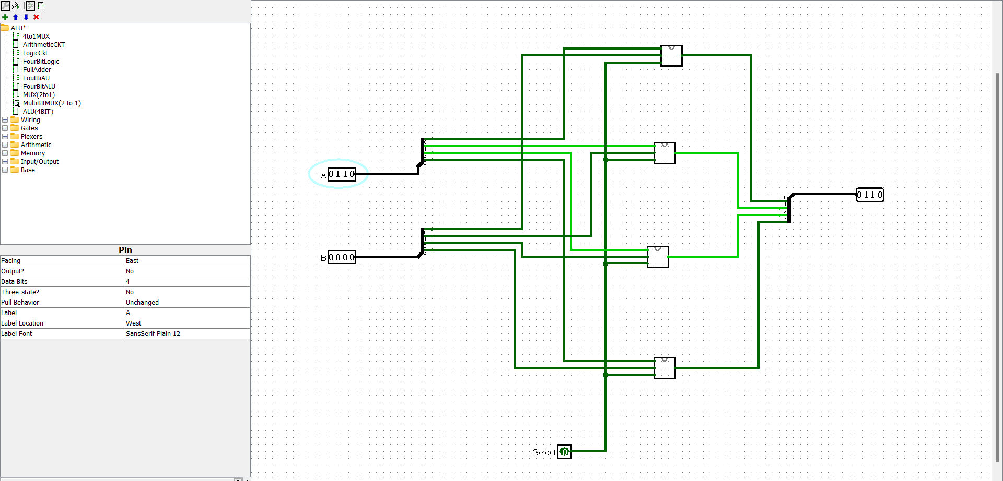
2 to 1 Multibit MUX( four bit)

Slide 12
Step 4 : Combine all the blocks
Project → add circuit
Give name as four bit ALU
Drag one block of 4 bit Arithmetic Unit
Drag one block of 4 bit Logic Unit
Drag one block of four bit 2 to 1 MUX
Give input variables including select lines and Cin
Test and verify

Slide 13
Function Table of Arithmetic Operations
S2 | S1 | S0 | Cin | Output of MUX
0 | 0 | 0 | 0 | A + B
0 | 0 | 0 | 1 | A + B +1
0 | 0 | 1 | 0 | A + B’
0 | 0 | 1 | 1 | A - B
0 | 1 | 0 | 0 | A
0 | 1 | 0 | 1 | A +1
0 | 1 | 1 | 0 | A -1

Slide 14
Function Table of logic operations
S2 | S1 | S0 | Cin | Output of MUX
1 | 0 | 0 | x ( 0/1) | A and B
1 | 0 | 1 | x | A or B
1 | 1 | 0 | x | A Ex-OR B
1 | 1 | 1 | x | A’

Slide 15
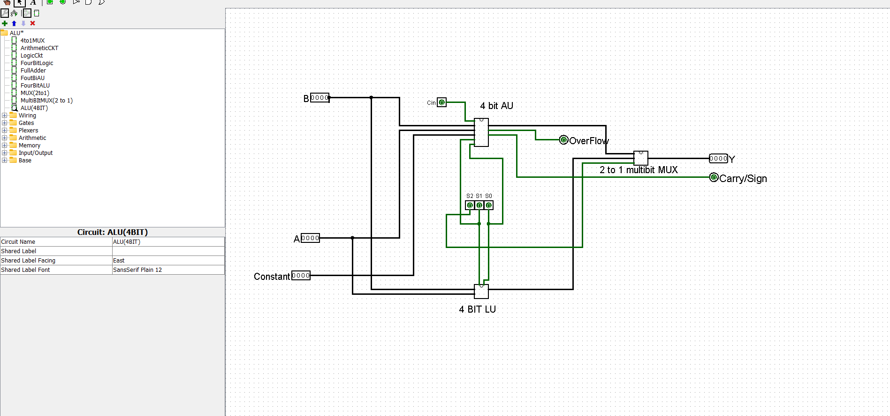
Screen Shot

