Slide 1

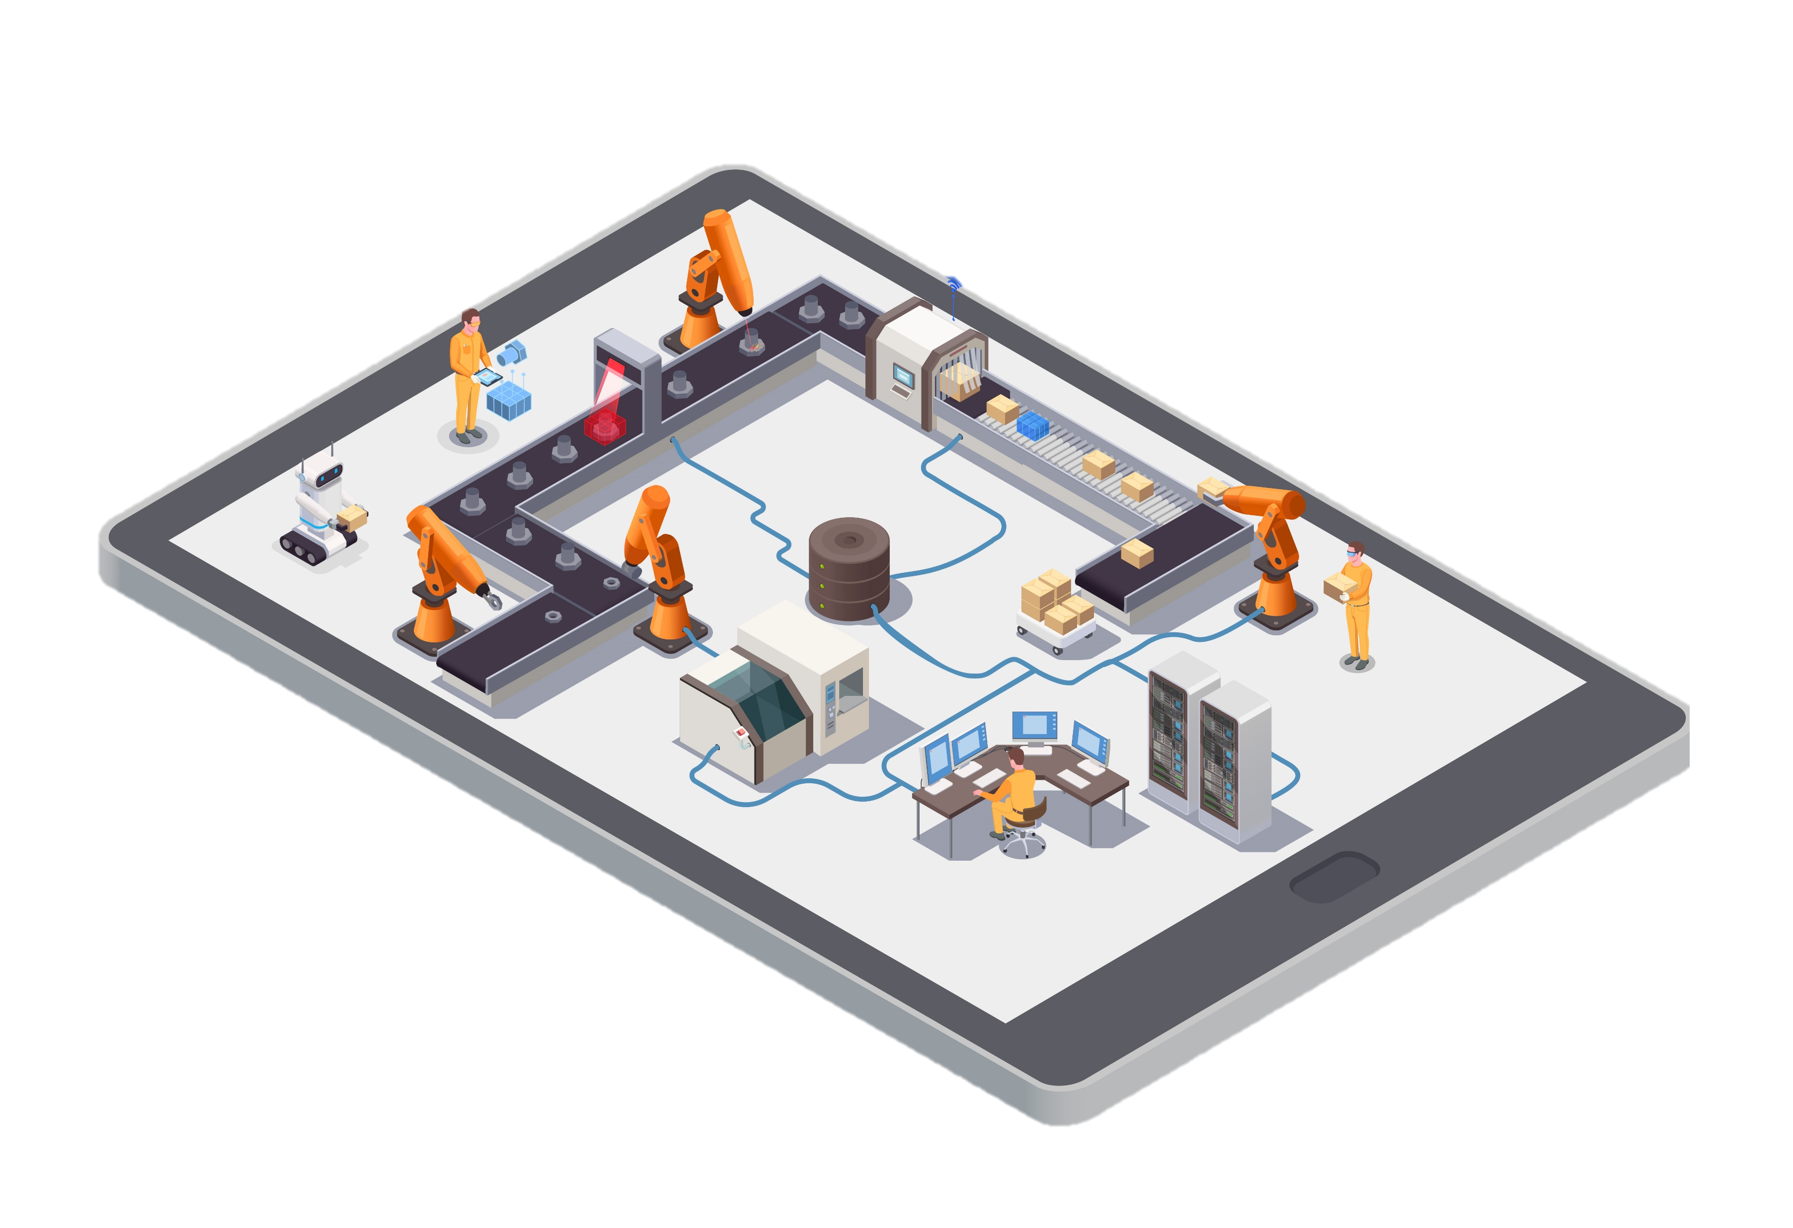
i-Scheduling
SMART – MAN PLANNING
MACHINE DIGITAL TWIN
PRODUCTION MANAGEMENT SYSTEM
Augmented reality learning & regulatory ai
Quarantine on the road
Your Factory Insights, Anytime, Anywhere.
PR-PO RM PM
STOCK INVENTORY
PM SCHEDULE
WEIGHING
HARDSKILL TRAINING
START
FG ANALYSIS
MATERIAL ANALYSIS
MACHINE ALLOCATION
COMPOUNDING
REGULATION TRAINING
DISPOSITION
MONITORING
PRODUCTION SCHEDULING
PERSONNEL COMPETENCE
BULK ANALYSIS
COMPLIANCE BOT/AI
WO PRODUKSI
PERSONNEL ALLOCATION
MACHINE REAL TIME STATUS
FG DELIVERY
FILLING
E-BATCH RECORD
PACKAGING

