Slide 1
Tutor Bot
Noah Harvey, Jenny Goldsher, Deandra Martin, Hiro Sato

Slide 2
Purpose
Design an application that can help intro CS students learn key python concepts while actually coding
Not meant to compile the code, but rather asks relevant questions that further students’ understanding of important concepts
Will serve as a supplement to in-person tutoring

Slide 3
Design: Overview
The tutor bot will use a backend server API through slack to communicate with students
The implementation of the question generation and parser will be in Python
The use of an online application makes this software constantly accessible to CS students

Slide 4
Requirements Elicitation
JAD Sessions
Feedback from Tutors
Discussed over what tutors wanted and what we could possibly implement

Slide 5
Requirements Engineering: Functional
o The system should allow users to enter a snippet of Python code
o The system should generate set of questions based on the Python code that user feeds in
o The system is a parser, not a compiler. This program should not execute the Python code and provide its output.
o The system should provide a link to a page that discusses common error messages and their meaning.
o The system should generate questions such as:
▪ Data type questions
▪ Basic syntax questions
▪ Questions about functions

Slide 6
Requirements Engineering: Non-Functional
o The system should be accessible to all students via the internet (Web application)
o It should be clear to user where they should insert their code snippet
o The application should be in the form of a chatbot where user can easily interact
o The system should generate answers but not show the answer until students at least try to answer those questions on their own first.
o The system does not necessarily have to display all the possible questions, the number of questions can be selected or randomly generated (Default is 7).
o The system should be implemented on a Linux server and using Python 3.

Slide 7
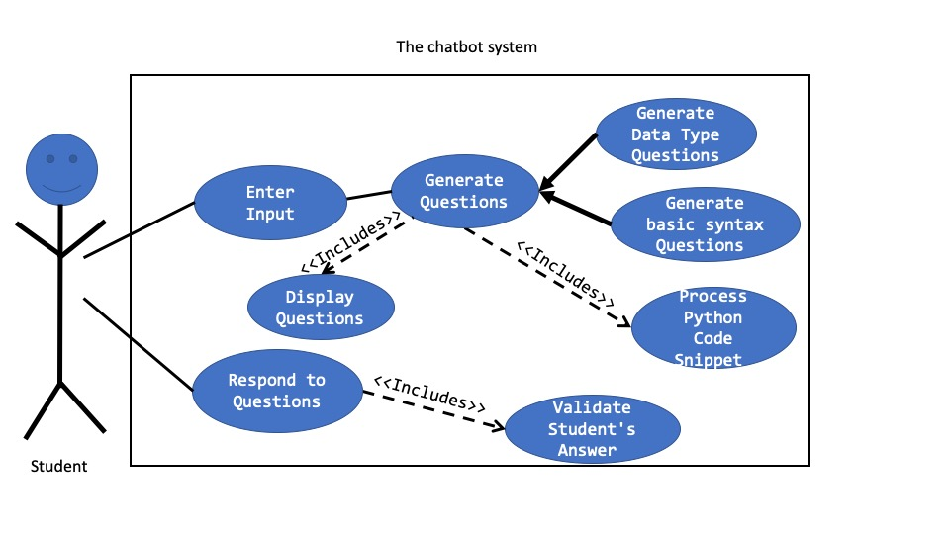
Use Case Diagram

Slide 8
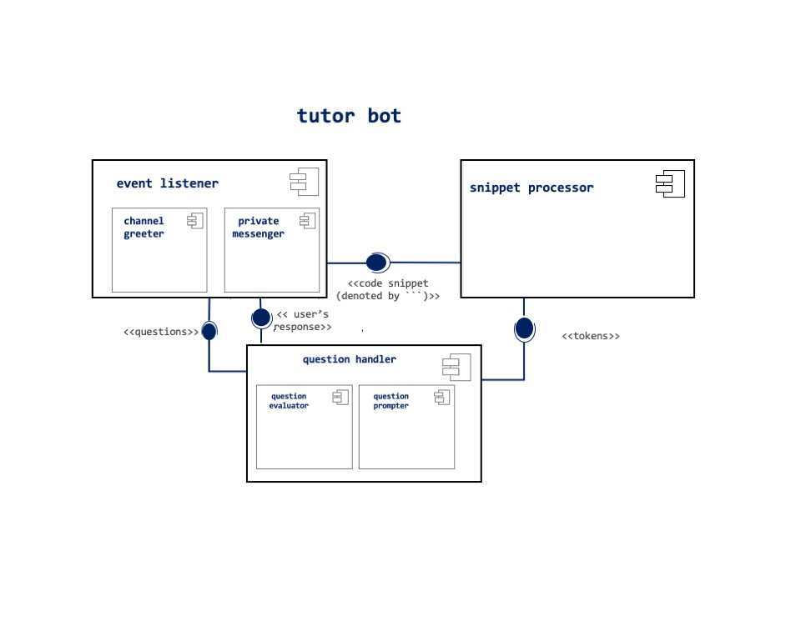
Design: Component Diagram

Slide 9
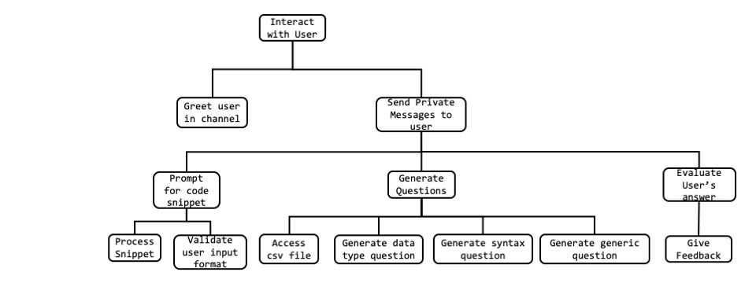
Function Decomposition

Slide 10
Implementation Question Generator
Pandas
A python library that allows us to easily manipulate a data file such as csv or json file using pandas dataframe
Dictionary
Python built-in data structure that functions as a hashmap that has key-value pair
Used as Question’s function, generate questions will return a list of dictionaries.
Being able to create questions according to the input

Slide 11
Implementation: Parser
Took the user input as a string, and returned a 2D array containing the parsed content of each line
The first element of each line was the number of spaces that the line began with, this allowed us to determine if the line was properly indented
The parser must also identify non-alphabetic and non-numerical characters as their own entities
The parser also identifies comments ‘#’ and these are not parsed
EX: ‘(‘ or ‘:’

Slide 12
Testing
Unit testing for the individual components (Event Listener, Snippet Processor, Question Generator) took place in multiple stages - implementation
Integration testing: Combining components that interact with each other and testing them
System testing: Making sure they system functions correctly as a whole and can handle abnormal inputs

Slide 13
Reflection: What went well
Transition from purpose to design - the process of creating the idea of an application to help students
Creating diagrams based off of the requirements we had previously made - this facilitated the Use Case Diagram
Implementation of components based off of component diagram
Learning new programming concepts with the help of the team

Slide 14
Reflection: Challenges
Testing - as we discussed in class, testing is an integral part of SDLC, but with limited implementation time, our testing was not able to be as exhaustive
Combining components from different programmers - although we made efforts to have clear documentation of inputs/outputs of functions or programs, it is always a challenge to combine code from multiple programmers
Using many platforms - this is also a main concern of SDLC (System Heterogeneity), specific to our project we used python as well as Slack’s API which made the implementation more challenging

Slide 15
Reflection: Helpful Changes
Have a longer time devoted to implementation which would have allowed for more thorough testing
More common documentation on how the different tools we were using interacted with each other
Differentiate which programmer writes the test cases (not on the code they wrote)

