Slide 1
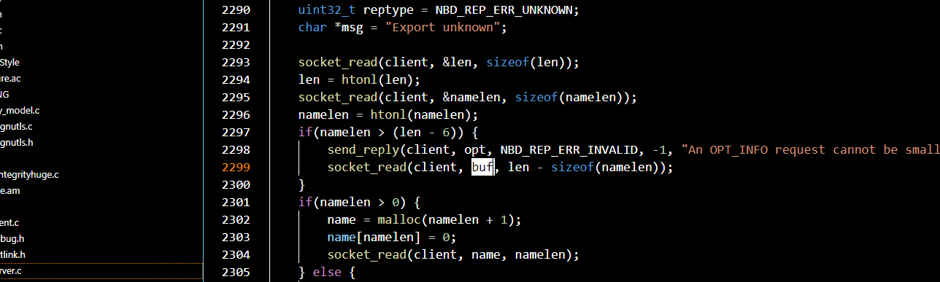


Buffer Overflow
How did I use 30Lines to solve P1
Xiang Mei
xm2146@nyu.edu

Slide 2

Outline
Buffer Overflow
Canary
Baby BOF
Real World

Slide 3
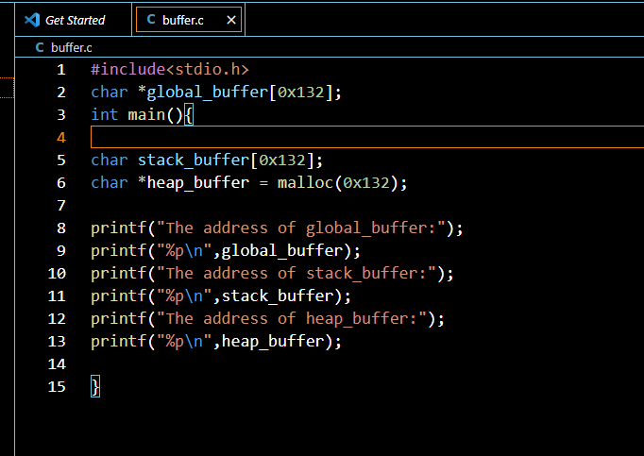
What’s Buffer?
A Chunk of Memory.
Global Buffer
Stack Buffer
Heap Buffer

Slide 4
How do we describe a buffer?
Where it starts, the address
Where is ends, the length
What would happen if we dump data to the buffer regardless the length?
Overflow
B
u
f
f
e
r
o
v
e
r
f
l
o
w

Slide 5
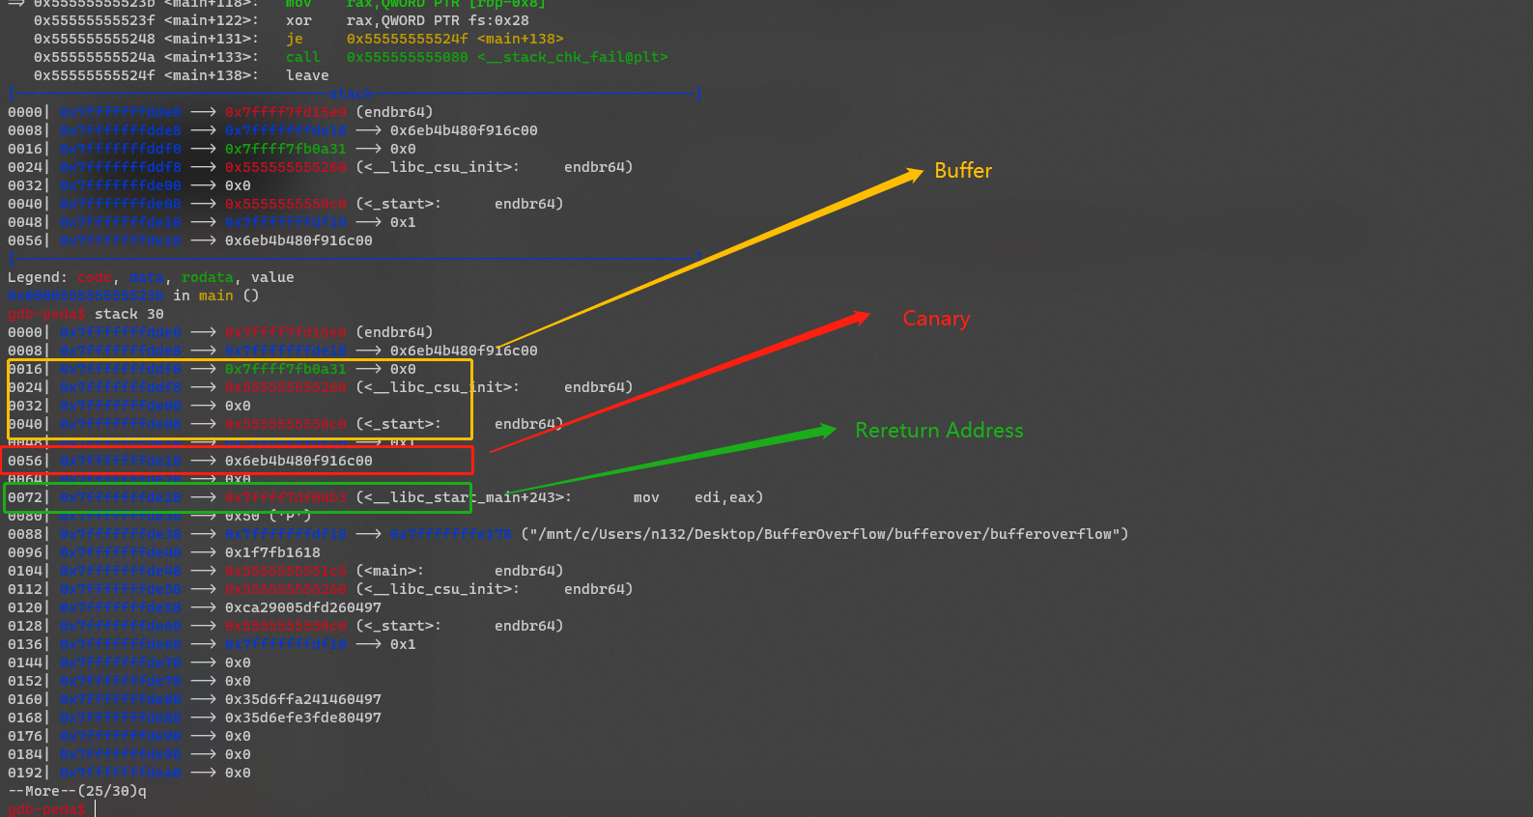
Canary
A random string, at the end of stack frame, the top of return information
RBP and return address
How could we pass it?
Leak it
Sub-Progress has the same canary as the father.

Slide 6
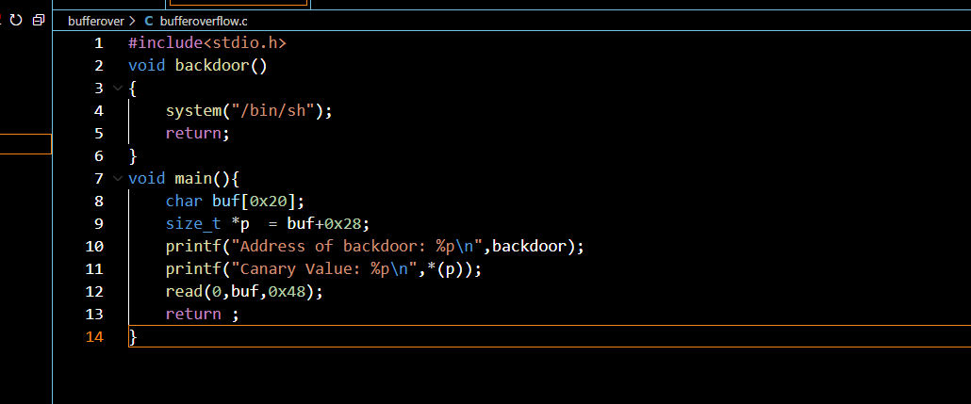
How do we use it?
B
u
f
f
e
r
o
v
e
r
f
l
o
w
The yellow cubes could be the return address, so we could modify the return address to execute arbitrary code(Bufferoverflow.c)

Slide 7
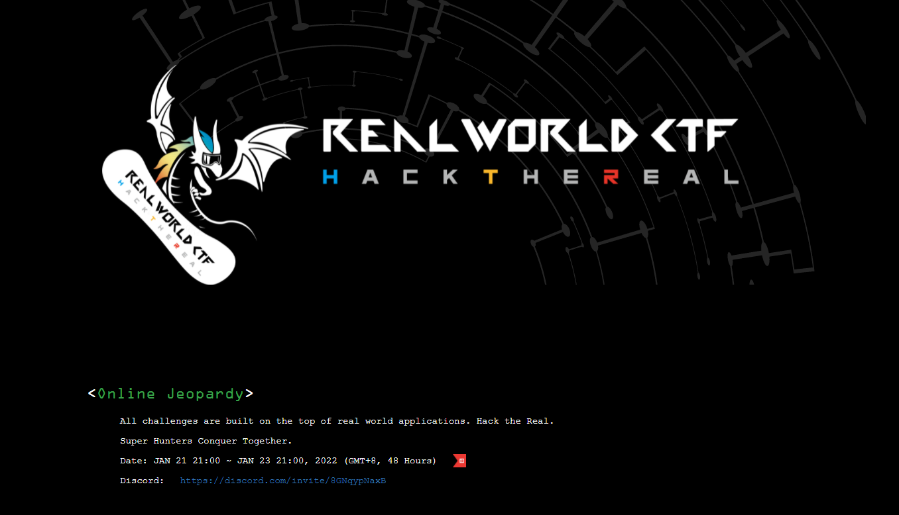
https://www.youtube.com/watch?v=Kq21DQ1_VfU

Slide 8
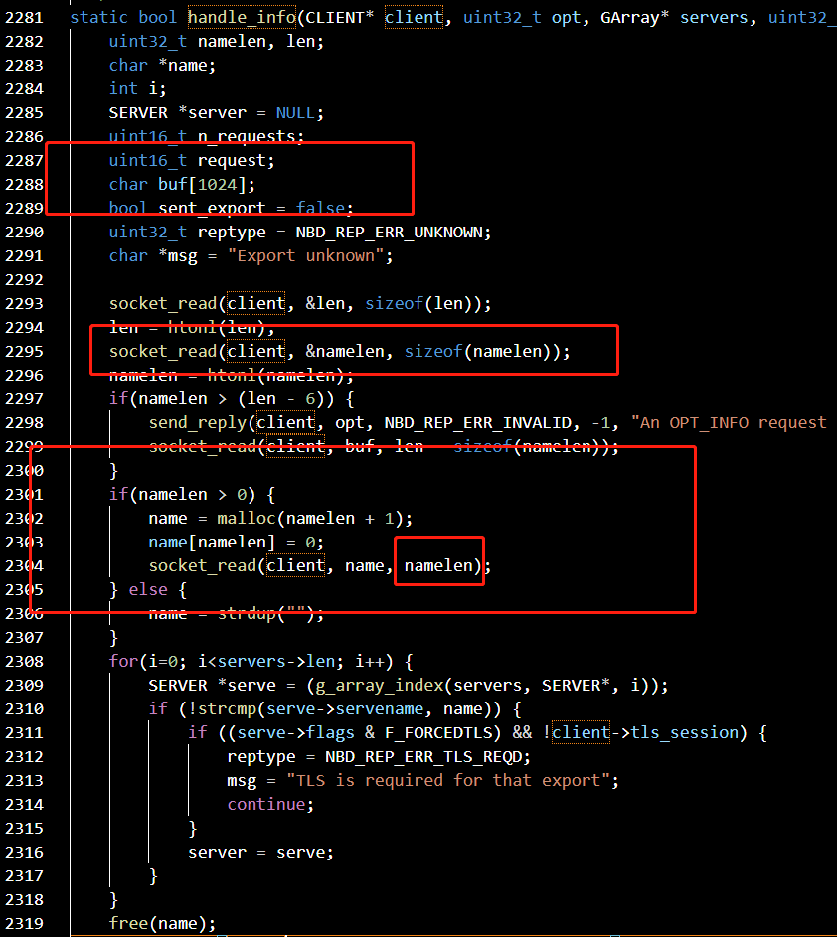
Clone & Pwn
https://github.com/NetworkBlockDevice/nbd
commit: 5750003711b8050bad3ddaf5196201ef419ce15d
./configure –enable-debug && make && make install

