Slide 1
Secure Multi-Party Communication
Xiang Mei, Ben Hou, Rachel Tao

Slide 2
Outline:
BackGround
Yao’s Protocol
Garbled Circuits
1-2 OT
GMW Protocol
Secret Sharing
1-4 OT
Compare
Runtime, Communication Complexity, Message Size
Summary

Slide 3


Scenario
Alice and Bob both input a number and hide it from each other
Alice and Bob want to know if their numbers are equal without knowing each other’s inputs
No trusted third party is present
?
10011
11110

Slide 4
MPC(Multi-Party Computation) Solutions
Protocol based on FHE (Fully Homomorphic Encryption)
Protocol based on boolean circuits
Yao’s Protocol
GMW Protocol
Protocols | Type | Results
BFV, CKKS | FHE | Slow and can only evaluate small circuits, but have low bandwidth
Yao’s garbled circuit, GMW | Boolean Circuits | Fast but complex
Notes:
in some cases it is beneficial to decrease the communication complexity at the cost of an increased round complexity by performing additions or multiplications using additively homomorphic encryption
SFE, a combination of GC and FHE, reduces GC size

Slide 5
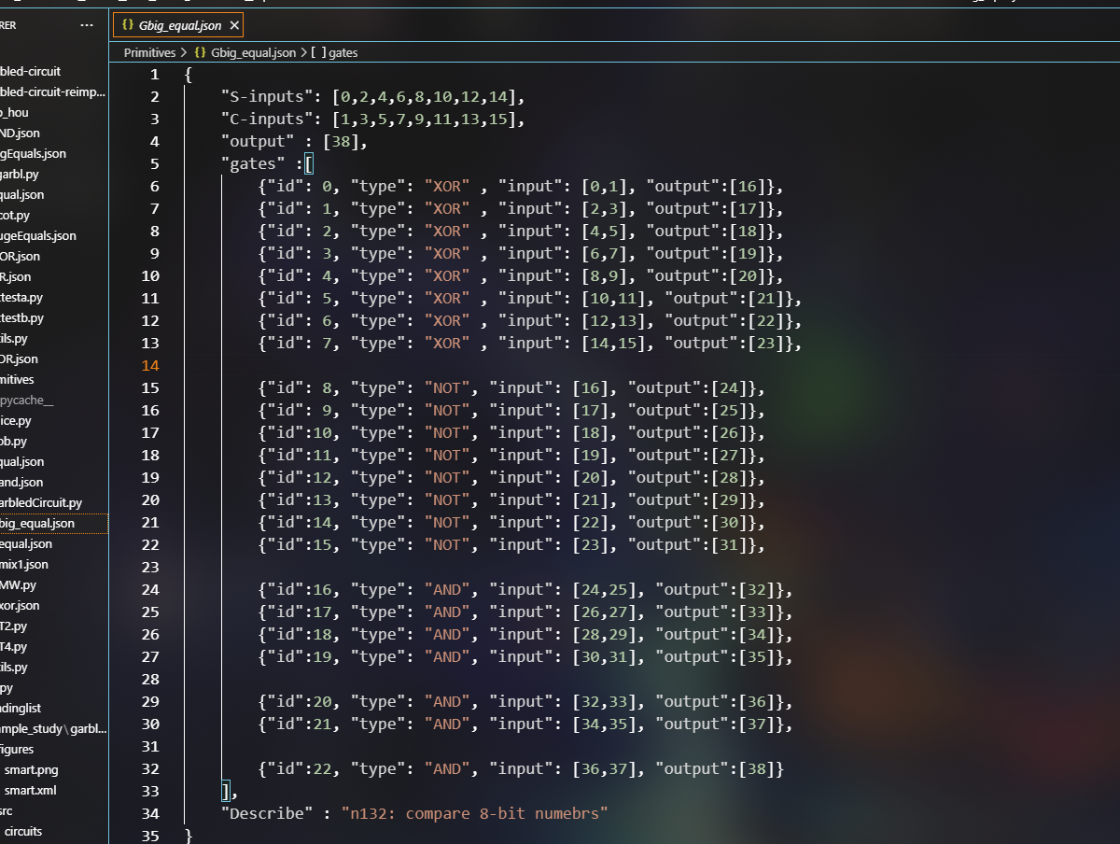
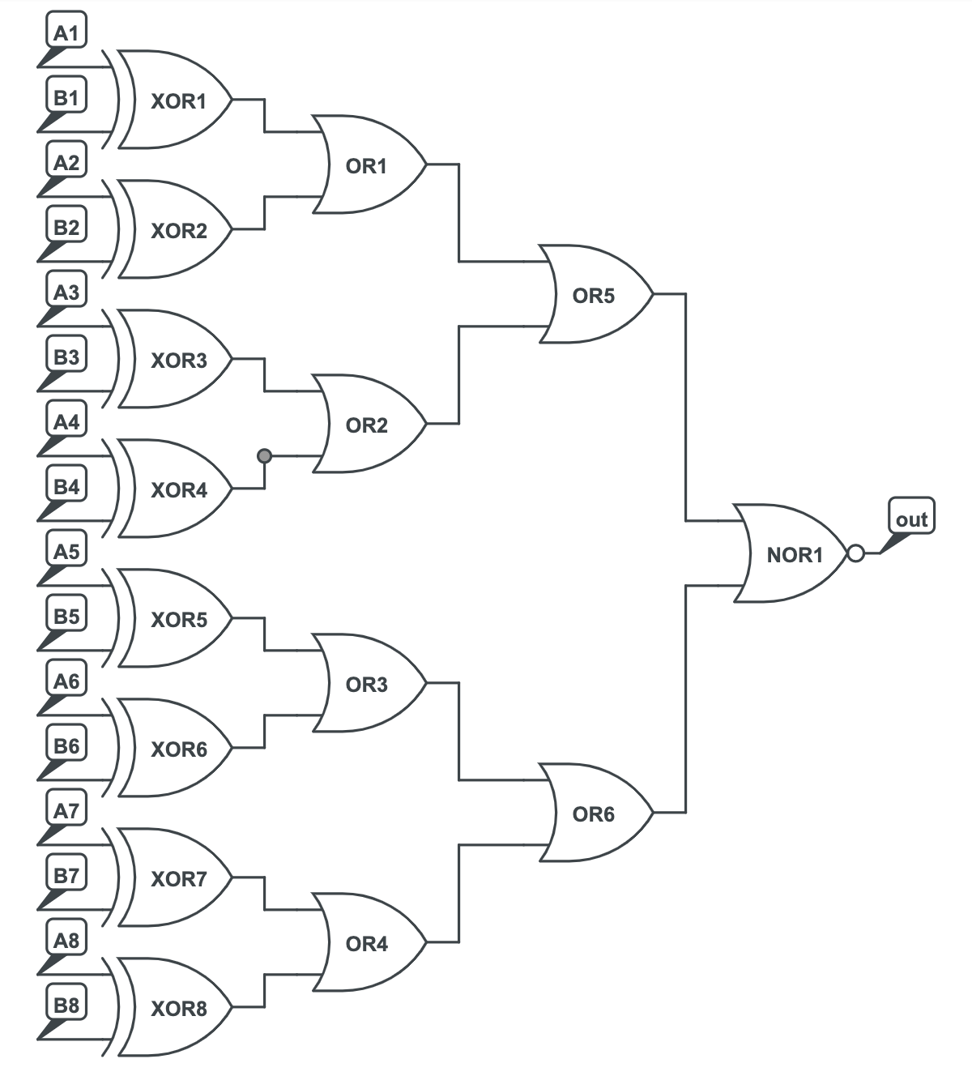
Function/Circuit
ANY FUNCTION (Theoretically)
Example: 8-bit equality circuit
Notes:
所有的可以转化为boolean circuits 的函数都是可以的，只要提供电路的描述文件就行，我们这里用Equality来举例。

Slide 6
Yao’s Garbled Circuit
GC Garbled Circuit
iLabel: Label input wires
cGarble: Generate garbled circuits
gcEval: Evaluate the garbled circuits
OT Oblivious Transfer
Sender transfers one of potentially many pieces of information to a receiver
But the remains oblivious as to what piece has been transferred.
Notes:
<1 minute. Should be a quick slide

Slide 7
Our implementation
The representation of the circuit
Symmetric Encryption: Fernet from python Cryptography module
AES-128-CBC
PKCS7 Padding
Secure Key Generation
Generating the garbled circuit
Each gate becomes a table, and the garbled circuit is a dictionary containing the tables for each gate
Map result keys to 0 and 1
Evaluating the Circuit
For each gate, attempt to decrypt rows with the keys
The resulting output key is checked with the result map to get the final result (0 or 1)
OT(1 in 2)

Slide 8
Implementation of Oblivious Transfer (BM Protocol)
Cyclic Group
Find a Generator
Options on cyclic group ( for example, Div Mul & Inverse)
The Procedure
1 in 2 OT & 1 in 4 OT
Concatenate three 1 in 2 OT
Use corresponding “keys” to decrypt the encoded message

Slide 9
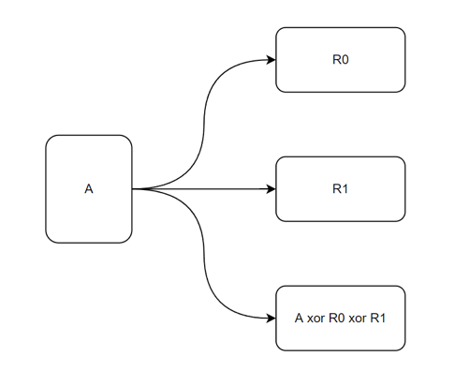
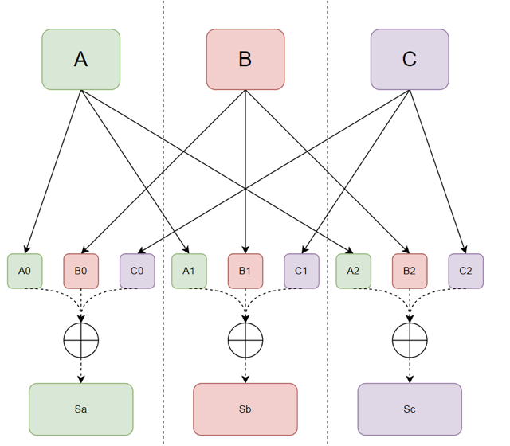
GMW
Secret Sharing
Each party separates inputs to n shares
Exchange shares
People could only reconstruct a secret with all its shares
Evaluation
NOT: Single Input Wire
XOR:
AND: 1 in 4 OT
OR: A ⋁ B = ¬ ( ( ¬ A ) ⋀ ( ¬ B ) )

Slide 10
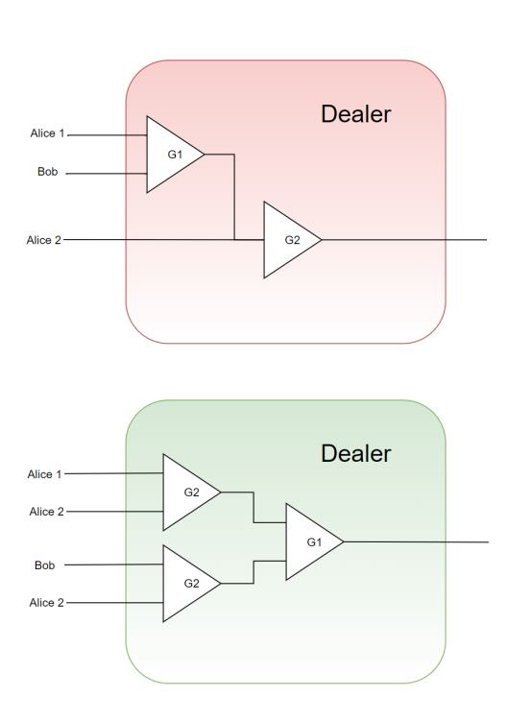
GMW Implementation (GMW-X)
Model 1
2-Party Secret Sharing + Evaluation Dealer
If we don’t have a dealer, the one who performs evaluation could know the other party’s input
Dealer evaluate the circuit without knowing people’s input
A problem:
So what if dealer need data only from one party ?
All the circuits in Model 1 could be transfer to Model 2
G1, G2 is one of [XOR, AND]
Model 2

Slide 11
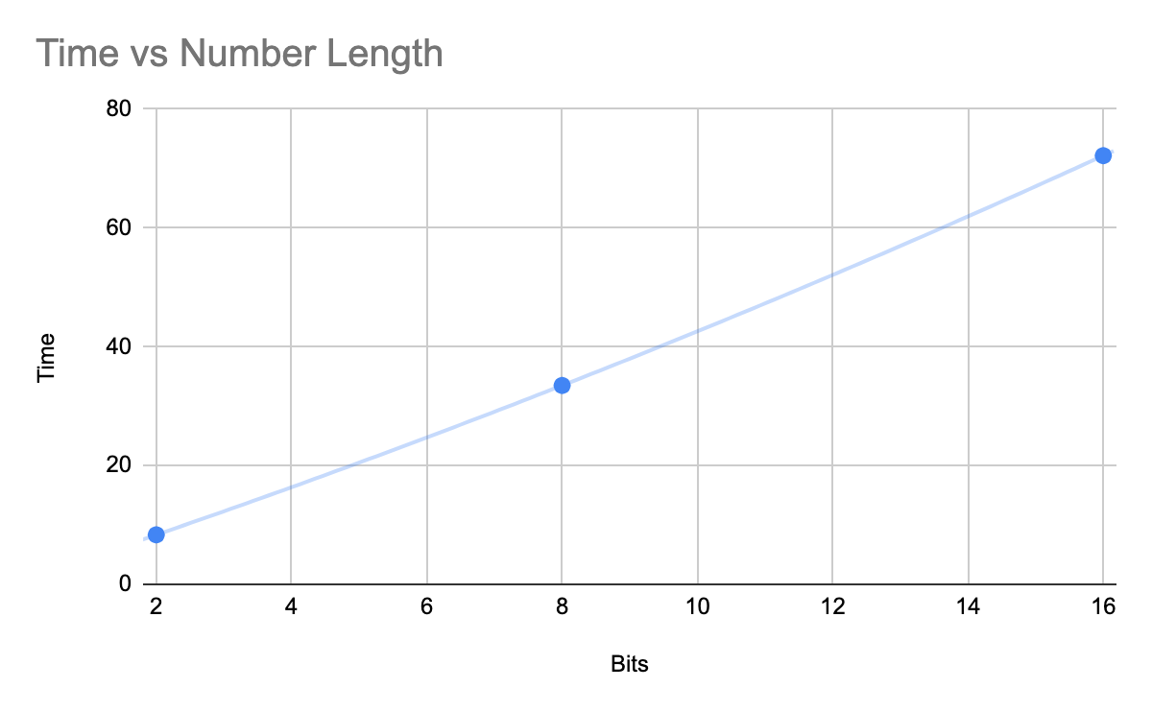
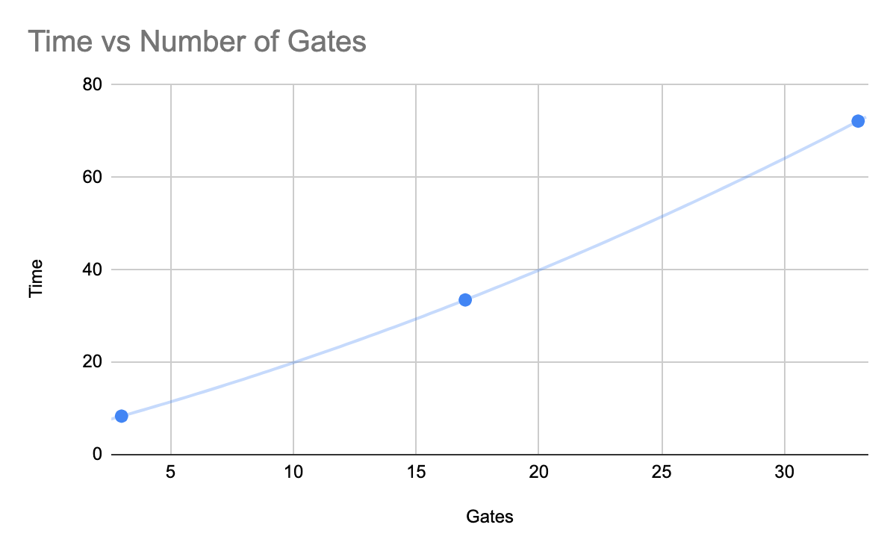
Performance - Yao’s garbled circuit
1-of-2 OT: ~2.03ms per secret transferred
Connection: ~0.5ms to establish TCP between Alice and Bob
About half the runtime is occupied by OT tests
Bits | Gates | Time
2 | 3 | 8.33
8 | 17 | 33.48
16 | 33 | 72.18

Slide 12
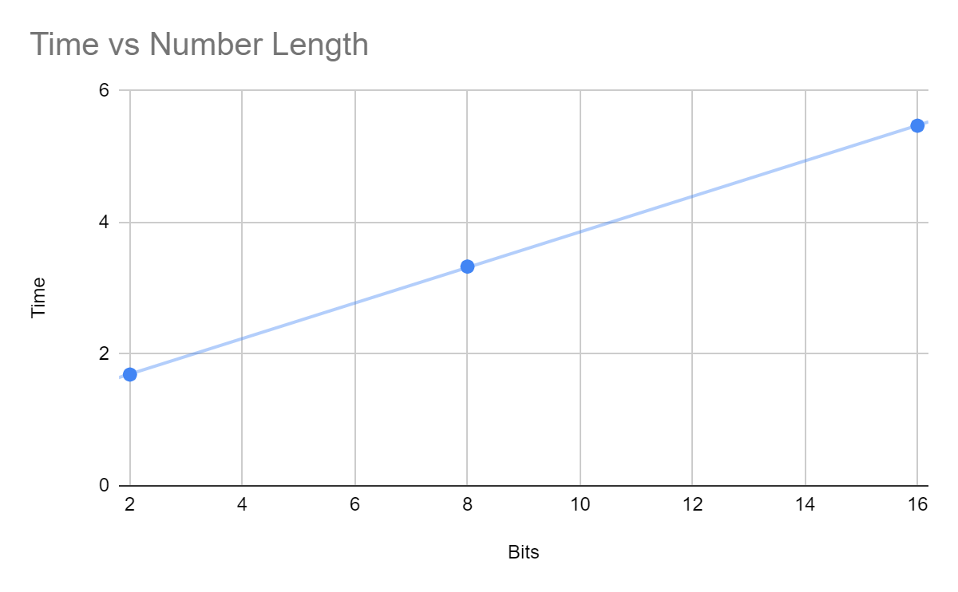
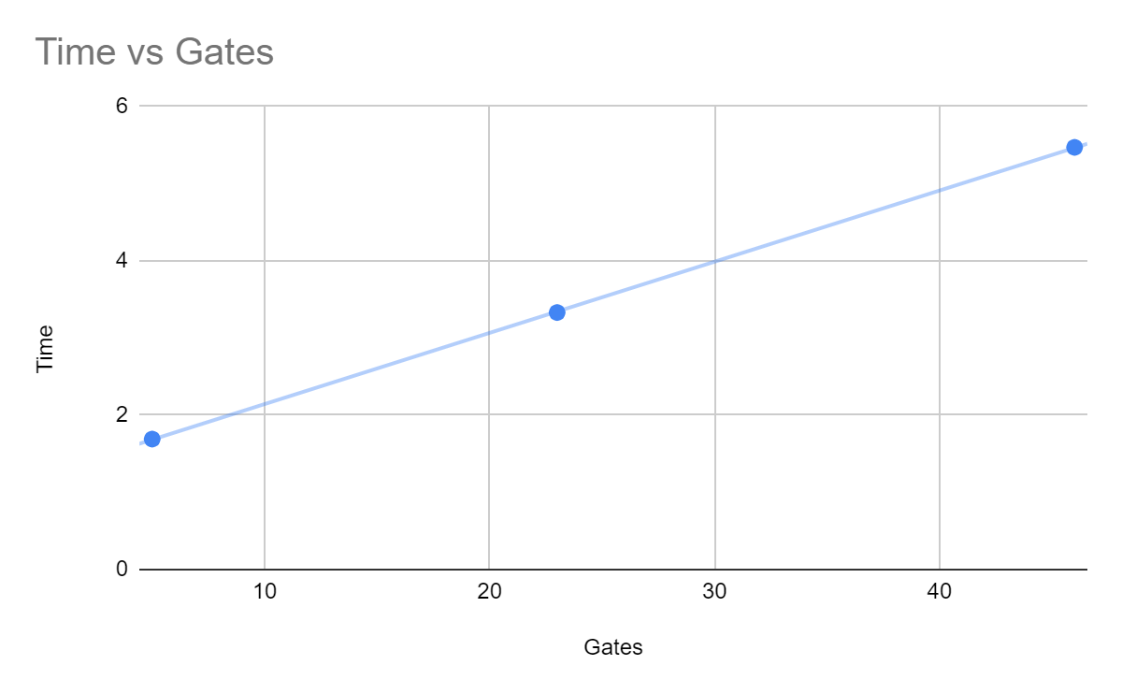
Performance - GMW-X
1-of-4 OT: ~6.09ms (3 1-of-2 OTs to complete)
Connection: ~1.00 ms for building 3 connections between Alice, Bob, Dealer
Bits | Gates | Time
2 | 5 | 1.69
8 | 23 | 3.33
16 | 46 | 5.47

Slide 13
Yao’s Pros & Cons
Pros:
Computationally efficient as long as data transfer is efficient
70ms on a 16-bit number comparison
Result is accurate, privacy is protected
Works well with two parties
Cons:
The garbled circuit (which needs to be transferred) can be very long
Our 16-bit number equality circuit was many kilobytes on some iterations
Potentially mitigated by more efficient key generation algorithms
Circuit Generation
While it is possible to generate a circuit for any arbitrary function F to compute, the generation of complex functions is not within the scope of this project

Slide 14
GMW-X Pros & Cons
Pros
Dealer could perform most computation locally, only the first layer gates need shares from A&B
Could naturally generalize to more than two parties
Less data transfer, Faster Evaluation
Cons
Complex Communication: Each end should connect other two (e.g. Alice should connect Bob and Dealer)
For simple circuits, building communication takes most time!
Only support XOR, AND, NOT
although we could convert OR to AND+NOT, it makes the circuits more complex

Slide 15
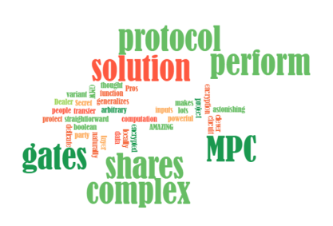
Summary
OT is AMAZING, both protocols are clever uses of OT
GC (+ OT) makes MPC possible with arbitrary boolean function, but Yao’s solution needs transfer lots of encrypted data for each gate
GMW uses Secret Sharing and OT to perform a more straightforward but delicate MPC
At first, I thought it was a variant of Yao’s solution
After this project, it’s another astonishing protocol!
More powerful when the circuit is complex
Could naturally generalizes to more than two party
SS could protect people's inputs without complex encryption

Slide 16
Project Address
Github.com/n132/SMC

