Slide 1
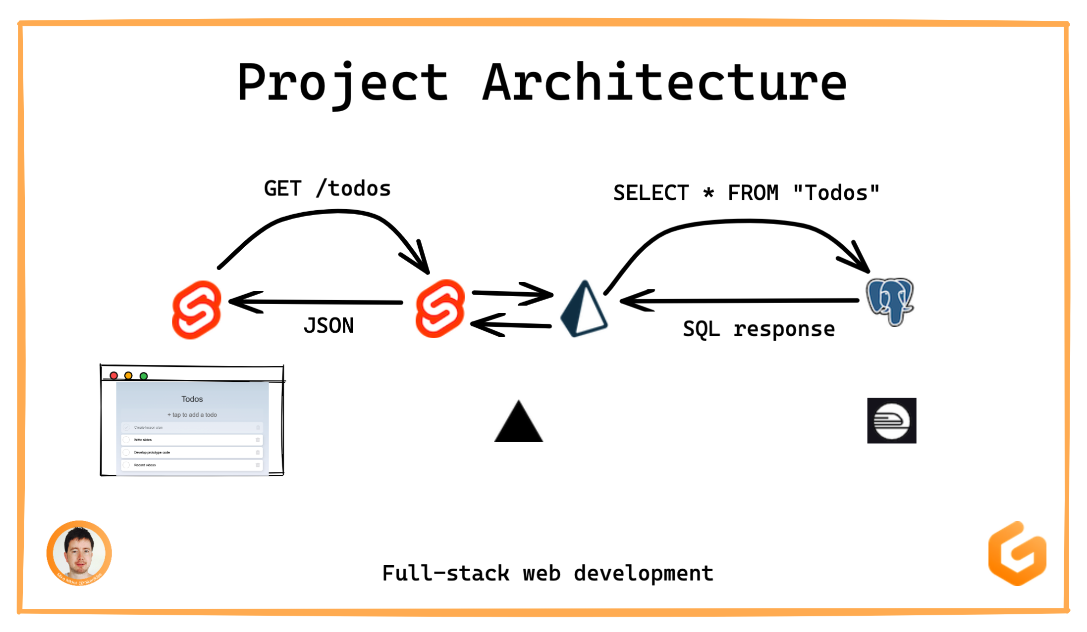

_{NodeJS Prisma Client}

Slide 2
Svelte
It extends HTML by allowing JavaScript expressions in markup and providing directives to use conditions and loops, in a fashion similar to handlebars.
It extends CSS by adding a scoping mechanism, allowing each component to define its own styles without the risk of clashing with other components' styles.
It extends JavaScript by reinterpreting specific directives of the language to achieve true reactivity and ease component state management.

Slide 3
.
├── package.json
├── package-lock.json
├── prisma
│ ├── migrations
│ │ ├── 20220420025406_init
│ │ │ └── migration.sql
│ │ └── migration_lock.toml
│ └── schema.prisma
├── src
│ ├── app.css
│ ├── app.html
│ ├── global.d.ts
│ ├── lib
│ │ ├── actions
│ │ │ └── forms.ts
│ │ ├── prisma.ts
│ │ └── todo-item.svelte
│ └── routes
│ ├── about-us.svelte
│ ├── index.svelte
│ ├── __layout.svelte
│ └── todos
│ ├── _api.ts
│ ├── index.json.ts
│ └── [uid].json.ts
├── static
│ └── favicon.png
├── svelte.config.js
└── tsconfig.json
_{Svelte}
_{SvelteKit}
_{NodeJS Prisma}
_{Postgres}
component framework, like vue/react
svelte speciality: works on built time, therefore more like a compiler. Creates vanilla js out of svelte files. => No runtime needed
application framework, like angular
= svelte + handy features
file-based router
adapter, to transform code to deployment platform

Slide 4

_{Python Prisma Client}

Slide 5
.
├── package.json
├── package-lock.json
├── prisma
│ ├── migrations
│ │ ├── 20220420025406_init
│ │ │ └── migration.sql
│ │ └── migration_lock.toml
│ └── schema.prisma
├── src
│ ├── app.css
│ ├── app.html
│ ├── global.d.ts
│ ├── lib
│ │ ├── actions
│ │ │ └── forms.ts
│ │ ├── prisma.ts
│ │ └── todo-item.svelte
│ └── routes
│ ├── about-us.svelte
│ ├── index.svelte
│ ├── __layout.svelte
│ └── todos
│ ├── _api.ts
│ ├── index.json.ts
│ └── [uid].json.ts
├── static
│ └── favicon.png
├── svelte.config.js
└── tsconfig.json
_{Svelte}
_{SvelteKit}
_{NodeJS Prisma}
_{Postgres}
component framework, like vue/react
svelte speciality: works on built time, therefore more like a compiler. Creates vanilla js out of svelte files. => No runtime needed
application framework, like angular
= svelte + handy features
file-based router
adapter, to transform code to deployment platform
options for using python with svelte-kit:
deploy the svelte-kit app as a static page, and then making direct requests to your python based service.
use svelte-kit endpoints as a proxy to make requests to your python service. This strategy fit's more into a microservice architecture, or if you are only making a new frontend for a existing backend application
https://stackoverflow.com/questions/71855048/sveltekit-with-flask-backend-some-questions

