Slide 1
Classes2

Slide 2
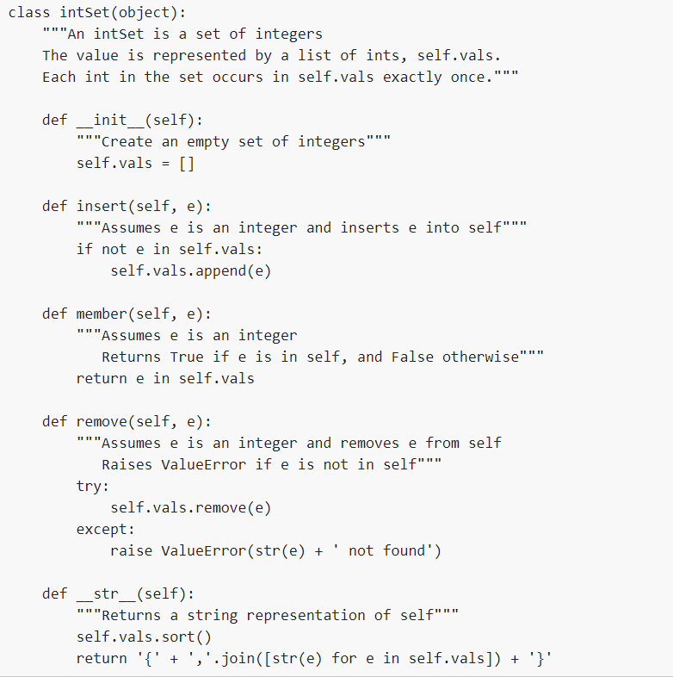
Define an intersect method that returns a new intSet containing elements that appear in both sets. In other words,
s1.intersect(s2)
would return a new intSet of integers that appear in both s1 and s2. Think carefully - what should happen if s1 and s2 have no elements in common?
Add the appropriate method(s) so that len(s) returns the number of elements in s.

Slide 3
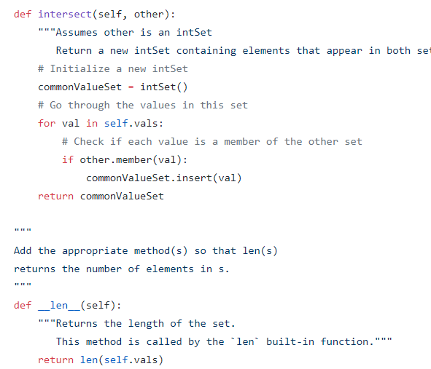
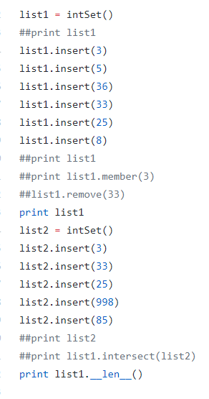

Slide 4
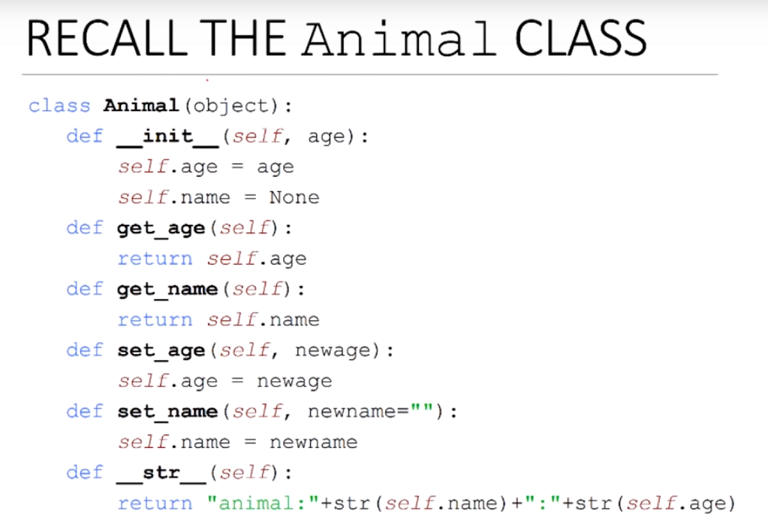

Slide 5
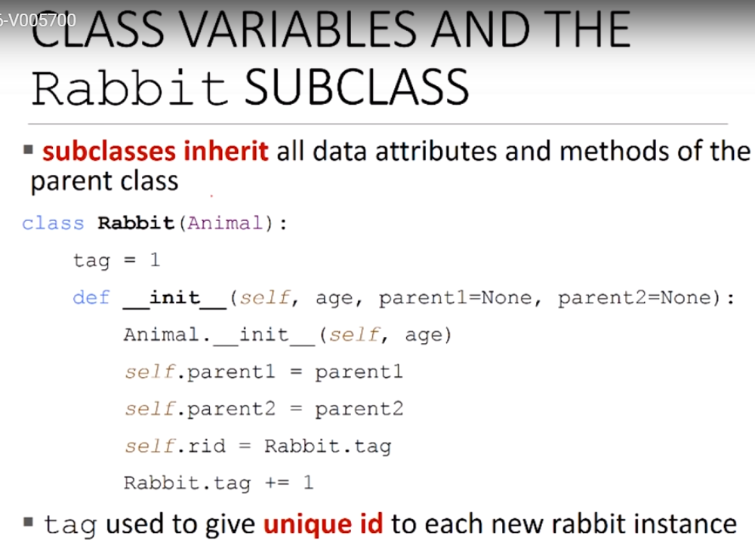

Slide 6
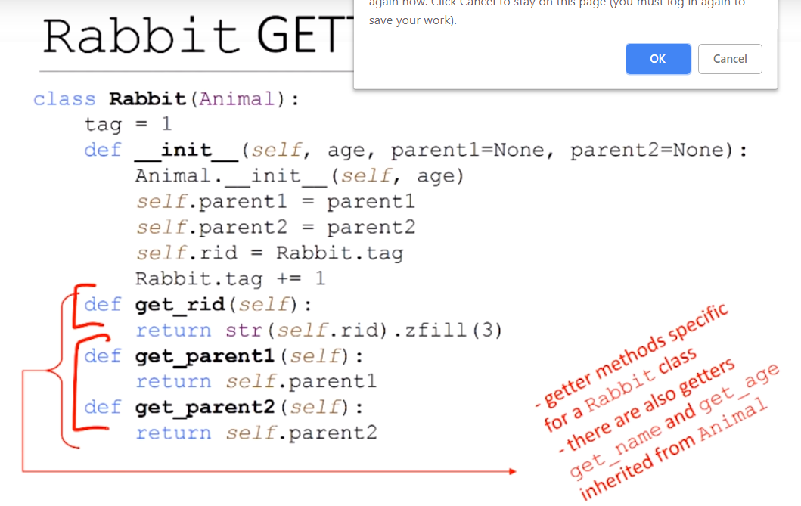

Slide 7
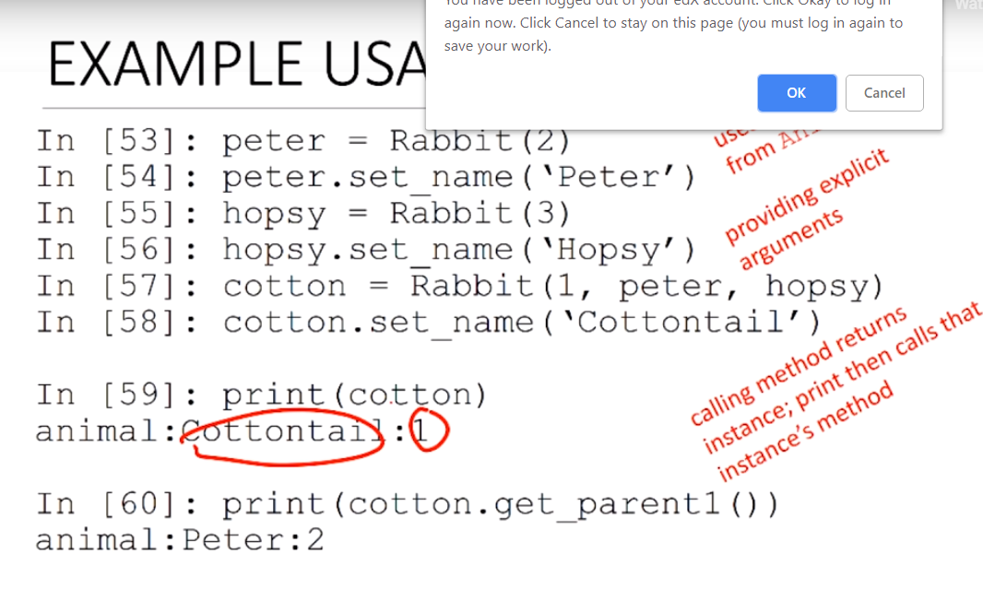

Slide 8
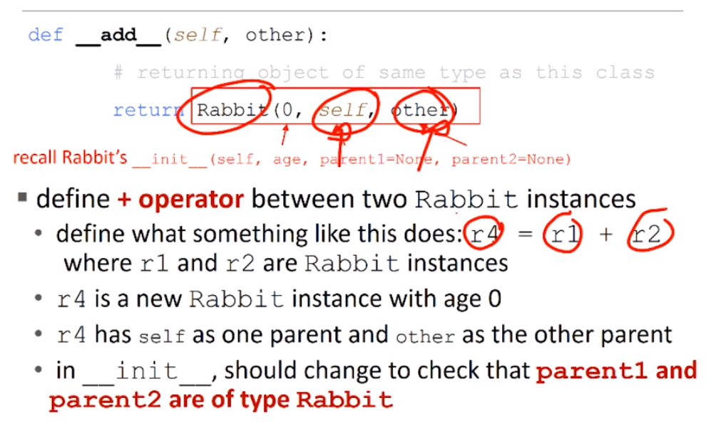

Slide 9
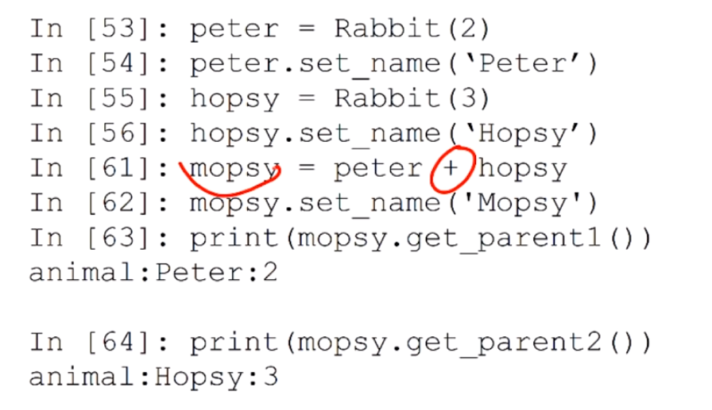

Slide 10
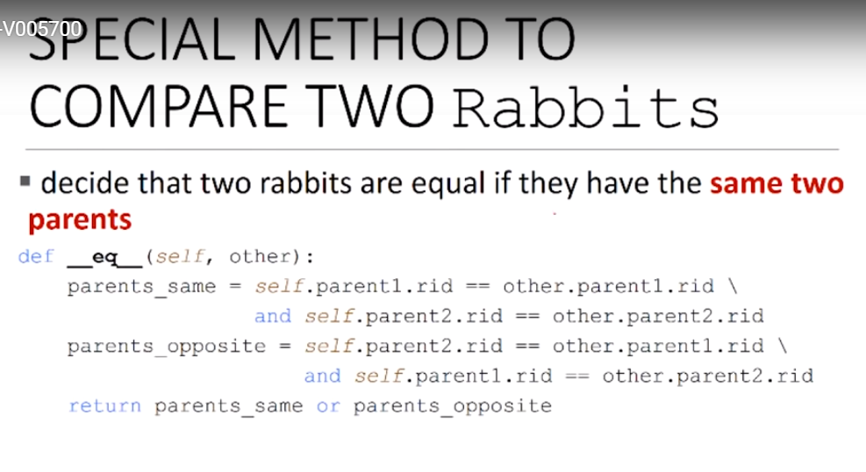

Slide 11
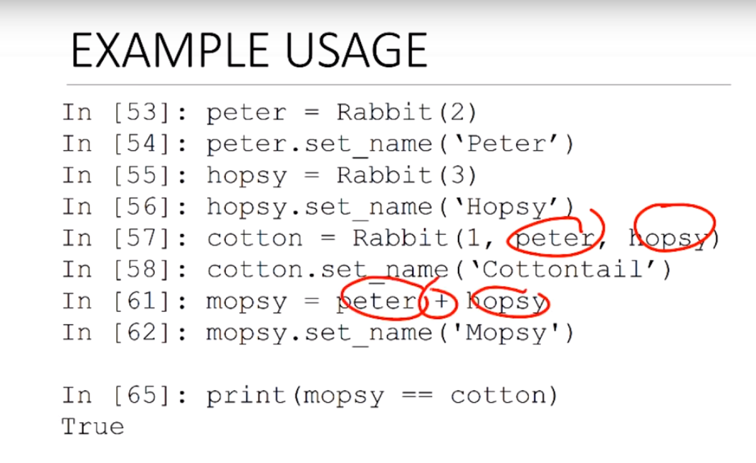

Slide 12
The ability of a subclass to override a method allows a class to inherit from a superclass whose behavior is "close enough" and then to modify behavior as needed. The overriding method has the same name, number and type of parameters, and return type as the method that it overrides.

Slide 13
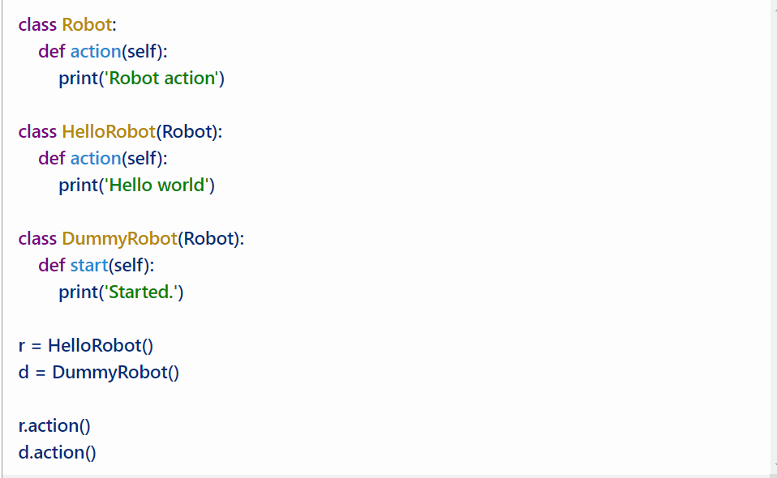
Method override

Slide 14
Method Overloading is a feature that allows a class to have more than one method having the same name, if their argument lists are different. It is similar to constructor overloading in Java, that allows a class to have more than one constructor having different argument lists.

Slide 15
