Slide 1
Write a program that prints the number of times the string 'bob' occurs in s. For example, if s = 'azcbobobegghakl', then your program should print 2

Slide 2
numBobs = 0
for i in range(1, len(s)-1):
if s[i-1:i+2] == 'bob':
numBobs += 1
print ('Number of times bob occurs is:', numBobs)

Slide 3
Write a program that prints the longest substring of s in which the letters occur in alphabetical order. For example, if s = 'azcbobobegghakl', then your program should print Longest substring in alphabetical order is: beggh

Slide 4
test = s[0]
best = ''
for n in range(1, len(s)): # have s[0] so compare to s[1]
if len(test) > len(best):
best = test
if s[n] >= s[n-1]:
test = test + s[n] # add s[1] to s[0] if greater or equal
else: # if not, do one of these options
test = s[n]
print ("Longest substring in alphabetical order is:", best)

Slide 5
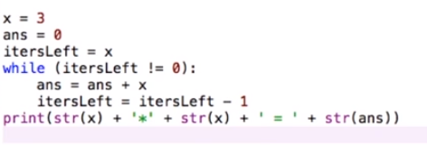
SQUARE with while

Slide 6
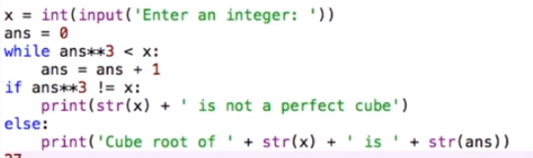
CUBE root(while)

Slide 7
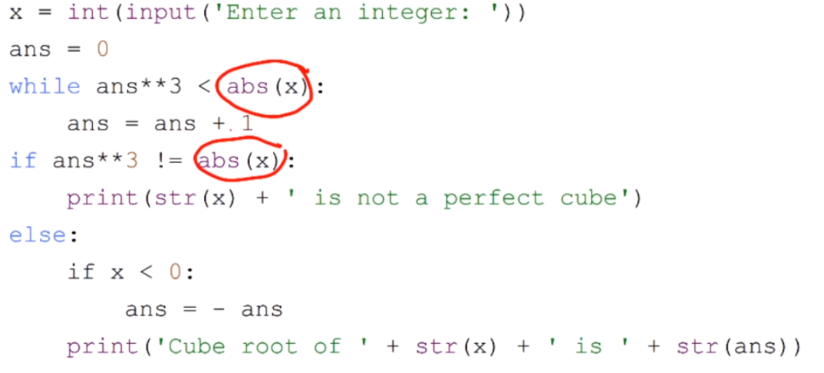
CUBE +- (while)

Slide 8

CUBE FOR

Slide 9
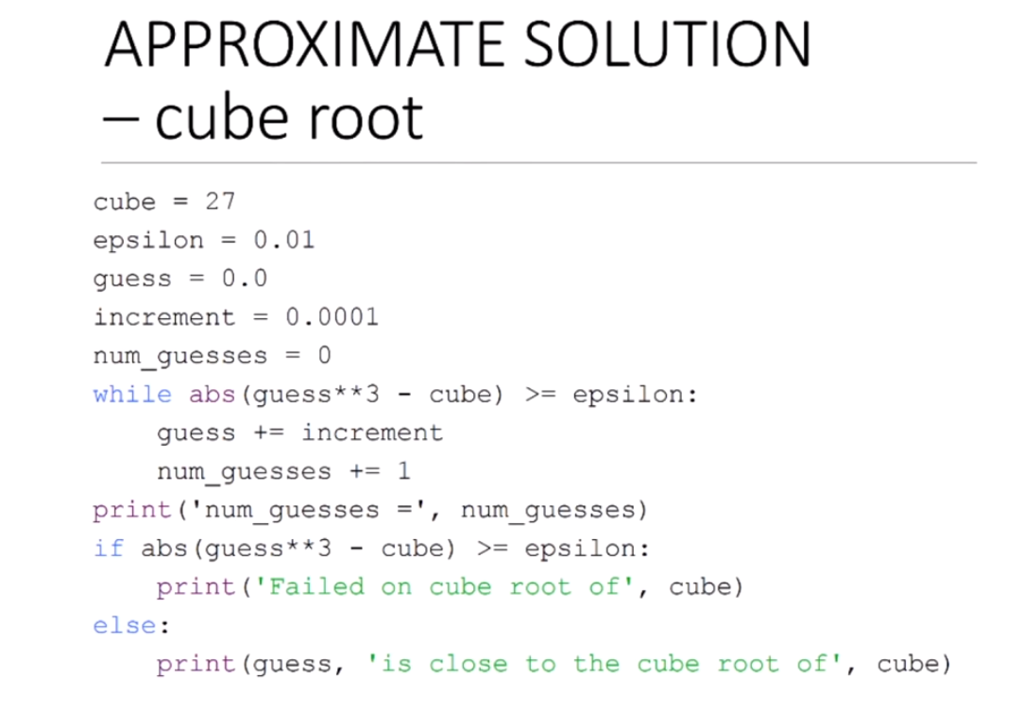

Slide 10
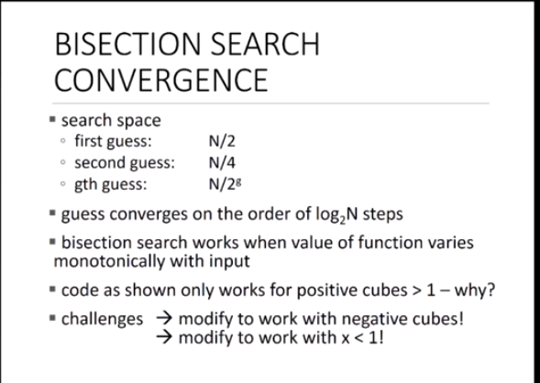

Slide 11
