Slide 1
Run 22: Gaussian labels
Run 19 (river + 1 px buffer, RF / UNet++ / 2D CNN, four states at once) with the labels from run 17's Gaussian footprint shares instead of box counts.

Slide 2
Gaussian labels help the strict rule
model | run 22 rule50 acc / F1 | run 22 rule90 | run 19 rule50 | run 19 rule90
RF | 0.771 / 0.619 | 0.860 / 0.671 | 0.794 / 0.644 | 0.818 / 0.662
UNet++ | 0.740 / 0.569 | 0.757 / 0.459 | 0.714 / 0.535 | 0.742 / 0.477
2D CNN | 0.807 / 0.630 | 0.880 / 0.674 | 0.812 / 0.655 | 0.854 / 0.664
Box labels (run 19): every Landsat pixel inside the VIIRS pixel counts equally.
Gaussian labels (run 22): weights fall off from the pixel centre (sigma 134 m, cut at 2 sigma), as in run 17.
rule90 improves for every model; rule50 about the same.
Totals boxes in the images still use the run 18 box % models.

Slide 3
Run 22: river + buffer, Gaussian labels
Water mask occurrence >= 0.05 (988 px) plus a 1-pixel buffer (678 px); labels from Gaussian shares.

Slide 4
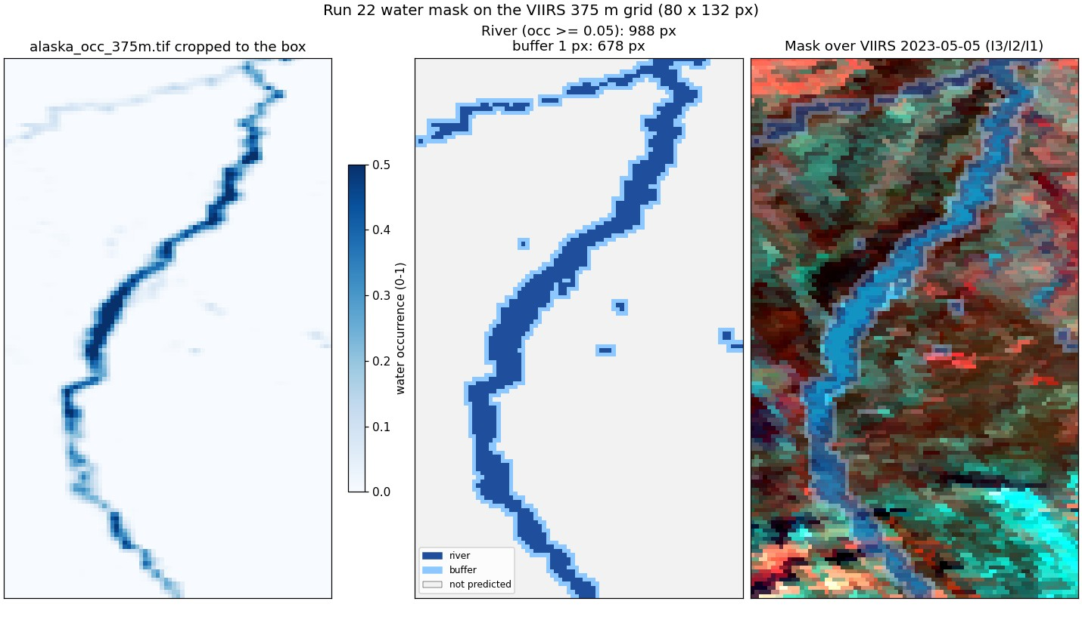
Run 22: the predicted area
Water mask occurrence >= 0.05 (988 px) plus a 1-pixel buffer (678 px); labels from Gaussian shares.
Pixels outside the mask are not predicted.
9,565 scored pixels over 6 days.

Slide 5
Run 22: four states at once, three models
model | rule50 acc | rule50 F1 | rule90 acc | rule90 F1
RF | 0.771 | 0.619 | 0.860 | 0.671
UNet++ | 0.740 | 0.569 | 0.757 | 0.459
2D CNN | 0.807 | 0.630 | 0.880 | 0.674
RF: depth 16, leaf 20, balanced classes (run 16 settings).
UNet++: resnet18, masked cross-entropy.
2D CNN: 4 conv 3 x 3 layers, 9 x 9 pixel view, 97k params.
State 2 (open river, snow land) is rare: low F1 everywhere.

Slide 6
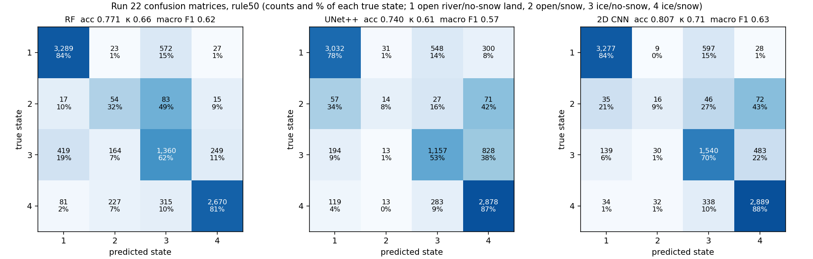
Run 22: confusion matrices, rule50
Rows true state, columns predicted; cell = pixels and % of the true state. 1 open river / no-snow land, 2 open / snow, 3 ice / no-snow, 4 ice / snow.

Slide 7
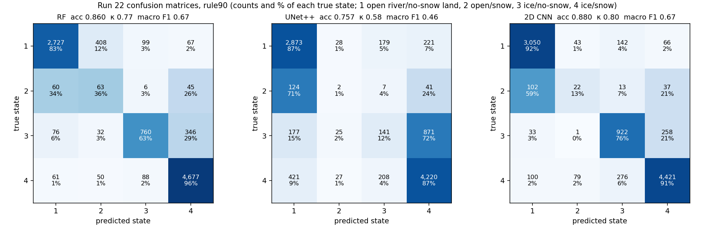
Run 22: confusion matrices, rule90
Rows true state, columns predicted; cell = pixels and % of the true state. 1 open river / no-snow land, 2 open / snow, 3 ice / no-snow, 4 ice / snow.

Slide 8
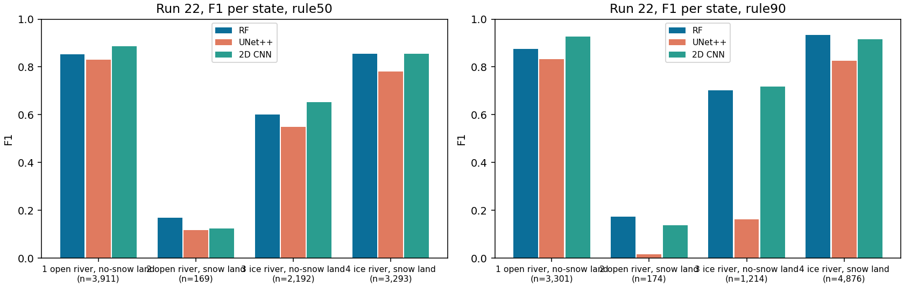
Run 22: all metrics and F1 per state
rule | model | acc | bal. acc | κ | macro P | macro R | macro F1 | wtd F1
rule50 | RF | 0.771 | 0.648 | 0.660 | 0.616 | 0.648 | 0.619 | 0.783
rule50 | UNet++ | 0.740 | 0.565 | 0.606 | 0.592 | 0.565 | 0.569 | 0.736
rule50 | 2D CNN | 0.807 | 0.628 | 0.710 | 0.642 | 0.628 | 0.630 | 0.808
rule90 | RF | 0.860 | 0.693 | 0.770 | 0.689 | 0.693 | 0.671 | 0.871
rule90 | UNet++ | 0.757 | 0.466 | 0.579 | 0.469 | 0.466 | 0.459 | 0.729
rule90 | 2D CNN | 0.880 | 0.679 | 0.802 | 0.672 | 0.679 | 0.674 | 0.880

Slide 9
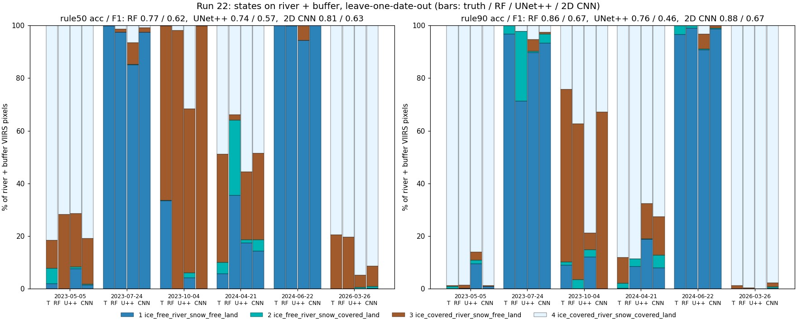
Run 22: states per day, truth and every model

Slide 10
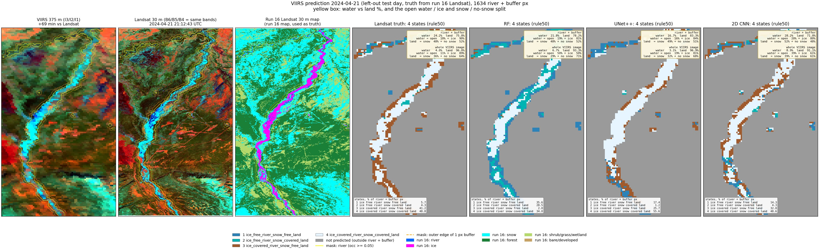
Run 22, 2024-04-21: predicted states (left-out test day)

Slide 11
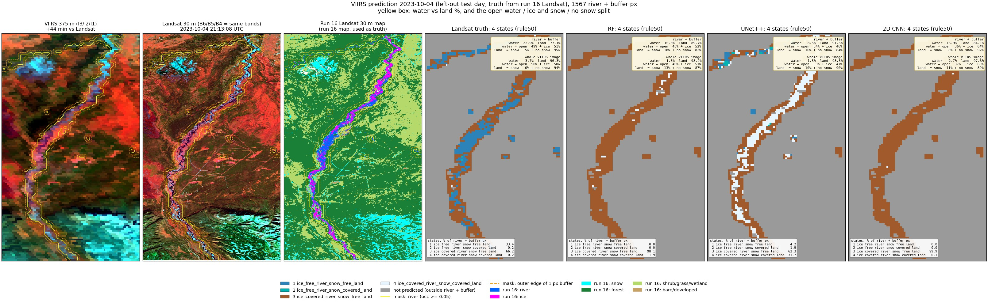
Run 22, 2023-10-04: predicted states (left-out test day)

Slide 12
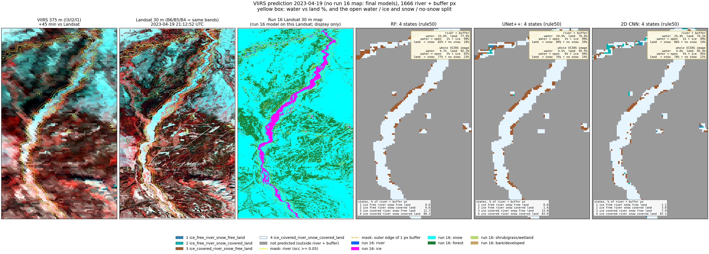
Run 22, 2023-04-19: predicted states (VIIRS only)

Slide 13
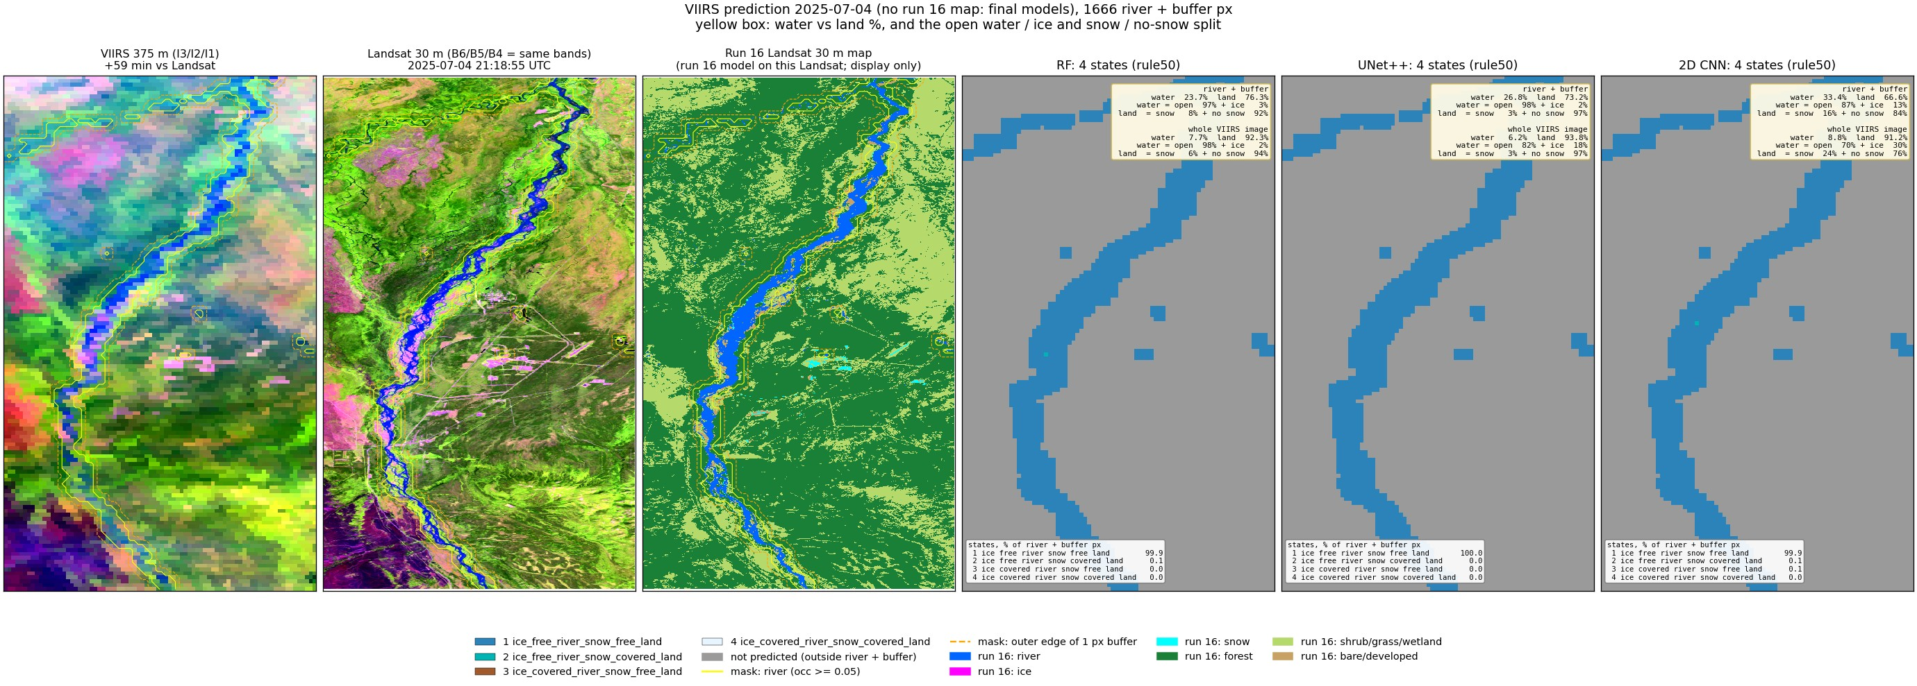
Run 22, 2025-07-04: predicted states (VIIRS only)

Slide 14
Run 22: water and land split (river + buffer, Gaussian labels)
date | Landsat truth | RF | UNet++ | 2D CNN
2023-05-05 | 25 % (5/95) | 77/23 | 24 % (12/88) | 65/35 | 17 % (3/97) | 67/33 | 22 % (4/96) | 88/12
2023-07-24 | 24 % (100/0) | 1/99 | 21 % (92/8) | 7/93 | 21 % (89/11) | 11/89 | 24 % (98/2) | 4/96
2023-10-04 | 23 % (49/51) | 5/95 | 10 % (48/52) | 18/82 | 8 % (54/46) | 16/84 | 16 % (36/64) | 8/92
2024-04-21 | 24 % (10/90) | 48/52 | 22 % (19/81) | 48/52 | 17 % (16/84) | 49/51 | 28 % (20/80) | 52/48
2024-06-22 | 24 % (100/0) | 1/99 | 21 % (97/3) | 2/98 | 18 % (97/3) | 1/99 | 25 % (100/0) | 0/100
2026-03-26 | 26 % (0/100) | 70/30 | 24 % (7/93) | 74/26 | 29 % (1/99) | 82/18 | 18 % (0/100) | 89/11
2023-04-19 | - | 23 % (1/99) | 82/18 | 24 % (1/99) | 80/20 | 26 % (1/99) | 86/14
2024-09-02 | - | 18 % (90/10) | 4/96 | 22 % (92/8) | 2/98 | 26 % (93/7) | 3/97
2025-07-04 | - | 24 % (97/3) | 8/92 | 27 % (98/2) | 3/97 | 33 % (87/13) | 16/84
2026-08-01 | - | 20 % (96/4) | 3/97 | 26 % (97/3) | 3/97 | 20 % (100/0) | 0/100
Cell: water % of the area (open / ice % of the water) | snow / no-snow % of the land. Labelled days: left-out predictions. VIIRS-only days: final models.

