Slide 1
Run 21: run 16 on VIIRS at 30 m
Run 16 repeated with VIIRS upsampled to the Landsat 30 m grid instead of Landsat: same six classes, water-mask rule, hand labels, Random Forest and spatial cross-validation.

Slide 2
VIIRS keeps river and land, loses snow and some ice
0.962
0.985
0.04
run 21 RF accuracy (VIIRS), rule labels, 5-fold spatial CV
run 16 RF accuracy (Landsat), same 4 dates
snow F1 on VIIRS (Landsat: 0.57)
Macro F1 0.761 on VIIRS vs 0.904 on Landsat (rule labels).
River, forest, shrub, bare stay high: the water mask fixes river, NLCD drives the land classes.
Snow patches and the ice / open-water mix are smaller than a 375 m pixel, so they cannot be placed at 30 m.
Summer days near perfect; freeze-up and break-up drop to about 0.72.

Slide 3
Same as run 16, only the image changed
 | run 16 | run 21
image | Landsat 30 m | VIIRS I1-I5 upsampled to 30 m (bilinear + run 17 shift)
classes / rule | 6 classes; water mask: river / ice only | same
labels | hand labels -> rule labels | same (dates with VIIRS)
model | one RF per zone, top 25, depth 16, leaf 20 | same code
evaluation | 5-fold spatial CV | same code
dates | 7 labelled | 4 labelled; maps for all 10 VIIRS dates
inputs | 66 Landsat-based | 46 VIIRS-based (no blue / green I-band)
date | season | labelled px
2023-07-24 | summer | 31,028
2023-10-04 | freeze-up | 7,833
2024-04-21 | break-up | 3,048
2024-06-22 | summer | 40,812
No VIIRS for 2024-03-12, 2024-04-20, 2024-04-29: left out (incl. run 16's external test).

Slide 4
Scores: VIIRS vs Landsat on the same dates
model / labels | pixels | accuracy | balanced acc | κ | macro F1
RF (VIIRS), rule labels | 72,989 | 0.962 | 0.769 | 0.943 | 0.761
RF (VIIRS), original labels | 82,721 | 0.845 | 0.612 | 0.771 | 0.601
UNet++ (VIIRS), rule labels | 72,989 | 0.828 | 0.660 | 0.754 | 0.620
UNet++ (VIIRS), original labels | 82,721 | 0.728 | 0.502 | 0.613 | 0.503
Run 16 RF (Landsat), rule labels, same dates | 73,078 | 0.985 | 0.962 | 0.977 | 0.904
Run 16 RF (Landsat), original labels, same dates | 82,812 | 0.864 | 0.708 | 0.800 | 0.675
class (rule labels) | RF F1 (VIIRS) | UNet++ F1 (VIIRS) | run 16 F1 (Landsat)
river | 0.98 | 0.98 | 0.99
ice | 0.65 | 0.52 | 0.90
snow | 0.04 | 0.01 | 0.57
forest | 0.98 | 0.71 | 0.99
shrub_grass_wetland | 0.97 | 0.90 | 0.98
bare_developed | 0.94 | 0.59 | 0.99

Slide 5
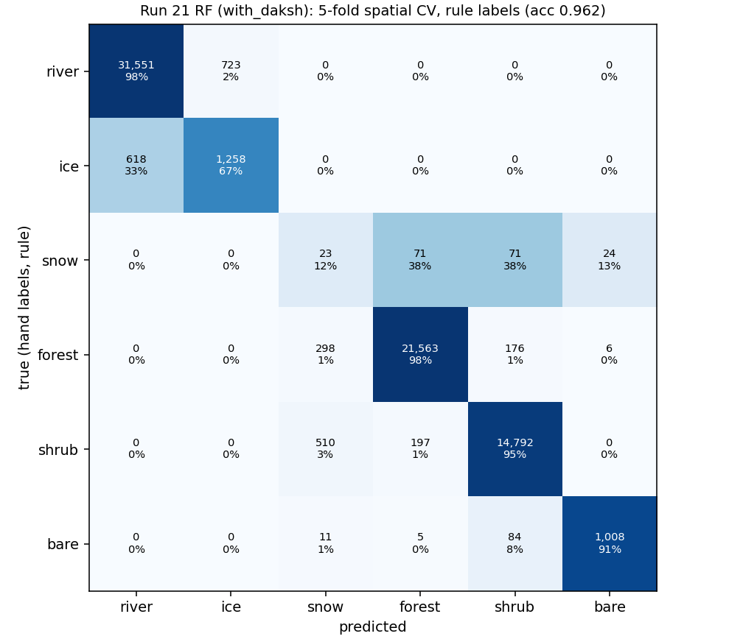
RF: confusion matrix (rule labels)
Rows: true class (hand labels, rule).
Columns: predicted.
Cell: pixels and % of the true class.
Snow is mostly called forest / shrub; ice partly river.

Slide 6
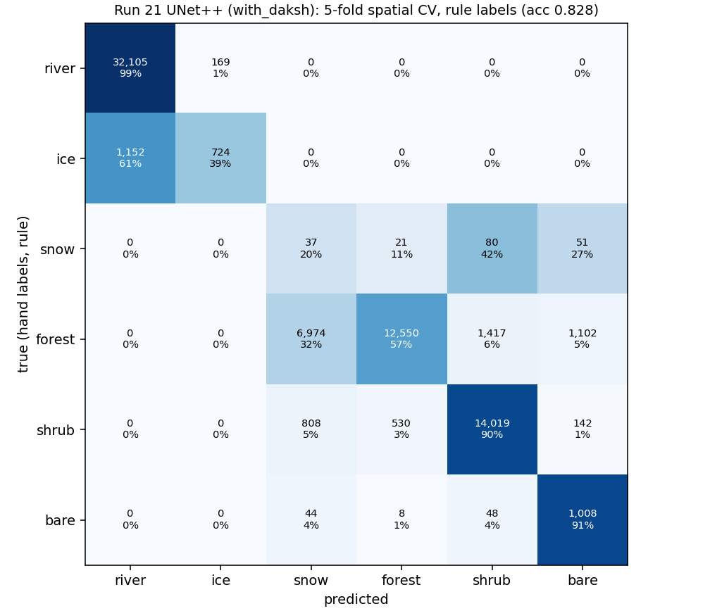
UNet++: confusion matrix (rule labels)
Rows: true class (hand labels, rule).
Columns: predicted.
Cell: pixels and % of the true class.
Snow is mostly called forest / shrub; ice partly river.

Slide 7
Per date (rule labels)
date | season | px | RF acc / F1 | UNet++ acc / F1
2023-07-24 | summer | 25,502 | 1.000 / 0.86 | 1.000 / 0.52
2023-10-04 | autumn freeze-up | 7,250 | 0.738 / 0.52 | 0.696 / 0.53
2024-04-21 | spring break-up | 2,297 | 0.715 / 0.47 | 0.623 / 0.34
2024-06-22 | summer | 37,940 | 0.994 / 1.00 | 0.750 / 0.82

Slide 8
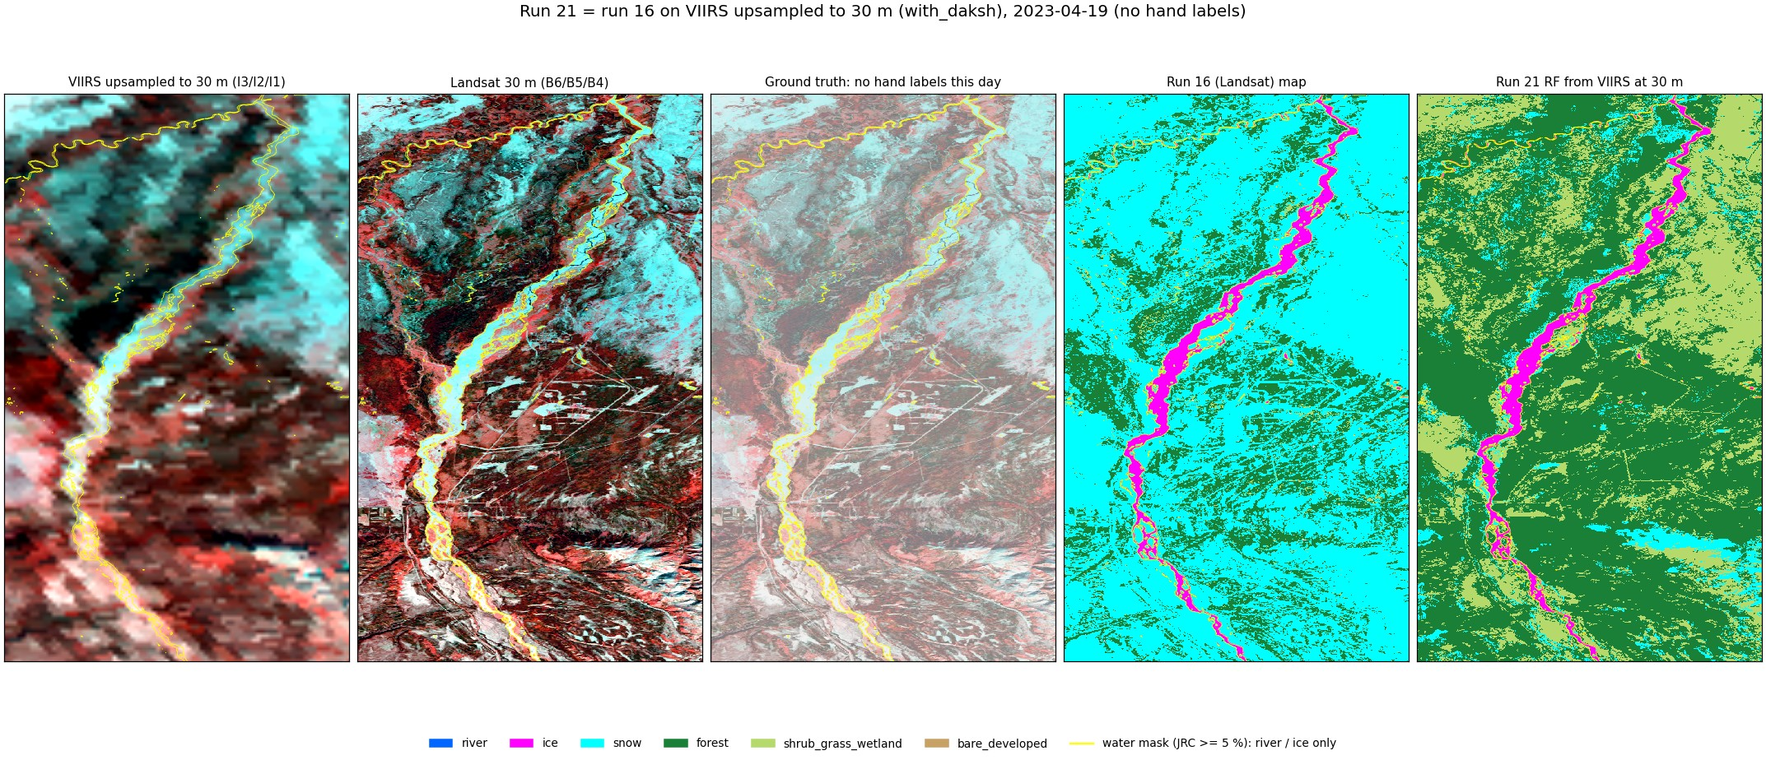
2023-04-19 (spring): no hand labels

Slide 9
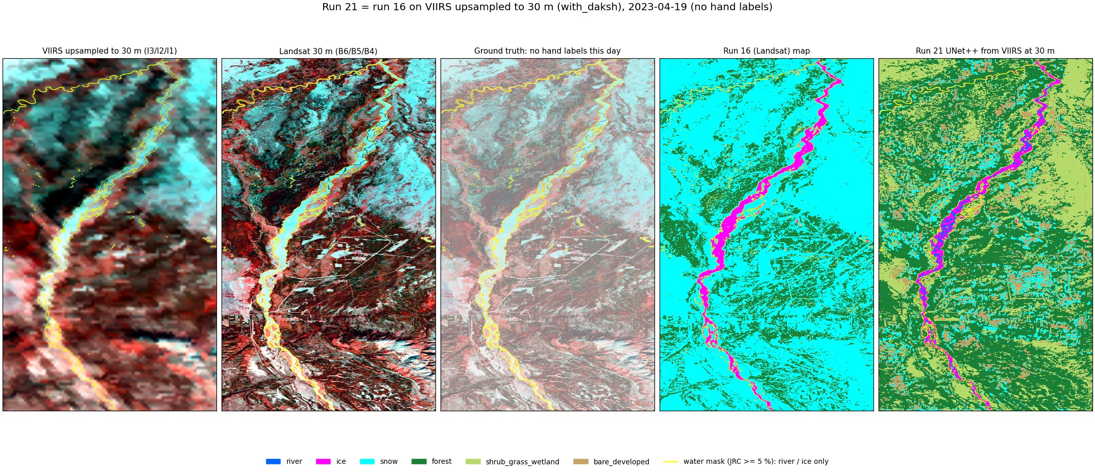
2023-04-19 (spring): no hand labels

Slide 10
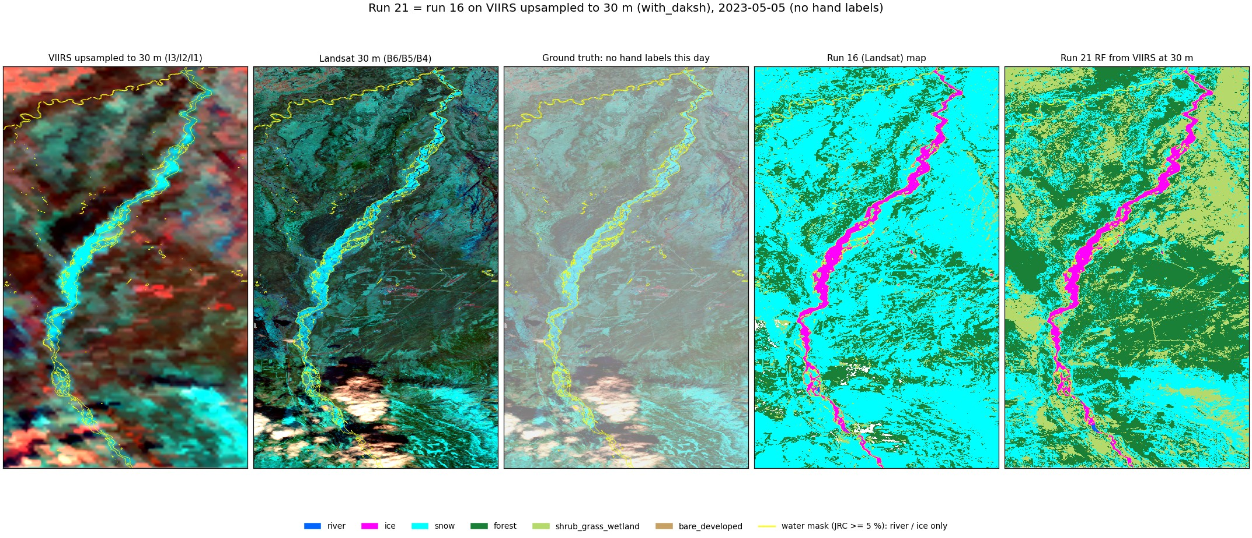
2023-05-05 (break-up): no hand labels

Slide 11
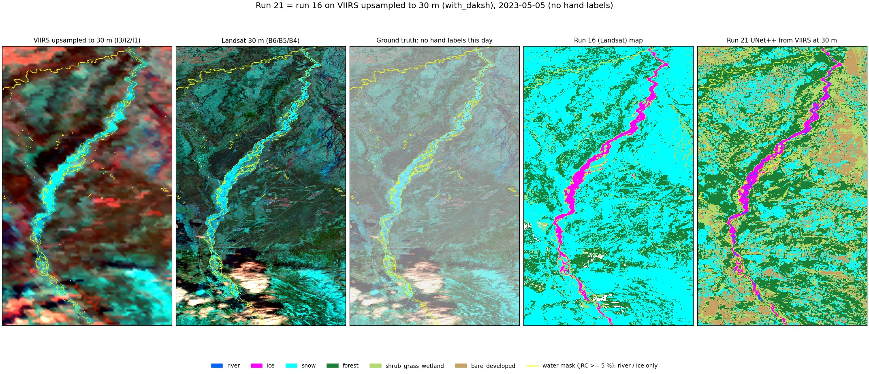
2023-05-05 (break-up): no hand labels

Slide 12
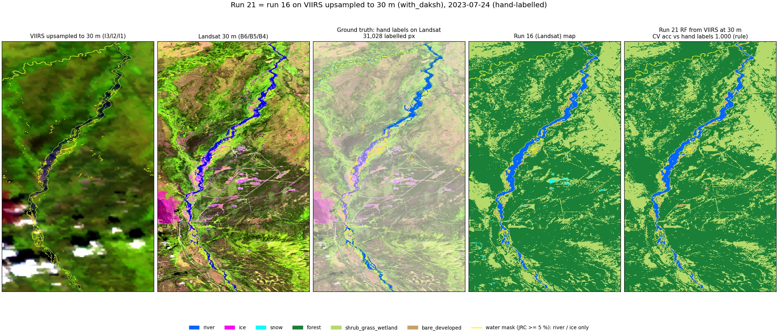
2023-07-24 (summer): hand-labelled

Slide 13
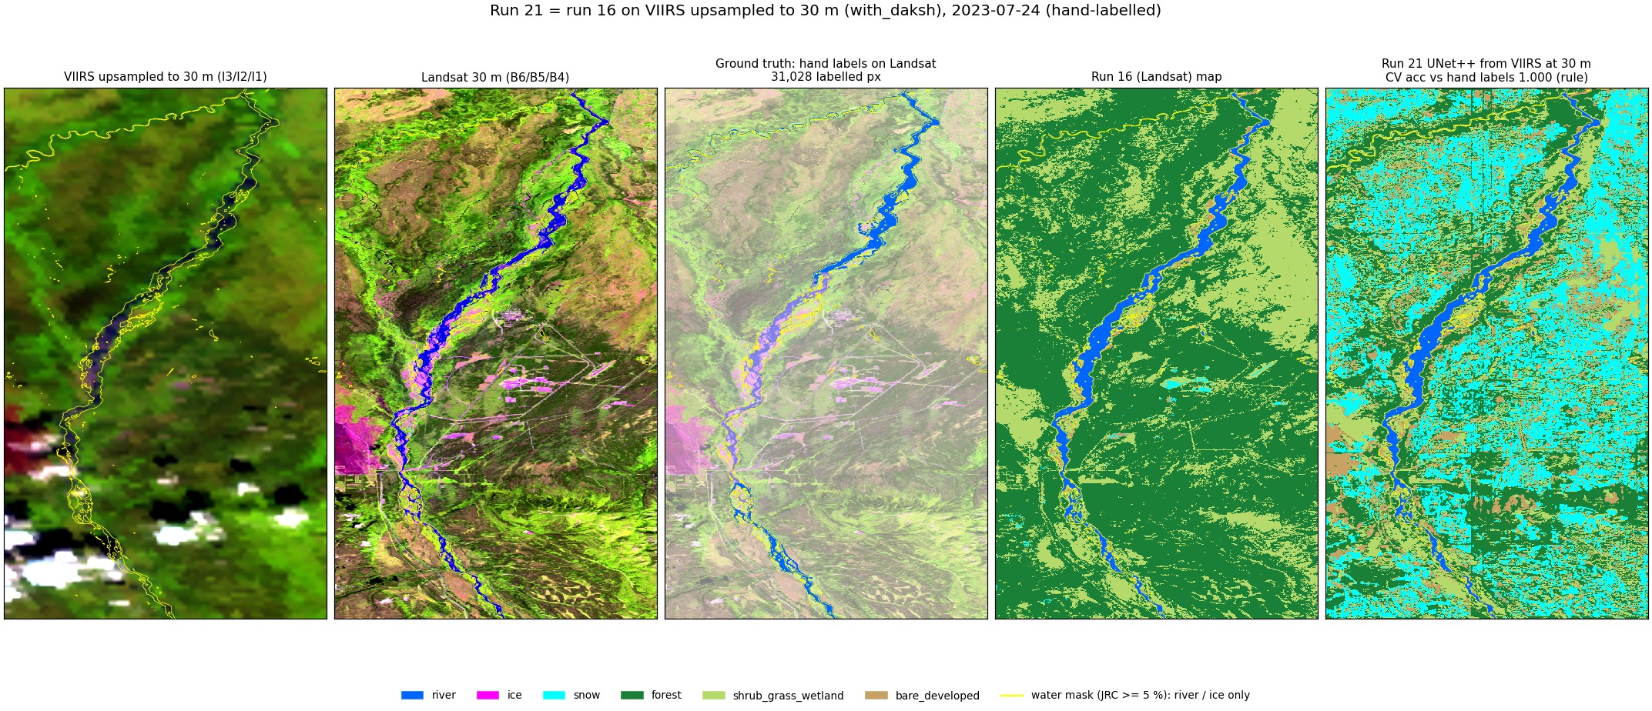
2023-07-24 (summer): hand-labelled

Slide 14
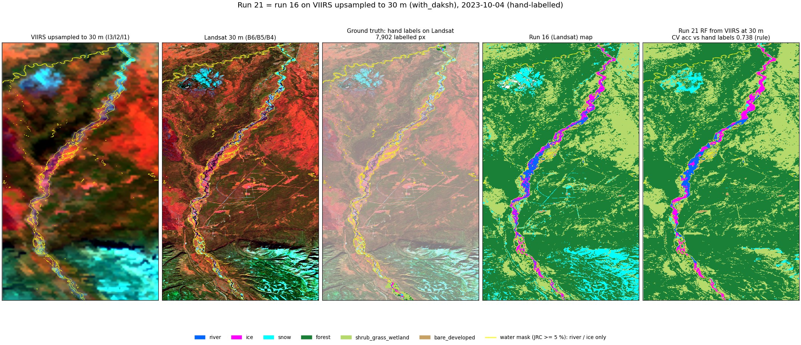
2023-10-04 (freeze-up): hand-labelled

Slide 15
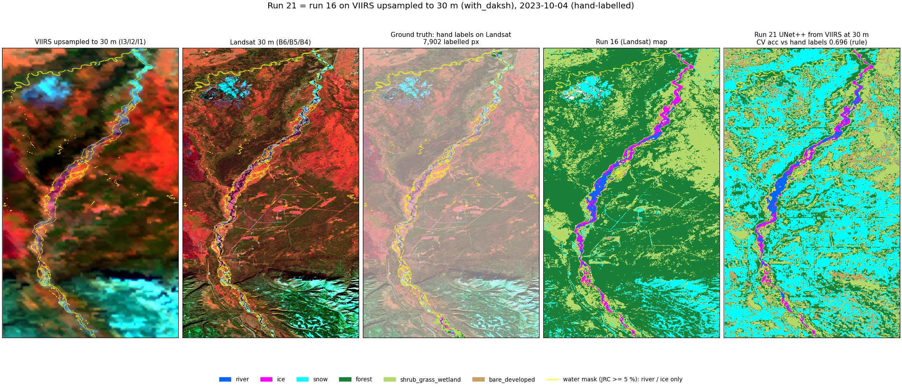
2023-10-04 (freeze-up): hand-labelled

Slide 16
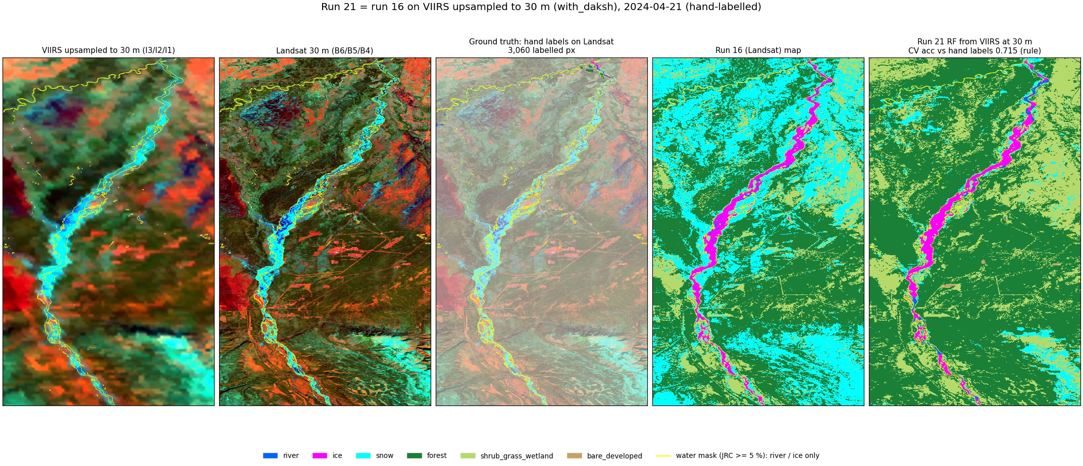
2024-04-21 (break-up): hand-labelled

Slide 17
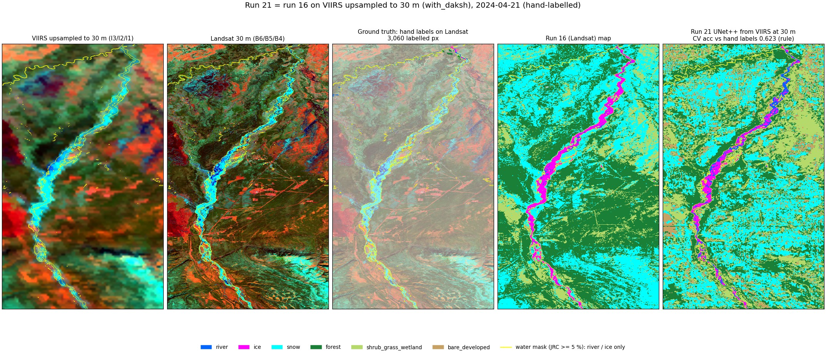
2024-04-21 (break-up): hand-labelled

Slide 18
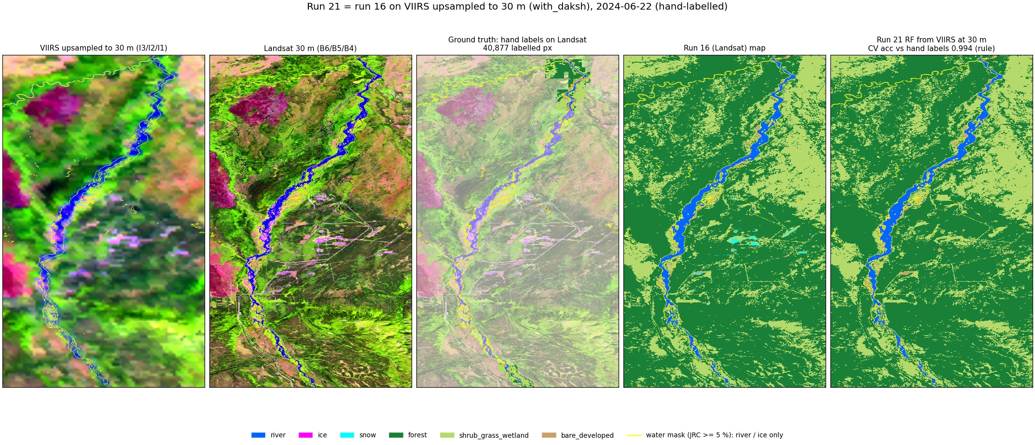
2024-06-22 (summer): hand-labelled

Slide 19
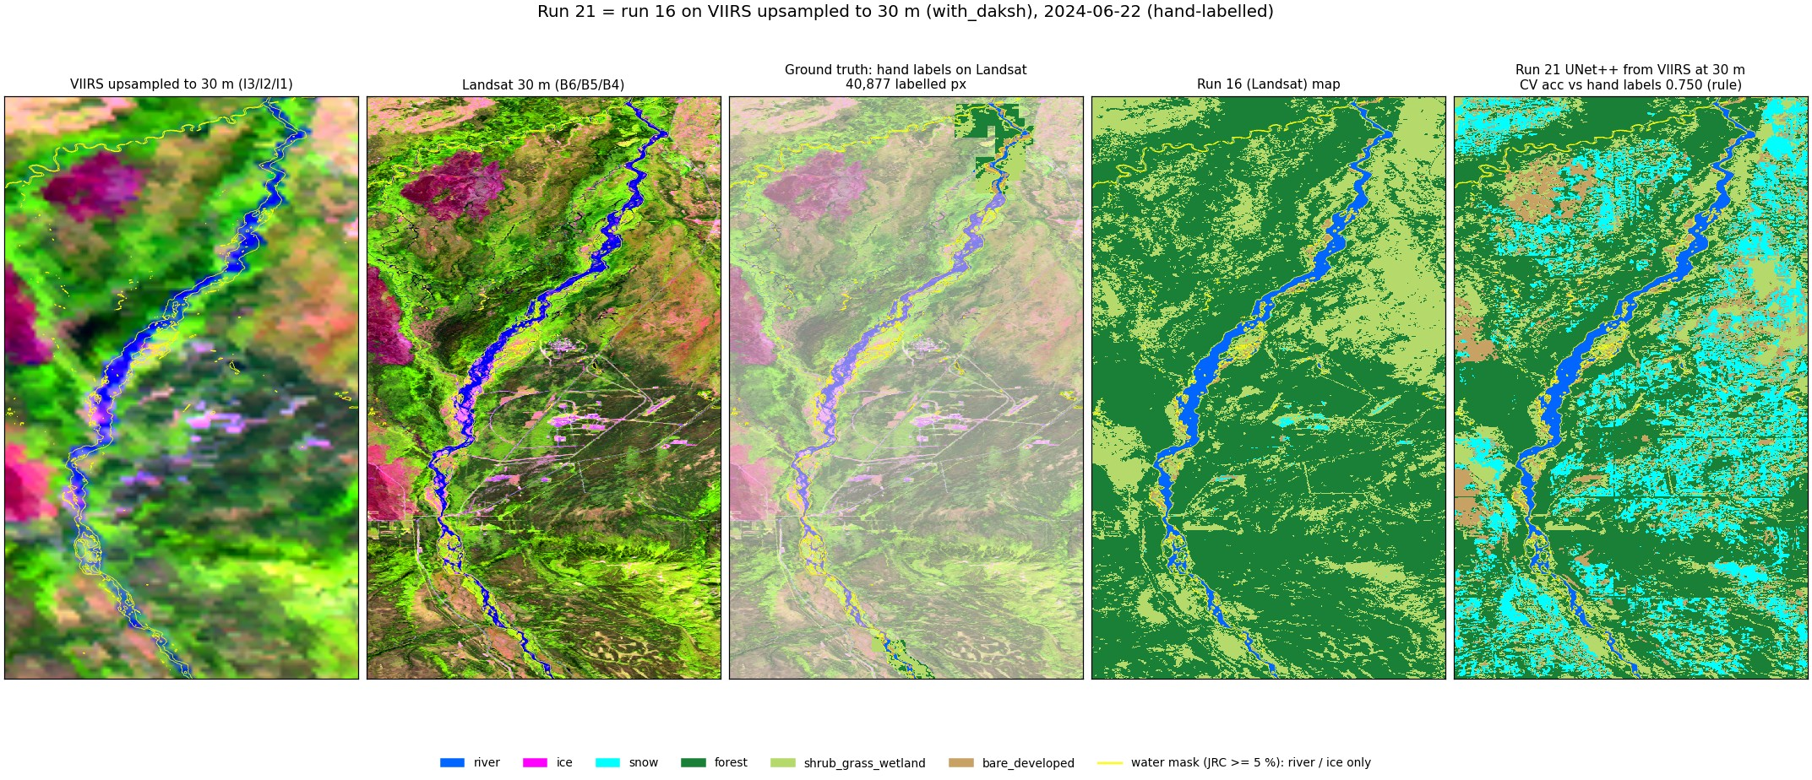
2024-06-22 (summer): hand-labelled

Slide 20
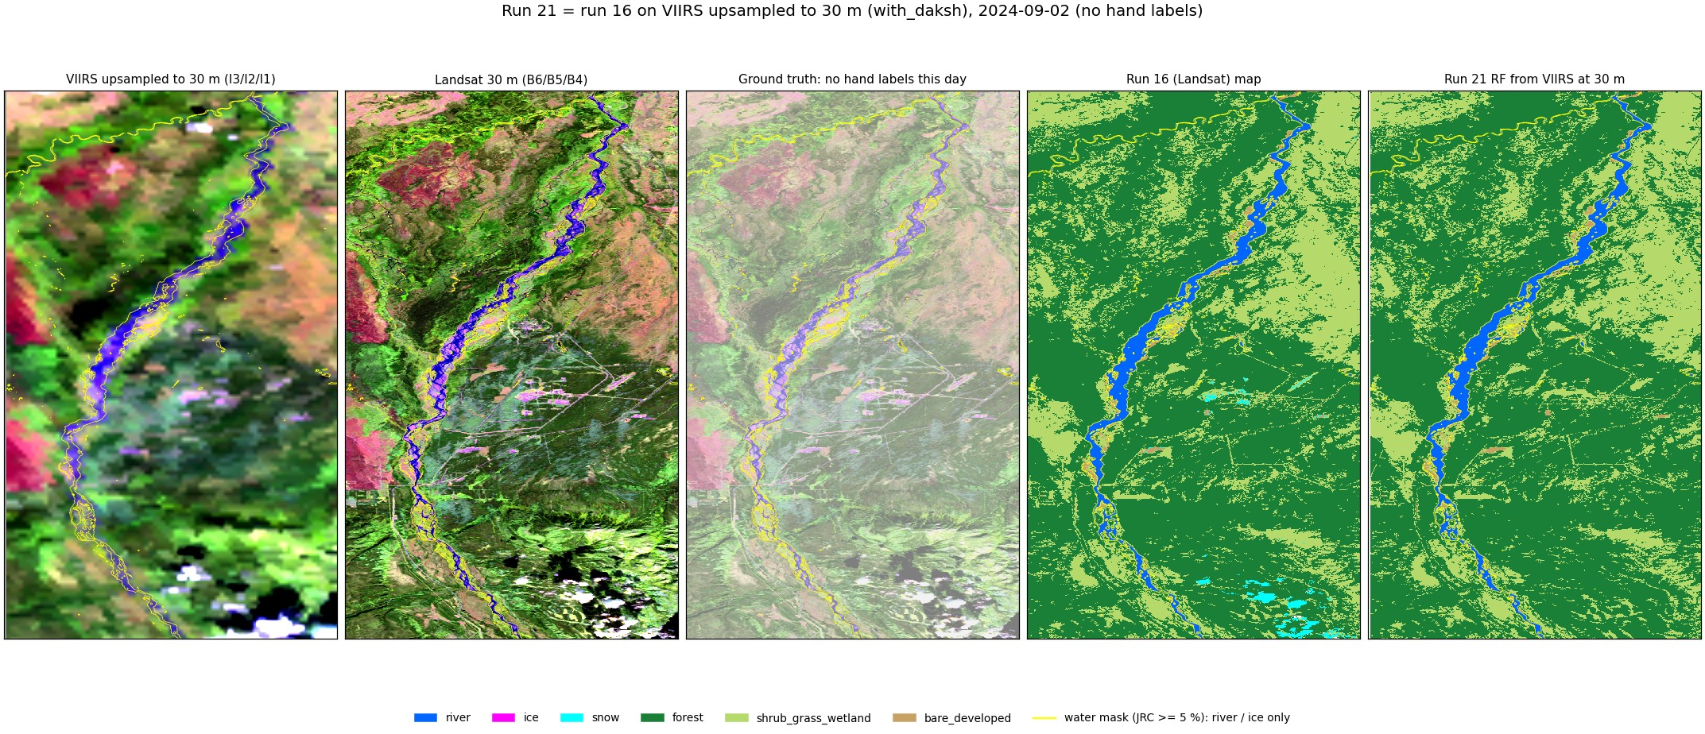
2024-09-02 (late summer): no hand labels

Slide 21
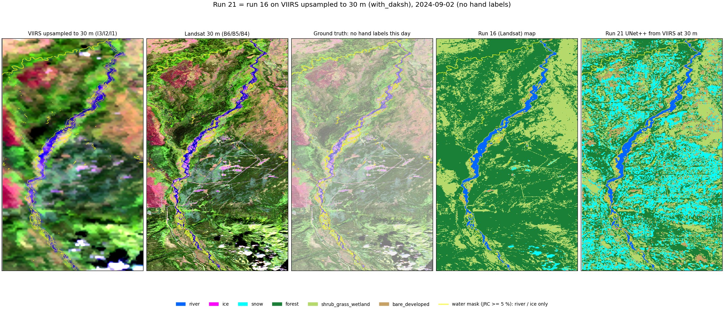
2024-09-02 (late summer): no hand labels

Slide 22
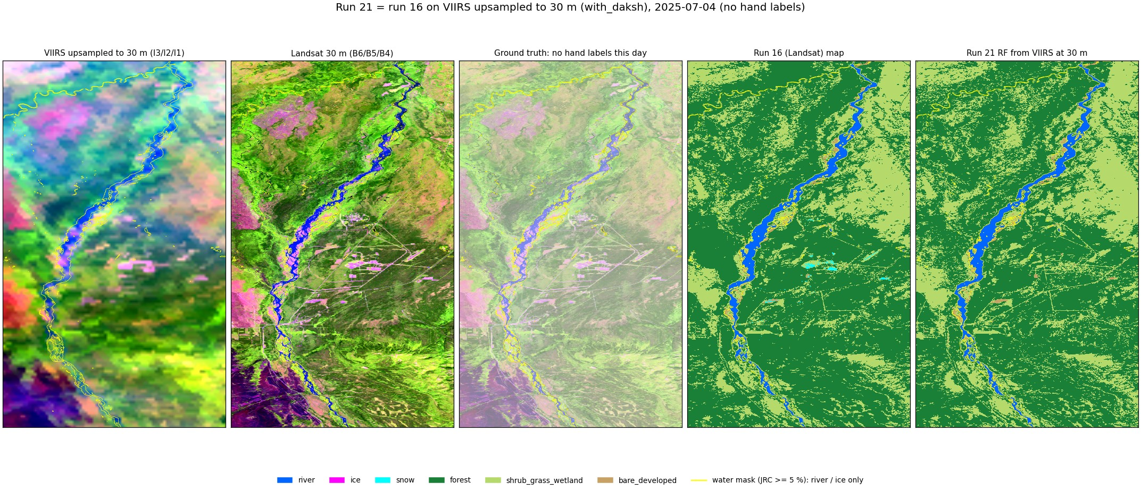
2025-07-04 (summer): no hand labels

Slide 23
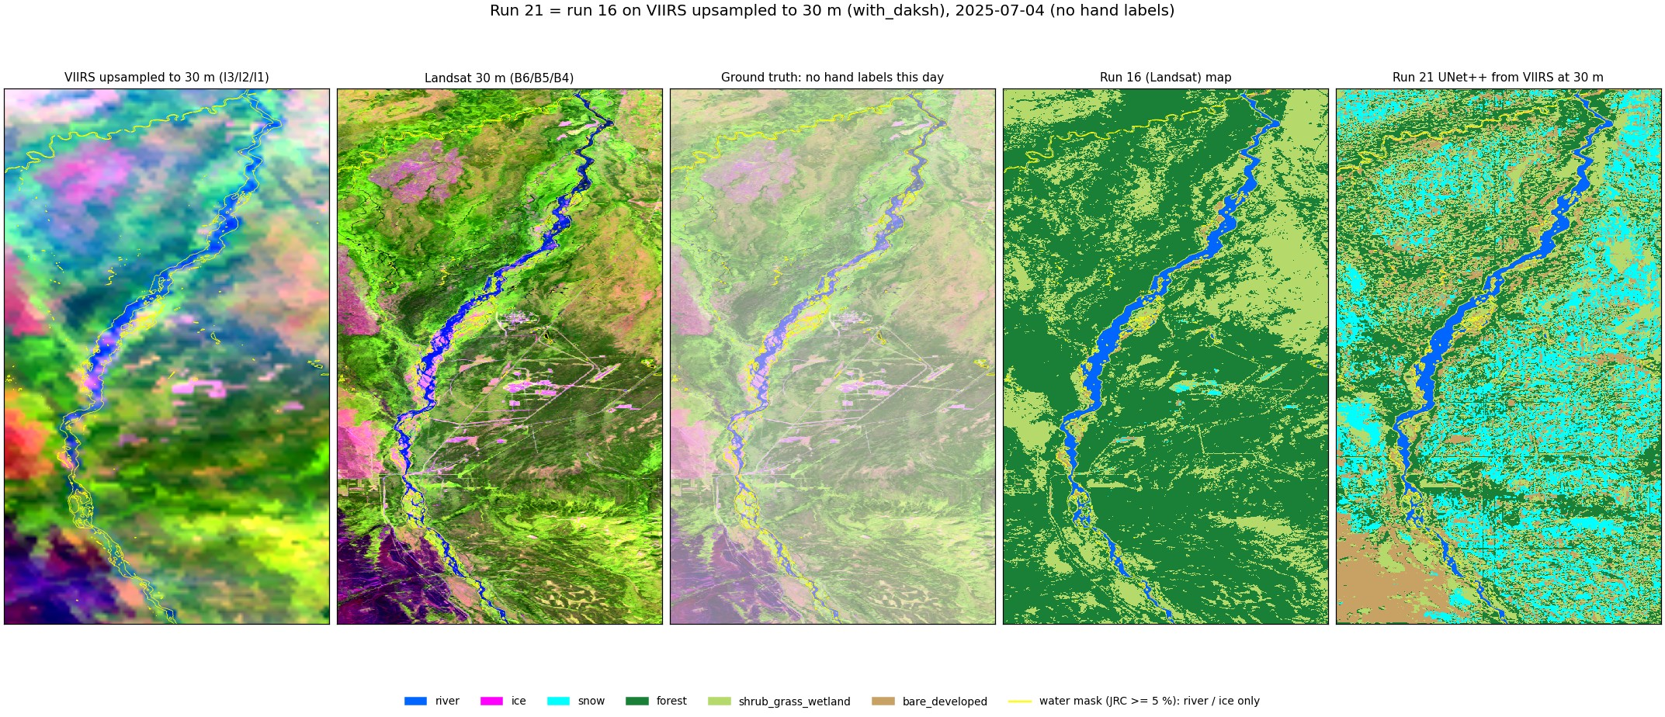
2025-07-04 (summer): no hand labels

Slide 24
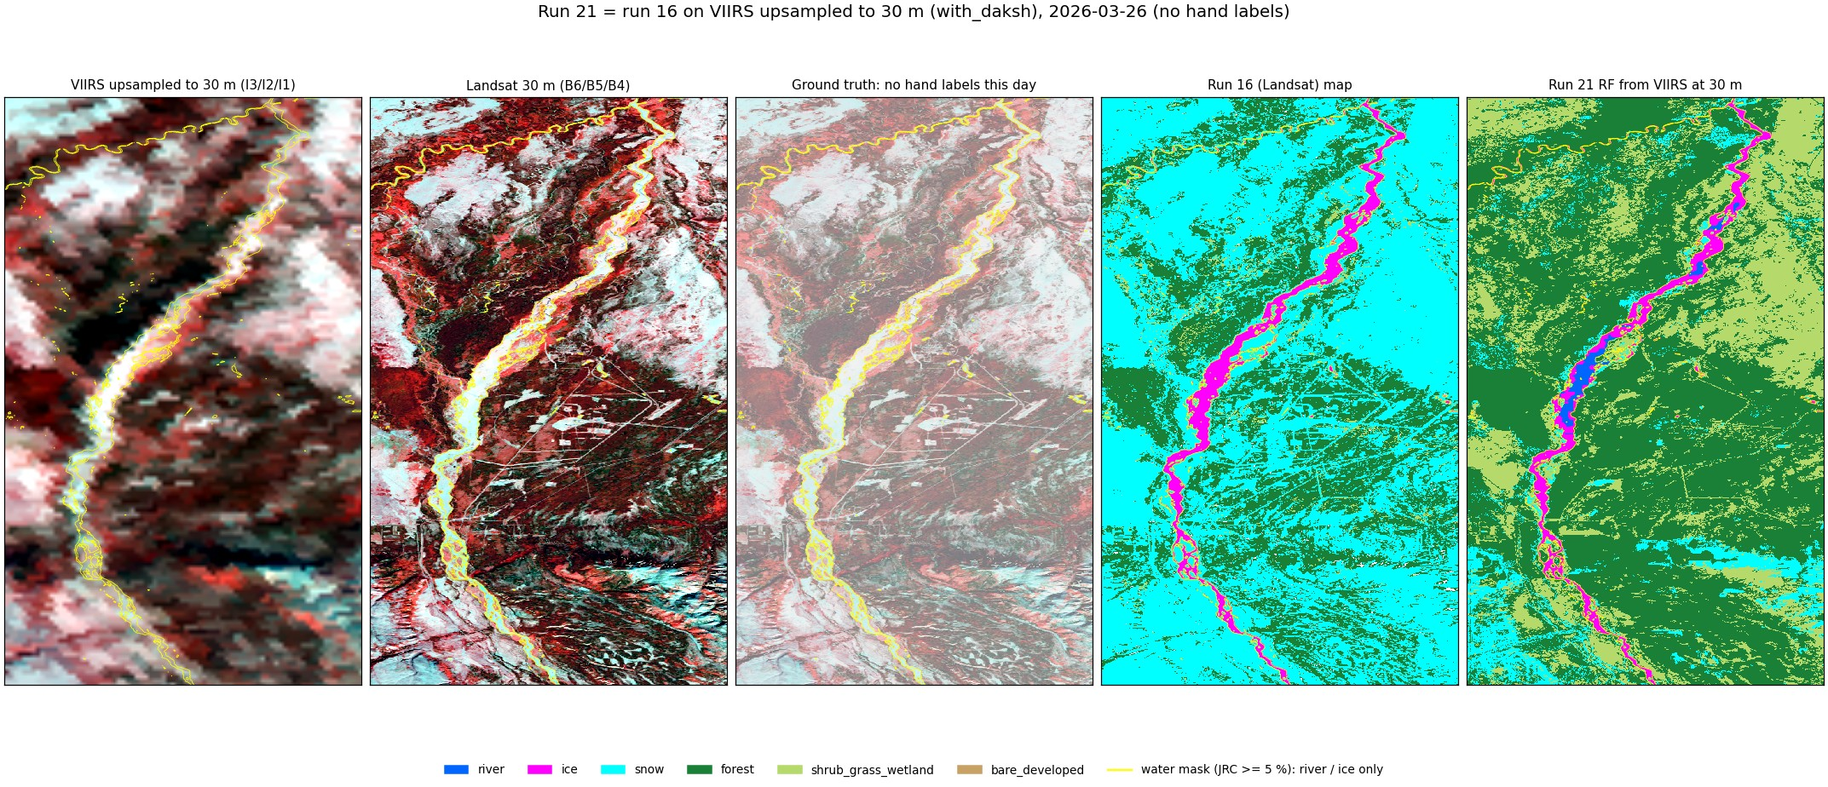
2026-03-26 (late winter): no hand labels

Slide 25
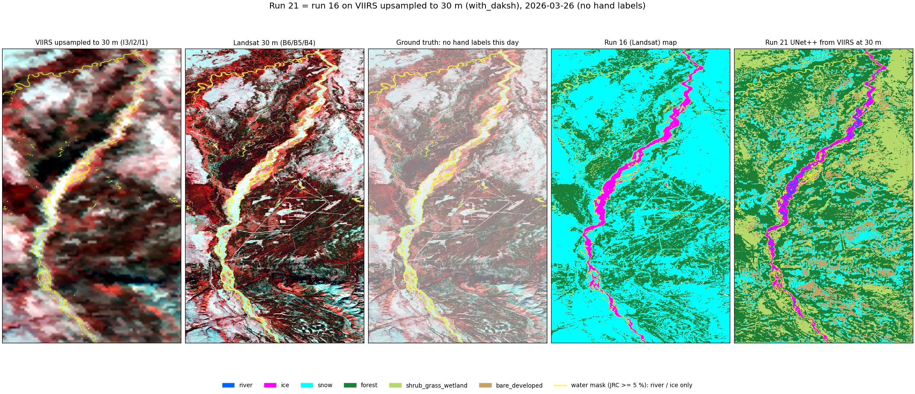
2026-03-26 (late winter): no hand labels

Slide 26
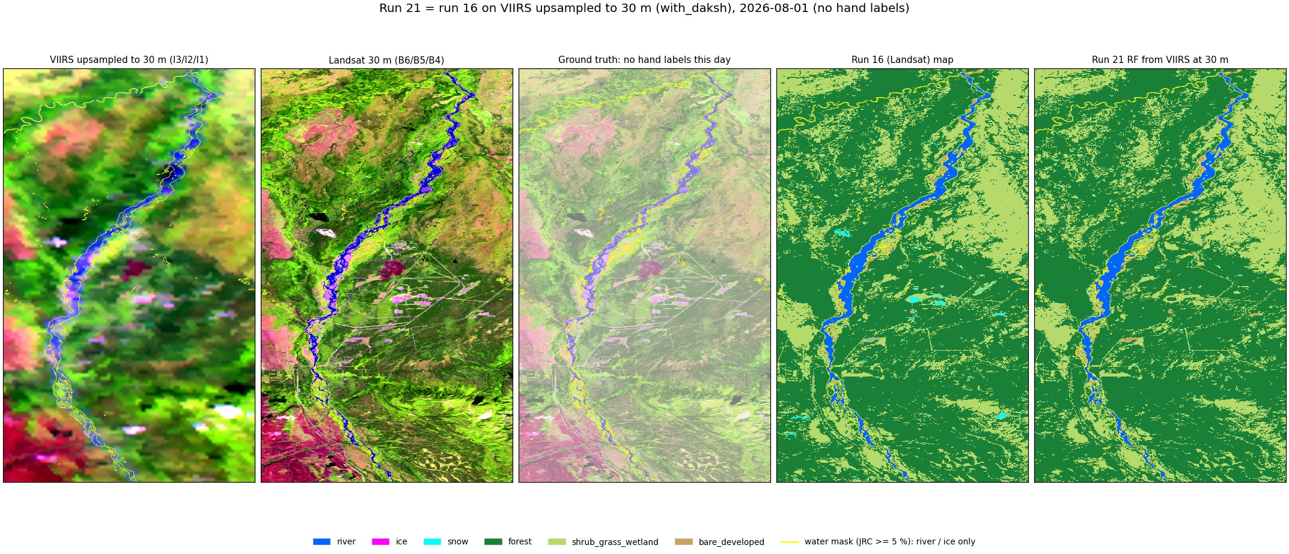
2026-08-01 (summer): no hand labels

Slide 27
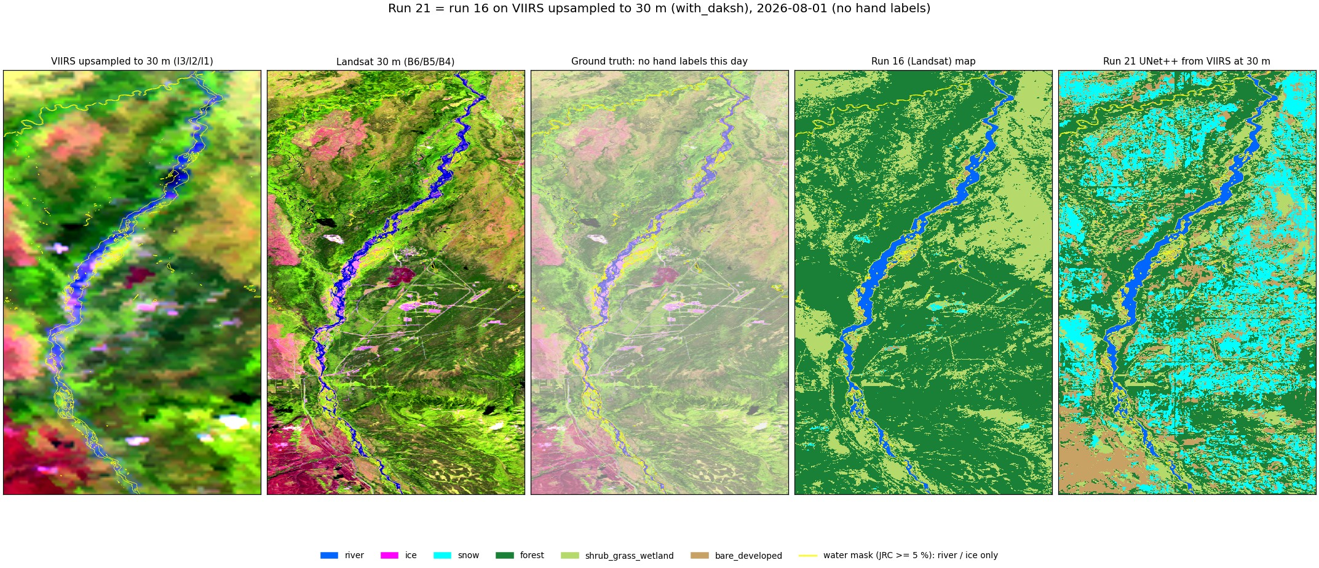
2026-08-01 (summer): no hand labels

Slide 28
Things to know
No 30 m detail from VIIRS
Land = NLCD
4 labelled dates
Upsampling copies the 375 m value; 30 m edges come from NLCD, terrain, the mask.
High forest / shrub / bare scores largely measure agreement with NLCD.
Run 16 had 7; ice and snow scores move with each polygon.
Spatial CV
No cloud mask
Row blocks held out, not dates (as run 16).
Cloudy VIIRS days give wrong snow / ice.

Slide 29
Run 16 on VIIRS
RF 0.962 on VIIRS vs 0.985 on Landsat (rule labels, same dates); snow is lost at 375 m. Next: UNet++ on the same set-up.

